Slide 1
Evolution of China-Africa Trade Relations
Presented by: Global Analytics

Slide 2
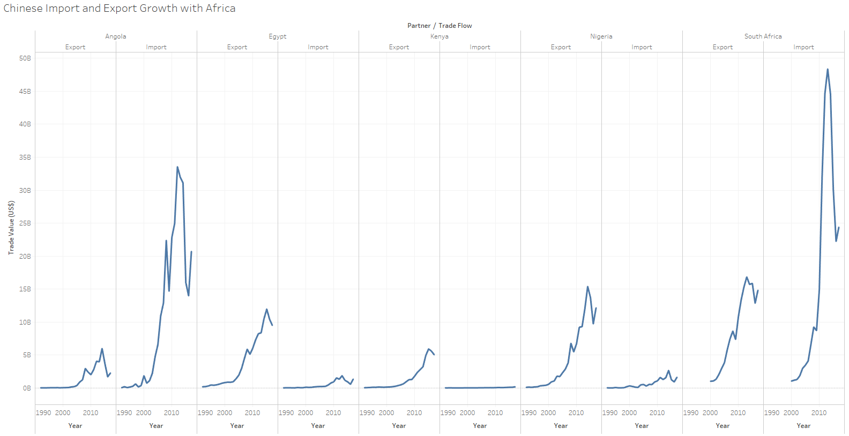
China has invested significantly in developing African countries

Slide 3
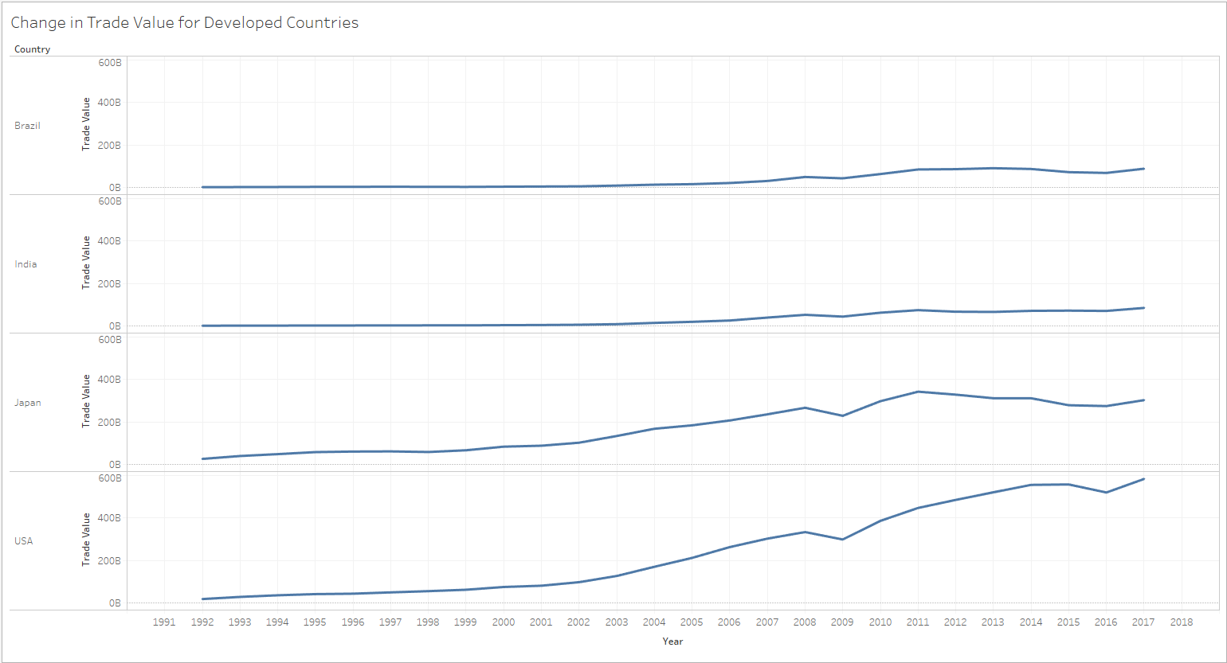
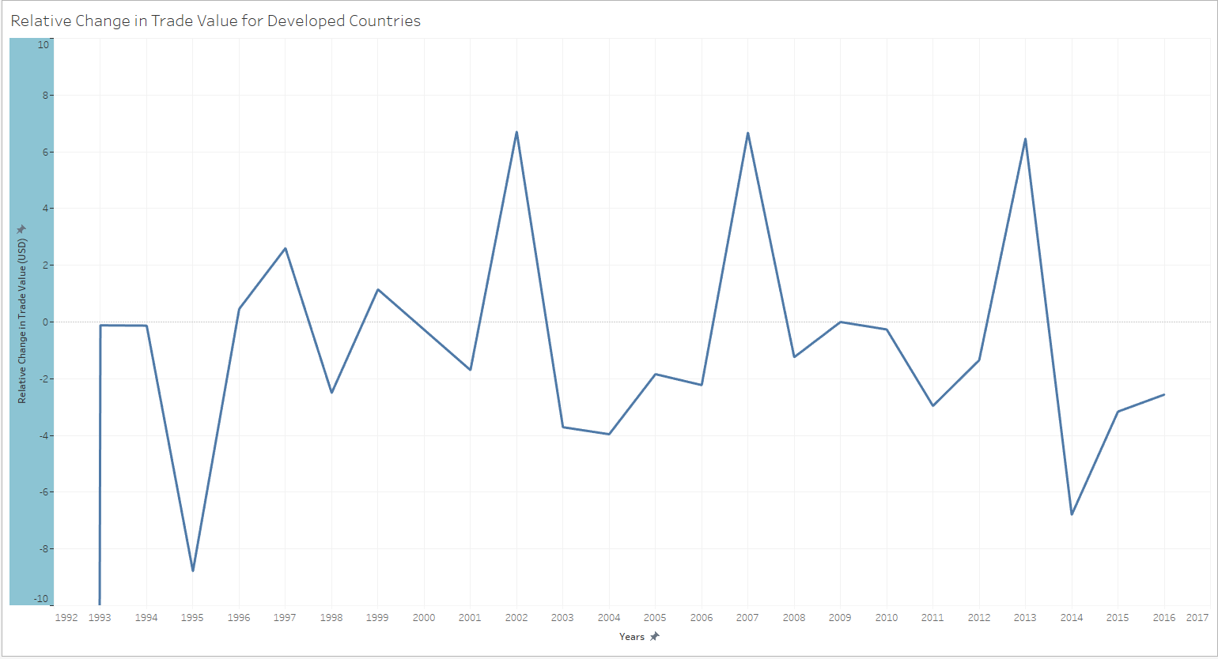
The developed world has not seen similar increases in Chinese investment

Slide 4
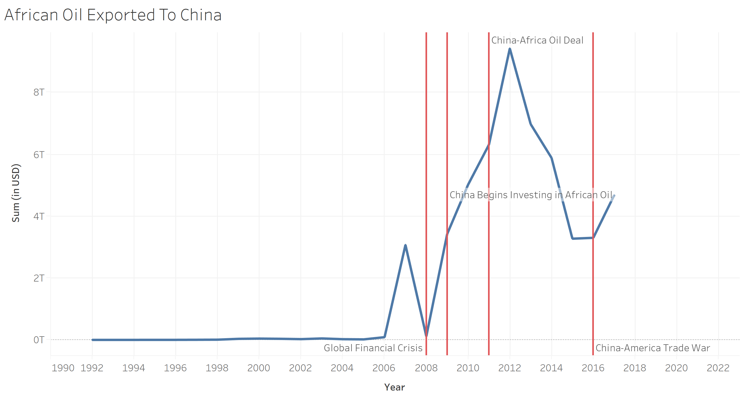
Chinese imports of Angola Oil dramatically increase

Slide 5
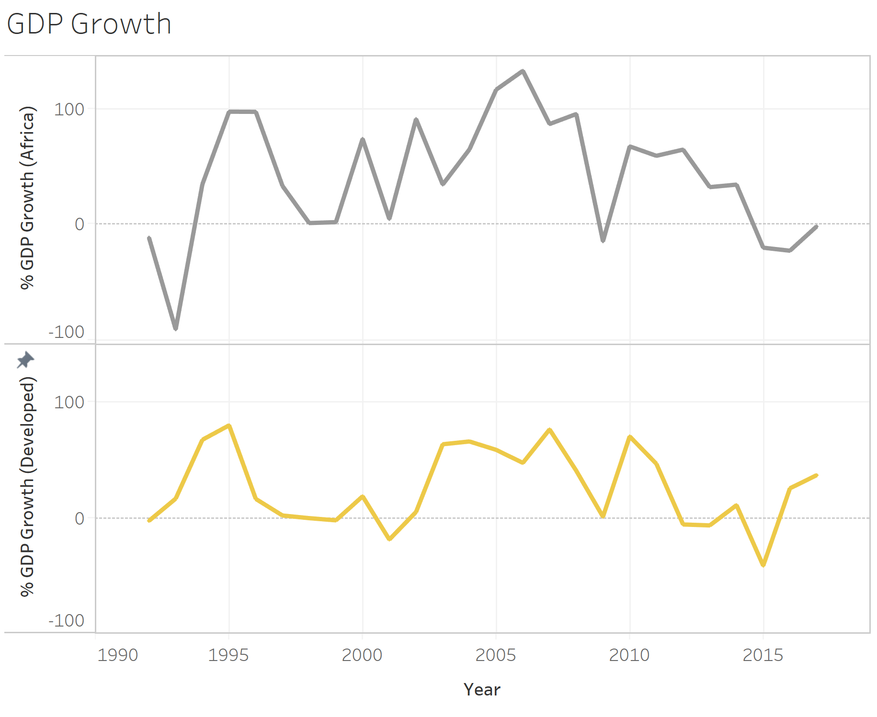
GDP growth in African countries has increased dramatically when compared to developed countries

Slide 6
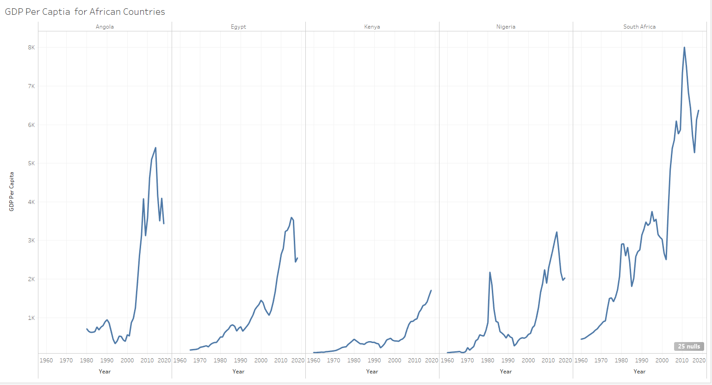
African GDP per capita has increased at similar times as Chinese investment has increased

