Slide 1
Evolution of China-Africa Trade Relations
By the Nerds

Slide 2
China has invested significantly in developing African countries
Data showing imports and exports of China into African countries (increasing)

Slide 3
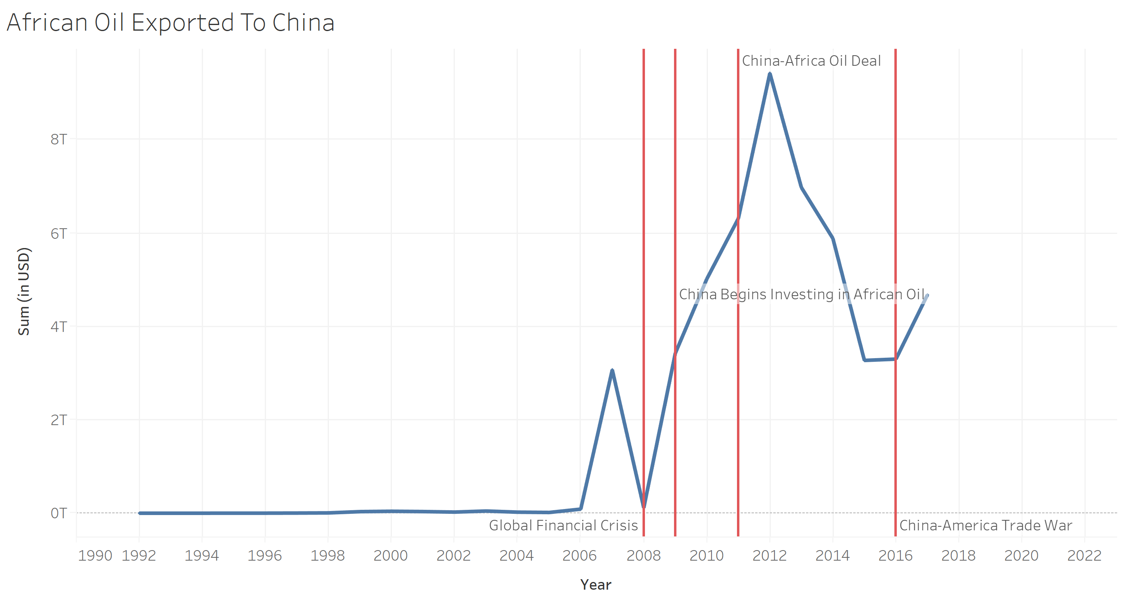
What type of goods are being imported to Africa, what goods are being imported
Examine goods, really oil is the connection but also manufactured products, agriculture.

Slide 4
How has this effected these countries
Changes in African countries GDP, GDP growth, GDP Per Capita around the time China increases those imports and exports

Slide 5
How has China responded to economic opportunities and threats
Trade war effects, global recession, etc.

Slide 6
How does this generally compare to Chinese trade with other nations
Look at our other examples. Look at their changes in GDP etc over these same time periods. Look how China has changed its imports and exports over time possibly corresponding to these significant events.

