Slide 1
Investment Opportunities for Graduate Students: Let’s get Rich
Hazem Sharaf (2021 GBCB PhD)
AGSO one day seminar
10/25/2025

Slide 2
DISCLAIMER
I am not an expert. A loss is on your own responsibility.
Always do your due diligence and own research

Slide 3
Investment opportunities for graduate students
Can you invest, and why you should and must
Available opportunities
Consequences

Slide 4
Investment opportunity for graduate students
Can you invest, and why you should and must
Available opportunities
Consequences

Slide 5
Investment opportunity for a graduate students
Can you invest, and why you should and must
Available opportunities
Consequences

Slide 6
Can I invest?
Anyone can invest (in the USA)
I am an international student: Yes you can invest, nothing restricts you
Are there opportunities?
Yes there are multiple opportunities and avenues
I can not invest because I have no information and I am afraid to lose
There are opportunities for each level of knowledge
Learn as you go
I can not invest as I do not have enough money
You can invest even with as little as $1!!

Slide 7
Why should I invest?
Time Value of Money
Money needs to be protected against time
In the current global financial system any currency loses value
Central banks interest rate (discount rate)
US Fed rate (4.00-4.25%)
Egypt and Nigeria 27%
GOLD (1 oz = $1200 in 2016, 1oz = $4300 in 2025)

Slide 8
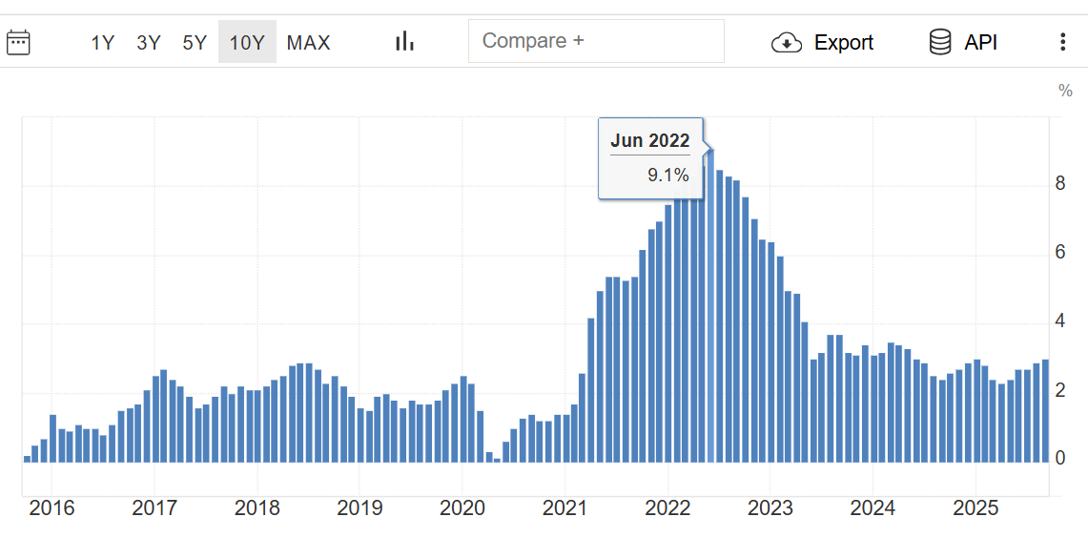
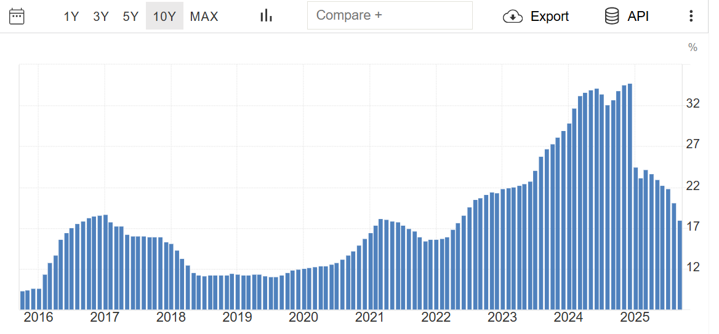
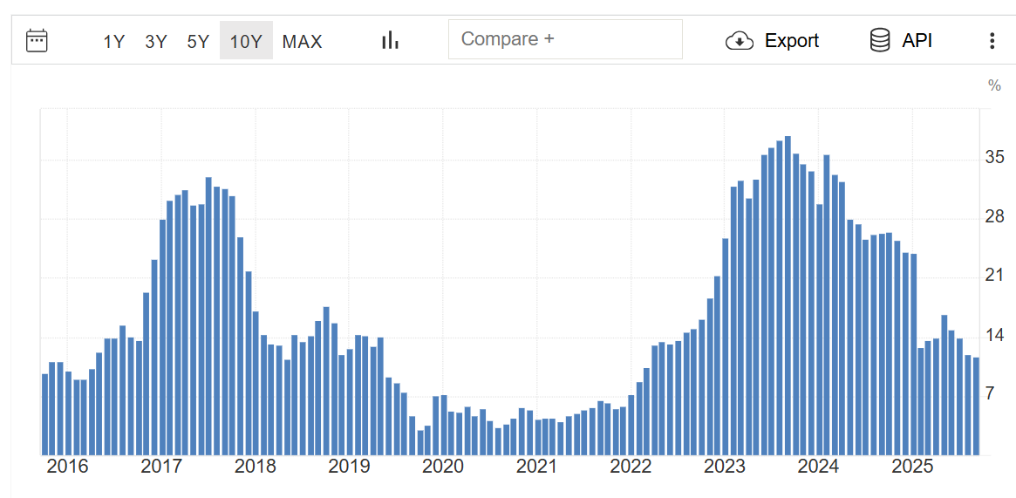
Why should I invest?
Protect against inflation
Money keeps losing value if sitting around)
Nigeria
Egypt
USA
Gain money management skills
May be generate passive income?
Bank account and dividend-paying stock

Slide 9

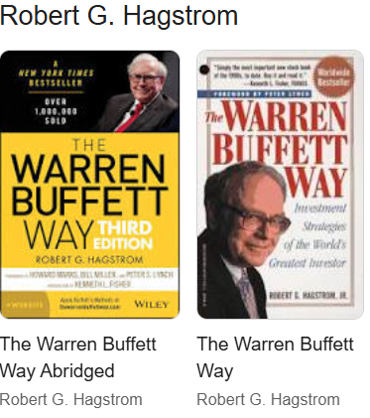
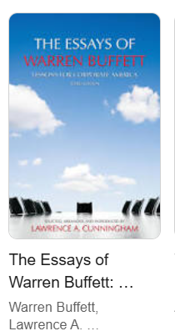
Why should I invest?
Slowly build wealth
Warren Buffett’s compounding method
Better start young and wealth builds slowly
Let your money works for you
Maybe become rich?
Why not? Let’s dream!

Slide 10
Investment opportunity for a graduate students
Can you invest, and why you should and must
Available opportunities
Consequences

Slide 11
Available opportunities
RETURN
Savings account
Time or certificate of deposit
T-bills
Equities and Commodities
RISK

Slide 12
Available opportunities
RETURN
Savings account
Time or certificate of deposit
T-bills
Equities and Commodities
RISK

Slide 13
Available opportunities
RETURN
Savings account
Time or certificate of deposit
T-bills
Equities and Commodities
RISK

Slide 14
Savings account
Easiest way
Safest as well if you are a beginner or afraid
Let money “sit” in a savings account
Least rate (0.01% with Wells Fargo)

Slide 15
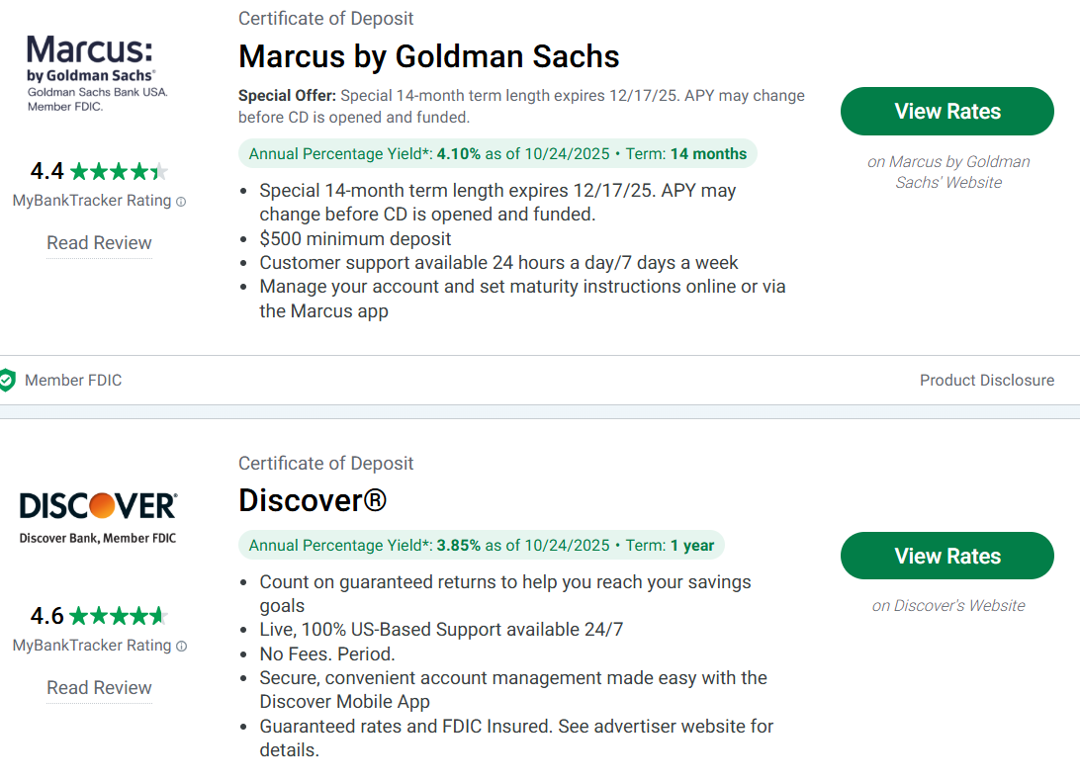
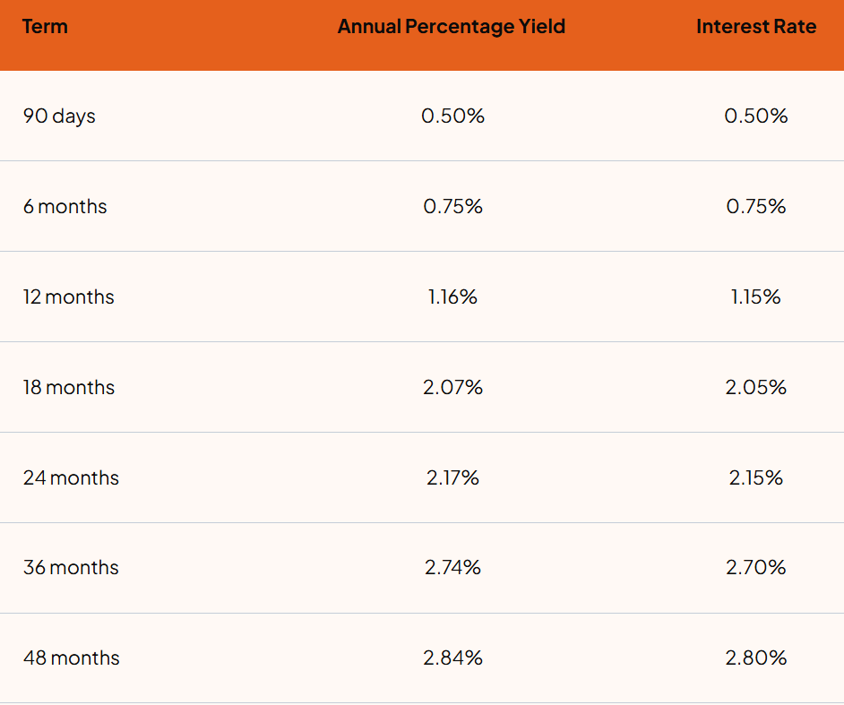
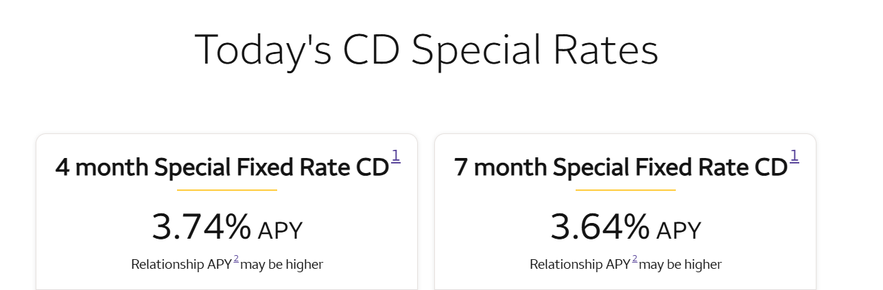
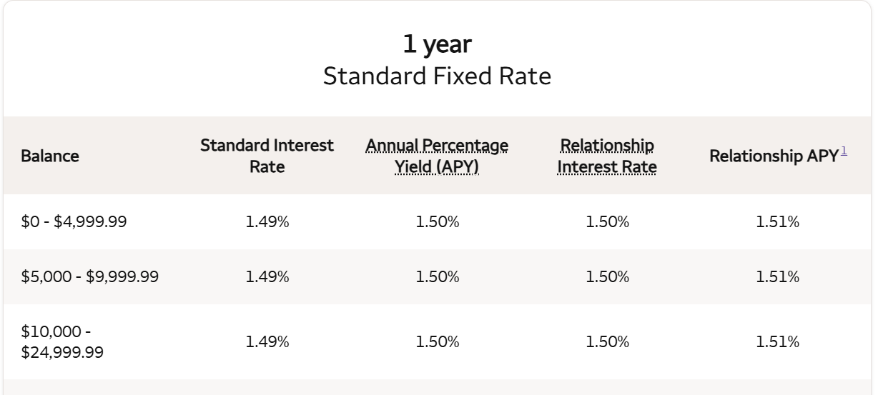
Time or certificate of deposit
National Bank of Blacksburg
Wells Fargo
Search other online virtual banks
Marcus

Slide 16
Available opportunities
RETURN
Savings account
Time or certificate of deposit
T-bills
Equities and Commodities
RISK

Slide 17
Time or certificate of deposit
Still an easy way to invest (or save)
It is still the safest (you do not lose it unless you withdraw early)
Money is tied for a set time (you can not withdraw)
Withdrawal penalty
Rate variable, the longer the higher the return

Slide 18
Time or certificate of deposit
WARNING
Special rate CDs NEVER renew at the same rate
You have to pay attention and withdraw in grace period around maturity
Otherwise they automatically renew at a much lower rate

Slide 19
Available opportunities
RETURN
Savings account
Time or certificate of deposit
T-bills
Equities and Commodities
RISK

Slide 20
DISCLAIMER
I am not an expert. A loss is on your own responsibility.
Always do your due diligence and own research

Slide 21
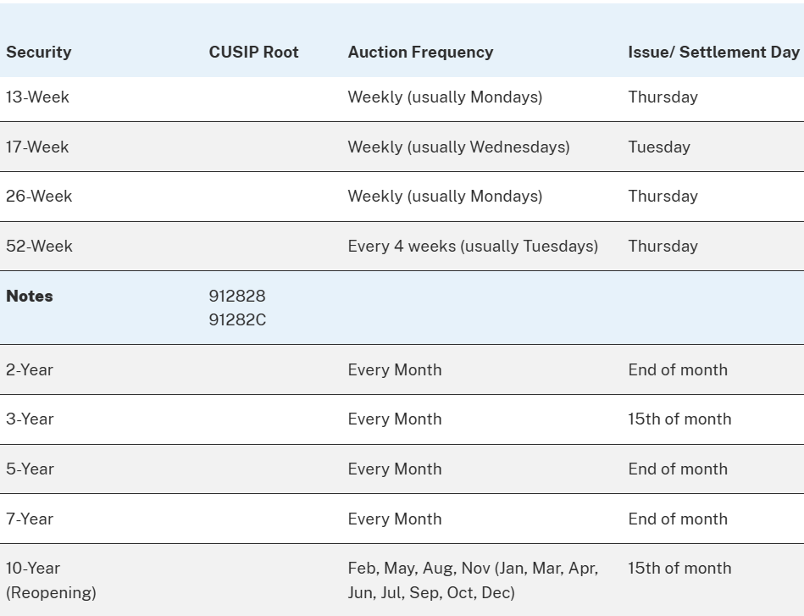
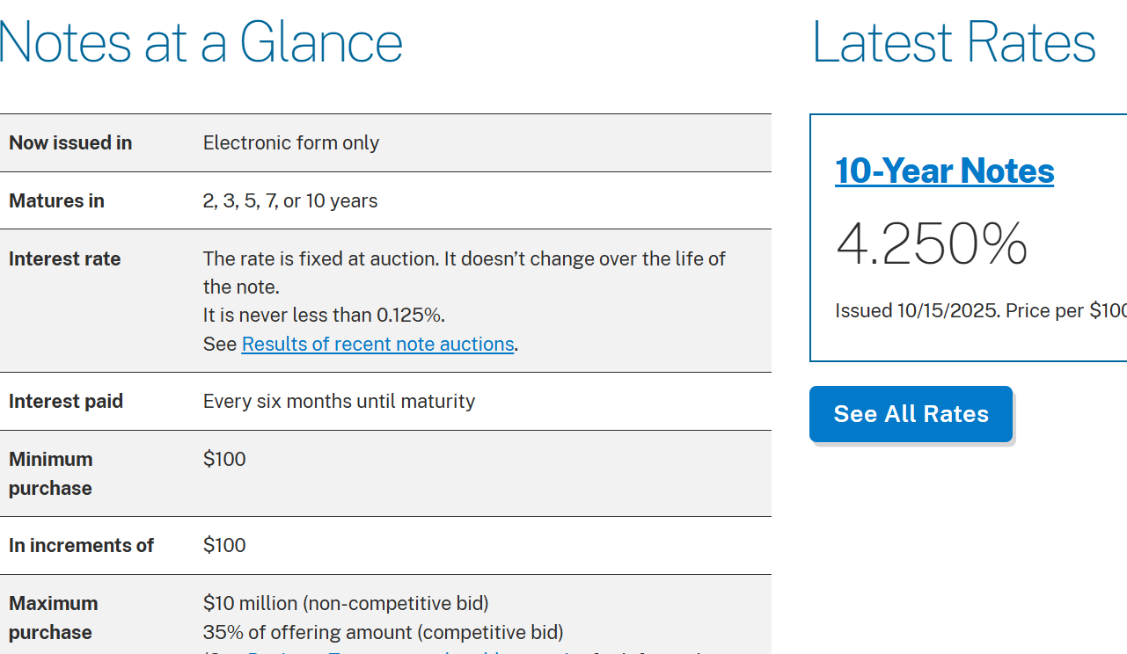

USA Treasury T-bills
Or is it T-bonds?
Similar to CDs but very variable by terms and returns
Buy yourself directly from USA Treasury through auctions and the secondary market
Guaranteed by the Federal Government
Buying US government debt

Slide 22
Available opportunities
RETURN
Savings account
Time or certificate of deposit
T-bills
Equities and Commodities
RISK

Slide 23
Equities and Commodities
Equities are stocks, exchange-traded funds (ETF), mutual funds, options and financial instruments traded in an exchange.
Commodities are (physical) goods and products
Precious metals like Gold, Silver, Platinum
Oil and gas
Others
Agricultural Products
Can be traded in the stock market, usually in a form of ETF

Slide 24
Equities and Commodities
This is the investment opportunity with the highest risk and return
It is not for the light-hearted
It is very sensitive to global and local events
Need some proper training

Slide 25

What do you need
Some basic knowledge of finance
Some basic knowledge of accounting
(I)GCSE O-level Accounting or equivalent
Stock market fundamental analysis
That’s why I mentioned accounting and finance
Workshops
Stock market technical analysis
Workshops

Slide 26
Ways to invest
Always set a strategy
Simply buy low and sell high
Profit (or loss) = Selling price – Buying price
Buy Dips (buy when the stock is slow)
Here, you need more technical analysis to identify when to buy (or sell)
Buy dividend-paying stocks
Return is usually lower than banks, but some stocks can pay more
Need more fundamental analysis
Liquidity Cash flow, Current Ratio, industry and market outlook

Slide 27
Some selling strategies
Also set a target
When you sell at a local peak, even if it keeps increasing, you do not lose an opportunity
A lose or a gain is not realised until you actually sell

Slide 28
Some selling strategies
Profit
Short-term capital gain = selling after less than a year
Long-term capital gain = selling after more than a year
Taxation:
Short-term = tax rate at your AGI tax bracked
~ 10 or 12% for our graduate student stipend level (VT step 9-13)
Long-term
0% up to $48,000 or $96,000 for married
Probably during postdoc as well.

Slide 29
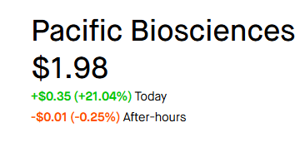
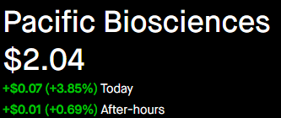
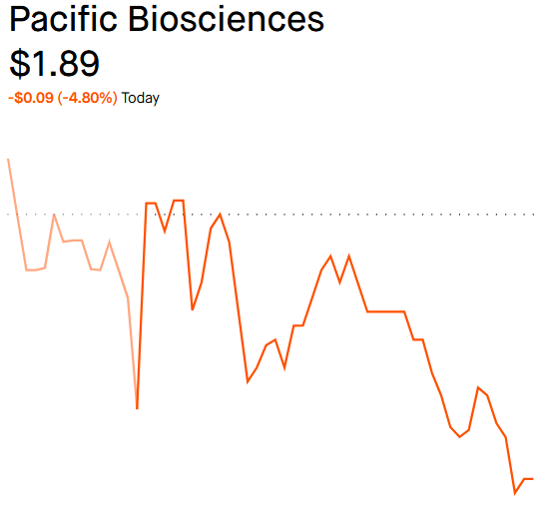
Volatility

Slide 30
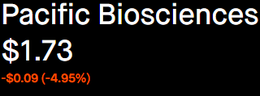
Volatility
Monday October 20
Frequently volatile stocks with good fundamentals
Assets vs. Liabilities ratios
Debt and payment
News and reputation
The largest stock in my portfolio is affected by an issue in the factory in India
Relationship affairs to Executive Board members
Examples
PacBio and Gold
Friday October 24
Wednesday
October 22

Slide 31
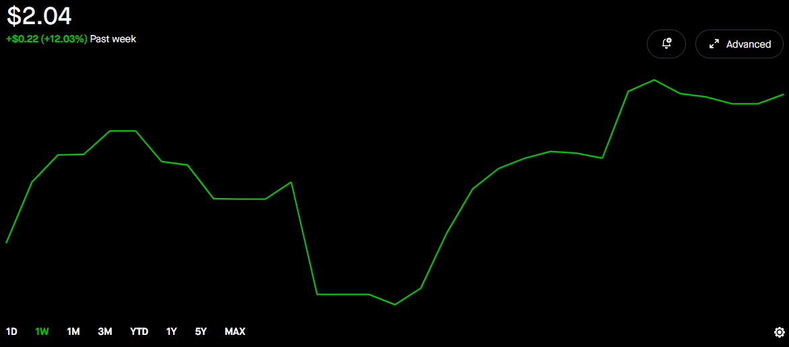
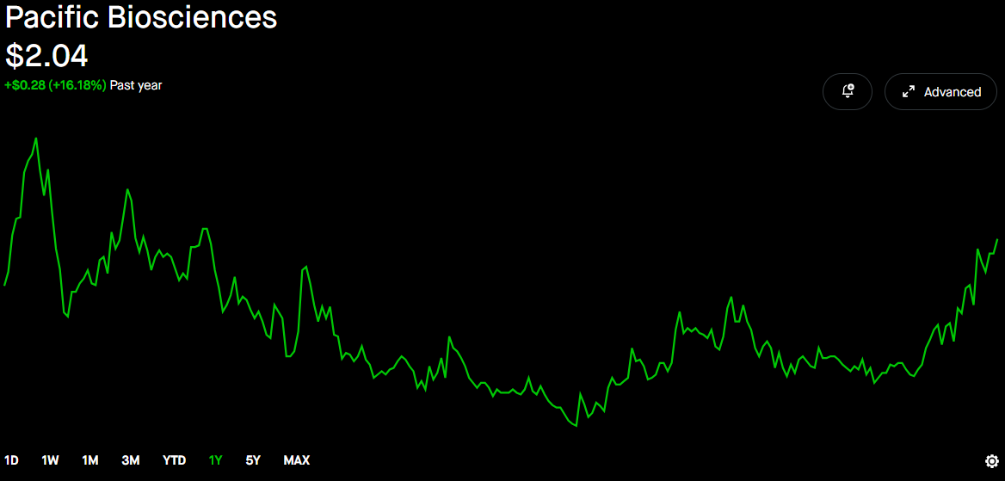
Volatility
Longer-term performance
This week (+12%)
1 year (52 weeks)
Low: $0.85
High: $2.72
Several ridges and peaks
Upward trend?

Slide 32
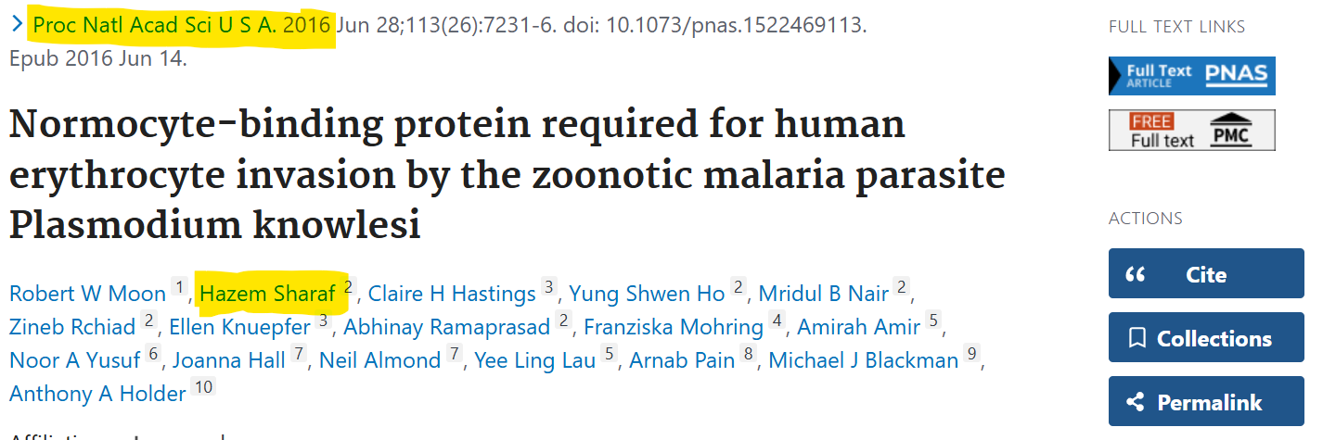
PacBio
Why did I buy it?
I used their services in 2015 paper that got published in PNAS
Part of my buying DIPS and gambling on long term booms
(100-300% on Long-term capital gains)

Slide 33
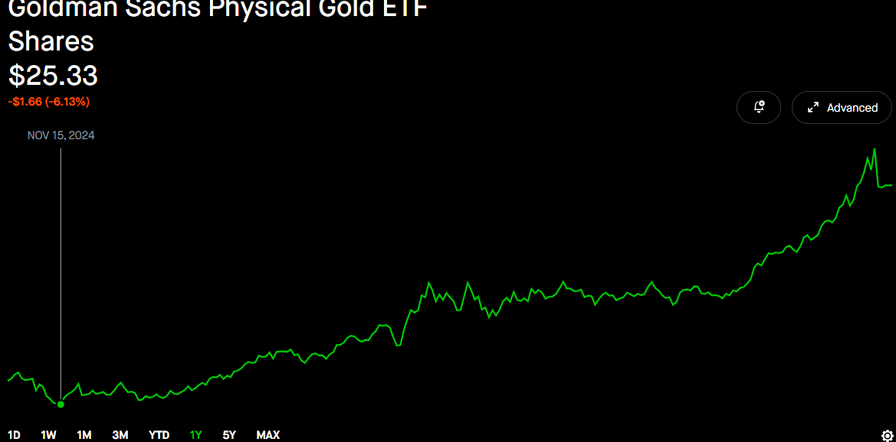
ETFs: Gold
Safer than buying physical gold
Want to keep a bullion at home?
Store it in a bank safe?
And pay fees?
Why buy gold?
Generally to diversify
Always good on the long term
Remember 1oz = $1600 in 2016
Calculate in your local currency!!!!!
Uncertainity, globally and locally
Everybody was wondering when will the price correction and profit-taking would occur?

Slide 34
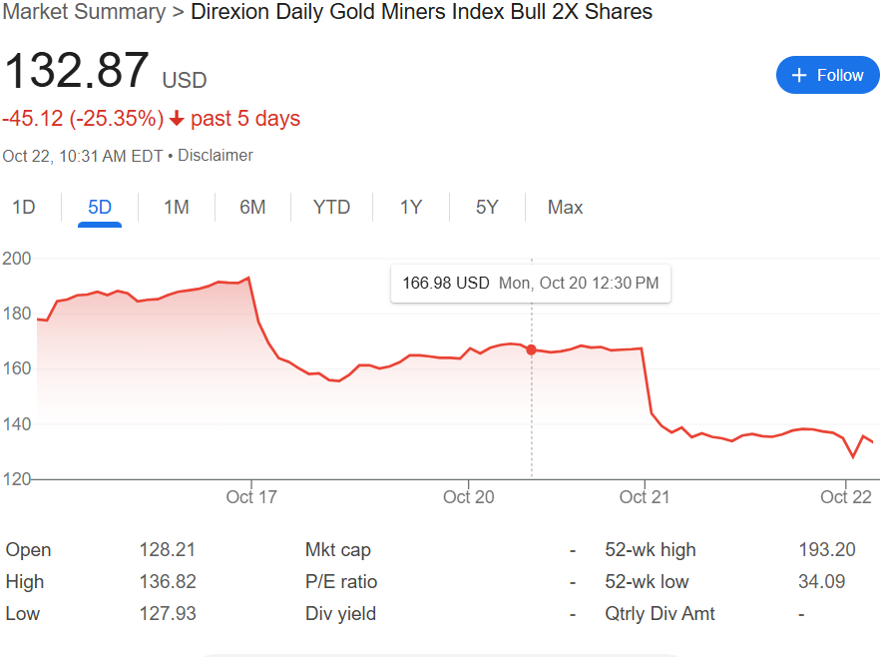
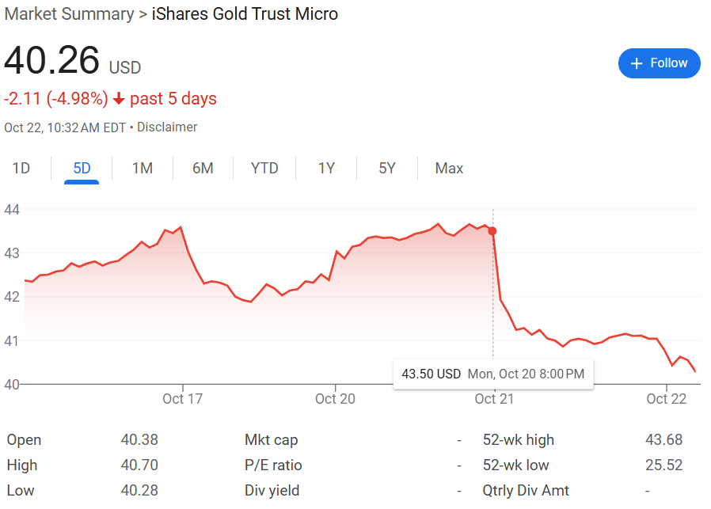
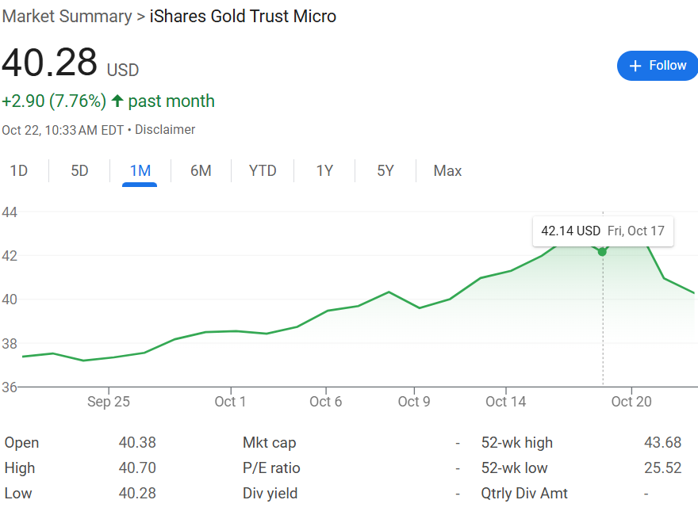
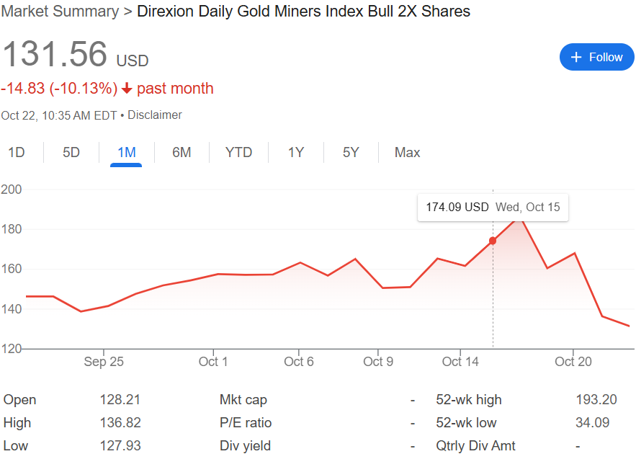
Leveraged ETFs
Another type of ETFs that I am studying
Also tracks a something but uses derivatives (check later slide)
Movements are compounded
If $1 increase it increases $2
If $2 decrease it deceases $2
Usually 2-5x
Still not sure how
Has more maintenance fees

Slide 35
Other ways to trade in stock market
Options
I can not explain it since I never understood
Futures market
Not exactly sure but they study it in Senior level undergraduate Finance courses
Short selling
Requires a margin trading account
Interest is paid like taking a loan
Gain money when the stock decreases in price

Slide 36
General Investment and Trading Advise
From a friend and mentor in the Egyptian stock market
Successful investment is about managing risks, not looking for profit
There are always opportunities, but protecting capital is more important
Sentiments if your number one enemy
Fear and greed are the main reasons for loss, not lack of experience
Technical analysis is beneficial, but logical thinking is more important
Do not get attached to a stock, it is not a love fair but a temporary deal

Slide 37
General Investment and Trading Advise
From a friend and mentor in the Egyptian stock market
Do not get attached to a stock (or ETF)
It is not a love affair. It is a temporary deal. Buy and sell logically, not sentimentally
Diversification is the base of safety
Do not put all of your eggs in one basket
Always make a plan before entering a stock
Set a buying price, selling price and stop loss limit
Entering without a place is a recipe for failure

Slide 38
General Investment and Trading Advise
From a friend and mentor in the Egyptian stock market
Smaller continuous profit is better than one large hit
These changed my life, although I do not adhere to them

Slide 39
Other investment options not covered
Real Estate
Requires Large amounts of cash
Corporate bonds
Debt instruments for companies that are also traded
Sovereign bonds
How our countries borrow money (part of the external debts)
Eurobonds
Also requires a minimum of $100,000

Slide 40
Cryptocurrency
I am very skeptical
I believe Cryptos are part of Ponzi scheme.
They very volatile and not backed up by anything
I started with etherum ETF though and it had nearly doubled so far

Slide 41
Investment opportunity for a graduate students
Can you invest, and why you should and must
Available opportunities
Consequences

Slide 42
Consequences
More complicated Taxation
Sprintax does not properly handle capital gain taxes for international students (1040NR)
Need to consult the country-specific tax treaty
Preferably a dual citizen tax expert with ties to home countr
E.g. Nigerian-American or Ghanian American Tax Preparer
I had to manually do that
No free software that does for stockmark (or capital gains)
You have to pay extra for that
Stock market needs dedication
Can affect research work and focus

Slide 43
Consequences – More for Internaional students
More than 1 trade/day may constitute day-trading
Violates your F1 visa
Never enforced but things are different now
Taxation is flat 30% regardless of how long you hold a stock and the nature of the transaction
I was assessed interest and penalty when IRS lost my cheque, it was their fault during COVID.
I was not prepared for that after a 3x profit
Might be harder to to start if you are married and have kids

Slide 44
Advertisement
Final Disclaimer: I am not an expert.
A loss is on your own responsibility.
Always do your due diligence and own research
I trade with Robinhood
Please kindly sign up through my referral
We both benefit 1 free stock each once you make your first money transfer.

Slide 45

https://join.robinhood.com/hazems14

