Slide 1



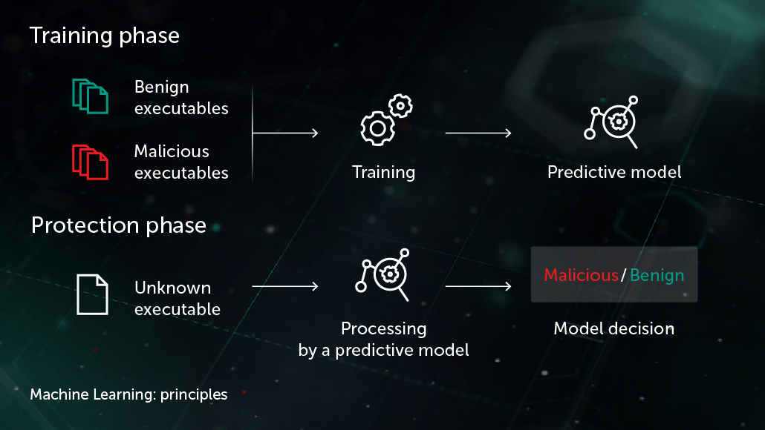

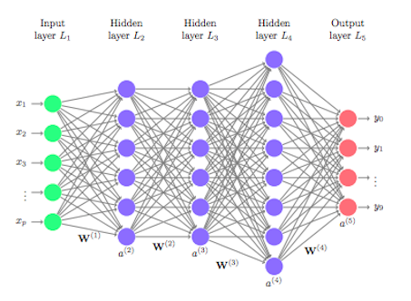
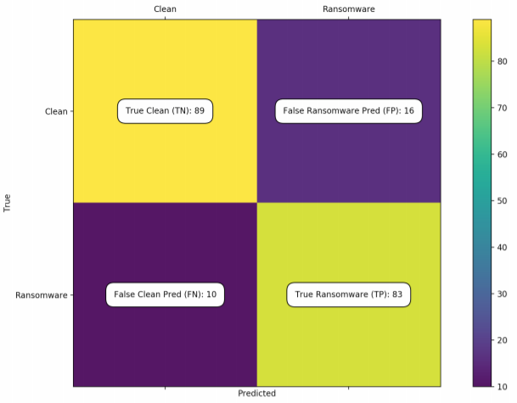
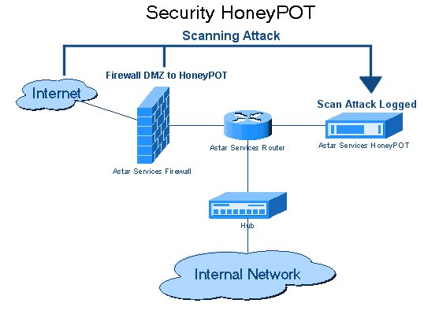
A Deep Learning Approach to Classification of Encrypted Malicious & Ransomware Files
Lital Shemesh, Elyasaf Zider
Supervisors : Dr. Amit Dvir, Harel Berger
Dept. of Computer Science, Ariel University
Motivation
Our Approach & Experimental design
Suggested method
Ransomware - is a type of malware from crypto-virology that threatens to publish the victim's data or perpetually block access to it unless a ransom is paid. advanced malware uses a technique called crypto-viral extortion, in which it encrypts the victim's files, making them inaccessible, and demands a ransom payment to decrypt them. Since Ransomware attacks learn and overcome defense tools, the need for refinement and defense tools is still a critical issue.
1. Machine learning - involves learning the patterns in data to create a model.
2. Honeypot - In general, a honey trap contains data that appears to be part of the database or system data, and which allegedly contains valuable information to attackers, but is in fact isolated, monitored and blocked by attackers.
Our approach for the classification of ransomware attack in a big-data files system consist of generic procedure, on which is performed the construction of a multiple Machine & Deep Learning based models framework for the classification task that determines whether a file is encrypted or not, we suggest the following framework:
One suggested method to detect ransomware attack includes a two-phase classifier that first detects whether a file is encrypted or not, and then decides whether to classify it as a ransomware attach:
1. The development process of a Deep Learning based approach such that given an encrypted file in a large data-base environment, our approach determines whether if it’s contains a malicious ransomware attack or not.
2. An architecture of a Multi-Layer Perceptron (MLP) as well as a Fully-Connected Neural Network that supports the construction of the development process of step 1.
Ingestion of a files set to the framework set of Black-Box classifiers that decides if a file is encrypted or not, using the feature engineering process.
Compute the Confusion Matrix of bothclassifiers set to measure their quality.
Classical Approaches
ransomware
Not ransomware
Feature Engineering
Check the percentage of “real” words in the file.
Modelling the Editing-Time of the file.
If both of the above are anomaly, we can suspect that the file is encrypted.

