Slide 1
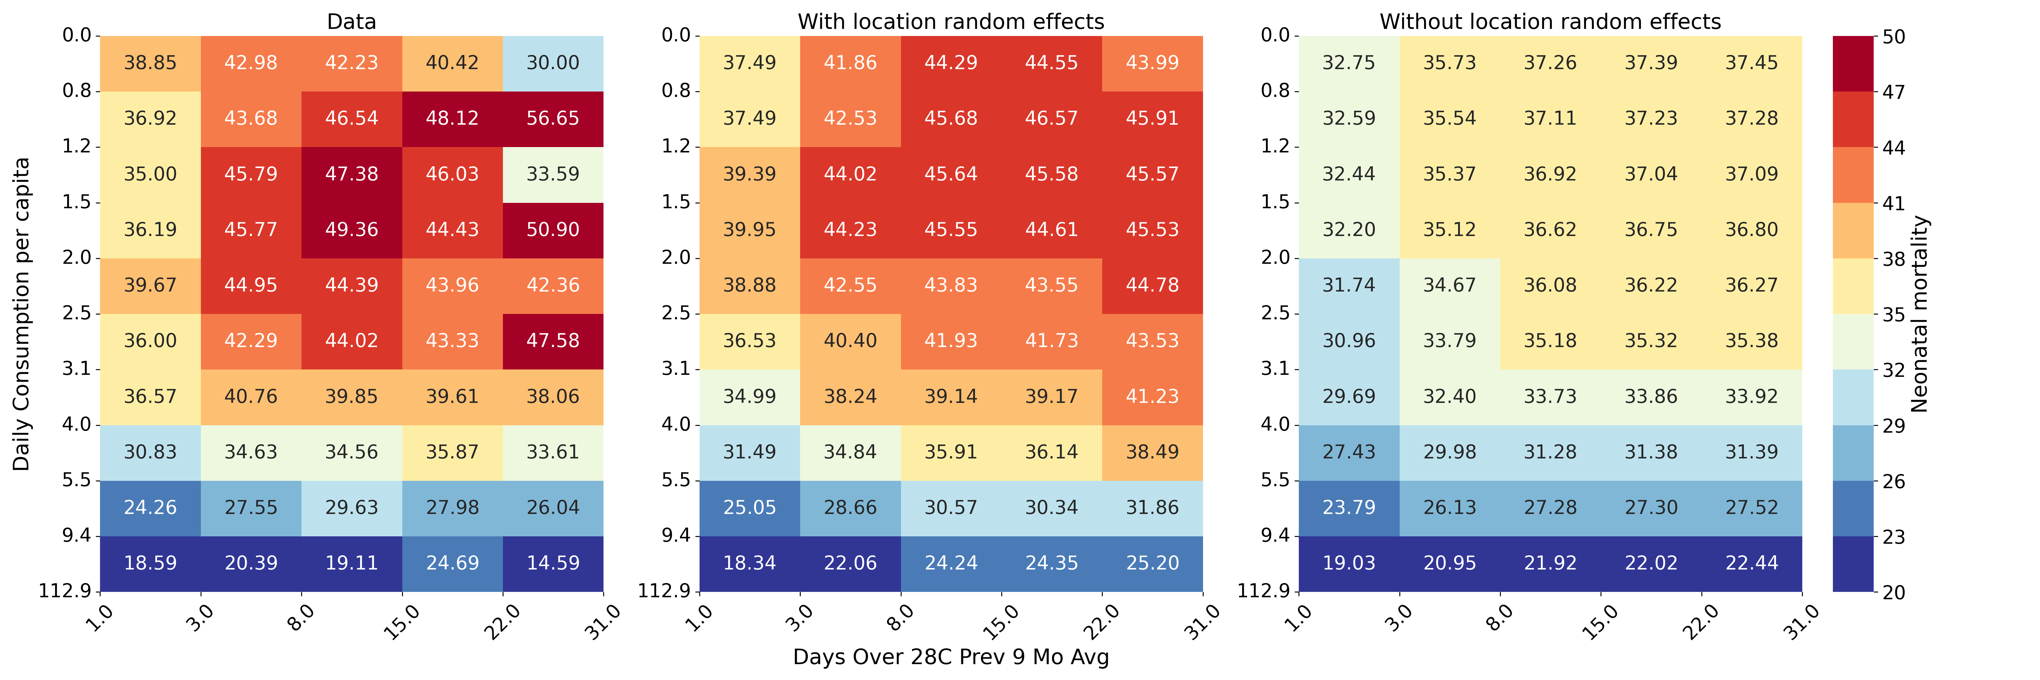
Temperature and neonatal mortality DHS analysis – top model by RMSE
Predicted neonatal mortality
Neonatal Mortality Data
With Location Random Effects
Without Location Random Effects
Daily Consumption per Capita
Neonatal Mortality
Average Number of Days Over 28° for Nine Months Prior to Birth Month

Slide 2
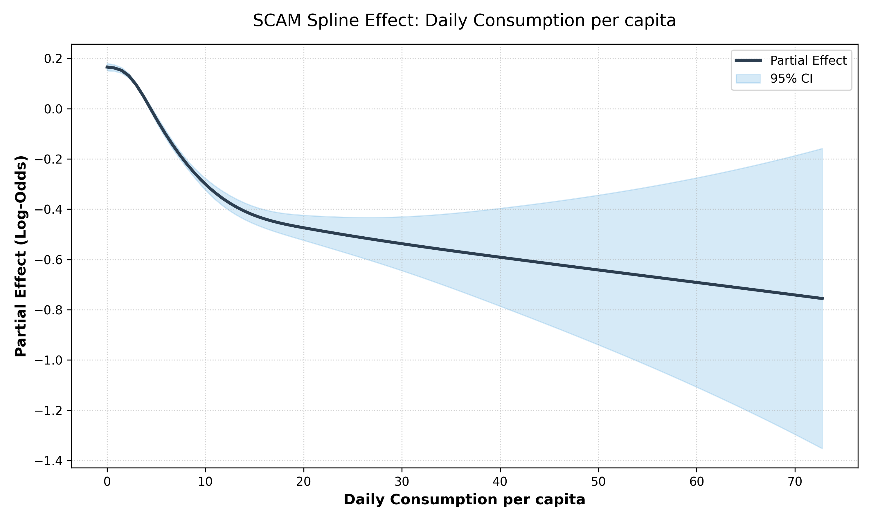
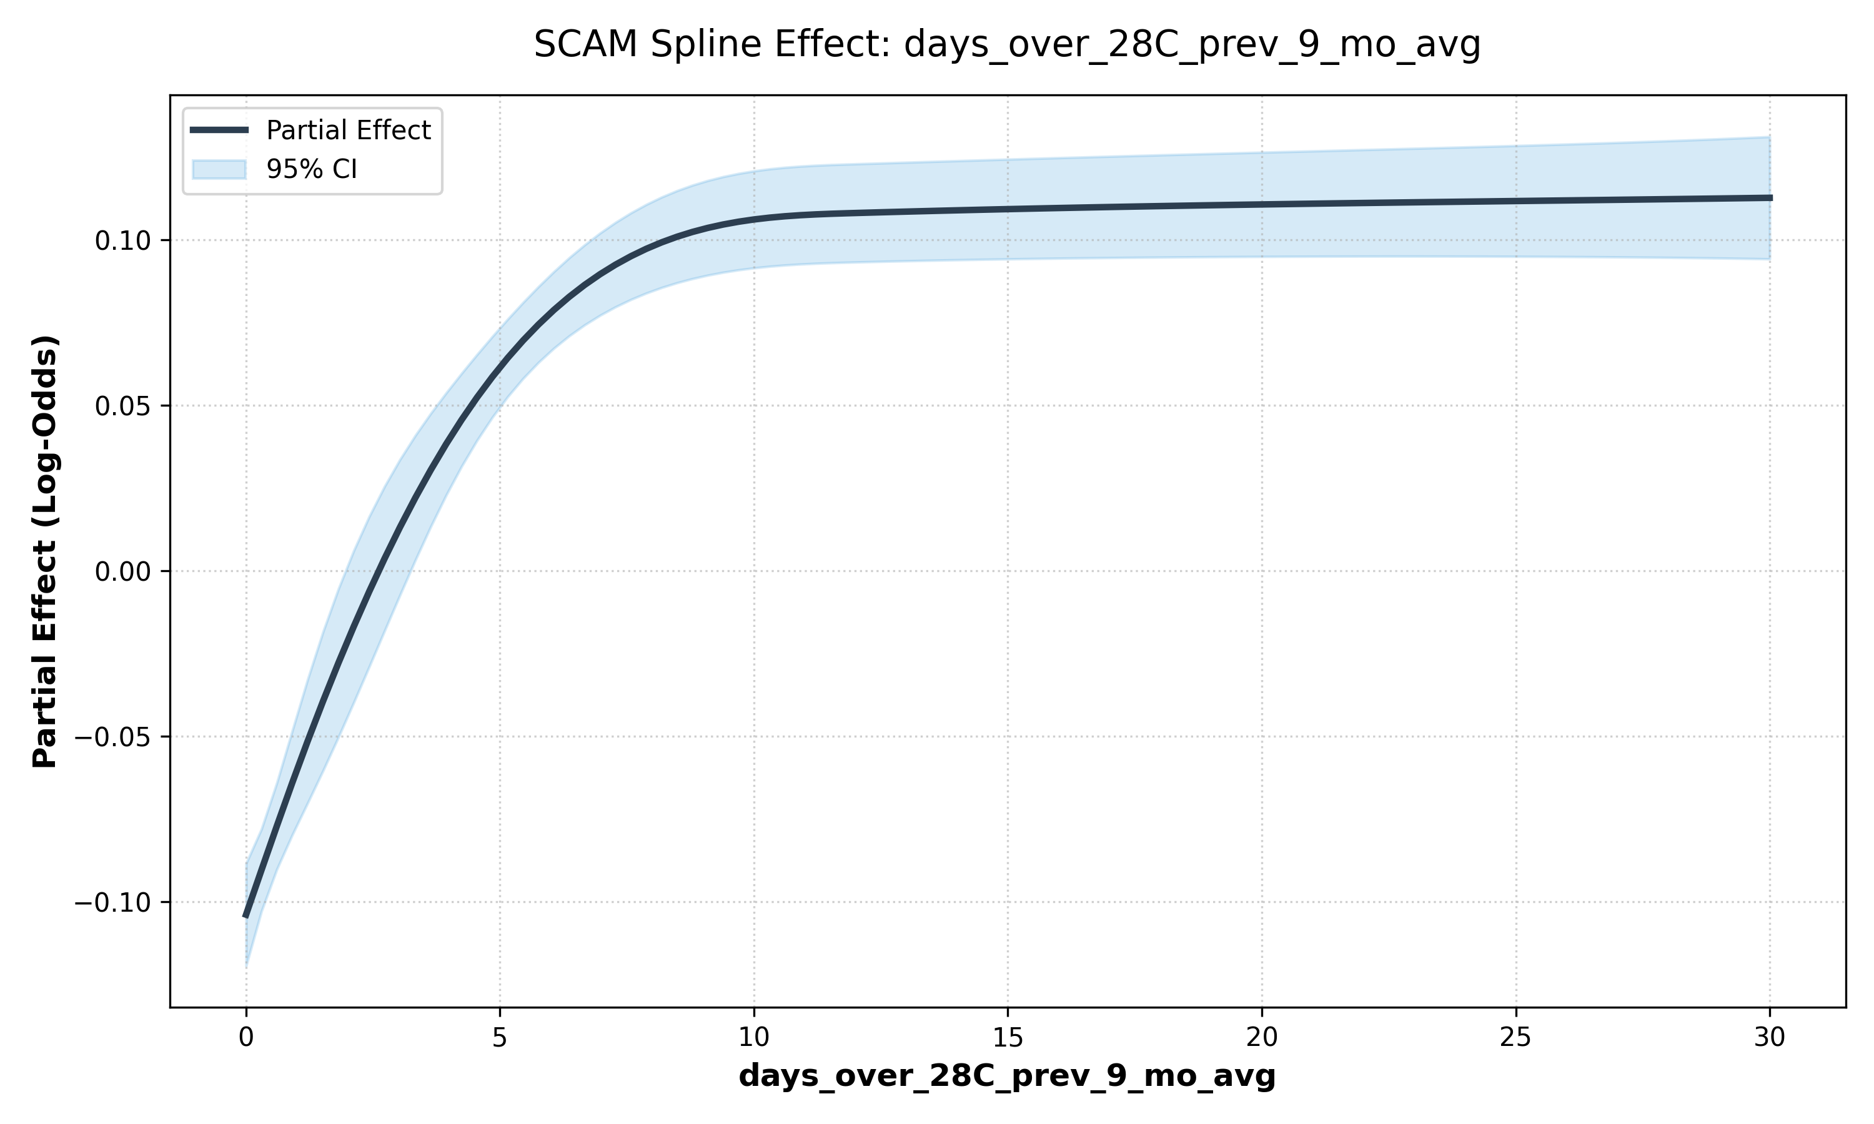
Top model spline effect–temperature and neonatal mortality
SCAM Spline Effect: Daily Consumption per Capita
SCAM Spline Effect: Average Number of Days Over 28°C for Nine Months Prior to Birth Month
Partial Effect (Log-Odds)
Partial Effect (Log-Odds)
Daily Consumption per Capita
Average Number of Days Over 28°C for Nine Months Prior to Birth Month

Slide 3
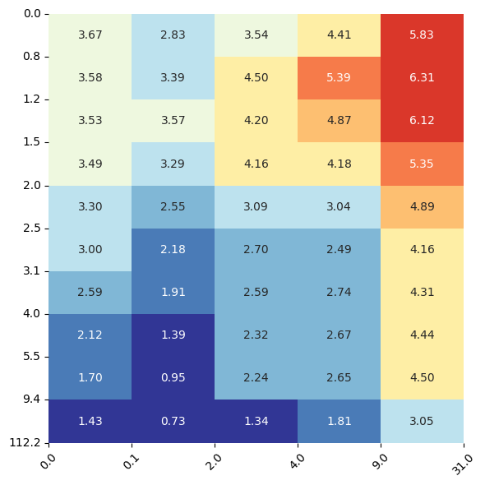
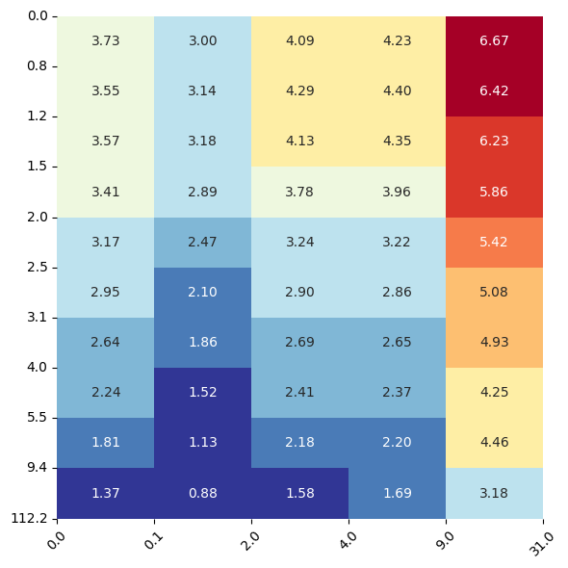
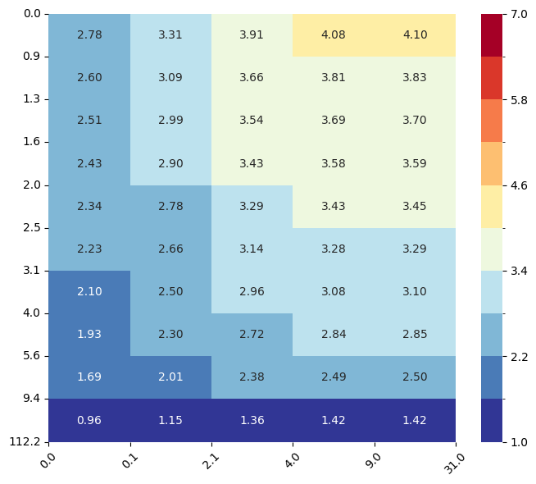
Temperature and under-five mortality DHS analysis
Predicted Under-five mortality
Under-five Mortality Data
With Location Random Effects
Without Location Random Effects
Daily Consumption per Capita
Under-five Mortality
Days Over 30°C During Birth Month

Slide 4
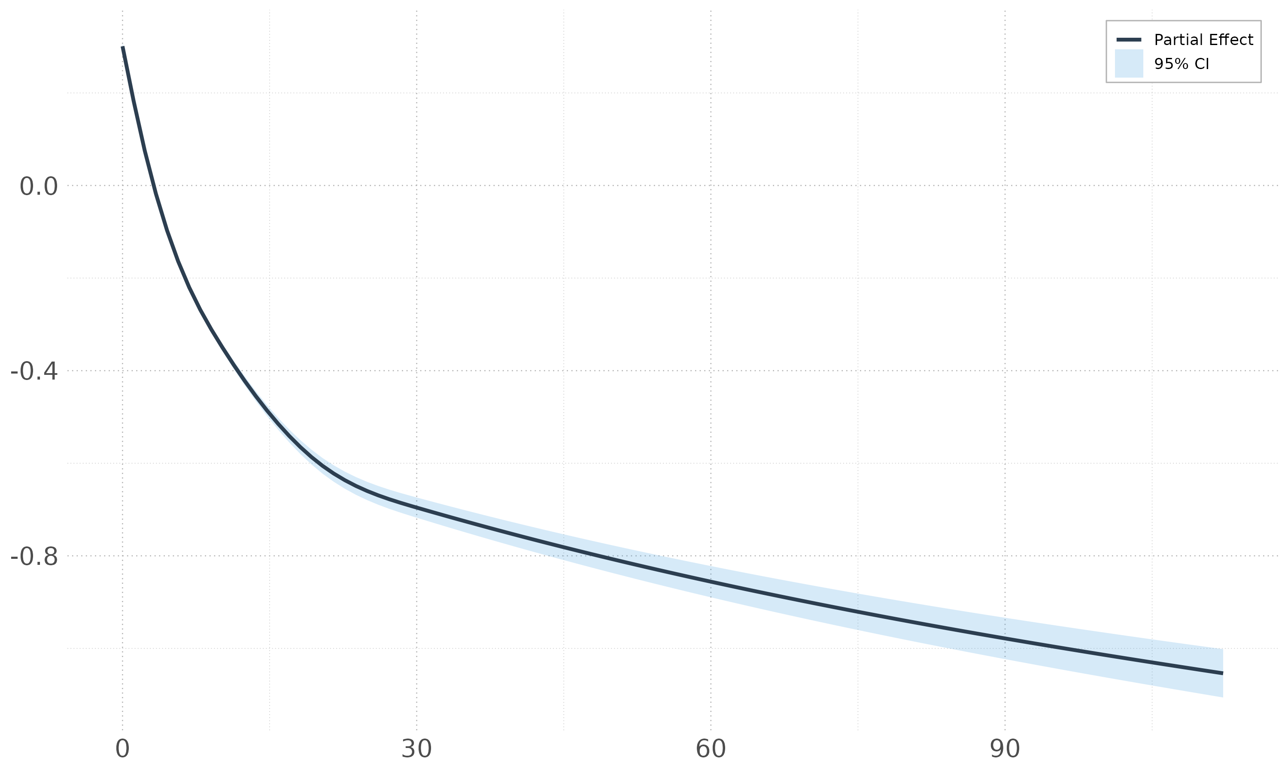
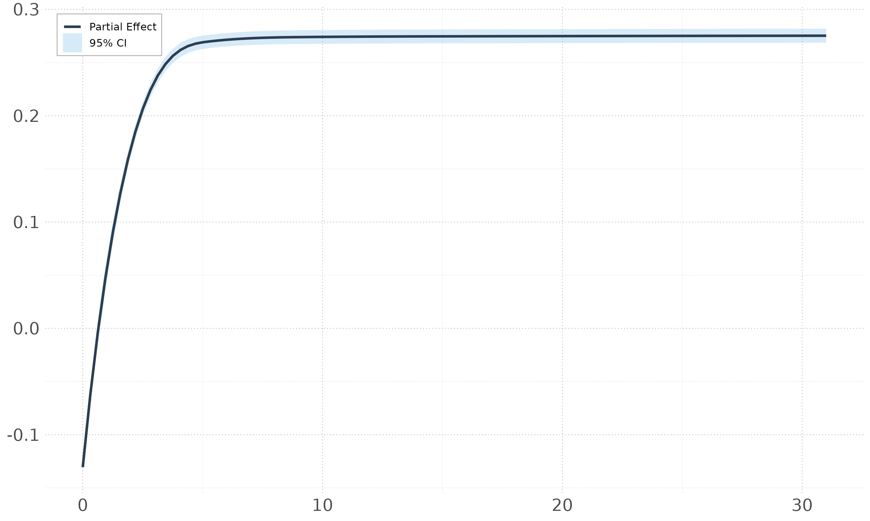
Spline effect–temperature and under-five mortality
SCAM Spline Effect: Daily Consumption per Capita
SCAM Spline Effect: Average Monthly Number of Days Over 30°C
Partial Effect (Log-Odds)
Partial Effect (Log-Odds)
Daily Consumption per Capita
Monthly of Days Over 30°C

