Slide 1
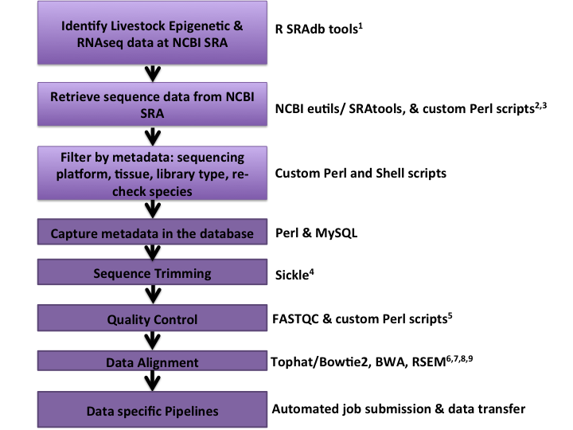
This needs to be reworked using NCBI’s new tools and scripts
This has been skipped for now as the discussion on this is still ongoing but I am in agreement that this does not need to be done for alignment given the ability of the aligners
I have not had a chance to get these scripts back up and running on the new server due to time constraints and complexity
Example scripts listed on next page
Discussed in write up

Slide 2
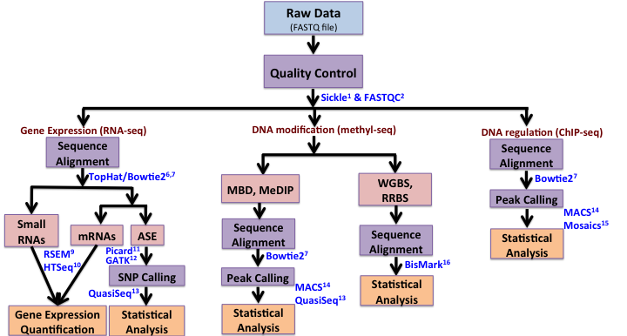
example.vcf.species.job
example.vcf2.species.job
example.htseq.speceis.job
example.rsem.species.job
example.tp.species.job
Have not been set up on the new server due to time constraints

