Slide 1
Introduction to Databases
Andrejs Liepiņš

Slide 2
Database
A database is an organized collection of data, generally stored and accessed electronically from a computer system. Where databases are more complex they are often developed using formal design and modeling techniques.
Formally, a "database" refers to a set of related data and the way it is organized. Access to this data is usually provided by a "database management system" (DBMS) consisting of an integrated set of computer software that allows users to interact with one or more databases and provides access to all of the data contained in the database.

Slide 3
Database Management System (DBMS)
The database management system (DBMS) is the software that interacts with end users, applications, and the database itself to capture and analyze the data. The DBMS software additionally encompasses the core facilities provided to administer the database. The sum total of the database, the DBMS and the associated applications can be referred to as a "database system". Often the term "database" is also used to loosely refer to any of the DBMS, the database system or an application associated with the database.

Slide 4
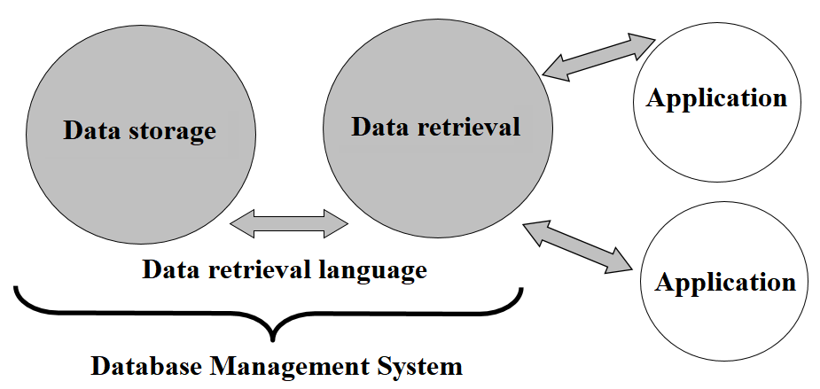
Database Management System (DBMS)

Slide 5
Database organisation
This material will look at relationship databases. Relational databases became dominant since the 1980s. These model data as rows and columns in a series of tables, and the vast majority use SQL for writing and querying data.

Slide 6
Relational model
The relational model consists of three components:
data structure - a set of rules through which a database is developed
data integrity - set of rules to support data correctness
data management - set of possible data processing operations

Slide 7
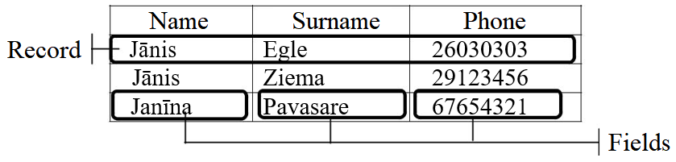
Table
Data table is used to store and display the data. The data table consists of records and fields.
Table - A set of records sharing the same attributes; a set of columns and rows Column – A field name, e.g. "Address" or "Date of birth“, and a field data set.
Row - A data set representing a single item

Slide 8
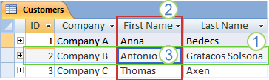
Record
A record (1) is an element of a database structure that consists of fields (2). The record contains information about one table object, such as the name, surname of one person. Each record forms one row of the data table. The table below contains three records. Records in a database or spreadsheet are usually called "rows".

Slide 9
Column
Сolumn (2) is a set of data values of a particular simple type, one value for each row of the database.

Slide 10
Value
A database value (3) is a single piece of information from a record. A database record (1) is a set of fields.

Slide 11
Field
When defining a data field, the following principle is followed: the field must contain one indivisible piece of information. In the example below, the record consists of 4 fields: ID, Company, first name, last name, and phone number.
It would be wrong to create one field for the name and last name, because then, for example, the information in the table could not be sorted by last name.

Slide 12
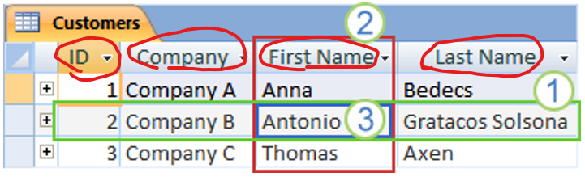
Field name
Each field has a field name that helps the user determine the contents of the field and is used by the database application to identify a specific data field.

Slide 13
Field
Only certain types of data can be stored in a data field. Field data type indicates what type of data can be entered and stored in this data field. The most common data types are text, number, date, currency.

Slide 14
Primary Key
A primary key is a field or group of fields that uniquely identifies each record in a database. The data in the primary key field is unique, i.e., there are no entries with the same primary key values ​​in the same table.
A table can have only ONE primary key.

Slide 15
Primary Key
The primary key can be created in different ways:
One or more fields are chosen as the primary key. For example, the primary key is a Name. Usually, this approach is not used because it is not always possible to ensure the uniqueness of the key (in this case there may be people with the same Name)
Name | Surname | Phone
Janīna | Pavasara | 7654321
Jānis | Egle | 6030303
Jānis | Ziema | 9123456

Slide 16
Primary Key
A primary key field is added to the table, the content of which can be created in two ways:
the user chooses the content of the primary key field, for example Personal Code;
Personal Code | Name | Surname | Phone
111111-11111 | Jānis | Egle | 6030303
222222-22222 | Jānis | Ziema | 9123456
333333-33333 | Janīna | Pavasara | 7654321

Slide 17
Primary Key
the content of the primary key field is generated by the database application.
Generated PK | Name | Surname | Phone
1 | Jānis | Egle | 6030303
2 | Jānis | Ziema | 9123456
3 | Janīna | Pavasara | 7654321

Slide 18
Indexing
A database index is a data structure that improves the speed of data retrieval operations on a database table at the cost of additional writes and storage space to maintain the index data structure. Indexes are used to quickly locate data without having to search every row in a database table every time a database table is accessed.
Indexes can be created using one or more columns of a database table, providing the basis for both rapid random lookups and efficient access of ordered records.

Slide 19
Index
An index is a copy of selected columns of data from a table, called a database key or simply key, that can be searched very efficiently that also includes a direct link to the complete row of data it was copied from.
Because records are often sorted and searched by the primary key field, indexation is enabled automatically (by default) for the primary key field.

Slide 20
Table relationships (Relations)
The use of table relationships or relations minimizes duplication of information in the database.
Relationships between tables are implemented by special types of fields called primary keys and foreign keys.

Slide 21
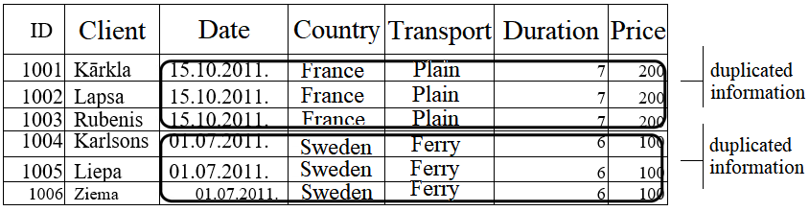
Table relationships (Relations)
Int the example below the data table Tourism contains the information about the activity of a tourism company (the primary key field is marked with an ID). It is easy to notice that part of the information is duplicated.

Slide 22
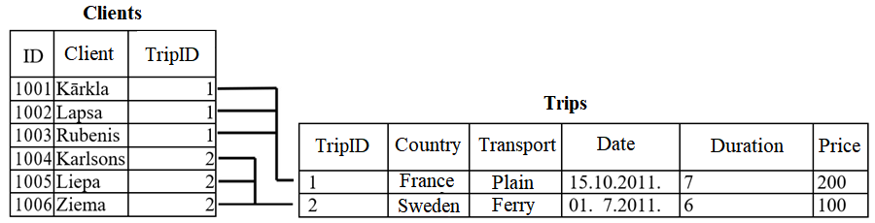
Table relationships (Relations)
The same information can be arranged in two tables, such as Clients and Trips.
In the Clients table, the TripID field points to an entry in the Trip table that describes the trip data, thus avoiding duplication of information.

Slide 23
Table relationships (Relations)
To create relationships, a primary key field is usually used. For example, the TripID primary key field in the Trips table is refers to a field of the same name in the Clients table.

Slide 24
Foreign Key
A FOREIGN KEY is a key used to link two tables together.
A FOREIGN KEY is a field (or collection of fields) in one table that refers to the PRIMARY KEY in another table.
The table containing the foreign key is called the child table, and the table containing the candidate key is called the referenced or parent table.

Slide 25
Foreign Key
The TripID field from the Clients table is a foreign key that refers to the primary key TripID in the Trips table. As a result, each customer is assigned the appropriate trip from the Trips table.
To establish a link between a primary and a foreign key, their data types must match.

Slide 26
Types of Relationships
One of the huge advantages of a relational database is that, once you have your data held in clearly defined, compact tables, you can connect or relate the data held in different tables. There are three types of relationships between the data you are likely to encounter at this stage in the design:
one-to-one,
one-to-many,
many-to-many.
To be able to identify these relationships, you need to examine the data and have an understanding of what business rules apply to the data and tables. If you're not sure, it can be helpful to meet with someone who does have a thorough knowledge of the data.
When analyzing table relationships, you need to look at the relationship from both sides. When creating table relationships you always work with two tables at a time. One table is called the primary or parent table and the other is the related or child table.

Slide 27
Types of Relationships
One-To-Many Relationship
A one-to-many (1:N) relationship means a record in Table A can relate to zero, one, or many records in Table B. Many records in Table B can relate to one record in Table A. The potential relationship is what's important; for a single record in Table A, there might be no related records in Table B, or there might be only one related record, but there could be many.
Such a relation is usually denoted as 1 - ∞, or 1:N.

Slide 28
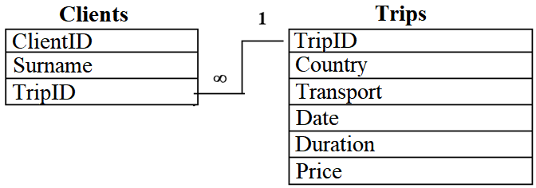
Types of Relationships
In the example below, the contents of the primary key value of the Trips table, can be used several times in the Clients table, because several clients can choose the same trip. Such a relation is called one to many.

Slide 29
Types of Relationships
One-to-one relation
A one-to-one (1:1) relationship means that each record in Table A relates to one, and only one, record in Table B, and each record in Table B relates to one, and only one, record in Table A.
This relation is most commonly used to split a single table into several parts.

Slide 30
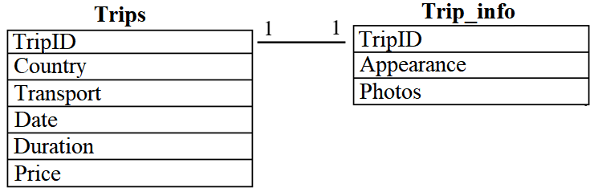
Types of Relationships
For example, the Trips table provides basic information and the Trip_info table provides additional information. The relationship between the TripID fields is a one-to-one relationship that indicates that in both tables TripID primary key field value can only be repeated once.

Slide 31
Types of Relationships
Many-to-many relation
The most common is the many-to-many relation, which indicates that each record in the first table can be related with several records in the second table, and that each record in the second table can be related with several records in the first table. Such type of relation is usually denoted as follows: ∞ - ∞ or M-N.
For example, one client can choose several trips and one trip can be chosen by several clients.

Slide 32
Types of Relationships
A many-to-many relation can not be established between two tables directly, this relation could be thought of as two one-to-many relationships, linked by an intermediary table.
The intermediary table is typically referred to as a “junction table” (also as a “cross-reference table”). This table is used to link the other two tables together. It does this by having two fields that reference the primary key of each of the other two tables.

Slide 33
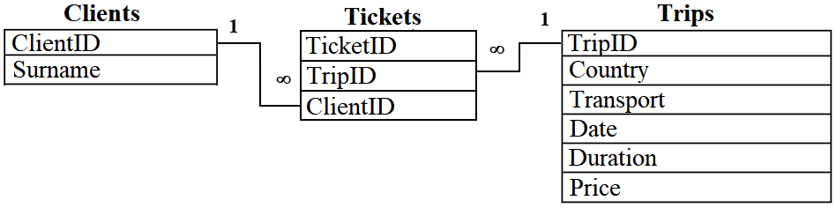
Types of Relationships
For example, using the Tickets table, you can define a many-to-many relationship between the Clients and Trips tables.
one client can choose several trips;
one trip can be chosen by several clients.

Slide 34
Referential Integrity
Referential integrity means that security measures are taken in the database for activities with related fields. Records adding and deleting processes in a single table are under control to check how it affects the records in the related table.
For example, you can't delete a trip while at least one client has chosen it, or you can’t sell a customer a non-existent trip.

Slide 35
Practice
Define a primary key for the given tables. Select it from an existing fields or add your own.
Prescriptions
ID | Date | Doctor | Medical institution | Medicine name | Quantity
Books
Author | Title | Publisher | Year of publishing | Number of copies | Annotation

Slide 36
Practice
Library readers
ReaderID | Name | Surname | Phone | Date of birth
Hotel register
Name | Surname | Date of birth | Date | Room number | Payment
Hotels
Name | Address | Guest number | Phone number | Director

Slide 37
Practice
Books taken
Reader ID | Book ID | Return date
Departments Wards Patients
Department ID | Ward ID | Bed number | Patient surname
Computer class schedule
Day of week | Time | Class

Slide 38
Practice
There is a 1:M relation between the tables. What happens if we try to:
enter a value to the child table foreign key field which is missing in the parent table?
enter new data to the parent table?
delete a record from a child table?
delete records from the parent table?
change the foreign key field values ​​of the child table?
change the parent table primary key field values?

