Slide 1
Test DB description

Slide 2
Database scheme
The database is designed for the library needs, it is intended to serve readers and contains the following data:
data about books (Tables Books, Authors, Title_page, Comments, Books_taken)
data about readers (Table Readers)
data about library services (Tables Services and Journal)
data about librarians and reading rooms (Tables Librarians and Reading_rooms).

Slide 3
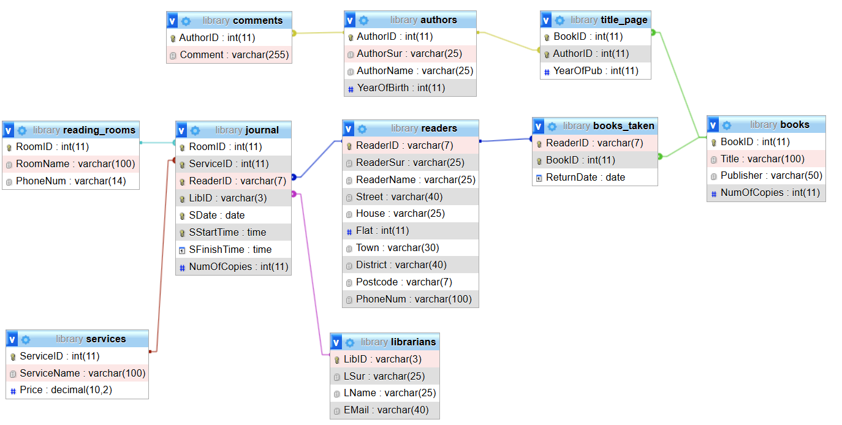
Database scheme

Slide 4
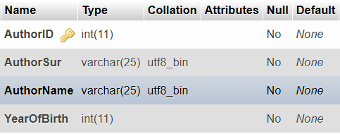
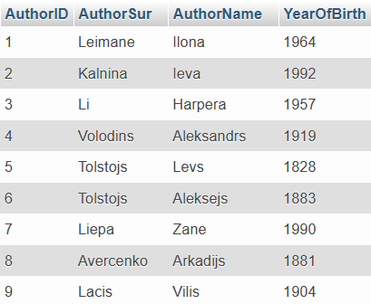
Table description. Authors

Slide 5
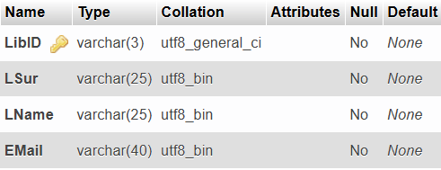
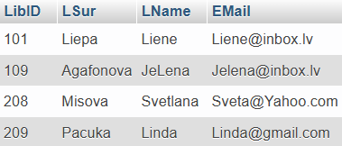
Table description. Librarians

Slide 6
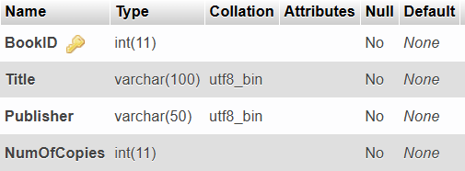
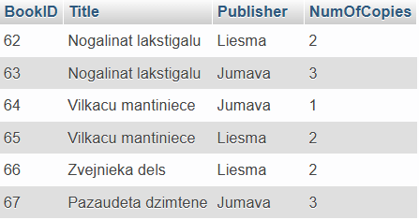
Table description. Books

Slide 7


Table description. Comments

Slide 8
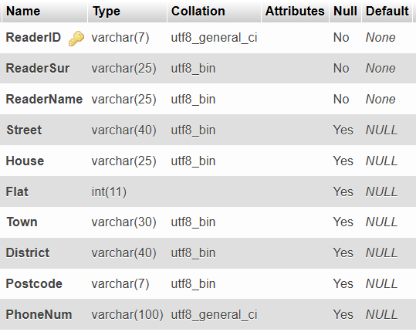
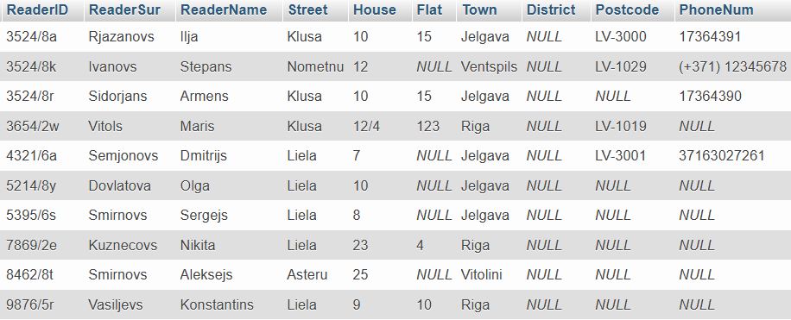
Table description. Readers

Slide 9

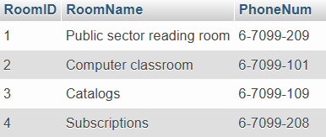
Table description. Reading_rooms

Slide 10

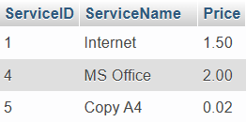
Table description. Services

Slide 11

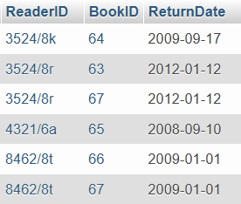
Table description. Books_taken

Slide 12

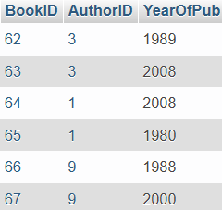
Table description. Title_page

Slide 13
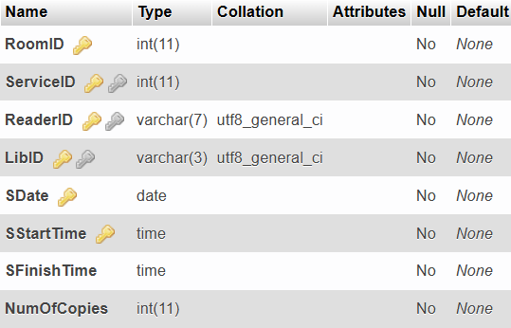
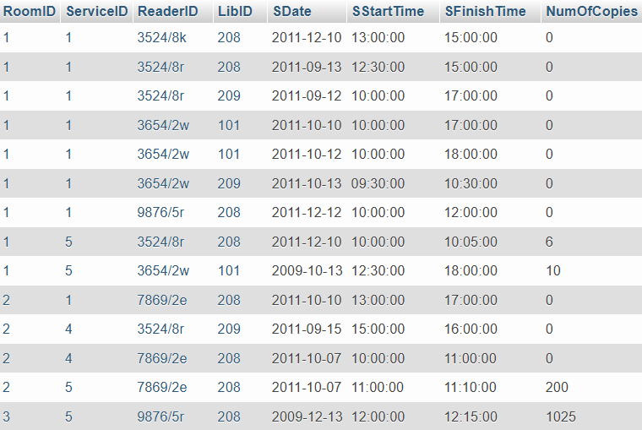
Table description. Journal

