Slide 1
MySQL DBVS

Slide 2
MySQL
MySQL is a relational database management system. MySQL is a solution for small and medium DB applications. MySQL is typically used as a server accessed by local or remote clients.
https://www.mysql.com

Slide 3
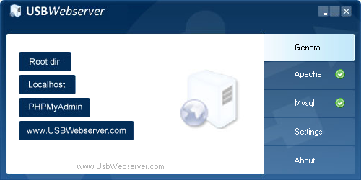

USBWebServer
A program that combines MySQL and Apache servers, allowing them to be started and configured quickly.
http://www.usbwebserver.net/webserver/
We will use 8.6.6. version during this course.
It can be found in the Moodle as well.

Slide 4
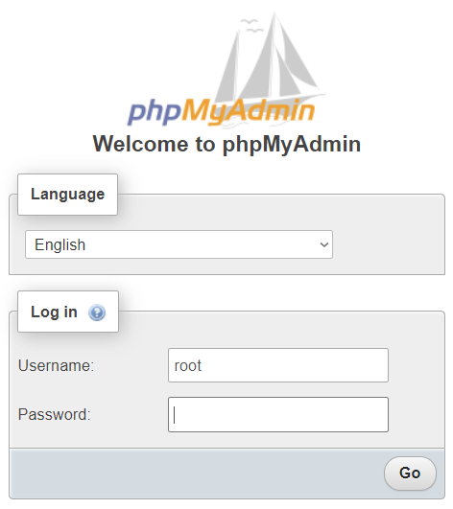
USBWebServer
To be able to administer your database you need to execute an USBWebServer and open PHPMyAdmin. Enter username (root) and password (usbw).

Slide 5
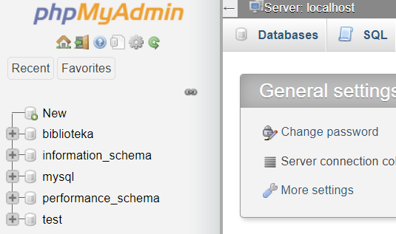
PHPMyAdmin
In a Databases section you can see system databases.

Slide 6
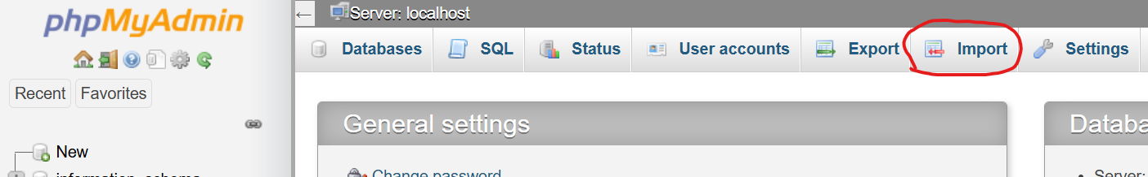
DB import (optional)
In case you do not use my program kit – the database «Library» must be imported independently. This can be done in the «Import» section

Slide 7
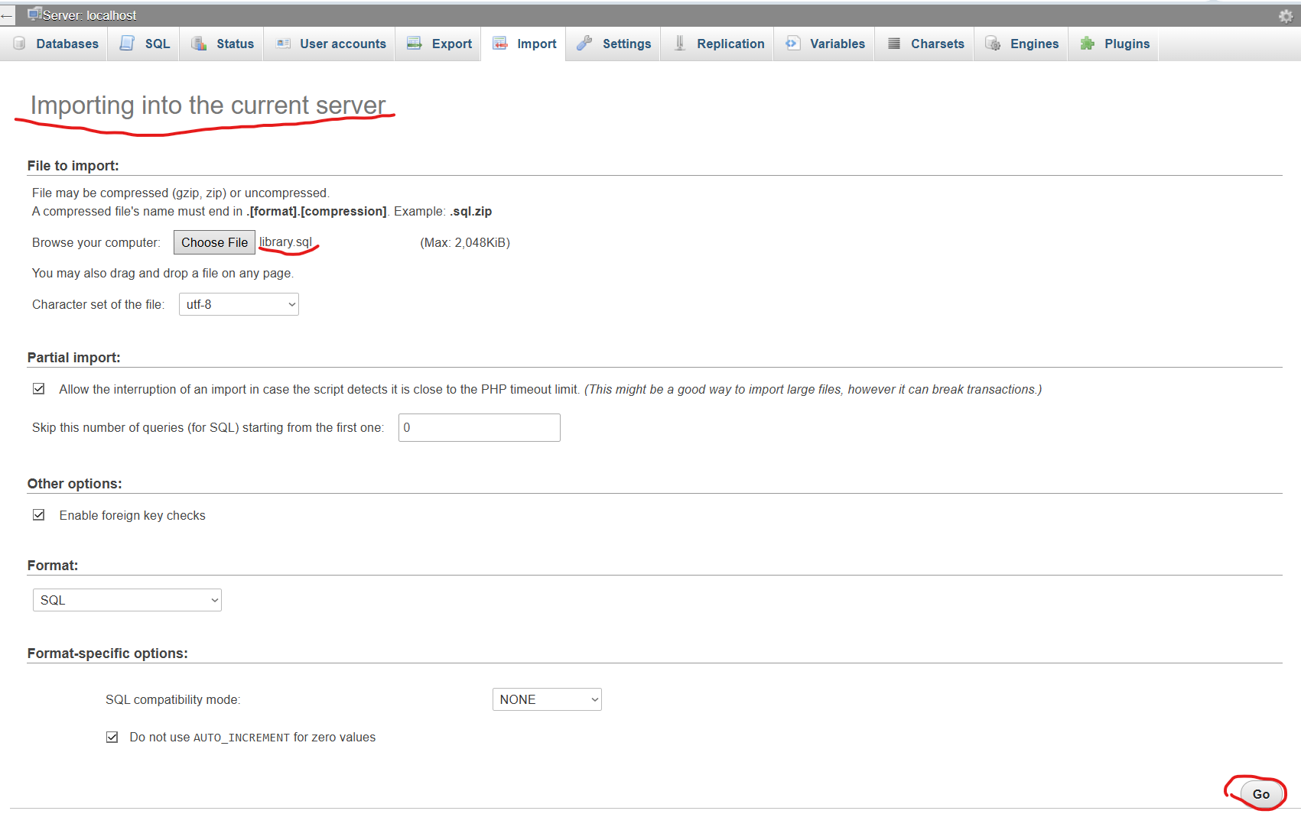
DB import (optional)
Before importing it is necessary to make sure that you see the phrase «Importing into the current server» Then you need to take the DB code (library.sql) from the training materials and press the «Go» button. (no options need to be changed)

Slide 8
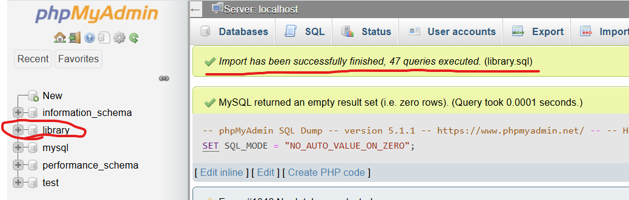
DB import (optional)
DB import may take 15-20 seconds. As a result, several notifications about the successful execution of SQL code and the «library» database in the server DB list should appear

Slide 9
Web Server – Query configuration (optional)
In a default installation, the DB web interface does not offer query saving. To turn it on, you need to follow a couple of configuration steps.

Slide 10
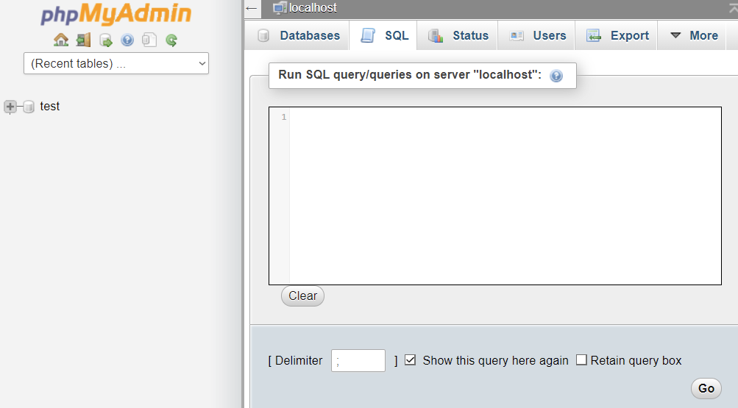
Web Server – Query configuration (optional)
1. In the SQL section, copy and run the code from the create_table.sql file that can be found in the Files->MySQL Configs folder.

Slide 11
Web Server – Query configuration (optional)
2. Replace the file version USBWebserver v8.6.6\phpmyadmin\config.inc.php with the version can be found in the Files->MySQL Configs folder
Re-login.

Slide 12
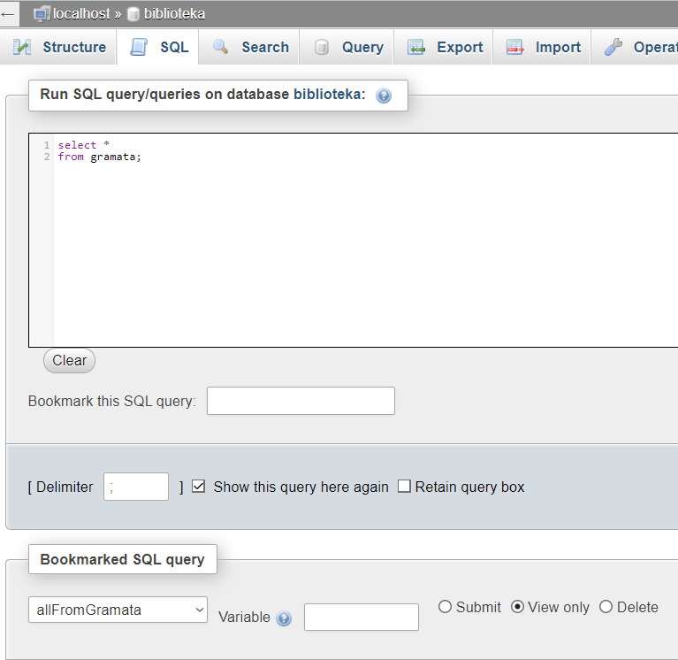
Web Server – Query configuration (optional)
Now, when writing a query, it is possible to save it by specifying the name in Bookmark this SQL query section, as well as view saved queries in the Bookmarked SQL query section.

Slide 13
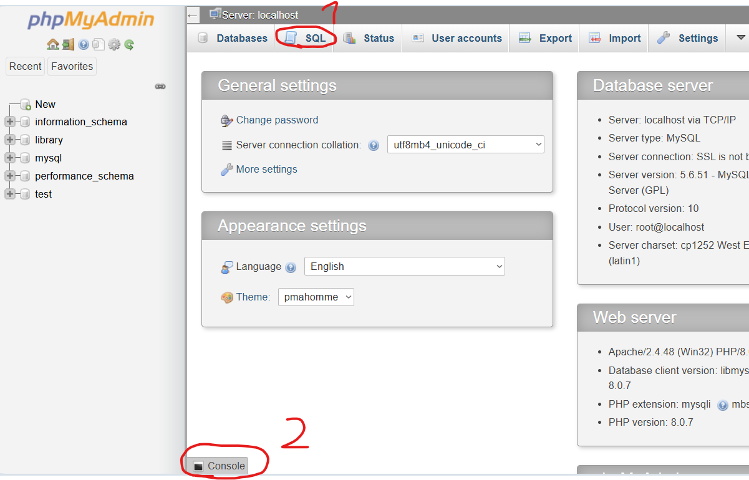
Where to write SQL code?
You can do it in:
“SQL” section
Console

Slide 14
PHPMyAdmin documentation
Additional information about PHPMyAdmin:
https://github.com/phpmyadmin/phpmyadmin/wiki
https://docs.phpmyadmin.net/en/latest/
https://docs.phpmyadmin.net/_/downloads/en/master/pdf/

