Slide 1
Database design

Slide 2
Database design
DB Design consist of 8 steps:
Step 1: Determination of the purpose of your database
Step 2: Definition of tables and relations
Step 3: Decomposition of a Relations
Step 4: Definition of attributes
Step 5: Attribute decomposition
Step 6: Definition of primary keys
Step 7: Setting up table relationships
Step 8: Implementation of the scheme

Slide 3
Step 1: Determination of the purpose of your database
Select the organization for which the database is created. This helps prepare you for the remaining steps. Gather all of the types of information you might want to record in the database. Example: Create a database to automate user service in a library.

Slide 4
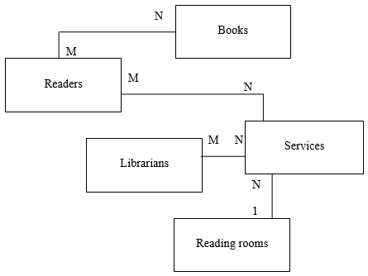
Step 2: Definition of tables and relations
At this stage, distinguish the objects of the subject area and their relations. It can be parts of physical or logical information.
In our example, these are: Readers, Librarians, Books, Services, and Reading Rooms. There are also links between objects.

Slide 5
Step 3: Decomposition of a Relations
Decomposition of a Relation:
The process of breaking up or dividing a single relation into two or more sub relations is called as decomposition of a relation.
At this step, decomposition of M:N links and sometimes recursive links is performed.

Slide 6
Decomposition of a Relations
A many-to-many relation can not be established between two tables directly, this relation could be thought of as two one-to-many relationships, linked by an intermediary table.
The intermediary table is typically referred to as a “junction table” (also as a “cross-reference table”). This table is used to link the other two tables together. It does this by having two fields that reference the primary key of each of the other two tables.

Slide 7
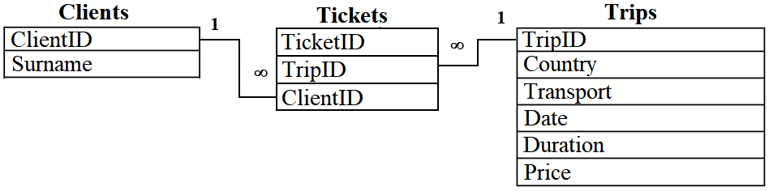
Decomposition of a Relations
For example, using the Tickets table, you can define a many-to-many relationship between the Clients and Trips tables.
one client can choose several trips;
one trip can be chosen by several clients.

Slide 8
Decomposition of a Relations
In our example, the relations between the tables:
Librarians and Services
Readers and Services
Reading Rooms and Services
will be transformed into links 1:M by creating an additional cross-reference table Journal. This table will collect the information about all library services provided.
Relation M:N between tables
Readers and Books
also will be transformed. The cross-reference table Books_taken will be created, to link the Readers and Books tables and to store the information about whom the book was issued.
As a result, a new scheme will be created.
Books_taken
N
N
1
Books
1
Readers
1
N
Librarians
N
Journal
N
Services
1
1
N
1
Reading rooms

Slide 9
Step 3: Decomposition of a Relations
Books_taken
N
N
1
Books
1
Readers
1
N
Librarians
N
Journal
N
Services
1
1
N
1
Reading rooms

Slide 10
Step 4: Definition of attributes
Books_taken
Books
ReaderID Book title Return date
BookID Book title Authors Publisher Year of publishing Number of copies
N
1
At this step, each object is assigned attributes or properties.
N
Readers
1
ReaderID Last Name First Name Address Phone
1
Journal
N
Reading Room Service name LibrarianID ReaderID Date Start of service End of service
Librarians
LibrarianID Last Name First Name Phone e-mail
1
N
N
N
Services
Reading Rooms
Number Name Price
1
1
Number Name Phone

Slide 11
Step 5: Attribute decomposition
Books
If multiple (M) copies of an attribute can be assigned to one (1) record, the attribute need to be transformed into a separate object, the relation is defined, and decomposition of the relation is performed if necessary.
If only one (1) instance of an attribute can be assigned to one (1) record, but the attribute consists of several attributes (is complex), it is replaced by the attributes of which it consists.
BookID Book title Authors Publisher Year of publishing Number of copies
Readers
ReaderID Last Name First Name Address Phone

Slide 12
Step 5: Attribute decomposition
In our example, among the defined attributes of the Book object is the Authors attribute. There is a relation 1:M between any copy of the Book and the Authors attributes. This situation prompts you to create an Authors table. There is an M:N relation between the Authors and Books tables. This means that the relation must also be decomposed. Our example also contains a complex attribute – the Address attribute of the Readers object. The link between the copy of the Reader object and the Address attribute is 1:1, but the attribute consists of several attributes. This means that it needs to be expanded.
Books
BookID Book title Authors Publisher Year of publishing Number of copies
Readers
ReaderID Last Name First Name Address Phone

Slide 13
Step 5: Attribute decomposition
Books_taken
Books
Books_taken
Books
ReaderID Book title Return date
BookID Book title Publisher Year of publishing Number of copies
N
1
ReaderID Book title Return date
BookID Book title Authors Publisher Year of publishing Number of copies
N
1
N
N
Readers
1
1
Readers
ReaderID Last Name First Name Street House Apartment City District Post code Phone
Title page
1
N
ReaderID Last Name First Name Address Phone
1
Author's last name Author’s first name Book title Year of publishing
N
Journal
1
N
1
Authors
Reading Room Service name LibrarianID ReaderID Date Start of service End of service
AuthorID Last name First name Year of birth
Librarians
Journal
N
LibrarianID Last Name First Name Phone e-mail
1
N
Reading Room Service name LibrarianID ReaderID Date Start of service End of service
N
N
Librarians
N
LibrarianID Last Name First Name Phone e-mail
N
Services
Reading Rooms
1
Number Name Price
1
N
1
Number Name Phone
Reading Rooms
Services
1
1
Number Name Price
Number Name Phone

Slide 14
Step 6: Definition of primary keys
Books_taken
Books
ReaderID Book title Return date
BookID Book title Publisher Year of publishing Number of copies
N
1
At this step, choose each table’s primary key. The primary key is a column that is used to uniquely identify each row.
N
Readers
1
1
ReaderID Last Name First Name Street House Apartment City District Post code Phone
Title page
N
Author's last name Author’s first name Book title Year of publishing
N
1
1
Authors
AuthorID Last name First name Year of birth
Journal
N
Reading Room Service name LibrarianID ReaderID Date Start of service End of service
Librarians
N
LibrarianID Last Name First Name Phone e-mail
N
1
N
Services
1
Reading Rooms
1
Number Name Price
Number Name Phone

Slide 15
Step 7: Setting up table relationships
You can create a relation between two tables only by using the attributes with matching data types.
In our example, the difficulties will appear while linking the attributes:
BookTitle from the Books_taken and the BookID from the Books
BookID from Books with BookTitle from Title Page
AuthorID from Authors with Author’s Lastname from Title Page
and so on…

Slide 16
Step 7: Setting up table relationships
Books_taken
Books
ReaderID BookID Return date
BookID Book title Publisher Year of publishing Number of copies
The scheme needs to be redesigned again. Now, for example, Books and Books_taken are related by attributes called BookID.
N
1
N
Readers
1
1
ReaderID Last Name First Name Street House Apartment City District Post code Phone
Title page
N
AuthorID BookID Year of publishing
N
1
1
Authors
AuthorID Last name First name Year of birth
Journal
N
RoomID ServiceID LibrarianID ReaderID Date Start of service End of service
Librarians
N
LibrarianID Last Name First Name Phone e-mail
N
1
N
Services
1
Reading Rooms
1
ServiceID Name Price
RoomID Name Phone

Slide 17
Step 8: Implementation of the scheme
Implementation…

