Slide 1
Group 5 Members:
Yves BAHATI - 2305000921
Elysée NIYIBIZI - 2305000921

Slide 2
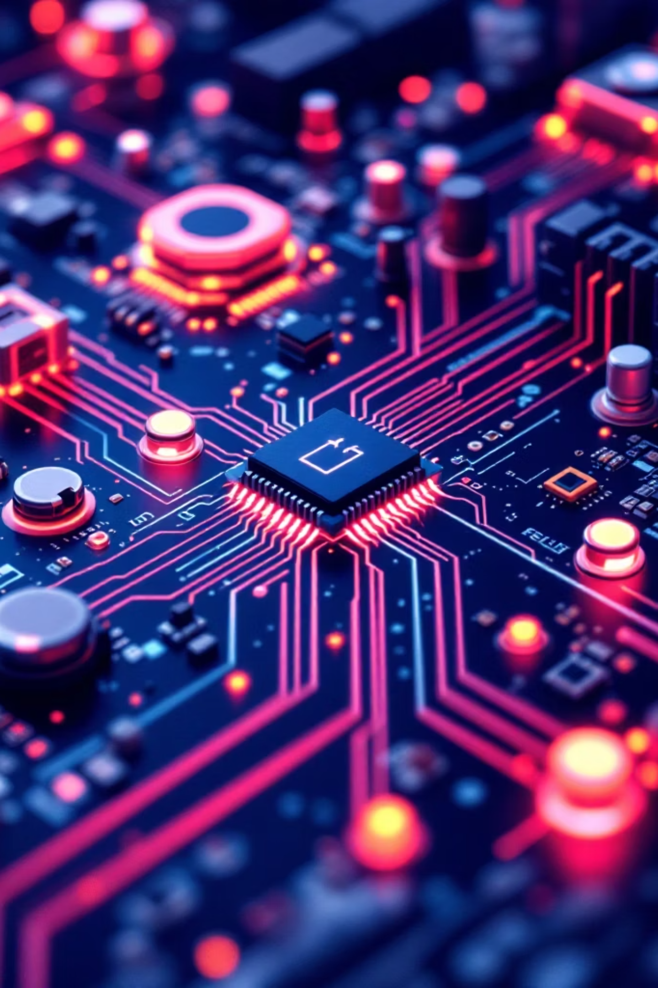
🎓 Sensors and Actuators in IoT
Types, Technology Principles & Real-World Applications
Group Assignment | IoT & Embeeded systems

Slide 3


Sensors in IoT (Overview)
What is a Sensor?
A device that detects physical/environmental changes
Converts physical quantities into electrical signals
Provides input to IoT systems
Most Common IoT Sensors:
Temperature
Humidity
Motion
Light
Gas
Key Idea: Sensors allow IoT systems to understand the environment.

Slide 4
Popular Environmental Sensors
1️⃣ Temperature Sensor
2️⃣ Humidity Sensor
Example: DHT22, LM35
Example: DHT22
Technology:
Technology:
Resistance or voltage changes with temperature
Digital sensors use built-in ADC
Capacitive sensing
Moisture changes capacitance
Application:
Application:
Smart thermostats
Greenhouse monitoring
Smart irrigation
Weather stations

Slide 5
Popular Detection Sensors
1
2
3
Motion Sensor
Light Sensor
Gas Sensor
Example: PIR sensor
Example: LDR
Example: MQ-2
Technology:
Technology:
Technology:
Detects infrared radiation changes from moving objects
Resistance decreases as light increases
Gas exposure changes semiconductor resistance
Application:
Application:
Application:
Security systems
Automatic lighting
Automatic street lights
Phone brightness control
Smoke detection
Air quality monitoring

Slide 6






Actuators in IoT (Overview)
What is an Actuator?
Converts electrical signals into physical action
Produces movement, light, sound, or switching
Most Common IoT Actuators:
DC Motor
Servo Motor
Relay
LED
Buzzer
Key Idea: Actuators allow IoT systems to interact with the environment.

Slide 7
Popular Actuators
1️⃣ DC Motor
2️⃣ Servo Motor
3️⃣ Relay
4️⃣ LED / Buzzer
Technology: Electromagnetism → electrical energy into rotation
Technology: PWM + feedback system for precise position
Technology: Electromagnetic switch controlling high voltage
Technology:
LED → Electroluminescence
Buzzer → Piezoelectric effect
Application: Robotic arms, camera control
Application: Smart doors, conveyor systems
Application: Smart home appliance control
Application:
Status indicators
Alarm systems

Slide 8


How They Work Together
IoT Workflow
Sense
Process
Decide
Act
This workflow illustrates the complete cycle from sensing to action in any IoT system.
Example:
Temperature rises → Controller detects → Fan motor turns ON

Slide 9

🔎 Short Conclusion
Sensors = Input
Actuators = Output
Together they enable automation, monitoring, and smart control
Applications include:
Smart homes
Smart agriculture
Industrial automation

