Slide 1

Server and System administration
Module Code : CSC3504 NDAYAMBAJE Simeon
Server and Systems Administration , CSC3504

Slide 2
Introduction to Backup
Backup is a copy of data stored separately for recovery purposes
Ensures business continuity and disaster recovery
Prevents data loss due to failure, cyberattacks, or human error
Backup vs Archiving vs Replication explained

Slide 3
Backup Strategies
3-2-1 rule: 3 copies, 2 media types, 1 offsite
GFS rotation strategy
Define schedules: daily, weekly, monthly
Retention policies based on business needs

Slide 4
Backup Storage Options
Local storage: fast but limited
Offsite storage: disaster protection
Cloud backup: scalable and flexible
Hybrid combines local + cloud

Slide 5
Backup Planning
Identify critical systems and data
Define RPO: acceptable data loss
Define RTO: acceptable downtime
Plan storage and capacity

Slide 6
Backup Security
Encrypt backup data
Restrict access
Protect against ransomware
Use immutable backups

Slide 7
Monitoring
Check logs regularly
Set alerts for failures
Generate reports
Ensure SLA compliance

Slide 8
Challenges
Storage limitations
Network issues
Backup failures
Human errors

Slide 9
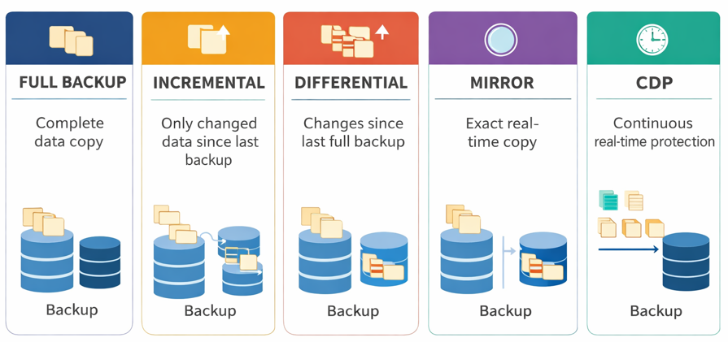
Types of Backup

Slide 10
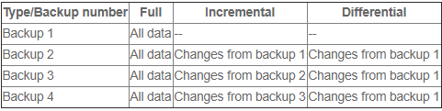
Types of data backups
Notes:
The main input to an MRS is data collected and stored by transaction processing systems. An MRS further processes transaction data to produce information useful for specific purposes.

Slide 11
1. Full Backup
A full backup copies all selected data (files, folders, or system data) to a backup storage location.
Features:
Complete copy of all data
Simplest to restore (only one backup needed)
Takes the most time and storage space
Best Used:
For weekly or monthly backups
When you need a full copy for disaster recovery

Slide 12
1. Full Backup
Advantages:
Easy and quick to restore
Reliable as all data is backed up
Disadvantages:
Time-consuming to perform
Requires a lot of storage space

Slide 13
2. Differential Backup
A differential backup saves only the data that has changed since the last full backup.
Features:
Quicker than a full backup
Requires the full backup + latest differential to restore
Best Used:
For mid-week backups
When you want a balance between speed and reliability

Slide 14
2. Differential Backup
Advantages:
Faster than full backups
Easier to restore than incremental backups
Disadvantages:
Grows in size each day after the full backup
Longer restore time compared to full backup

Slide 15
3. Incremental Backup
An incremental backup saves only the data that has changed since the last backup (whether full or incremental).
Features:
Fastest backup type
Requires full backup + all subsequent incremental backups to restore
Best Used:
For daily or hourly backups
When storage and speed are priorities

Slide 16
3. Incremental Backup
Advantages:
Saves time and storage space
Efficient for daily or frequent backups
Disadvantages:
Slower and more complex to restore
If one backup in the chain is missing, restore fails

Slide 17
Mirror Backup
Mirror Backup (Exact Real-Time Copy)is backup that creates an exact copy of your data at a specific point in time.
This backup is identical to the source — same structure, same files, and same state.
How It Works
Files are copied from source → backup location
No compression or versioning is usually applied
If a file is deleted or modified in the source, the same change is reflected in the mirror.

Slide 18
Mirror Backup
Key Characteristics
Exact 1:1 copy of data
No historical versions (usually)
Fast restore (just copy back)
Simple to understand and manage
Example Use Case
File servers where quick restore is needed
Development environments

Slide 19
Mirror Backup
Advantages
Very fast recovery (no reconstruction needed)
Easy to access files directly from backup
Good for systems needing quick restore
Disadvantages
No protection against accidental deletion
(if deleted in source → deleted in backup)
No version history
Not ideal for ransomware protection

Slide 20
Continuous Data Protection (CDP)
CDP is an advanced backup method that captures every change made to data in real time, allowing recovery to any point in time.
How It Works
System monitors data continuously
Every change (file edit, delete, update) is recorded instantly
Data is stored as a series of versions or changes
You can restore data to any specific second/minute

Slide 21
Continuous Data Protection (CDP)
Key Characteristics
Real-time or near real-time backup
Maintains multiple versions of data
Allows point-in-time recovery
Works at block-level or file-level
Example Use Case
Banking systems
Government critical systems
Databases requiring high availability
Systems where data loss is unacceptable

Slide 22
Continuous Data Protection (CDP)
Advantages
Best protection against data loss
Can recover from: Human error ,System failure and Ransomware attacks
Disadvantages
Requires more storage
More complex to implement
Higher cost (enterprise solutions)

Slide 23
Thank you

