Slide 1
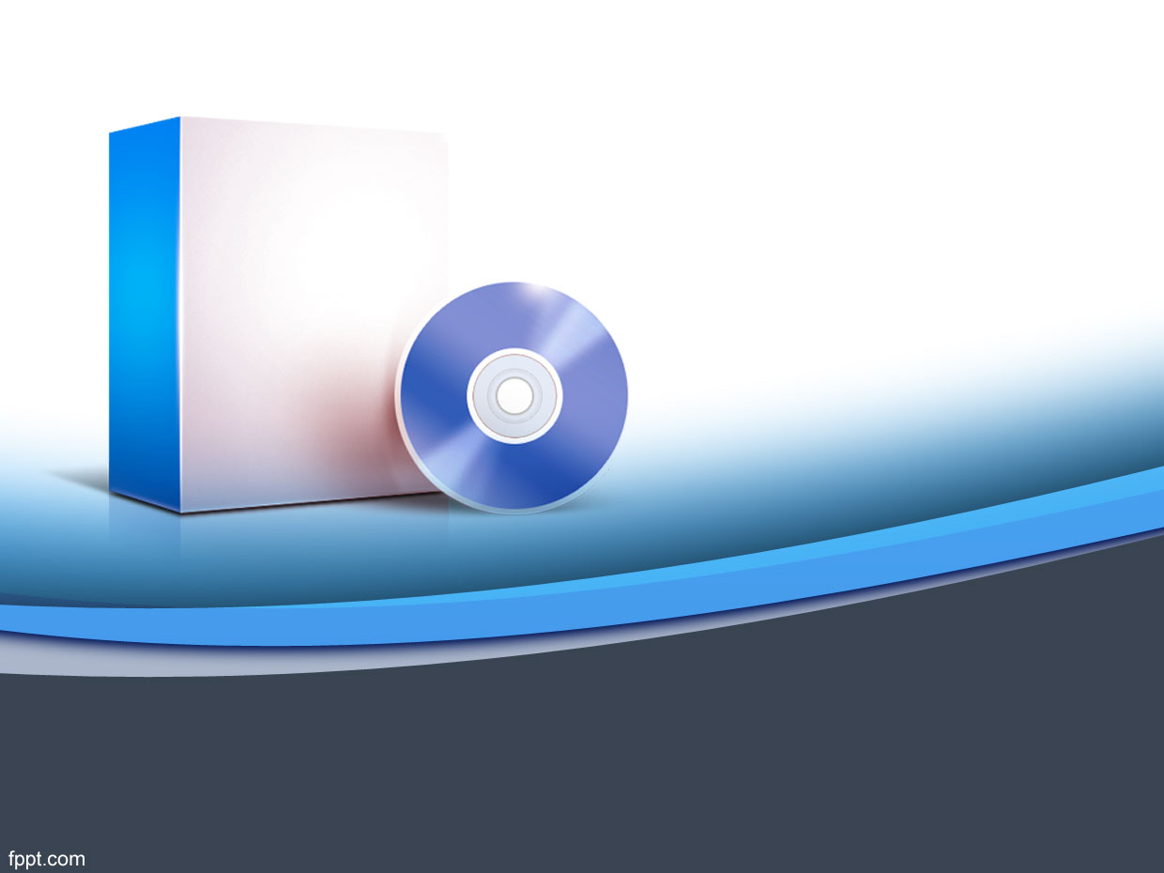
SOFTWARE ENGINEERING

Slide 2
CHAPTER II: Software Development Process

Slide 3
Objectives
Role of a process and a process model in a software project;
Various models for the development process: waterfall, prototyping, iterative, timeboxing, and Agile methods (Extreme Programming)XP;

Slide 4
Project and Process
A process is a sequence of steps performed for a given purpose.
Development process takes the project from user needs to software.
There are other goals of cost, schedule and quality, besides delivering software

Slide 5
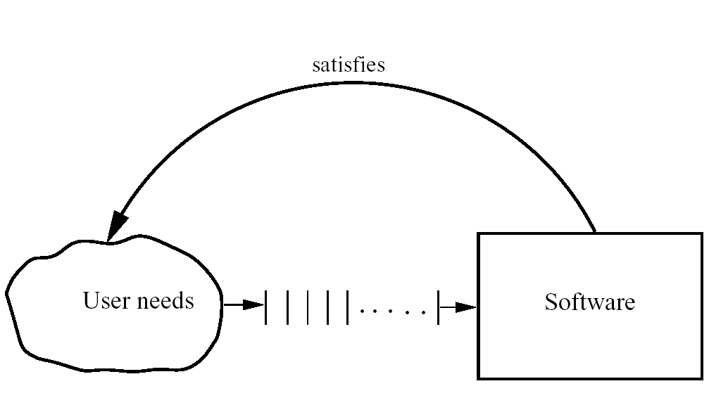
Software Development Problem
While developing software, the purpose is to develop software to satisfy the needs of some users or clients.

Slide 6
The 4 P’s of software engineering
Project: The task at hand
People: By whom is done
Process: The manner it is done
Product: The artifacts produced

Slide 7
Process, People, Technology
Quality & Productivity depends on people, process, and technology
Processes help people become more productive and create fewer errors
Tools help people execute some tasks in the process more efficiently and effectively
So, process forms the core

Slide 8
Software Process
Software Process: The sequence of steps performed to produce software with high quality, within budget and schedule.
Many types of activities performed by different people in a software project.
Process is distinct from product ; products are outcomes of executing a process on a project.

Slide 9
Component of Software Processes
Two major processes:
Development Process– focuses on development and quality steps needed to engineer the software.
Project management – focuses on planning and controlling the development process

Slide 10
Process Specification
Process is generally a set of phases
Each phase performs a well defined task and generally produces an output
Intermediate outputs – work products
How to perform a particular phase methodologies have been proposed

Slide 11
Software Development Process
Why we have phases
To employ divide and conquer
each phase handles a different part of the problem
helps in continuous validation
Commonly 5 phases

Slide 12
1. Systems Analysis
what the system should do to meet information requirements
analyze the current situation to determine the real cause of the problem

Slide 13
2. Systems Design
how the system will actually solve the problem.
logical and physical design specifications.

Slide 14
Logical design specifications
This lays out the components of the system and their relationship to each other as they would appear to users
shows what the system does.
It describes inputs and outputs, processing functions to be performed, business procedures, data models and controls.

Slide 15
Physical design specifications
process of translating the abstract logical model into the specific technical design for the new system.
It produces the actual specifications for hardware, software physical database, input/output media and manual procedures.

Slide 16
3. Programming/Coding
System specifications that were prepared during the design stage are translated into program code

Slide 17
4. System Testing and integration
Unit testing or program testing
System testing
Acceptance testing

Slide 18
5. Operation and maintenance
System is periodically reviewed by both users and technical specialists to determine how well it has met its original objectives and
To decide whether any revisions or modifications are in order.

Slide 19
Development Process and Process Models

Slide 20
Process Models
Process model : A simplified representation of a software process presented from a specific perspective. It describes the workflow and how the process elements interact together.
Process Models may be linear, incremental or iteratively.
Different models perform them in different manner

Slide 21
Software Development Process Model
1. Waterfall Model;
2. Prototyping Model;
3. Iterative Development Model;
4. Timeboxing Model;
5. Agile Model (Extreme Programming )

Slide 22

1. Waterfall Model
Dependent phases that are executed in a sequential order.
The complete solution is not released until the final phase. Linear sequence of stages/phases.
A phase starts only when the previous has completed; no feedback
The phases partition the project, each addressing a separate concern

Slide 23
Waterfall…
Linear ordering implies each phase should have some output
The output must be validated/certified
Common outputs of a waterfall:
Project plan, Software Requirement Specification and analysis, design docs, test plan and reports, final code, supporting docs.

Slide 24
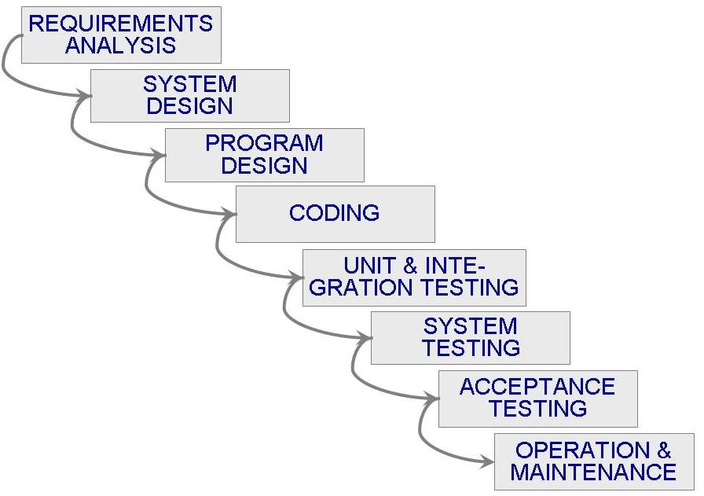

Slide 25
Waterfall Advantages
Conceptually simple, cleanly divides the problem into distinct phases that can be performed independently
Natural approach for problem solving
Easy to administer in a contractual setup – each phase is a milestone

Slide 26
Waterfall disadvantages
All delivery is at the end: no available working model early in the project time plan
Assumes that requirements can be specified and frozen early
May fix hardware and other technologies too early
Follows the “big bang” approach – all or nothing delivery; too risky(if the project runs out of money in the middle, then there will be no software.)

Slide 27
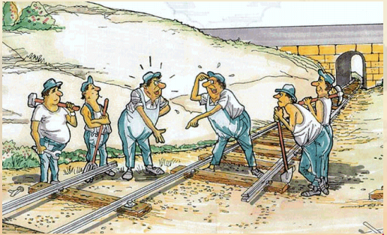
Very document oriented, requiring docs at the end of each phase
Difficulty of accommodating change after the process is underway. One phase has to be complete before moving onto the next phase.

Slide 28
Waterfall Usage
Waterfall model is appropriate when:
- The requirements are well-understood, clear and fixed.
- Product definition is stable.
- Technology is understood.
- The project is short.

Slide 29
2. Prototyping
Used when customer defines a set of objective but does not identify input, output, or processing requirements ; a prototype is built to understand the requirements
Helps alleviate the requirements risk
Prototyping addresses the requirement specification limitation of waterfall

Slide 30
Prototype evaluation leads to redefining requirements
Process is iterated until customer and developer are satisfied

Slide 31
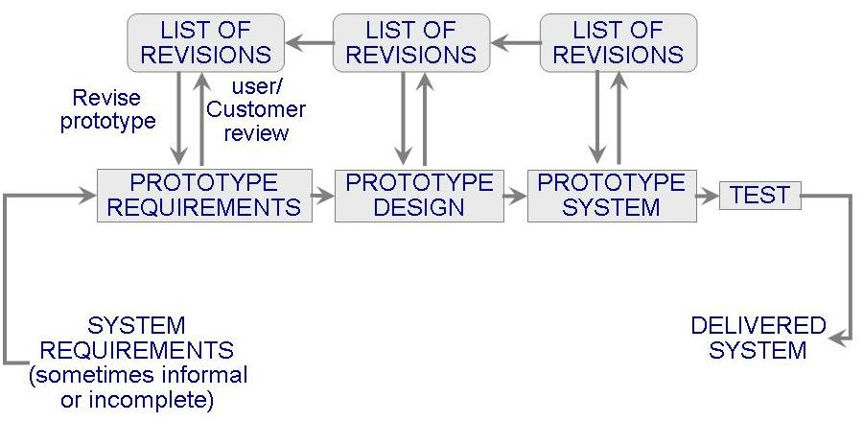

Slide 32
Prototyping
Development of prototype
Starts with initial requirements
Only key features which need better understanding are included in prototype
Feedback from users taken to improve the understanding of the requirements

Slide 33
Prototyping
Cost can be kept low
Build only features needing clarification
“quick and dirty” – quality not important.
Things like exception handling, recovery, standards are omitted

Slide 34
Advantages of Prototyping
requirements will be more stable,
requirement frozen later.

Slide 35
Disadvantages of Prototyping
In a rush to get it working, overall software quality or long term maintainability are generally overlooked.
May use inappropriate Operating Systems, Programming languages.
Client is likely to recommend to do a few changes on the prototype instead of developing the initial software.

Slide 36
Developer may get a working prototype quickly and forget why they are inappropriate.
Applicability: When requirement are hard to elicit and confidence in requirements is low; i.e. where requirements are not well understood.

Slide 37
3. Iterative Development
Counters the “all or nothing” drawback of the waterfall model
Used when initial requirements are reasonably well-defined
Combines benefit of prototyping and waterfall
Develop and deliver software in increments
Each increment is complete in itself

Slide 38
Can be viewed as a sequence of waterfalls
Feedback from one iteration is used in the future iterations
Lower risk of overall project failure
User requirements are prioritized and the highest priority requirements are included in early increments.

Slide 39
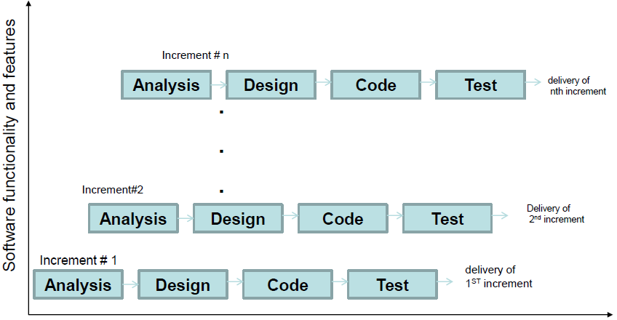

Slide 40
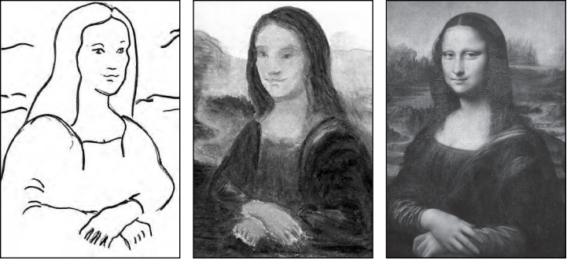
Iterative, phases

Slide 41
The requirements phase: requirements are gathered and analyzed.
A design phase: architecture and components to meet the requirements are designed
An Implementation phase, when the software is coded, integrated and tested.
A review phase, in which the software is evaluated, the current requirements are reviewed, and changes and additions to requirements proposed.

Slide 42
Iterative Development
Used commonly in customized development also
Businesses want quick response for SW
Newer approaches like XP, Agile,… all rely on iterative development

Slide 43
Iterative Development
Benefits:
Get-as-you-pay,
It is easier to get customer’s feedback on the development work done
The cost of accommodating changing customer requirements is reduced- analysis and documentation is less

Slide 44
Problems associated
The user is actively involved.
Even if is positive for the project, it is demanding on the time of the staff and can add project delay.
Informal requests for improvement after each phase may lead to confusion -- a controlled mechanism for
Handling additional requests needs to be developed.

Slide 45
Since user feedback following each phase , this may lead to increased customer demands.
Architecture/design may not be optimal, rework may increase, total cost may be more

Slide 46
Applicability: where response time is important, risk of long projects cannot be taken, all requirement not known
Each release is a mini-waterfall, process is repeated until the complete product is produced.

Slide 47
4. Timeboxing
Development is done iteratively in fixed duration time boxes
Each time box divided in fixed stages
Each stage performs a clearly defined task that can be done independently
Each stage approximately equal in duration

Slide 48
There is a dedicated team for each stage
When one stage team finishes, it hands over the project to the next team
Iterations are executed in parallel(to reduce cycle time)

Slide 49
Timeboxing Execution

Slide 50
Time Boxed Iterations
General iterative development – fix the functionality for each iteration, then plan and execute it
Completion time is fixed predictable delivery times (non-negotiable), the functionality to be delivered is flexible.
Overall development time is still unchanged

Slide 51
Example
An iteration with three stages – Requirement, Build, Deploy
These stages are approximatively equal in many situations
Can adjust duration by adjusting the team size for each stage
Have separate teams for A, B and C

Slide 52
Example
If the time box duration T is 9 weeks (and each stage duration is 3 weeks),
the first delivery is made 9 weeks after the start of the project.
The second is made after 12 weeks, the third after 15 weeks, and so on.
Contrast this with a linear execution of iterations, in which the first delivery will be made after 9 weeks, the second after 18 weeks, the third after 27 weeks, and so on.

Slide 53
Timeboxing execution
Duration of each iteration still the same
Total work done in a time box is also the same
Productivity of a time box is same
Yet, delivery time has reduced to a third.

Slide 54
Timeboxing
Advantages: Shortened delivery times, other advantages of iterative, distribution execution
Disadvantages: Larger teams, project management is harder, high synchronization needed, Configuration Management is harder
Applicability: When short delivery times ; flexibility in feature grouping

Slide 55
5. Extreme Programming or Agile Process Model
Agile approaches developed in 90s as a reaction to document driven approaches
Most agile approaches have some common principles
Working software is the measure of progress
Software should be delivered in small increments
Even late changes should be allowed
Prefer face to face communication over documentation

Slide 56
encourages rapid and flexible response to change
Continuous feedback and customer involvement is necessary
Delivery dates are decided by the empowered teams

Slide 57
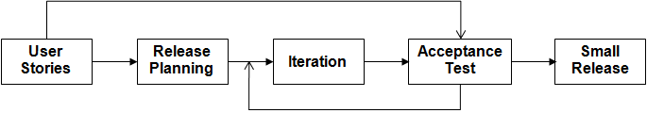
XP process

Slide 58
XP…
Many agile methodologies have been proposed; extreme programming (XP) is one of the most popular
An XP project starts with user stories, which are short description of user needs
- Details are not included
- Each user story written separately so they can be combined in different ways

Slide 59
XP …
Team estimates how long it will take to implement a user story
Release planning is done
Defines which stories are to be built in which release, and dates for release
Frequent and small releases encouraged
Acceptance tests also built from user stories; used to test before release
Bugs found in Acceptance Tests are fixed in next release

Slide 60
XP …
Pair programming: programming is done in pairs of programmers

Slide 61
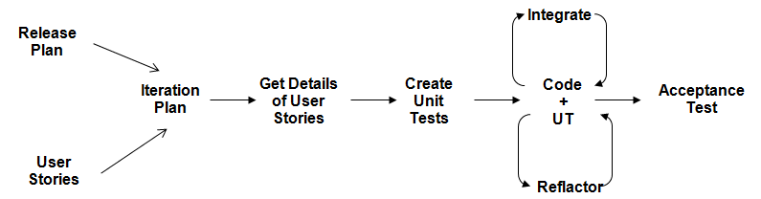
An Iteration

Slide 62
XP - Applicability
Well suited for situations where volume and pace of requirements is high
Customer is willing to engage heavily with the team
The team is not too large (less than 20)
Requires strong capability in team members

Slide 63
Exercises
1. If a system is being developed where the customers are not sure of what they want, the requirements are often poorly defined. Which of the following would be an appropriate process model for this type of development? And explain why.
A. Waterfall Model;
B. Prototyping Model;
C. Iterative Development Model;
D. Timeboxing Model;
E. Extreme Programming.

Slide 64
2. The project team developing a new system is experienced in the domain. Although the new project is fairly large, it is not expected to vary much from applications that have been developed by this team in the past.
Which process model would be appropriate for this type of development? And explain why.
A. Waterfall Model;
B. Prototyping Model;
C. Iterative Development Model;
D. Timeboxing Model;
E. Extreme Programming.

Slide 65
GROUP Exercise
1. Choose a software project
2. Problem statement
3. Choose an appropriate software development model and specify the reason

Slide 66
Summary – waterfall
Strength | Weakness | Types of Projects
Simple Easy to execute Easy contractually | All or nothing – too risky Req frozen early May chose outdated hardware/tech Disallows changes No feedback from users | Well understood problems, short duration projects, automation of existing manual systems

Slide 67
Summary – Prototyping
Strength | Weakness | Types of Projects
Helps req elicitation Reduces risk Better and more stable final system | Possibly higher cost and schedule Disallows later change | Systems with novice users; or areas with req uncertainity.

Slide 68
Summary – Iterative
Strength | Weakness | Types of Projects
Regular deliveries, leading to biz benefit Can accommodate changes naturally Allows user feedback Naturally prioritizes req Reduces risks | Overhead of planning each iteration Total cost may increase Rework may increase | For businesses where time is critical; risk of long projects cannot be taken; req not known and evolve with time

Slide 69
Summary – Timeboxing
Strength | Weakness | Types of Projects
All benefits of iterative Planning for iterations somewhat easier Very short delivery times | PM becomes more complex Team size is larger | Where very short delivery times are very important Where flexibility in grouping features Arch is stable

Slide 70
Summary – XP
Strength | Weakness | Types of Projects
Short delivery cycles Continuous feedback can lead to better acceptance | Lack of documentation can be an issue Continuous code change is risky | Where requirements are changing a lot, customer is deeply engaged in development, and where the size of the project is not too large

Slide 71
Summary
Process has a major impact on the quality and productivity
Different processes at work in a software project
Process models are general process structures, that work well for some types of problems
A project should select a process model that is best suited for it (and tailor it to meet its requirements)

Slide 72
End of chapter 2
Thank you

