Slide 1

SOFTWARE ENGINEERING

Slide 2
Chapter 3: Software Requirements Analysis and Specification
Notes:
Acronym/Initialism Meaning
Modem: modulation/demodulation
ASAP As Soon As Possible
BTWBy The Way FWIWFor What It's Worth
FYI For Your Information
IMHOIn My Humble Opinion IMOIn My Opinion
LOL Laughing Out Loud
ROTFL Rolling On The Floor Laughing
TIAT hanks In Advance

Slide 3
Objectives
- To introduce the concepts of software requirements
requirements
To describe user requirement and system requirements
To explain how software requirements may be organized in a requirements document

Slide 4
Requirement
Requirement (IEEE) is defined as:
1. A condition or capability that must be possessed by a system to satisfy a contract, standard, specification, or other formally imposed document.
2. A condition of capability needed by a user to solve a problem or achieve an objective;

Slide 5
Requirement phase ends with a Software Requirements Specification (SRS) document
SRS specifies what the proposed system should do
Identifying and specifying requirement necessarily involves people interaction

Slide 6
Requirements
The requirements must be written so that several contractors can bid for the contract
Once a contract has been awarded, the contractor must write a system definition for the client in more detail so that the client understands and can validate what the software will do.
Both of these documents may be called the requirements document for the system.

Slide 7
Function and Goals of requirement
May be the basis for a bid for a contract - therefore must be open to interpretation
- Understand the requirements in detail.
- Define the requirements in a manner that is clear to the client. This may be a written specification, prototype system, or other form of communication.

Slide 8
- Define the requirements in a manner that is clear to the people who will design, implement and maintain the system.
- Ensure that the client and developers understand the requirements and their implications.
The set of requirements will be the basis for acceptance testing.

Slide 9
Why are Requirements Important?
Causes of failed software projects
- Incomplete requirements 13.1%
- Lack of user involvement 12.4%
- Lack of resources 10.6%
- Unrealistic expectations 9.9%
- Lack of executive support 9.3%
- Changing requirs & specs 8.8%
- Lack of planning 8.1%
- System no longer needed 7.5%
The commonest mistake is to build the wrong system.

Slide 10
Types of software requirements
1. User requirements
2. System requirements
3. Software specification

Slide 11
Software requirements
User requirements
System requirements
Software specification

Slide 12
1. User requirements
Statements in natural language plus diagrams of the services the system provides and its operational constraints. Written for customers
- Functional and
Non-functional requirements
User requirement should describe functional and non-functional requirements so that they are understandable by system users who don’t have detailed technical knowledge.

Slide 13
Functional requirements
Statements of services/functionality the system should provide/ do,
how the system should react to particular inputs and how the system should behave in particular situations.
- Describe functionality or system services
Depend on the type of software, expected users and the type of system where the software is used

Slide 14
Examples of functional requirements
The user shall be able to search either all of the initial set of databases or select a subset from it.
In library, member should be able to borrow a book, return a book, …
- The system shall provide appropriate viewers for the user to read documents in the document store.

Slide 15
No-Functional requirements
Also called Quality requirement.
They define system properties and constraints e.g.
reliability, response time, timing constraints, constraints on the development process, standards and storage requirements.
Constraints are I/O device capability, system representations, etc.

Slide 16
Non-functional requirements
Not directly concerned with specific services to be delivered by the system.
Non-functional requirements may be more critical than functional requirements. If these are not met, the system is useless

Slide 17
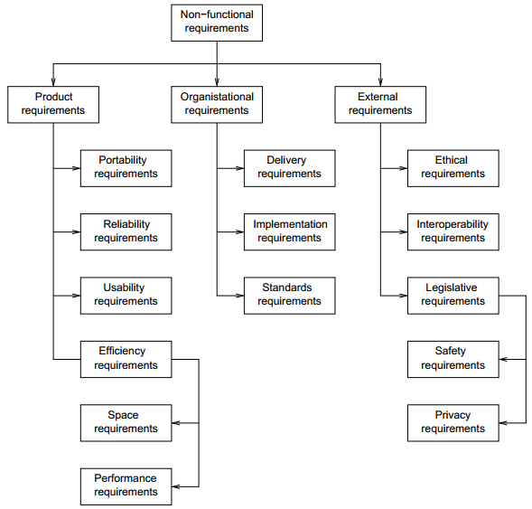

Slide 18
Non-functional classifications
Product requirements
Requirements which specify that the delivered product must behave in a particular way e.g. reliability, portability, usability, efficiency (space(storage), performance ).
Performance
Eg. 1. The medical system shall be available to all clinics during working hours Mon- Fri 7.30 -17.30, down time should not exceed 5 second in any one day

Slide 19
2. The system shall accommodate 400 users during the peak time windows of 8:00 to 10:00 am local time.
3. All web pages generated by the system shall be fully downloadable in no more than 7 seconds over 40kbps modem connection.
4. The system shall display the confirmation messages to users within 4 seconds after user submit information to the system.

Slide 20
Usability requirements include:
Well-structured user manuals
Informative error messages
Help facilities
Well-formed graphical user interfaces

Slide 21
Organizational requirements
Requirements which are a consequence of organizational policies and procedures e.g. process standards used, implementation requirements, delivery, etc.
Ex. Users of system shall authenticate themselves using their identity card

Slide 22
External requirements
Requirements which arise from factors which are external to the system and its development process e.g. interoperability requirements, legislative requirements (privacy and safety).
Safety
e.g : The system shall not operate if the external temperature is below 4 degrees Celsius.
The database may get crashed at any certain time due to virus or operating system failure. Therefore, it is required to take the database backup.

Slide 23
Privacy
The system shall not disclose any personal information about customers apart from their name and reference number to the operators of the system.

Slide 24
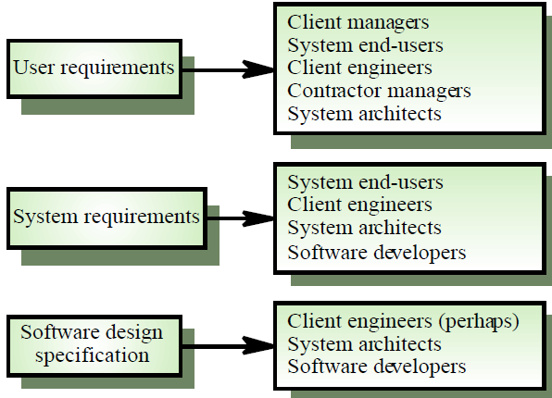
Requirements readers

Slide 25
Requirements imprecision
- Problems arise when requirements are not precisely stated
- Ambiguous requirements may be interpreted in
different ways by developers and users
Consider the term ‘appropriate viewers’
- Developer interpretation - Provide a text viewer that shows the contents of the document

Slide 26
Requirements completeness and consistency
Complete
They should include descriptions of all facilities required
Consistent
There should be no conflicts or contradictions in the descriptions of the system facilities
In practice, it is impossible to produce a complete and consistent requirements document.

Slide 27
Goals of no-functional requirements
Non-functional requirements may be very difficult to state precisely and imprecise requirements may be difficult to verify.
Goal:
- A general intention of the user such as ease of use
- Verifiable non-functional requirement

Slide 28
Examples
A system goal
The system should be easy to use by experienced controllers and should be organised in such a way that user errors are minimised.
A verifiable non-functional requirement
Experienced controllers shall be able to use all the system functions after a total of two hours training.
After this training, the average number of errors made by experienced users shall not exceed two per day.

Slide 29
Requirements measures
Property | Measure
Speed | Processed transactions/second User/Event response time Screen refresh time
Size | K Bytes Number of RAM chips
Ease of use | Training time Number of help frames
Reliability | Mean time to failure Probability of unavailability Rate of failure occurrence Availability
Robustness | Time to restart after failure Percentage of events causing failure Probability of data corruption on failure
Portability | Percentage of target dependent statements Number of target systems

Slide 30
Domain requirements
Requirements that come from the application domain of the system and that reflect characteristics of that domain
Derived from the application domain and describe system characteristics and features that reflect the domain
If domain requirements are not satisfied, the system may be unworkable

Slide 31
Domain requirements problems
Understandability
Requirements are expressed in the language of the application domain
This is often not understood by software engineers developing the system
Implicitness
Domain specialists understand the area so well that they do not think of making the domain requirements explicit

Slide 32
Problems with natural language
User requirements are defined using natural language, tables and diagrams.
Lack of clarity
Precision is difficult without making the document difficult to read
Requirements confusion
Functional and non-functional requirements tend to be mixed-up.
Notes:
Join up, mixture

Slide 33
Database requirement
The database shall support the generation and control of configuration objects; that is, objects which are themselves groupings of other objects in the database.
The configuration control facilities shall allow access to the objects in a version group by the use of an incomplete name.

Slide 34
2. System requirements
A structured document setting out detailed descriptions of the system services.
Minimum End-user Hardware Requirements
Such as Operating System , Processor , RAM, Screen Resolution , Color Settings , Audio Support , Internet Connection Speed
Minimum End-user Software Requirements
Such as Web Browser, Adobe Flash Player , Java plug-ins …

Slide 35
Proxy and Firewall Administration (listening port)
Written for developers

Slide 36
3. Software specification
A detailed software description which can serve as a basis for a design or implementation. Written for developers

Slide 37
Requirements and design
In principle, requirements should state what the
system should do and the design should describe how it does this
In practice, requirements analysis and design are inseparable
The system may inter-operate with other systems that generate design requirements

Slide 38
The requirements document
The requirements document, also called Software requirement specification (SRS) is the official statement of what is required of the system developers
Should include both a definition and a specification of requirements
It is NOT a design document. It should set of WHAT the system should do rather than HOW it should do it

Slide 39
It includes user requirements for a system and detailed specification of the system requirements.
User and system requirements are integrated into a single description other times user requirements are put in the introduction of SRS.

Slide 40
Guidelines for writing requirements
Use a standard format and use it for all
requirements
Use language in a consistent way. Use shall for mandatory requirements, should for desirable requirements
Use text highlighting to identify key parts of the requirement
Avoid the use of computer jargon

Slide 41
Generic Requirements document structure
Introduction
Glossary
User requirements definition
System architecture
System requirements specification
System models
System evolution
Appendices
Index

Slide 42
Requirements document structure
Introduction
Describe need for the system and how it fits with business objectives
Glossary
Define technical terms used
Functional requirements definition (user reqs.)
Describe the services to be provided

Slide 43
Non-functional requirements definition (user reqs.)
Define constraints on the system and the development process
System Architecture
helps structuring requirements around subsystems
System evolution
Define fundamental assumptions on which the system is based and anticipated changes

Slide 44
System and software requirements specification
Detailed specification of functional requirements
System models
Define models showing system components and relationships

Slide 45
Appendices
System hardware platform description
Database requirements (as an ER model perhaps)
May include USER MANUAL and TEST PLAN
Index

Slide 46
Summary
Having a good quality SRS is essential for Q&P
The req. phase has 3 major sub phases
analysis , specification and validation
Analysis
for problem understanding and modeling
Key properties of an SRS: correctness, completeness, consistency, unambiguousness

Slide 47
END OF CHAPTER 3
Thank you.

Slide 48
From Library Management System, provide:
1. FUNCTIONAL REQUIREMENTS,
2. NO-FUNCTIONAL REQUIREMENTS AND
3. SYSTEM REQUIREMENTS

Slide 49
Project proposal
Topic : Transport agency management system
Case study : Stella Express

Slide 50
1. Introduction
2. Problem statement
3. Objectives
- general objectives
-Specific objectives
4. Scope of the project
5. Interest of the project (Personal, Org, Community)
6. Methodology
7. Organization/ Division of the project

Slide 51
1. Introduction (1page)
The use of Information technology has been of great importance within transport area. Many companies has adopted IT for managing their daily activities. (Name, date).
Stella Express, one of the transport agency in Rwanda. Where different customers comes to buy ticket….
Stella express has many problems such customer has to come to office to do reservation, they record customer on piece of paper,….
The purpose of this project entitled “….” is to develop a software which will help SE to overcome the stated problem.

Slide 52
2. Problem statement
Stella E has been using manual way for record customers, selling tickets.
This created many problem:
- Time and money consuming to go to the office for reservation
-Search of existing customers is very difficult
- Daily inventory,
-
-

Slide 53
3. Objectives
General objectives
The general objective of this project is to analyze, design and implement Stella Express management system
Specific objectives
- record client
- Record driver
- Record bus
- Reserve place online
- cancel reservation
- Record line
- Schedule trip
- Buy ticket

Slide 54
4. Scope of the project
There are many activities that can be computerized with Stella express such Human resource management, payment management, salary management. But due to the time and budget limitation, this project will be limited to scheduling management.

Slide 55
5. Interest of the study
- Personal Interest
- Organization/Company/ Institution interest
- Community interest

Slide 56
6.Methodology
6.1. Data collection methods
- Interview
(short description)
- Observation
(short description)
- Documentation
(short description)

Slide 57
6.2. Software engineering methods
- Software development process model
( W, P, I, XP, TB)
Analysis and design methods (Structured System analysis and Design OR Object oriented analysis and Design).
Database management system (DBMS): Mysql, OR Oracle, OR Microsoft access
Programming language: Java, C#, …
Any other tools, ….

Slide 58
7. Division of the project
Chapter 1 will provide an introduction, problem,…..
Chapter 2 provide a literature review (basic concepts about our project, ), methodology
Chapter 3 will deal system analysis and design
Chapter 4 will deal with implementation
Chapter 5 provide conclusion and recommendations.

