Slide 1

SOFTWARE ENGINEERING

Slide 2
CHAPTER 4: SOFTWARE ARCHITECTURE

Slide 3

Architecting a dog house
Can be built by one person
Requires
Minimal modeling
Simple process
Simple tools

Slide 4
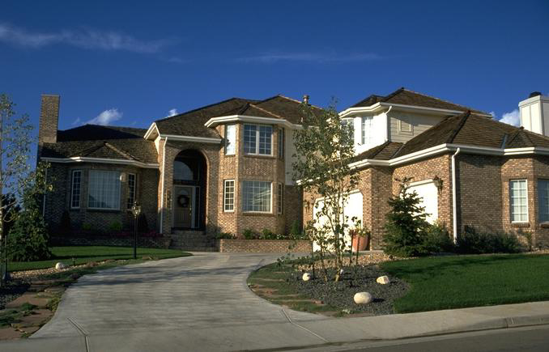
Architecting a house
Built most efficiently and timely by a team
Requires
Modeling
Well-defined process
Power tools

Slide 5
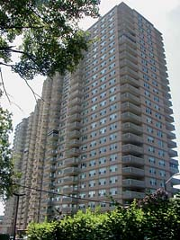
Architecting a high rise

Slide 6
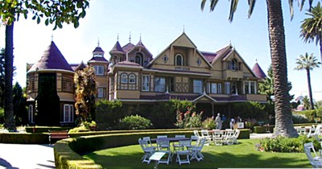

The Need of Architecture The Winchester “Mystery” House
38 years of construction – 147 builders architects
160 rooms – 40 bedrooms, 6 kitchens, 950 doors
65 doors to blank walls, 13 staircases abandoned
No architectural blueprint exists
Notes:
Skylights in floors : amatara yerekana imbago z’inzu

Slide 7
SOFTWARE ARCHITECTURE
Software architecture is the structures of the system, which comprise software elements,
the externally visible properties of those elements, and the relationships among them.
Due to a wide range of options now available for how a system may be configured and connected, carefully designing the architecture becomes very important.

Slide 8
Architecture is the system design at the highest level
A complex system can be partitioned in many different ways, each providing a useful view
There is no unique structure; many possible
An architecture description describes the different structures of the system

Slide 9
Choices about technologies, products to use, servers, etc are made at architecture level
Not possible to design system details and then accommodate these choices
Is the earliest action when properties like reliability/performance can be evaluated

Slide 10
Software systems increasingly become distributed and more complex.
Architecture becomes an important step in building the system.
Due to a wide range of options now available for how a system may be configured and connected, carefully designing the architecture becomes very important.

Slide 11
Any complex system is composed of sub-systems that it interacts with
While designing systems, an approach is to identify sub-systems and how they interact with each other

Slide 12
Software architecture
The design process for identifying the sub-systems making up a system and the framework for sub-system control and communication is architectural design.
The output of this design process is a description of the software architecture.

Slide 13
Architectural Views
There is no unique architecture of a system
A view consists of elements and relationships between them, and describes a structure
A view focusing on some aspects reduces its complexity

Slide 14
Views…
Many types of views have been proposed
Most belong to one of these three types
1. Module
2. Component and Connector
3. Allocation
The different views are not unrelated – they all represent the same system

Slide 15
Views…
1. Module view
A system is a collection of coded units i.e. they do not represent the same runtime entities.
I.e. elements are modules, eg. Class, package, function, procedure,…
Relationship between them is code based, e.g. part of, depends on, calls, ..

Slide 16
2. Component and Connector View
Components: Computational elements or data stores
Connectors: Means of interaction between comps
The C&C view describes a runtime structure of the system – what components exist at runtime and how they interact during execution
Is a graph; often shown as a box-and-line drawing
Most commonly used structure

Slide 17
Components
Units of computations or data stores
Has a name, which represents its role, and provides it identity
Components use ports (or interfaces) to communicate with others

Slide 18
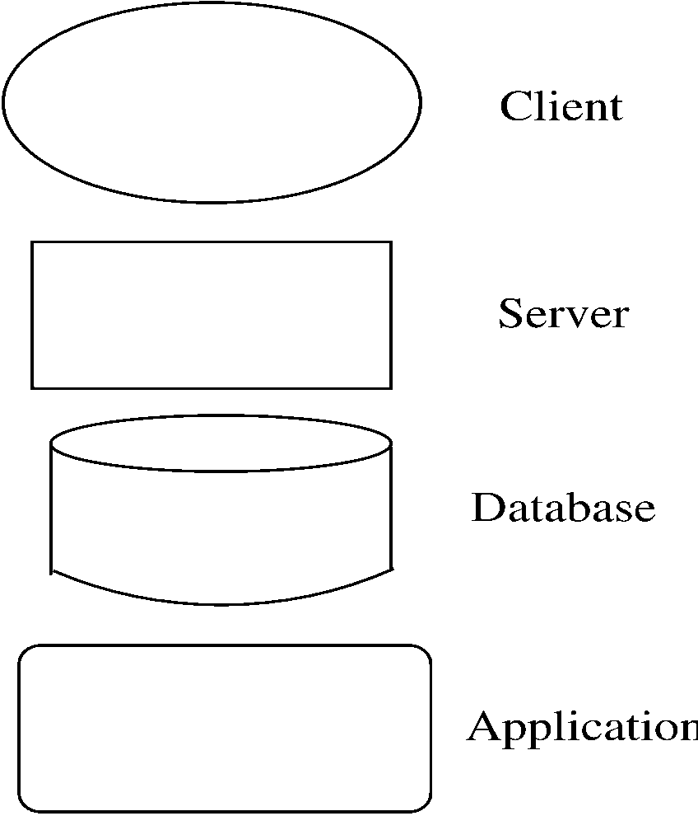
Component and Connector (C&C)

Slide 19
Connectors
Interaction between components happen through connectors
A connector may be provided by the runtime environment, e.g. procedure call
But there may be complex mechanisms for interaction, e.g http, tcp/ip, ports,…; a lot of s/w needed to support them

Slide 20
Connectors…
Connector has a name (and a type)
Often connectors represented as protocol – i.e. components need to follow some conventions when using the connector
Best to use diff notation for different types of connectors; all connectors should not be shown by simple lines

Slide 21
An Example
Design a system for taking online survey of students on campus
Multiple choice questions, students submit online
When a student submits, current result of the survey is shown
Is best built using web; a 3-tier architecture is proposed
Has a client, server, and a database components (each of a diff type)
Connector between them are also of diff types

Slide 22
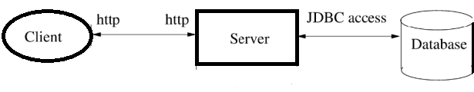
Example…

Slide 23
Extension 1
This arch has no security – anyone can take the survey
We want that only registered students can take the survey (at most once)
To identify students and check for one-only submission, need a authentication server

Slide 24
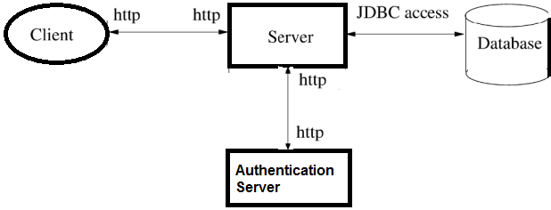
Extension 1…

Slide 25
Extension 2
It was found that DB is frequently down
For improving reliability, what if DB is down, student is given an older survey result data stored.
The survey data given can be outdated by at most 5 survey data points
For this, will add a cache component, which will store data as well as results

Slide 26
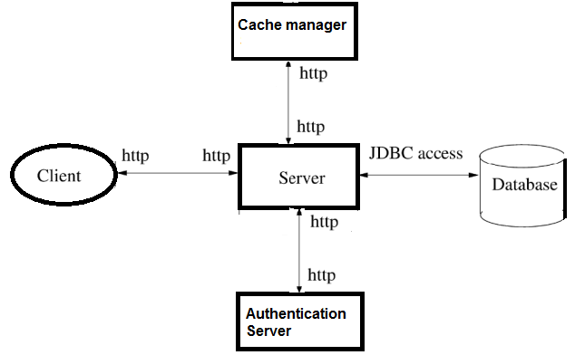
Extension 2…

Slide 27
Example…
One change increased security, 2nd increased performance and reliability
I.e. Arch level choices have a big impact on system properties
That is why, choosing a suitable arch can help build a good system

Slide 28
Architectural Styles for C&C View
Different systems have different C&C structure
Some structures are general and are useful for a class of problems – architectural styles
An arch style defines a family of architectures that satisfy the constraint of that style
We discuss a few common styles

Slide 29
Reflects the basic strategy that is used to structure a system.
Organizational styles that are widely used:
– Pipe and filter architecture
- Repository architecture
– Client-server architecture

Slide 30
1. Pipe and filter
Well suited for systems that mainly do data transformations
A system using this style uses a network of transforms to achieve the desired result
Has one component type – filter
Has one connector type – pipe
A filter does some transformation and passes data to other filters through pipes.

Slide 31
Pipe and Filter…
A filter is independent; need not know the identification of filters sending/receiving data
A pipe is unidirectional channel which moves streams of data from one filter to another
A pipe is a 2-way connector
A pipe must connect the output port of one filter to input port of another

Slide 32
Example
A system needed to count the frequency of different words in a file
One approach: first split the file into a sequence of words, sort them, then count the frequency of occurrences
The arch of this system can naturally use the pipe and filter style

Slide 33
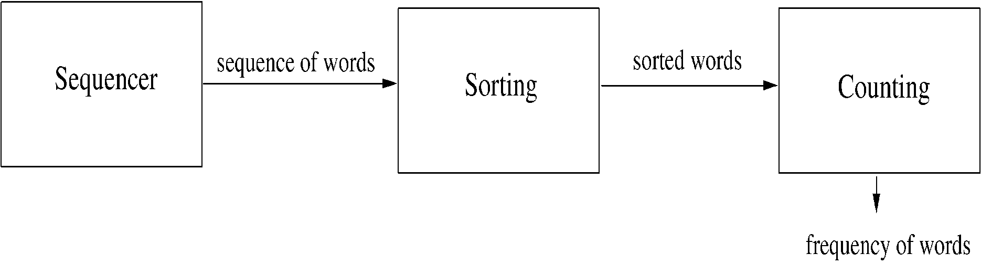
Example..

Slide 34
2. Shared-data style
Two component types – data repository and data accessors
Data repository – provides reliable permanent storage
Data accessors – access data in repositories, perform computations, and may also put the results back into the repository
Communication between data accessors is only through the repository

Slide 35
Example
A student registration system of a university
Repository contains all the data about students, courses, schedules, Course notes,…
Accessors like admin, approvals, registration, students reports which perform operations on the data

Slide 36
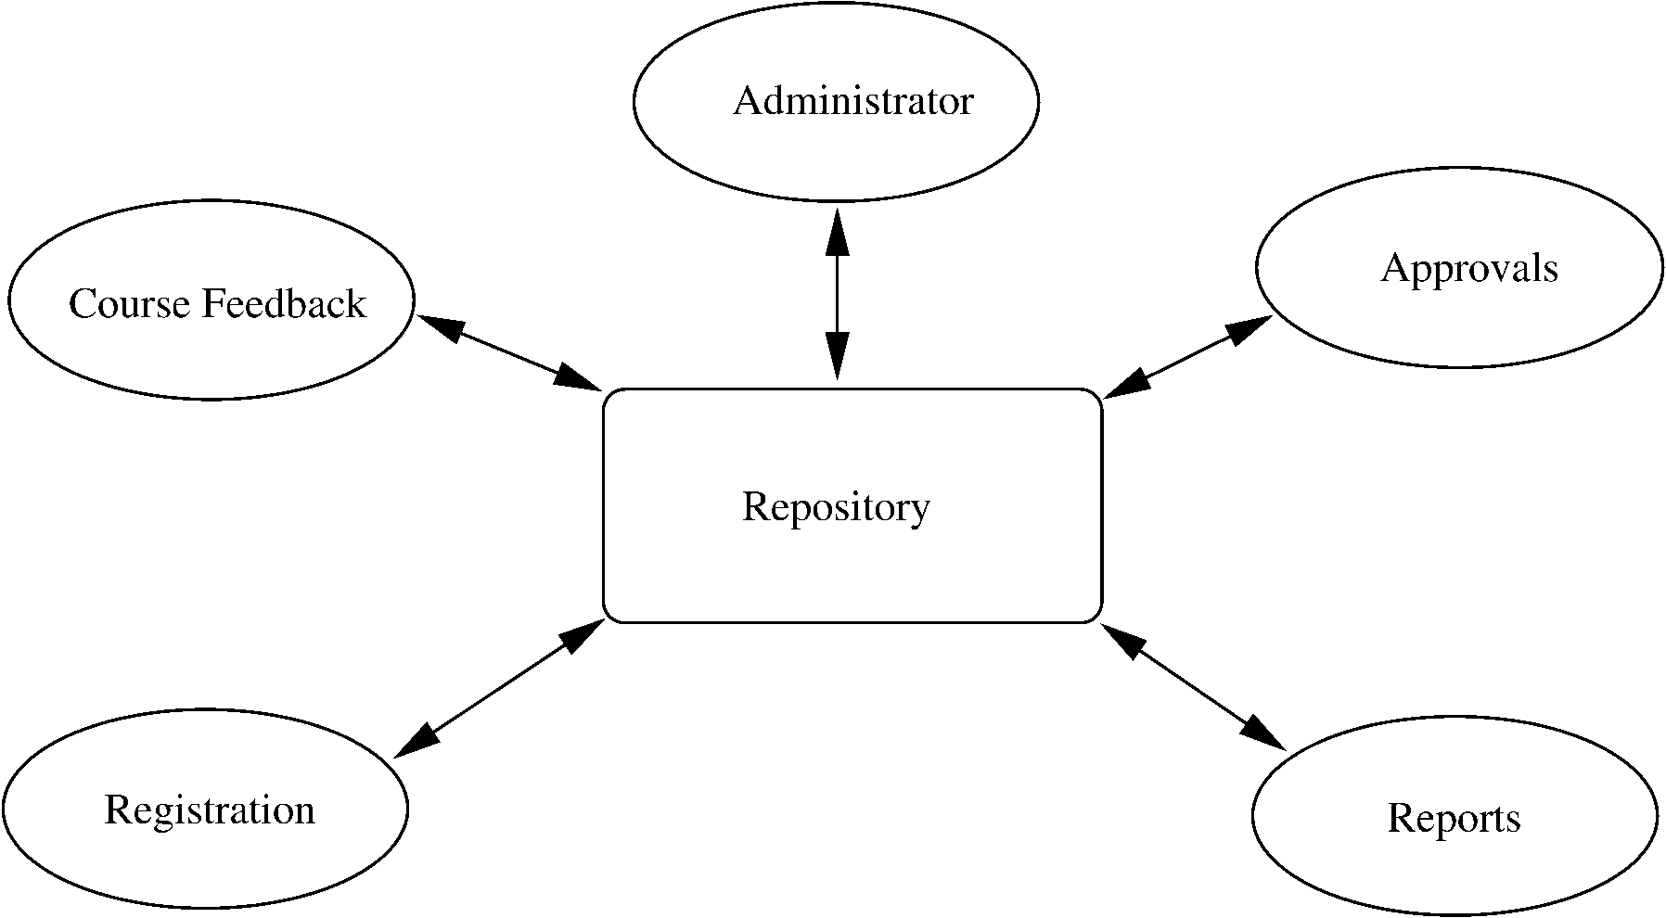
Example…

Slide 37
Example..
Components do not directly communicate with each other
Easy to extend – if a scheduler is needed, it is added as a new accessor
No existing component needs to be changed
Only one connector style in this – read/write

Slide 38
3. Client-Server Style
Two component types – clients and servers
Clients can only communicate with the server, but not with other clients
Communication is initiated by a client which sends request and server responds
One connector type – request/reply
Often the client and the servers reside on different machines

Slide 39
Client-server style…
A general form of this style is the n-tier structure
A 3-tier structure is commonly used by many application and web systems
Client-tier contains the clients
Middle-tier contains the business rules
Database tier has the information

Slide 40
Major components of this architecture are:
1. Set of servers which provide specific services such as printing, data management, etc.
2. Set of clients which call on these services.
3. Network which allows clients to access servers.

Slide 41
Advantages
–Makes effective use of networked systems. May require cheaper hardware;
–Separation and independence: Easy to add new servers or upgrade existing servers.
–Clients may have to know the names of available servers and the services they provide; but the servers do not need to know the identity of clients or how many clients access their services.

Slide 42
Disadvantages
- Redundant management in each server;
- No central register of names and services - it may be hard to find out what servers and services are available.

Slide 43
N-tier architecture
In a two-tier architecture, a client talks directly to a server, with no intervening server.
This type of architecture is used in small environments with less than 50 users.
To scale up to hundreds or thousands of users, it is necessary to move to a 3-tier architecture.
Three-tier architecture introduces a server between the client and the server.

Slide 44
Views…
3. Allocation view
Focuses on how SW units are allocated to resources like hardware, file system, people
I.e. specifies relationship between SW elements and execution units in the environment
Expose structural properties like which process runs on which processor, which file resides where, …

Slide 45
Some other styles
Publish-subscribe style
Some components generate events, and others subscribe to them
On an event, those component that subscribe to it are invoked
Peer-to-peer style
components use services from each other through methods

Slide 46
Role of Software Architecture
Understanding and communication
By showing a system at a high level and hiding complexity of parts, architecture description facilitates communication
To get a common understanding between the different stakeholders (users, clients, architect, designer,…)
For negotiation and agreement
Architecture description can also aid in understanding of existing systems

Slide 47
Role of Software Architecture
Reuse
A method of reuse is to compose systems from parts and reuse existing parts
To reuse existing components, arch must be chosen such that these components fit together with other components
Hence, decision about using existing components is made at arch design time

Slide 48
Role of Software Architecture
Construction and evolution
Some structures in arch description will be used to guide system development
In evolution, architecture helps decide what needs to be changed to incorporate the new changes.
Architecture can help decide what is the impact of changes to existing components on others

Slide 49
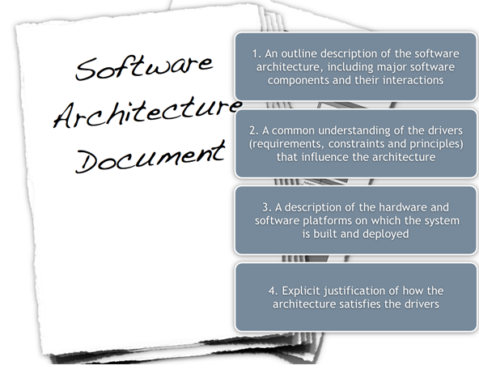

Slide 50
Documenting…
An architecture document should contain
System and architecture context
Description of architecture views
A context diagram that establishes the system scope, key actors, and data sources/sinks can provide the overall context
A view description will generally have a pictorial representation.

Slide 51
Summary
Arch of a s/w system is its structures comprising of elements, their external properties, and relationships
Arch is a high level design
Three main view types – module, component and connector, and allocation
Component and connector (C&C) view is most commonly used

Slide 52
Summary…
There are some C&C styles that are commonly used, e.g. pipe-and-filter, shared data, client server,....
An architecture description should document the different views and their relationship – views can be combined

Slide 53
End of chapter 4.
Thank you

