Slide 1

SOFTWARE ENGINEERING

Slide 2
CHAPTER 6: Software Coding and Testing

Slide 3
Coding
Goal is to implement the design in best possible manner
Coding affects testing and maintenance
As testing and maintenance costs are high, aim of coding activity should be to write code that reduces them
Hence, goal should not be to reduce coding cost, but testing and maintenance cost, i.e. make the job of tester and maintainer easier

Slide 4
Coding…
Code is read a lot more
Coders themselves read the code many times for debugging, extending etc
Maintainers spend a lot of effort reading and understanding code
Other developers read code when they add to existing code
Hence, code should be written so it is easy to understand and read, not easy to write!

Slide 5
mysql> CREATE TABLE patient (
last_name varchar(15) not null,
first_name varchar(15) not null,
state varchar(2) not null,
city varchar(20) not null,
birth date not null default '0000-00-00',
death date null
);

Slide 6
Programming Principles
Objectives are to minimize the effort required to complete the program, to minimize the number of statements, minimize the memory required, maximize the program clarity, and maximize the output clarity.
The main goal of the programmer is write simple and easy programs to read with few bugs in it; the programmer has to develop it quickly to keep productivity high

Slide 7
There are various programming principles that can help write code that is easier to understand and test.

Slide 8
1. Structured Programming
Structured programming is a programming paradigm aimed at improving the clarity, quality, and development time of a computer program by making extensive use of the structured control flow constructs of selection and repetition, block structures, and subroutines
Structured programming started in the 70s, primarily against indiscriminate use of control constructs like gotos.
Goto is:omeone or something that is regularly or repeatedly chosen or employed for reliably good results.
Structured programming is often regarded as “goto-less” programming.
Goal was to simplify program structure so it is easier to disagree about programs

Slide 9
Structured Programming…
A program has a static structure which is the ordering of statements in the code – and this is a linear ordering
A program also has dynamic structure –order in which statements are executed
Both dynamic and static structures are ordering of statements
Correctness of a program must talk about the dynamic structure

Slide 10
Structured Programming…
To show a program as correct, we must show that its dynamic behavior is as expected
This will become easier if the dynamic and static structures are similar
Closer correspondence will make it easier to understand dynamic behavior from static structure
This is the idea behind structured programming

Slide 11
Goal of Structured Programming
Goal of structured programming is:
To write programs whose dynamic structure is same as static
As statements organized linearly, the objective is to develop programs whose control flow is linear

Slide 12
Structured Programming…
Meaningful programs cannot be written as sequence of simple statements
To achieve the objectives, structured constructs are to be used
These are single-entry-single-exit constructs
With these, execution of the statements can be in the order they appear in code
The dynamic and static order becomes same

Slide 13
Uses basic control structures and modules that have only one entry point and one exit point.

Slide 14
There are three basic Control Constructs :
1) Sequence; programs executed sequentially by default
2) Selection; Java has three types: if, if/else, and case.
3) Repetition structures: Java has four types: while, do/while, do/until and for

Slide 15
Sequence
The actions are performed in the sequence (following the arrows)
Example : What do you do in the morning?
Brush teeth
Wash face
Comb hair
Having breakfast
Enter
Perform one or more actions in sequence
Exit

Slide 16
Sequence
void doSomething(){
cout << "Hello Viet Nam\n";
cout << "Hello Iraq\n";
cout << "Hello America\n";
cout << "Hello World\n"; }//end doSomething function

Slide 17
The if Selection Structure
Ex. If grade >= 60, print passed
true
print “Passed”
grade >= 60
false

Slide 18
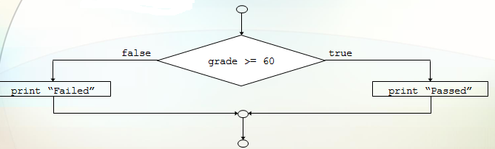
The if/else Selection Structure

Slide 19
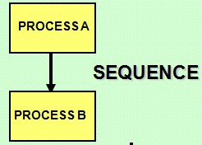
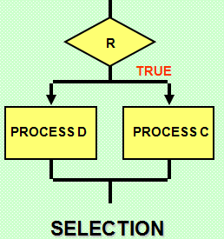
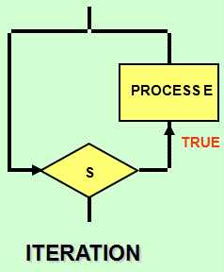

Slide 20
2. Information Hiding
Software solutions always contain data structures that hold information
Programs work on these data structure to perform the functions they want
In general, only some operations are performed on the information.
Make everything private
E.g. on a bank’s ledger, only debit, credit, check current balance etc are done

Slide 21
Information Hiding…
Information hiding – the information should be hidden; only operations on it should be exposed
- Information hiding is the ability to prevent certain aspects of a class or software component from being accessible to its clients. Using either programming language features (like private variables).

Slide 22
Some Programming Practices
Control constructs: Use only a few structured constructs (rather than using a large no of constructs)
Go to: Use them sparingly, and only when the alternatives are worse
Nesting: Avoid heavy nesting of if-then-else; if disjoint nesting can be avoided
Module interface: make it simple
Robustness: Handle exceptional situations

Slide 23
Coding Standards
Programmers spend more time reading code than writing code
They read their own code as well as other programmers code
Readability is enhanced if some coding conventions are followed by all
Coding standards provide these guidelines for programmers
Generally are regarding naming, file organization, statements/declarations, …

Slide 24
Coding Standards…
Statements
Decision-making statements (if-then, if-then-else, switch).
Looping statements (for, while, do-while), and
Branching statements (break, continue, return)
are all supported by the Java programming language.

Slide 25
Class variables should never be declared public
Loop variables should be initialized just before the loop
Avoid using break and continue in loops
Avoid using the do… while construct

Slide 26
1. for (int i = 0; i < 10; i++) {
System.out.println(i); }
2. int i = 0;
while(i < 10) {
System.out.println(i++); //prints i before
} //applying i++
1. int i = 0;
Do {
System.out.println(i++); }
while(i < 10)

Slide 27
3. Pair Programming
Also a coding process that has been proposed as key practice in XP
Code is written by pair of programmers rather than individuals
The pair together design algorithms, data structures, strategies, etc.
One person types the code, the other actively reviews what is being typed
Errors are pointed out and together solutions are formulated
Roles are reversed periodically

Slide 28
Source Code Control and Built
Source code control is an essential step programmers have to do
Generally tools like Concurrent versions system(CVS), Visual Source Safe(VSS) are used
A tool consists of repository, which is a controlled directory structure
The repository is the official source for all the code files
Notes:
Version manager,

Slide 29
Refactoring
As code evolves, the design becomes more complex
Refactoring is a technique to improve existing code by improving its design (i.e. the internal structure)
Refactoring is done generally to reduce coupling or increase cohesion
No new functionality is added

Slide 30
Refactoring…
“Bad smells” that suggest that refactoring may be desired
Duplicate code
Long parameter list
Switch statement
Too much communication between objects

Slide 31
Software Testing

Slide 32
Background
Main objectives of a project: High Quality & High Productivity (Q&P)
Quality has many dimensions
reliability, maintainability, interoperability etc.
Reliability is perhaps the most important
Reliability: The chances of software failing
More defects => more chances of failure => lesser reliability

Slide 33
The average software product released on the market should be error free.
Testing is obviously concerned with errors, faults, failures and incidents.
A test is the act of exercising software with test cases with an objective of:
- Finding failure
- Demonstrate correct execution

Slide 34
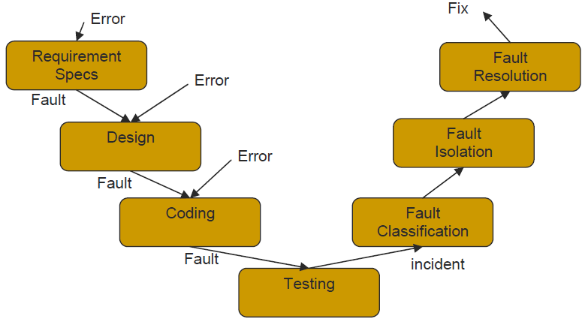
A Testing Life Cycle

Slide 35
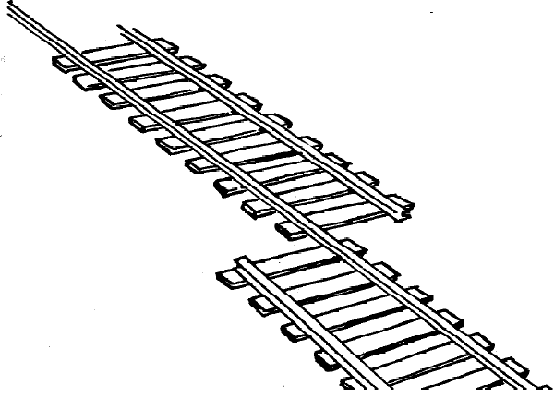
Testing key concepts
Error
Represents mistakes made by people.
That is, error refers to the difference between the actual output of a software and the correct output.

Slide 36

Fault (Defect or bug )
is the result of error.
Fault is a condition that causes a system to fail in performing its required function.

Slide 37

Failure
Occurs when fault executes.
Failure is the inability of a system or component to perform a required
function according to its specifications.

Slide 38
Faults & Failure
Failure: A software failure occurs if the behavior of the s/w is different from expected/specified.
Fault (defect): cause of software failure
Fault = bug = defect
Failure implies presence of defects

Slide 39
Role of Testing
Reviews are human processes - can not catch all defects
Hence there will be requirement defects, design defects and coding defects in code
These defects have to be identified by testing
Therefore testing plays a critical role in ensuring quality.

Slide 40
Detecting defects in Testing
During testing, software under test (SUT) executed with set of test cases
Failure during testing => defects are present
No failure => confidence grows, but can not say “defects are absent”

Slide 41
Testing types
Development testing
Test-driven development
Release testing
User/customer testing
Acceptance testing

Slide 42
1. Development testing
This includes all testing activities that are carried out by the team developing the system. Testing is carried out at 3 levels.
Unity testing: the process of testing program components, such as methods or object classes. Test are calls to routine with input parameters.
Component testing: this test shows if the component interface behaves according to its specification.
System testing: this checks that components are compatible, interact correctly and transfer the right data at the right time across their interfaces.

Slide 43
2. Test-driven development
Test-driven development (TDD) is an approach where you develop the code incrementally, along with a test for that increment. You can only move to the next increment only if the previous increment passes its test.
Benefits of the test driven development are:
- Code coverage: defects are discovered early in the development process.

Slide 44
Regression testing: regression tests are used to
check that changes to the program have not introduced
new bugs . test that previous functionality works alright;
important when changes are made
- Simplified debugging: when test fails, it is obvious that the problem lies in the newly written code. The newly written code needs to be checked and modified.
- System documentation: The tests themselves are a form of a documentation that describe what the code should be doing.

Slide 45

Test-driven development

Slide 46
3. Release testing
This is the process of testing a particular release of a system that is intended for use outside of the development team.
Requirement based testing: this checks if the requirement has been satisfied. This validates proper implementation of the requirement
Scenario testing: this is a way of testing a scenario ( a story that describes a way in which the system might be used)

Slide 47
Performance testing: once the system is complete, some properties like performance and reliability are tested.
Performance testing involves running a series of tests where you can increase the load until the performance becomes unacceptable.
Release testing is a form of system testing.
Notes:
Black box testing
Release testing

Slide 48
4. User/customer testing
Is the testing process where users or customers provide input and advice on system testing. It is an experiment to check if the system does what is needed.
There are 3 different types of user testing:
Alpha testing: users and developer test the software at the developer’s site.
Beta testing: a release of software is given to user to experiment it and raise discovered problems with developers.

Slide 49
Acceptance testing: customers test if the system is acceptable and can be deployed in the customer’s environment.

Slide 50
Acceptance testing
Acceptance testing is an inherent part of custom system development. It takes place after release testing. Acceptance implies that payment should be made for the system.
There are 6 stages in the acceptance testing process:
1.Define acceptance criteria
2.Plan acceptance testing
3.Derive acceptance tests
4.Run acceptance tests
5.Negotiate test results
6.Reject/accept system

Slide 51

The acceptance testing process

Slide 52
Levels of Testing
The code contains requirement defects, design defects, and coding defects
Nature of defects is different for different injection stages
One type of testing will be unable to detect the different types of defects
Different levels of testing are used to uncover these defects

Slide 53
User needs
Acceptance testing
Requirement
specification
System testing
Design
Integration testing
code
Unit testing

Slide 54
Unit Testing
Different modules tested separately
Focus: defects injected during coding
Essentially a code verification technique
UT is closely associated with coding
Frequently the programmer does UT; coding phase sometimes called “coding and unit testing”

Slide 55
Integration Testing
Focuses on interaction of modules in a subsystem
Unit tested modules combined to form subsystems
Test cases to “exercise” the interaction of modules in different ways
May be skipped if the system is not too large

Slide 56
System Testing
Entire software system is tested
Focus: does the software implement the requirements?
Validation exercise for the system with respect to the requirements
Generally the final testing stage before the software is delivered
May be done by independent people
Defects removed by developers
Most time consuming test phase

Slide 57
Acceptance Testing
Focus: Does the software satisfy user needs?
Generally done by end users/customer in customer environment, with real data
Only after successful AT software is deployed
Any defects found, are removed by developers
Acceptance test plan is based on the acceptance test criteria in the SRS

Slide 58
Summary
Goal of coding is to convert a design into easy to read code with few bugs
Good programming practices like structured programming, information hiding, and pair programming
There are many methods to verify the code of a module – unit testing and inspections are most commonly used

Slide 59
END Of CHAPTER 6
Thank you.

