Slide 1

SOFTWARE ENGINEERING

Slide 2

Chapter 7: SOFTWARE PROJECT MANAGEMENT

Slide 3
Introduction to SPM and feasibility analysis

Slide 4
Project concepts
Project
Management
Project management
Project Process
feasibility analysis

Slide 5
What is a Project?
Def 1:
A project is a temporary endeavor undertaken to produce a unique product or service.
Temporary – Definitive beginning and end
Unique – New undertaking, unfamiliar ground
Unique
Temporary
Characteristics of
Projects

Slide 6
Def 2:
-A project is an activity that :
brings about change
Specific Deliverable
has unknown elements, which therefore create risk

Slide 7
Other Common Characteristics of Projects
The need for planning
The no-routine nature of tasks
Having a pre-determined time span
Specific objectives to be met
Work being executed in phases
Multidisciplinary (involving several specialism)
Constrained resources
Being large and/or Complex
Notes:
Planning is a essence thinking carefully about something before you do it.

Slide 8
Is this a project?
- Building a house
- Coming to school everyday
- Getting married
- Investigating in user’s computer problem
- A programming coursework
- Writing an Operating system
- Installing a new application (Windows,…)
-Doing undergraduate studies

Slide 9
Software Project success rate
A successful project is one that has been delivered on time, on budget, with the required functionality.
A challenged project is one that is late, over budget or delivered with less that the required functionality.
A failed project is one that has either been cancelled prior to completion or delivered and never used.

Slide 10
Software Project Success Rates : 29% successul, 53% challenged, 18 failed. (Standish Group, 2004).
Software Project Success Rates : 16% successful, 74% challenged, 10 failed. (Ox ford University, 2004).

Slide 11

Project Success
Customer Requirements satisfied/exceeded
Completed within allocated time frame
Completed within allocated budget
Accepted by the customer

Slide 12

Project Failure
Scope Creep/uncontrolled
Poor Requirements Gathering
Unrealistic planning and scheduling
Lack of resources
Notes:
Creep refers to uncontrolled changes or continuous growth in a project’s scope

Slide 13
Triple Constraint
Time
Quality
Cost
Scope

Slide 14
Triple Constraint
Increased Scope = increased time and increased cost
Tight Time = decreased costs and/or reduced scope
Tight Budget = decreased time and/or reduced scope.

Slide 15
Common project terms
Deliverables: Tangible ‘things’ that the project produces
Milestones: Dates by which major activities are performed.
Tasks: Also called Actions. Activities undertaken during the project
Risks: Potential problems that may arise

Slide 16
Issues: Risks that have happened
Gantt Chart: A specific type of chart showing time and tasks. Usually created by a Project Management program like MS Project.
Stakeholder: Any person or group of person who may be affect by the project

Slide 17
What is management
Planning-- deciding what to be done (Predetermining a course of action for accomplishing organizational Objectives)
Organizing --making arrangement (Arranging the relationships among work units for accomplishment of objectives ).
Staffing -- selecting right people (Selecting and training people for positions in the organization)

Slide 18
Directing -- Creating an atmosphere that will assist and motivate people to achieve desired end results by giving instruction
Monitoring -- checking on progress
Controlling -- taking remedial action, Establishing, measuring, and evaluating performance of activities toward planned objectives
Innovating -- finding new solutions
Representing -- liaising with users (clients, developer, suppliers and stakeholders)

Slide 19
What is Project Management
Project Management is the application of skills, knowledge, tools and techniques to meet the needs and expectations of stakeholders for a project.
The purpose of project management is prediction and prevention.
Tools to aid in task sequencing, dependency analysis, resource allocation, scheduling, etc.
Tools to track progress relative to plan

Slide 20
Software project management
Software project management is the process of planning, organizing, staffing, monitoring, controlling and leading a software project.
Concerned with activities involved in ensuring that software is delivered on time and on schedule and in accordance with the requirements of the organisations developing and procuring the software.

Slide 21
Software vs hardware
The product is intangible (invisibility). Intellectual product.
The product is uniquely flexible. The ease with which software can be changed.
Many software projects are 'one-off' projects.
Conformity: software developers have to conform to the requirements of human client needs.

Slide 22
Process and Project management
A software project has two main activity dimensions: engineering and project management.
The engineering dimension deals with building the system such as how to perform requirement specification, design, code, test and so on.

Slide 23
The project management dimension deals with properly planning, how to set milestones, organize personnel, manage risks and controlling the engineering activities to meet project goals for cost, schedule, and quality.

Slide 24
For small project, project plan may be an e-mail specifies all the needs.
For large project, activities planned and allocated to project personnel and then tracked as the project executes.
A process for a task comprises a sequence of steps that should be followed to execute the task.
For a successful project, project managers have to follow processes.

Slide 25
Why should project managers follow processes?
Processes represent collective knowledge—increase chance of success.
A process may have some extra steps—don’t know beforehand which ones are not needed, and hence you will increase your risks by taking shortcuts.
Without processes, you cannot predict much about the outcome of your project.

Slide 26
Processes lower your anxiety level. Checklists cover 80 percent of what needs to be done. Your task reduces to working out the remaining 20 percent.

Slide 27
2. feasibility analysis

Slide 28
Feasibility is the measure of how beneficial or practical the development of an information system will be to an organization.
The decision to invest in a project should be based on Operational , technical, schedule and economic criteria. There are called Four Tests For Feasibility.

Slide 29
Four Tests For Feasibility
Operational feasibility is a measure of how well the solution will work in the organization. It is also a measure of how people feel about the system/project.
Technical feasibility is a measure of the practicality of a specific technical solution and the availability of technical resources and expertise.
Schedule feasibility is a measure of how reasonable the project timetable is.
Economic feasibility is a measure of the cost-effectiveness of a project or solution.

Slide 30
Cost-Benefit Analysis
Costs:
Development costs are one time costs that will not come back after the project has been completed (e.g. Labor, resources, salaries,…)
Set-up costs (e.g. installation cost, hardware, staff recruitment, training,….)
Operating costs are costs that tend to come back throughout the lifetime of the system (e.g. support, maintenance).

Slide 31
Benefits:
Direct (e.g. reduction in staff costs)
Indirect (e.g. reliability, usability)
Intangible (lower staff turnover, improve decision making,..).

Slide 32
Cost- benefit analysis compares project development, setup and operational costs with anticipated benefits.

Slide 33
Cost-Benefit Analysis Techniques
- Net profit
Pay-back period
Average Rate of Return (ARR) or Return On Investment (ROI)
Net Present value (NPV)

Slide 34
1. Net profit
Net profit is the residual income of a firm after adding total revenue and gains and subtracting all expenses and losses for the reporting period; the money left over after paying all the expenses of an endeavor.
Net profit = Total profit – Total investment

Slide 35
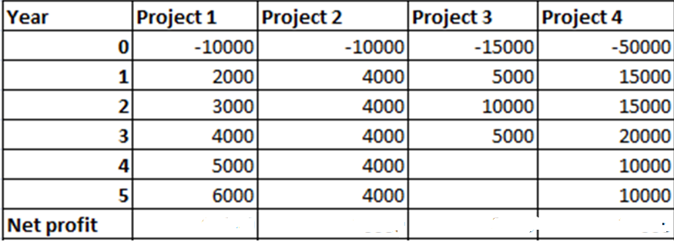

Slide 36
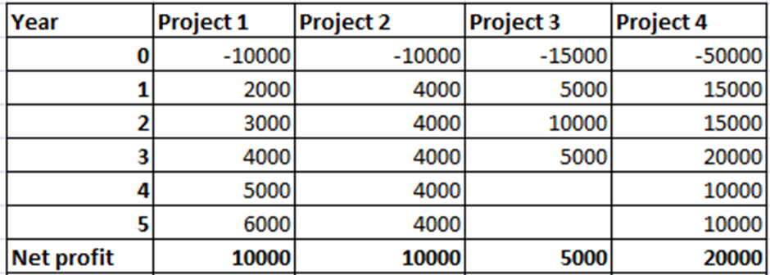

Slide 37
2. Payback Analysis
Payback analysis is a simple and popular method for determining if and when an investment will pay for itself.
Payback period is the period of time that it will take to pay back the investment .
Normally, a project with short payback will be chosen based on that the organization wish to minimize the time that a project is in debt.

Slide 39
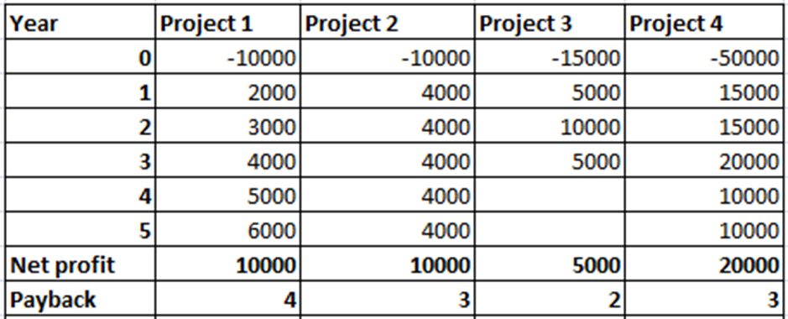

Slide 40
3. Average Rate of Return(ARR)
Average Rate of return or Return-on-Investment compares the lifetime profitability of alternative solutions or projects.
The ARR for a solution or project is a percentage rate that measures the relationship between the amount the business gets back from an investment and the amount invested.

Slide 41
If the project is financed from cash reserves then the cost is the interest that could otherwise have been earned.
Money used to finance a project itself cost money. If it has to be borrowed, the cost is the interest that has to be paid.

Slide 42
ROI or ARR Formulas
ARR = (AVERAGE NET PROFIT/TOTAL INVESTMENT)* 100
where NET PROFIT=INFLOW(REVENUES) –OUTFLOW(EXPENSES)

Slide 43
ARR PROJECT1
ARR = (AVERAGE NET PROFIT/PERIOD OF INVESTMENT/ TOTAL INVESTMENT)* 100
ARR= ((10.000 / 5)/ 10000)* 100
= 20

Slide 45
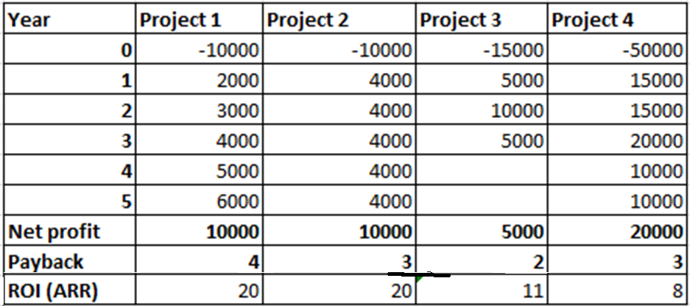

Slide 46
The Time Value of Money is a concept that should be applied to each technique in discount methods. The time value of money recognizes that a dollar today is worth more than a dollar one year from now.

Slide 47
Future value of money
This is the sum to which an initial amount of principal or present value is expected to grow over a period of t-years when the interest rate is at a rate of i%
$ 100 today is worth more than $ 100 tomorrow.
- It can earn bank interest
- Or save loan interest

Slide 48
10% growth will turn $ 100
FV= PV (1+i) ^{t}
Where FV: future value, PV: Present value, i: rate, T: no of years

Slide 49
FV= 100 (1+0.1)¹
= 110; $ 110 after 1 year;
FV= 100 (1+0.1)²
= 121; $ 121 after 2 years.

Slide 50
Present value of money
This concept acknowledges the fact that a dollar losses value with time and as such if it is to be compared with a dollar to be received in t year then the two must be at the same values.
Discount factor
Df=1/ (1+i/100) ^{t}

Slide 51
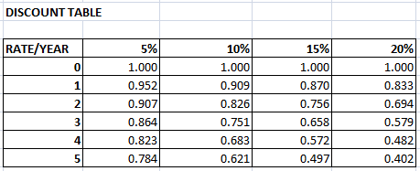

Slide 52
Example:
The future value of $ 100 today at a rate of 10% is :
PV = FV * DF
= $ 100 * 0.909
= $90.9 in 1 year time
In 2 years time PV= $82.8

Slide 53
4. Net Present Value (NPV)
The difference between the present value of the future cash flows from an investment and the amount of investment.
NPV is a central tool in discounted cash flow (DCF) analysis, and is a standard method for using the time value o money to appraise long-term projects.

Slide 54

Each cash inflow/outflow is discounted back to its present value (PV). Then they are summed. Therefore NPV is the sum of all.
t - the time of the cash flow
i - the discount rate;
R_{t} - the net cash flow (the amount of cash, inflow minus outflow) at time t.

Slide 55
Examples
Project 1
We have cash flow for 5 years
Rate = 15%
Calculate NPV

Slide 56
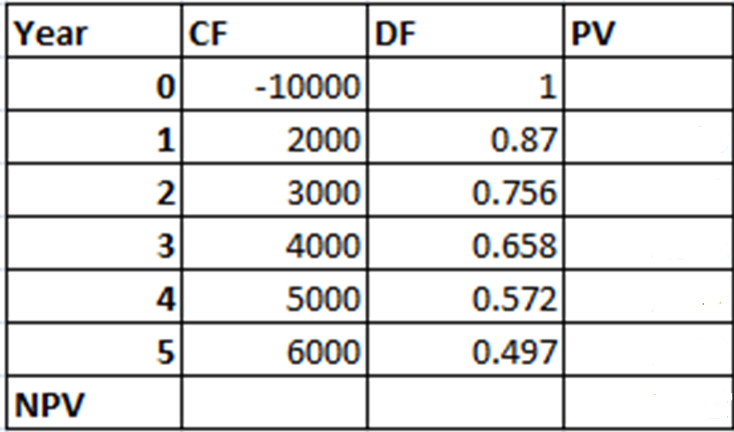

Slide 57
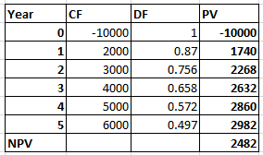
NPV PROJECT 1

Slide 58
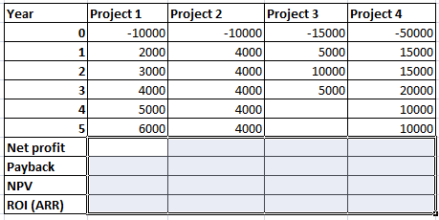

Slide 59
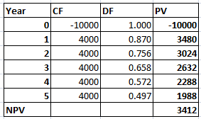
NPV PROJECT 2

Slide 60
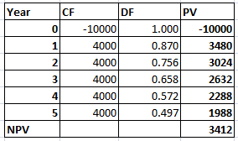
NPV PROJECT 3

Slide 61
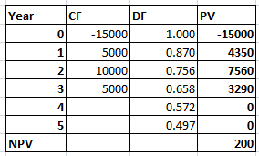
NPV PROJECT 4

Slide 63
The table shows the timing of cash flow over the lifetime of a project. The negative cash flow at the beginning represents the initial investment (cost) and the positive cash flows each year thereafter show investment return (benefits).
The sum of the discounted cash flows (including the initial cost) gives the net present value (NPV) of the project . This is the projected profit discounted to reflect it’s value in today’s money.

Slide 64
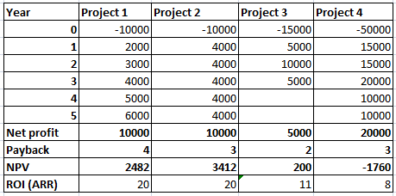
NP, Payback, NPV, ARR

Slide 65
NPV in decision making
NPV > 0 the investment would add value to the firm;
the project may be accepted
NPV < 0 the investment would subtract value from
the firm; the project should be rejected.
NPV = 0 the investment would neither gain nor lose
value for the firm; We should be indifferent
in the decision whether to accept or reject
the project.

Slide 66
Critique of methods
Net profit
- Ignore payback time
- Ignore risk
Payback period
- Ignore overall profitability
Average Rate of Return (ARR) or ROI
- Ignore timing of returns
Not directly comparable with bank rate
NPV
- Takes account of profitability and timing of cash flows

Slide 67
The Net profit, payback, Average rate of Return are less scientific, but nevertheless important as they are the most used. It has been estimated that many as 50% of firms still use the pay-back and at least 10% use the Average Rate of Return (ARR).
Note that the ARR Formula is also known as return on investment (ROI) or accounting rate of return, is sometimes modified to take account of depreciation by reducing the average annual profit figure.

Slide 68
The discounting method is more scientific approach and are of particular interest to economists because they take into account the opportunity cost of the use of capital funds.
Money used to finance a project itself cost money. If it has to be borrowed, the cost is the interest that has to be paid.
If the project is financed from cash reserves then the cost is the interest that could otherwise have been earned.

Slide 69
Discount rates reflect a risk premium over Bank interest rates.
Some project may be sensitive to small changes in rate

Slide 70
Other considerations
- Project must be considered within the political and economic framework of the organization as a whole.
- External factors may also influence a decision.
- Contractual or legal obligations may force unprofitable project to be undertaken.
- Unforeseen change in legislation, taxation, ... And/or other interest rate may invalidate a proposal.

Slide 71
End of chapter 7.
Thank you.

Slide 72
Exercise 1
Mr Kalisa is trying to sell a piece of land located at kigali. He has been offered 228450 frw by Kamali who will be paying the amount by the end of year.
And Kagabo has offered him 200000 frw, to be paid now.
Advice Mr Kalisa on which offer he should take. The required rate of return is 12% per year.

Slide 73
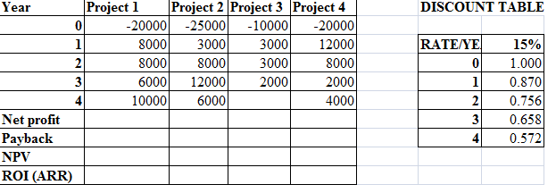

Slide 74
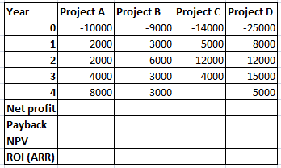
Exercises ; RATE 15%

