Slide 1

SOFTWARE ENGINEERING

Slide 2
Chapter 8: Effort estimation and Scheduling

Slide 3
Introduction
In early 2000, the newspapers and TV in India reported with jubilation the successful test flight of a newly built light combat aircraft. But the detailed reports also indicated a sad side: The prototype delivery was more than five years late, and the project had cost more than 10 times its initial estimated cost.
There are no quick and ready-made solutions for the estimation problem.
Project managers, however, can improve their estimation by using tested guidelines that are based on past experience and data.

Slide 4
Effort estimation usually takes place in the early stages of a project, when the software to be built is being understood.
The goal for a project manager is to obtain reasonable estimates so that the goals are met and the project personnel are not burned out.
PMs CAN USE PAST DATA OR EFFORT ESTIMATION MODELS.

Slide 5
Fundamental estimation questions
How much effort is required to complete an activity?
How much calendar time is needed to complete an activity?
What is the total cost of an activity?
Project estimation and scheduling are interleaved management activities

Slide 6
Principles of Cost Estimation
Cost estimation is really about estimating effort which is then converted to cost.
Estimates are required to:
- Prepare a tender or justify an internal project
- Chooses between alternative strategies
The main uncertainties are size and productivity.

Slide 7
Accuracy is improved by:
- Drawing on several different techniques
- Re-working estimates as more data become available
Maintaining historical data about past project
Effort estimation can rely on previous experience, but a more scientific and desirable approach is to use an estimation model.

Slide 8
Effort (SIZE) Estimation Models
A software estimation model defines the project characteristics whose values (or their estimates) it needs and the ways these values are used to compute the effort.
An estimation model needs inputs to produce the effort estimate as output.
A common approach is to use a simple equation to obtain an estimate of the overall effort from the size estimate.

Slide 9
Most common estimation model
1. Expert Judgment
2. Analogy
3. Parkinson’s law
4. Price to win
5. Top-down
6. Bottom- up
7. LINE OF CODE (LOC)
8. Function points

Slide 10
1. Expert judgment
One or more experts in both software development and the application domain use their experience to predict software costs.
Process iterates until some consensus is reached.
Advantages: Relatively cheap estimation method. Can be accurate if experts have direct experience of similar systems.
Disadvantages: Very inaccurate if there are no experts!

Slide 11
2.Estimation by analogy
The cost of a project is computed by comparing the project to a similar project in the same application domain
Advantages: May be accurate if project data are available and people/tools are the same
Disadvantages: Impossible if no comparable project has been undertaken. Needs systematically maintained cost database.

Slide 12
3. Parkinson's Law
The project costs whatever resources are available
Advantages: No overspend
Disadvantages: System is usually unfinished
E.g., if the software has to be delivered in 12 months and 5 people are available, the effort required is estimated to be 60 person-months.

Slide 13
4. Cost Pricing to win
The project costs whatever the customer has to spend on it
Advantages: You get the contract
Disadvantages: The probability that the customer gets the system he or she wants is small. Costs do not accurately reflect the work required.
How do you know what customer has?
Only a good strategy if you are willing to take a serious loss to get a first customer.

Slide 14
5. Top down approach
Estimate of the overall effort from the size estimate.
This equation can be determined through regression analysis of past data on effort and size.
Once the overall effort for the project is known, the effort for various phases or activities can be determined as a percentage of the total effort.

Slide 15
2. Bottom-up approach
You obtain the estimates first for parts of the project and then for the overall estimate. Activity-based estimation .
The bottom-up approach lends itself to direct estimation of effort; once the project is partitioned into smaller tasks, it is possible to directly estimate the effort required for them.
A risk of bottom-up methods is that you may omit some important activities in the list of tasks.

Slide 16
It may prove difficult to directly estimate the effort required for some overhead tasks, such as project management.
Top-down and the bottom-up approaches require information about the project: size (for top-down approaches) and a list of tasks (for bottom-up approaches).
In many ways, these approaches are complementary. Both types of estimates are more accurate if more information about the project is available or as the project proceeds.

Slide 17
A top-down approach gives a system level focus but lacks details. Bottom-up gives a detailed basis but may overlook system costs.

Slide 18
7. LINES OF CODE(LOC)
This consists of number of lines of code produced.
Lines of Code measure the solution not the problem.
Only deliverable code is included (comments and blank line are ignored).
Language dependent.
Difficult to estimate in early stages of development.
Doesn’t proper measure no-coding tasks.

Slide 19
Productivity comparisons
The lower level the language, the more productive the programmer
The same functionality takes more code to implement in a lower-level language than in a high-level language.
The more verbose the programmer, the higher the productivity
Measures of productivity based on lines of code suggest that programmers who write verbose code are more productive than programmers who write compact code.

Slide 20
Low-level languages are easy for the computer to understand but are more difficult for the programmer to write:
High level languages :C ++, Visual Basic, Pascal, Java, Fortran

Slide 21
System development times

Slide 22
8. Function points
Function Points measure software size by quantifying the functionality provided to the user based solely on logical design and functional specifications.
Function Point Analysis (FPA) is a method of quantifying the size and complexity of a software system in terms of the functions that the system delivers to the user.

Slide 23
It is independent of the computer language, development methodology, technology or capability of the project team used to develop the application.
Function points can be estimated early in analysis and design.

Slide 24
Function Point Counting Steps
1. Determine the Unadjusted Function Point Count
2. Determine the Technical complexity factor
3. Calculate the Environment Factor
4. Calculate FP

Slide 25
Function points analysis(FPA)
1. The unadjusted function point count (UFP) reflects the specific countable functionality provided to the user by the project or application.
Step 1: Count each of 5 information domain elements (inputs, outputs, queries, files and interfaces).
Step 2: Weight each domain element and sum to produce Unadjusted Function Point(UFP) count.

Slide 26
2.Technical complexity factor
2.Technical complexity factor
Step 3: Grade 13 general application characteristics on an ordinal scale from 0(no influence) to 5 (strong).
Step 4: Sum them to find their Combined Degree of Influence (CDI) and the technical complexity factor:
TCF=O.6 +(0.01 * CDI)

Slide 27
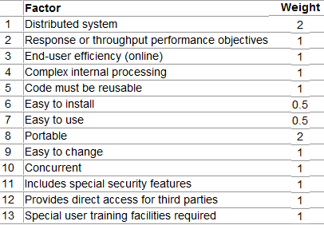
Technical Factors and Weights

Slide 28
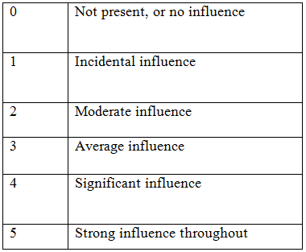
Degrees of influence

Slide 29
3. Environment factor (EF)
Step 5. Compute the environment factor (EF), Sum them to find the environment factor. A rating of 0 means that the factor is irrelevant for this project and 5 means it is essential.
EF = 1.4 + (–0.03 * EFactor)

Slide 30
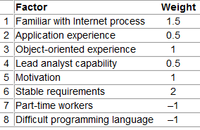

Slide 31
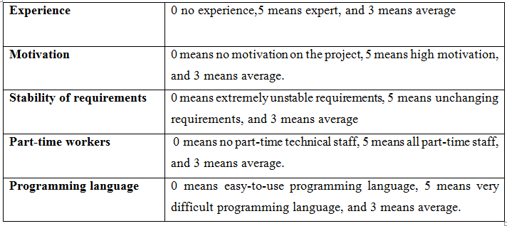
Environment factor(EF)

Slide 32
Step 6: Using the UFP, TCF, EF compute the final Function Point(FP) as follows:
Function Point (FP) = UFP * TCF * EF

Slide 33
FP is independent to language used.
Doesn’t penalize inventive solutions with fewer LOC.
Mainly suited to business software
Special training required.

Slide 34
Use case points approach
Use Case Points (UCP) is an estimation method that provides the ability to estimate an application’s size and effort from its use cases.

Slide 35
Use case points approach
Classify each use case as simple, medium, or complex(number of transactions in a use case).
N.B: simple use case (three or fewer transactions), an average use case(four to seven transactions), and a complex use case(more than seven transactions).
A simple use case is assigned a factor of 5, a medium use case a factor of 10, and a complex use case a factor of 15.
2. Obtain undjusted use case points(UUCP)
3. Technical factor
4. TCF = 0.6 + (0.01 * TFactor)
5. EF = 1.4 + (–0.03 * EFactor)
6. UCP = UUCP * EF * TFC

Slide 36
Simple: A simple user interface and touches only a single database entity; its success scenario has 3 steps or less;
Average: More interface design and touches 2 or more database entities; between 4 to 7 steps;
Complex: Involves a complex user interface or processing and touches 3 or more database entities; over seven steps;

Slide 37
EXAMPLE

Slide 38
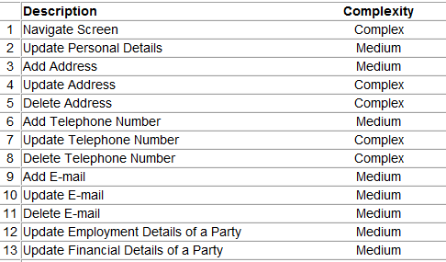

Slide 39
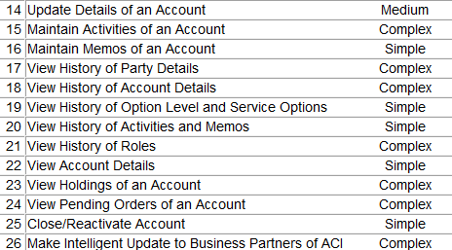

Slide 40
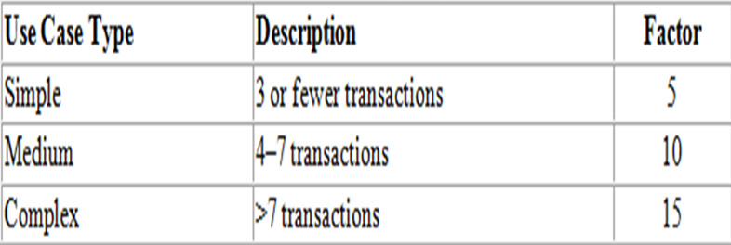
Use Case Complexity

Slide 41
UUCPs are determined from the use cases by assigning 5 points to each simple use case, 10 points to each medium-complexity use case, and 15 to each complex use case.
The number of simple use cases are 5 , medium use case are 9, and complex use cases were 12, respectively, so this translates to
UUCP = (5 * 5 )+( 9 * 10) + (12 * 15 )= 295

Slide 42
Technical Factors and Weights

Slide 43
He chose the following values of the factors; in the order given in Table : 4, 3, 5, 3, 4, 5, 5, 0, 4, 1, 2, 0, and 5.

Slide 44
4
3
5
3
4
5
5
0
4
1
2
0
5

Slide 45
Tfactor= (8 + 3 + 5 + 3 + 4 + 2.5 + 2.5 + 0 + 4 + 1 + 2 + 0 + 5)= 40
TCF= 0.6 + (0.01 * TFactor)
= 0.6 + (0.01 * 40)
= 1

Slide 46
Environmental Factors for Team and Weights

Slide 47
Then compute the environmental factor. We assigned the following weights to the environmental factors: 3, 1, 3, 4, 5, 5, 0, and 3.

Slide 48
3
1
3
4
5
5
0
3

Slide 49
EFactor (4.5 + 0.5 + 3 + 2 + 5 + 10 + 0 – 3) = 22
EF = 1.4 + (–0.03 * EFactor)
EF = 1.4 + (–0.03 * 22)
= 0.74
UCP = UUCP * TCF * EF
= 295 * 1.0 * 0.74
= 218.3

Slide 50
Count how many factors are less than 3 and how many factors are greater than 3.
If the total number of factors that have a value less than 3 are few, 20 person-hours per UCP is suitable.
If there are many, use 28 person-hours per UCP.
In other words, the range is 20 to 28 person-hours per UCP, and the project manager can decide which value to use depending on the various factors.

Slide 51
For an effort of 20 person-hours per UCP, the estimate effort is 218.3 *20= 4,366 person-hours .
= 499 person-day (At 8.75 hrs/day) or
= 513person-day(at 8.5 hours/day).

Slide 52
LOC VS. function POINT
-Language independent
-May be derived from specification document
- Accommodate reuse and object-oriented methods
- Special training required.
non-standard
Language dependent
Difficult to estimate in early stages of development.
Doesn’t proper measure non-coding task

Slide 53
Estimating Schedule
Once the effort is known or fixed, various schedules (or project duration) are possible, depending on the number of resources (people) put on the project.
For example, for a project whose effort estimate is 56 person-months, a total schedule of 8 months is possible with 7 people.
A schedule of 7 months with 8 people is also possible, as is a schedule of approximately 9 months with 6 people.
But 1 month with 56 people .

Slide 54
"Stretching" the schedule is easy; you simply apply fewer people (although the project may not be very valuable if completed over a long duration).
Compressing the schedule, however, is not easy. You cannot compress the schedule of a 56 person-month project to 1 month regardless of the resources you apply.

Slide 55
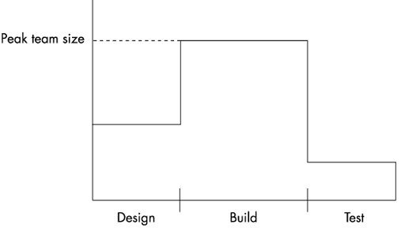
Manpower ramp-up in a typical project

Slide 56
Project managers often use a rule of thumb, called the square root check, to check the schedule of medium-sized projects.
The principle is that the proposed schedule should be around the square root of the total effort in person-months; the schedule can be met if resources are assigned to the project.
For example, if the effort estimate is 50 person-months, a schedule of about 7 to 8 months will be suitable with about 7 to 8 full-time resources.

Slide 57
Once the overall duration of the project is fixed, the schedule for the major milestones must be determined.
To determine the milestones, you must first understand the manpower ramp-up that usually takes place in a project.

Slide 58
The schedule distribution differs from the effort distribution.
For these three major phases, the percentage of the schedule consumed in the build phase is smaller than the percentage of the effort consumed because this phase involves more people.
Generally speaking, design requires about 40% of the schedule (20% for high-level design and 20% for detailed design), build consumes about 40%, and integration and system testing consume the remaining 20%.

Slide 59
The manpower ramp-up typically is around 1:2:1 for design, build, and integration and testing, respectively (giving an effort distribution among these phases as 1:4:1).
These types of guidelines provide a check for the milestones, which can be set based on other constraints.

Slide 60
In assigning resources, PM considers various factors such as :
leave plans of the team members,
their personal growth plans and career paths,
their skill sets and experience,
training and mentoring needs and
the criticality of the task.

Slide 61
For each lowest-level activity, they stipulate the effort, duration, start date, end date, and resources. For each activity, they also specify the activity code, the program code, and the module code.
They may also specify dependencies between activities, due either to an inherent dependency (for example, you can conduct a unit test plan for a program only after it has been coded) or to a resource-related dependency (the same resource is assigned two tasks).

Slide 62
Scheduling
Scheduling is the process of assigning start and end dates (CALENDAR TIME) to activities within the constraints imposed by other objectives.
It must also establish project milestone which allow management to assess and monitor progress.

Slide 63
A schedule must take into account of:
- weekends and holidays
- annual leave
- average sickness leave
- Training
- Administrative duties
This leaves only 225 working days in a year.

Slide 64
Detailed Scheduling
Once the milestones and the resources are fixed, it is time to set the detailed scheduling.
The project manager breaks the tasks into small schedulable activities in a hierarchical manner.
For each detailed task, the project manager estimates the time required to complete it and assigns a suitable resource so that the overall schedule is met.

Slide 65
In assigning resources, various factors such as
leave plans of the team members,
their personal growth plans and career paths,
their skill sets and experience,
training and mentoring needs,
the criticality of the task, and ...

Slide 66
For detailed scheduling, project managers frequently use Microsoft Project (MSP) or a spreadsheet.
For each lowest-level activity, they stipulate the effort, duration, start date, end date, and resources. They may also specify dependencies between activities.

Slide 67
Project Planning Techniques
The three basic project planning techniques are Gantt chart, CPM and PERT. All monitor progress and costs against resource budgets.

Slide 68
1. Gantt charts
Bar charts or Gantt charts (named after Henry Gantt(1800)) are effective and long established way of presenting project data in a form that is easily understood and interpreted.
Gantt chart is now commonly used for scheduling the tasks and tracking the progress of the project. Gantt charts are developed using bars to represent each task. The length of the bar shows how long the task is expected to take to complete. Duration is easily shown on Gantt charts.

Slide 69
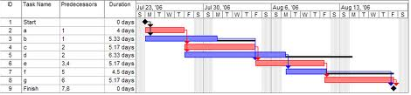

Slide 70
Each activity is listed separately in a vertical list and represented by a horizontal line or bar.

Slide 71
2. Critical Path
However sophisticated the time analysis becomes, a basic feature is always the calculation of the project duration which is the duration of the critical path.
The critical path of a network gives the shortest time in which the whole project can be completed. It is the chain of activities with the longest duration times. There may be more than one critical path in a network.

Slide 72
Critical Path Method
The process for determining and optimizing the critical path
All projects have a Critical Path
Accelerating non-critical tasks do not directly shorten the schedule

Slide 73
Steps in CPM Project Planning
1. Specify the individual activities.
2. Determine the sequence of those activities.
3. Draw a network diagram.
4. Estimate the completion time for each activity.
5. Identify the critical path (longest path through the network)
6. Update the CPM diagram as the project progresses.

Slide 74
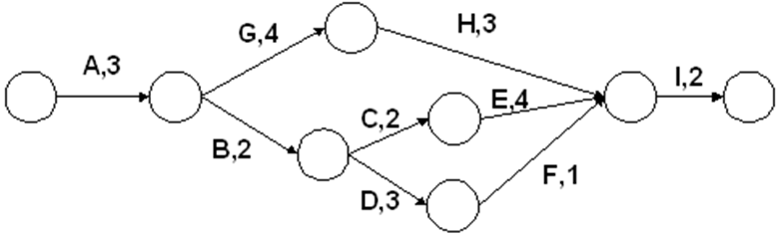
Critical Path Example

Slide 75
A, G, H, I = 12
A, B, C, E, I = 13 --- CP
A, B, D, f, I = 11

Slide 76
CPM Benefits
Provides a graphical view of the project.
Predicts the time required to complete the project.
Shows which activities are critical to maintaining the schedule and which are not.

Slide 77
Some rules of the thumb
Organize tasks concurrently to make optimal use of workforce.
Minimize task dependencies to avoid delays caused by one task waiting for another to complete.
Dependent on project managers experience.

Slide 78
Reducing Project Duration
How can you shorten the schedule?
Via
Reducing scope (or quality)
Adding resources
Concurrency (perform tasks in parallel)
Substitution of activities

Slide 79
Using Microsoft project
Lab activities.

Slide 80
End of chapter 8
Thank you.

