Slide 1
Suicide Rates in the Americas
ANALYZED BY
RUSS COLLINS, JASMIN RAVEN, ELYSE SULKEY, DAVID VANIE
Data set Reference: https://www.kaggle.com/russellyates88/suicide-rates-overview-1985-to-2016

Slide 2
Motivation & Summary
Our group decided to analyze the subject of suicide in the Americas
The motivation behind our subject matter was an interest in applying the skills we have learned thus far to a real-world issue
We chose specific variables that we agreed may have contributed and/or correlated with suicide rates in various countries
We took into account; GDP per country, Gender, Year, Age Range and Geographic Location, as variables that may have similar trends to the Suicide Rate Mean
Our goal is not to form our analysis from a predetermined outcome; but rather, our objective is to create a narrative from our findings through the data.
Notes:
Started with a global data set that ranged from the mid-1980s to 2016. First decided to go down to 2000-2010 (complete data in the set (before 2000 and in 2016, some incomplete data)), harder to account for effects of world events and general culture changes over time). Then decided to narrow scope to the Americas - felt that going down to one region would help mitigate the affect of varying cultural beliefs versus looking on a global scale. Finished cleaning data - Dropped incomplete data rows (HDI) and repetitive info (years & GDP v. “GDP and year”, age range v. “generation”, suicide count & population v. “suicide/100k”.

Slide 3
Questions & Data
Does the average GDP of sampled countries significantly impact Suicide Rates?
Does Gender present a disproportionate or proportionate role in Suicide Rates of sampled countries?
Is there a relationship between Age-Range and Suicide Rate?
Based on our findings from the 2000-2010 data set, is there potential to create a reliable way to predict future Suicide Rates?

Slide 4
Data Driven Findings regarding Research Questions

Slide 5
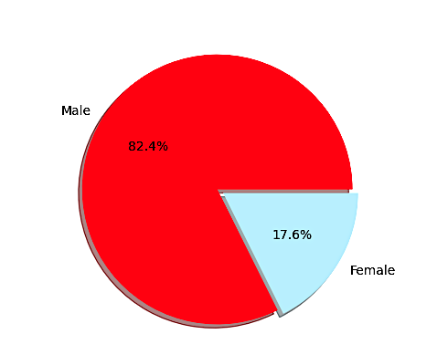
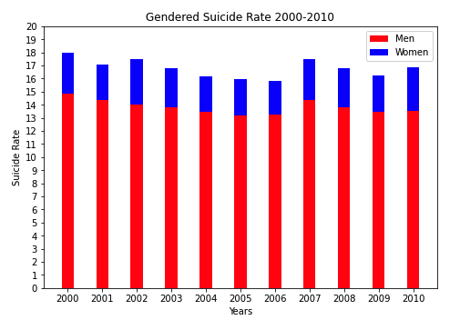
Is Gender represented disproportionately or proportionately in Suicide Rates of the sampled countries?
Based on our findings, Suicide Rates are disproportionatly distributed between Genders.
In our data set, ranging between 2000-2010, in the Americas; it was determined that Men make up 82.4% of the total Suicide Rate.
Women accounted for the the remaining 17.6 % of the total Suicide Rate.

Slide 6
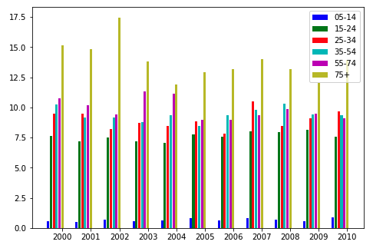
Is there a relationship between Age-Range and Suicide Rate?
According to our data analysis, Age-Range is most certainly related to suicide rate.
Within our data set, the 75+ age group had the highest Suicide Rate for every year analyzed.
While the numbers vary slightly, a conclusion can be made that Age Range increases the Rate of Suicide.

Slide 7
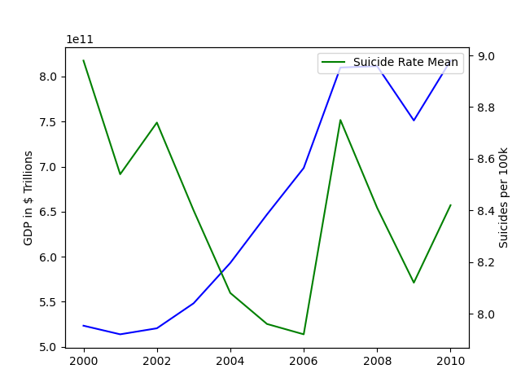
Does the average GDP of sampled countries impact Suicide Rates?
We determined the data did show some similarities.
However, it’s evident that more variables would be necessary to warrant establishing more consistent correlation.

Slide 8
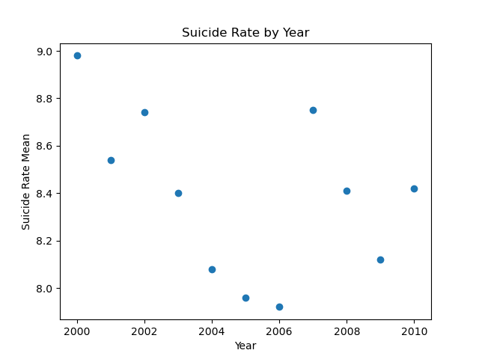
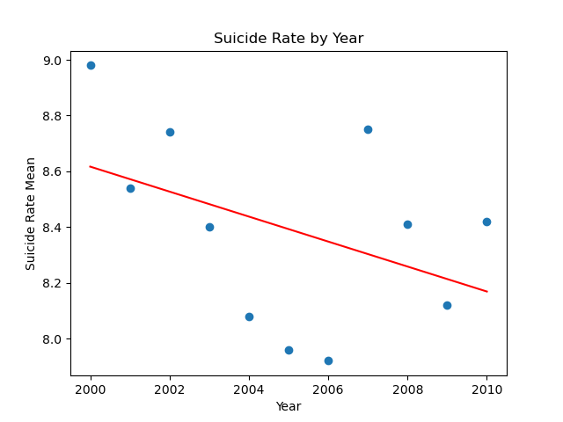
Total Mean of Suicides by Year and potential for a prediction model
We calculated the Suicide Rate by Year
We then applied a trend line to have analyze the direction in which the Suicide Rate would fall in future Years.
We determined from the 2000-2010 data set that the Suicide Rate was declining.

Slide 9
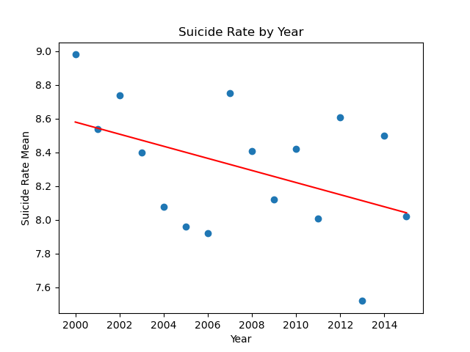

We were able to collect from our larger data set that the trend line was correct and the data from 2015 fell within a margin that we would have expected.
While we were working with limited variables, we feel that this process of data analysis does have potential for the basis of a more advanced predictive model concerning the subject matter.

Slide 10
What Did We Learn?
Did we select a valid data set?
Would we have benefited from using a broader/additional data set?
Are we satisfied with the chosen variables from our data set?
Were we biased in any way while processing our data?
If given more time and resources, would we do things differently? If so, how?.

