Slide 1

Recommending Products Based on the Latent Factors Model
Swetha Kolalapudi
CO-FOUNDER, LOONYCORN
www.loonycorn.com

Slide 2

Understand the latent factors model for collaborative filtering
Overview
Contrast the latent factors model and the nearest neighbors model
Use optimization techniques to solve for latent factors
- Stochastic gradient descent

Slide 3


Collaborative Filtering Techniques
Nearest Neighbors Model
Latent Factor Analysis
Use the ratings of “most similar” users
Solve for underlying factors that drive the ratings

Slide 4
Latent Factor Analysis
Analogous to PCA (Principal Components Analysis)
in matrix algebra

Slide 5
Latent Factor Analysis
Why are some products rated high and others low?
Why do some users like certain products?
Are there some underlying factors that influence all users’ ratings?

Slide 6
Once underlying factors are known
Predict any rating for a product by a user
 | P1 | P2 | P3 | P4 | P5
U1 | 3 | 4 | - | - | -
U2 | 3 | 2 | - | - | 5
U3 | - | 2 | - | 5 | 4
U4 | - | - | 4 | - | -
U5 | 1 | - | - | - | -
U6 | 3 | 4 | - | - | 5

Slide 7


Latent Factor Analysis
 | P1 | P2 | P3 | P4 | P5
U1 | 3 | 4 | - | - | -
U2 | 3 | 2 | - | - | 5
U3 | - | 2 | - | 5 | 4
U4 | - | - | 4 | - | -
U5 | 1 | - | - | - | -
U6 | 3 | 4 | - | - | 5
 | F1 | F2 | F3
U1
U2
U3
U4
U5
U6
 | P1 | P2 | P3 | P4 | P5
F1
F2
F3
*

Slide 8
Latent Factor Analysis
 | P1 | P2 | P3 | P4 | P5
U1 | 3 | 4 | 2 | 4 | 3
U2 | 3 | 2 | 5 | 1 | 5
U3 | 4 | 2 | 3 | 5 | 4
U4 | 1 | 2 | 4 | 3 | 5
U5 | 1 | 4 | 2 | 5 | 3
U6 | 3 | 4 | 3 | 1 | 5
 | F1 | F2 | F3
U1
U2
U3
U4
U5
U6
 | P1 | P2 | P3 | P4 | P5
F1
F2
F3
*
Users described by some underlying factors

Slide 9
Latent Factor Analysis
 | P1 | P2 | P3 | P4 | P5
U1 | 3 | 4 | 2 | 4 | 3
U2 | 3 | 2 | 5 | 1 | 5
U3 | 4 | 2 | 3 | 5 | 4
U4 | 1 | 2 | 4 | 3 | 5
U5 | 1 | 4 | 2 | 5 | 3
U6 | 3 | 4 | 3 | 1 | 5
 | F1 | F2 | F3
U1
U2
U3
U4
U5
U6
 | P1 | P2 | P3 | P4 | P5
F1
F2
F3
*
Products described by the same underlying factors

Slide 10


Latent Factor Analysis
 | P1 | P2 | P3 | P4 | P5
U1 | 3 | 4 | - | - | -
U2 | 3 | 2 | - | - | 5
U3 | - | 2 | - | 5 | 4
U4 | - | - | 4 | - | -
U5 | 1 | - | - | - | -
U6 | 3 | 4 | - | - | 5
 | F1 | F2 | F3
U1
U2
U3
U4
U5
U6
 | P1 | P2 | P3 | P4 | P5
F1
F2
F3
*
2
Solve using known ratings

Slide 11

Latent Factor Analysis
P1 P2 P3 P4 P5
3 4 - - -
3 2 - - 5
- 2 - 5 4
- - 4 - -
1 - - - -
3 4 - - 5
 | F1 | F2 | F3
U1
U2
U3
U4
U5
U6
U1
U2
 | P1 | P2 | P3 | P4 | P5
F1
F2
F3
*
U3
-
U4
U5 U6
Use the solution to find unknown ratings

Slide 12
Latent Factor Analysis
 | F1 | F2 | F3
U1
U2
U3
U4
U5
U6
 | P1 | P2 | P3 | P4 | P5
F1
F2
F3
This representation is analogous to content based filtering
*

Slide 13
Content Based Filtering
Rate every product against the relevant attributes
Rate the user on the importance he/she gives to these factors
Product | F1 | F2 | F3 | F4
A | 0 | 3 | 2 | 5
B | 5 | 2 | 3 | 4
C | 4 | 5 | 2 | 1
D | 3 | 4 | 5 | 2
User | F1 | F2 | F3 | F4
A | 0 | 3 | 2 | 5
Ex : Average of ratings of products that the user already likes

Slide 14
Data Representation
F3
Product
User
F1
F2

Slide 15


Content Based Filtering vs Latent Factor Analysis
Factors are identified by
experts
Factors are derived using machine learning techniques
Factors may be related to product attributes or may be abstract
Factors are product
attributes

Slide 16
Contrasting the Nearest Neighbors Model and Latent Factor Analysis

Slide 17



Nearest Neighbors Model vs Latent Factor Analysis
Data Representation
Model Updates
Memory Usage

Slide 18
Nearest Neighbors Model vs Latent Factor Analysis
Data Representation
Model Updates
Memory Usage

Slide 19
Nearest Neighbors Model
P3
User
P1
P2

Slide 20
Latent Factor Analysis
P3
P1
P2

Slide 21
Latent Factor Analysis
F3
F2
F1

Slide 22
Nearest Neighbors Model vs Latent Factor Analysis
Data Representation
Observable attributes vs hidden driving factors
Model Updates
Memory Usage

Slide 23
Nearest Neighbors Model vs Latent Factor Analysis
Data Representation
Observable attributes vs hidden driving factors
Model Updates
Memory Usage

Slide 24


Nearest Neighbors Model
 | P1 | P2 | P3 | P4 | P5
U1 | 3 | 4 | - | - | -
U2 | 3 | 2 | - | - | 5
U3 | - | 2 | - | 5 | 4
U4 | - | - | 4 | - | -
U5 | 1 | - | - | - | -
U6 | 3 | 4 | - | - | 5
Active user
Recommendations

Slide 25
Nearest Neighbors Model
Online updates
 | P1 | P2 | P3 | P4 | P5
U1 | 3 | 4 | - | - | -
U2 | 3 | 2 | - | - | 5
U3 | - | 2 | 7 | 5 | 4
U4 | - | - | 4 | - | -
U5 | 1 | - | - | - | -
U6 | 3 | 4 | - | - | 5
Active user
-
Recommendations

Slide 26

Latent Factor Analysis
 | P1 | P2 | P3 | P4 | P5
U1 | 3 | 4 | - | - | -
U2 | 3 | 2 | - | - | 5
U3 | - | 2 | - | 5 | 4
U4 | - | - | 4 | - | -
U5 | 1 | - | - | - | -
U6 | 3 | 4 | - | - | 5
 | F1 | F2 | F3
U1
U2
U3
U4
U5
U6
 | P1 | P2 | P3 | P4 | P5
F1
F2
F3
*

Slide 27




Latent Factor Analysis
 | F1 | F2 | F3
U1
U2
U3
U4
U5
U6
 | P1 | P2 | P3 | P4 | P5
U1 | 3 | 4 | - | - | -
U2 | 3 | 2 | - | - | 5
U3 | - | 2 | - | 5 | 4
U4 | - | - | 4 | - | -
U5 | 1 | - | - | - | -
U6 | 3 | 4 | - | - | 5
 | P1 | P2 | P3 | P4 | P5
F1
F2
F3
*
Recommendations
Active user

Slide 28
Latent Factor Analysis
Offline updates
 | F1 | F2 | F3
U1
U2
U3
U4
U5
U6
 | P1 | P2 | P3 | P4 | P5
U1 | 3 | 4 | - | - | -
U2 | 3 | 2 | - | - | 5
U3 | - | 2 | 7 | 5 | 4
U4 | - | - | 4 | - | -
U5 | 1 | - | - | - | -
U6 | 3 | 4 | - | - | 5
 | P1 | P2 | P3 | P4 | P5
F1
F2
F3
-
*
Recommendations
Active user

Slide 29
Nearest Neighbors Model vs Latent Factor Analysis
Data Representation
Observable attributes vs hidden driving factors
Model Updates
Online vs offline updates
Memory Usage

Slide 30
Nearest Neighbors Model vs Latent Factor Analysis
Data Representation
Observable attributes vs hidden driving factors
Model Updates
Online vs offline updates
Memory Usage

Slide 31
Nearest Neighbors Model
 | P1 | P2 | P3 | P4 | P5
U1 | 3 | 4 | - | - | -
U2 | 3 | 2 | - | - | 5
U3 | - | 2 | - | 5 | 4
U4 | - | - | 4 | - | -
U5 | 1 | - | - | - | -
U6 | 3 | 4 | - | - | 5
Ratings kept in-memory at all times
User recommendations computed on-demand

Slide 32
Latent Factor Analysis
 | F1 | F2 | F3
U1
U2
U3
U4
U5
U6
Rating matrix is decomposed oﬄine
 | P1 | P2 | P3 | P4 | P5
F1
F2
F3
*
All recommendations can easily be pre-computed as a one oﬀ

Slide 33
Nearest Neighbors Model vs Latent Factor Analysis
Data Representation
Observable attributes vs hidden driving factors
Model Updates
Online vs offline updates
Memory Usage
In-memory vs pre- computed

Slide 34
Nearest Neighbors Model vs Latent Factor Analysis
Data Representation
Observable attributes vs hidden driving factors
Model Updates
Online vs offline updates
Memory Usage
In-memory vs pre- computed

Slide 35
Decomposing the Rating Matrix

Slide 36




Using is Easy, Building is Hard
Driving a car
Building an engine

Slide 37
Solving for Factors
P
R
Q
 | I1 | I2 | I3 | I4 | I5
U1 | 3 | 4 | - | - | -
U2 | 3 | 2 | - | - | 5
U3 | - | r32 | - | 5 | 4
U4 | - | - | 4 | - | -
U5 | 1 | - | - | - | -
U6 | 3 | 4 | - | - | 5
 | F1 | F2 | F3
U1
U2
U3 | p3
U4
U5
U6
 | I1 | I2 | I3 | I4 | I5
F1 |  | q2
F2
F3
*
2

Slide 38
Solving for Factors
P
R
Q
 | I1 | I2 | I3 | I4 | I5
U1 | 3 | 4 | - | - | -
U2 | 3 | 2 | - | - | 5
U3 | - | 2 | - | 5 | 4
U4 | - | - | 4 | - | -
U5 | 1 | - | - | - | -
U6 | 3 | 4 | - | - | 5
 | F1 | F2 | F3
U1
U2
U3
U4
U5
U6
 | I1 | I2 | I3 | I4 | I5
F1
F2
F3
*
rui = pu . qi

Slide 39

Solve the set of equations
rui = pu . qi
# Equations = # Known ratings

Slide 40
Solving for Factors
P
R
Q
P1
P2
P3
P4
P5
 | I1 | I2 | I3 | I4 | I5
U1 | 3 | 4 | - | - | -
U2 | 3 | 2 | - | - | 5
U3 | - | 2 | - | 5 | 4
U4 | - | - | 4 | - | -
U5 | 1 | - | - | - | -
U6 | 3 | 4 | - | - | 5
 | F1 | F2 | F3
U1
U2
U3
U4
U5
U6
U1
3
4
-
-
-
U2
 | I1 | I2 | I3 | I4 | I5
F1
F2
F3
3
2
-
-
5
*
U3
-
2
-
5
4
U4
-
-
4
-
-
U5
1
-
-
-
-
U6
3
4
-
-
5
rui = pu . qi

Slide 41
Solving for Factors
P
R
Q
P1
P2
P3
P4
P5
 | I1 | I2 | I3 | I4 | I5
U1 | 3 | 4 | - | - | -
U2 | 3 | 2 | - | - | 5
U3 | - | 2 | - | 5 | 4
U4 | - | - | 4 | - | -
U5 | 1 | - | - | - | -
U6 | 3 | 4 | - | - | 5
 | F1 | F2 | F3
U1
U2
U3
U4
U5
U6
U1
3
4
-
-
-
U2
 | I1 | I2 | I3 | I4 | I5
F1
F2
F3
3
2
-
-
5
*
U3
-
2
-
5
4
U4
-
-
4
-
-
U5
1
-
-
-
-
U6
3
4
-
-
5
rui - pu . qi = εui

Slide 42
Find pu and qi such that
Σ(rui - pu . qi)²
Total error is minimized

Slide 43
min_{Σ}(rui -pu .qi)²+λ(||pu||²+||qi||²)
Add a term to penalize the model for the number of factors

Slide 44
min_{Σ}(rui -pu .qi)²+λ(||pu||²+||qi||²)
Regularization term

Slide 45
min_{Σ}(rui -pu .qi)²+λ(||pu||²+||qi||²)
Regularization factor

Slide 46
min E(pu, qi)
A standard optimization problem

Slide 47

Solve for latent factors using the Stochastic Gradient Descent method (SGD)
Demo
Set up a function to compute error
Set up a function to implement SGD

Slide 48
Solving for Latent Factors
Set up the data
Functions to access relevant information
Initialize factor matrices
Update the factor matrices
Minimize the error using SGD
Construct a rating matrix
The representation needed for collaborative filtering
Compute the error
Set up a function to measure RMSE

Slide 49
Solving for Latent Factors
Set up the data
Functions to access relevant information
Construct a rating matrix
The representation needed for collaborative filtering

Slide 50

Setting Up the Rating Matrix
 | I1 | I2 | I3 | I4 | I5
U1 | 3 | 4 | - | - | 4
U2 | 3 | 5 | 3 | 4 | 5
U3 | 4 | 2 | - | 5 | 4
U4 | 3 | - | 4 | 5 | 2
U5 | 1 | - | 4 | 2 | 1
U6 | 3 | 4 | - | 2 | 5
P1
P2
P3
P4
P5
U1
3
4
-
-
4
U2
3
5
3
4
5
User | ISBN | Rating
U3
4
2
-
5
4
U4
3
-
4
5
2
U5
1
-
4
2
1
U6
3
4
-
2
5
pandas.pivot_table

Slide 51
Setting Up the Rating Matrix
 | I1 | I2 | I3 | I4 | I5
U1 | 3 | 4 | - | - | 4
U2 | 3 | 5 | 3 | 4 | 5
U3 | 4 | 2 | - | 5 | 4
U4 | 3 | - | 4 | 5 | 2
U5 | 1 | - | 4 | 2 | 1
U6 | 3 | 4 | - | 2 | 5
P1
P2
P3
P4
P5
U1
3
4
-
-
4
U2
3
5
3
4
5
User | ISBN | Rating
U3
4
2
-
5
4
U4
3
-
4
5
2
U5
1
-
4
2
1
U6
3
4
-
2
5
scipy.coo_matrix

Slide 52
coo_matrix((values,(rowsource, columnsource)))
Creating a Rating Matrix
Takes a tuple with rating data, row names and column names

Slide 53
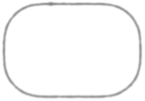

coo_matrix((values,(rowsource, columnsource)))
User | ISBN | Rating
Creating a Rating Matrix
Takes a tuple with rating data, row names and column names

Slide 54

coo_matrix((values,(rowsource, columnsource)))
User | ISBN | Rating
Creating a Rating Matrix
Takes a tuple with rating data, row names and column names

Slide 55

coo_matrix((values,(rowsource, columnsource)))
User | ISBN | Rating
Creating a Rating Matrix
Takes a tuple with rating data, row names and column names

Slide 56
 | .. | 3053 | .. | ..
.. | 4 | - | - | -
.. | 2 | - | - | 5
10633 | 2 | 0 | 5 | 4
.. | - | 4 | - | -
.. | - | - | - | -
.. | 4 | - | - | 5
-

Slide 57
Solving for Latent Factors
Set up the data
Functions to access relevant information
Initialize factor matrices
Construct a rating matrix
The representation needed for collaborative filtering

Slide 58
Solving for Latent Factors
Set up the data
Functions to access relevant information
Initialize factor matrices
Construct a rating matrix
The representation needed for collaborative filtering
Compute the error
Set up a function to measure RMSE

Slide 59
Solving for Latent Factors
Set up the data
Functions to access relevant information
Initialize factor matrices
Update the factor matrices
Minimize the error using SGD
Construct a rating matrix
The representation needed for collaborative filtering
Compute the error
Set up a function to measure RMSE

Slide 60

_{Σ}(rui-pu.qi)²+λ(||pu||²+||qi||²)
Stochastic Gradient Descent
Total error across all ratings

Slide 61
_{Σ}(rui-pu.qi)²+λ(||pu||²+||qi||²)
Stochastic Gradient Descent
Look at the error for 1 rating

Slide 62
e(pu, qi)=(rui-pu.qi)²+λ(||pu||²+||qi||²)
Stochastic Gradient Descent
Look at the error for 1 rating

Slide 63
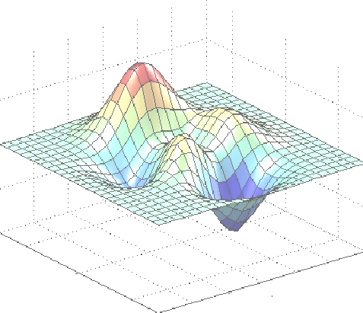
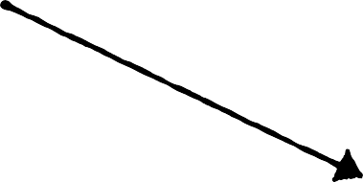

e(pu, qi)
Stochastic Gradient Descent
pu
qi

Slide 64

e(pu, qi)
Initial Position
Stochastic Gradient Descent
pu
qi
Compute the initial value of the error

Slide 65
e(pu, qi)
Initial Position
Stochastic Gradient Descent
pu
qi
Compute the slope at that point

Slide 66
e(pu, qi)
Initial Position
Stochastic Gradient Descent
pu
qi
Take a small step in the downward direction of the slope

Slide 67
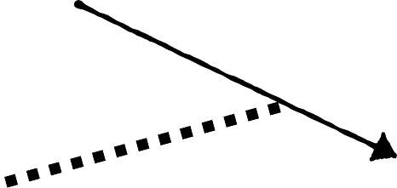
e(pu, qi)
Initial Position
Stochastic Gradient Descent
pu
qi
Take a small step i.e. update pu and qi by a small value

Slide 68


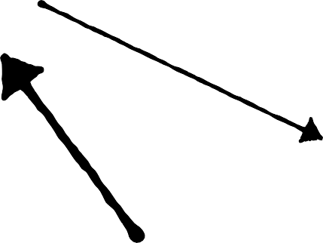
e(pu, qi)
Initial Position
pu
qi
Minimum
Stochastic Gradient Descent
Repeat until you reach a minimum

Slide 69

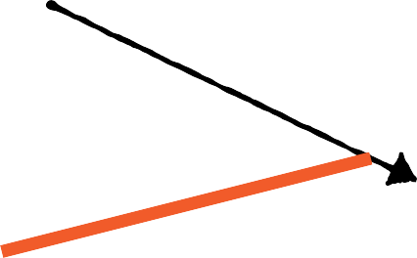
e(pu, qi)
Initial Position
Stochastic Gradient Descent
pu
qi
Take a small step i.e. update pu and qi by a small value

Slide 70
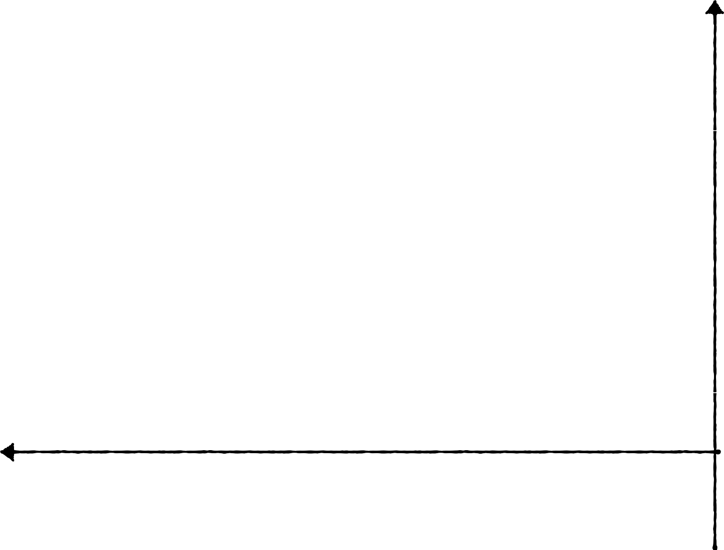
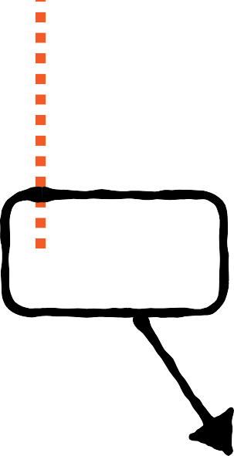
e(pu, qi)
Initial Position
γ
Stochastic Gradient Descent
pu
pu = pu+ γ ( -slope )

Slide 71
e(pu, qi)
Initial Position
γ
Stochastic Gradient Descent
pu
pu = pu+ γ ( - ∂E(pu, qi) )
∂pu

Slide 72
e(pu, qi)
Initial Position
Stochastic Gradient Descent
pu
qi

Slide 73

e(pu, qi)
Initial Position
Stochastic Gradient Descent
pu
qi
qi = qi+ γ ( - ∂E(pu, qi) )
∂qi

Slide 74

While max # allowed steps is not reached :
For each rating :
Update pu and qi by a small value
Stochastic Gradient Descent
If RMSE <threshold
Break

Slide 75
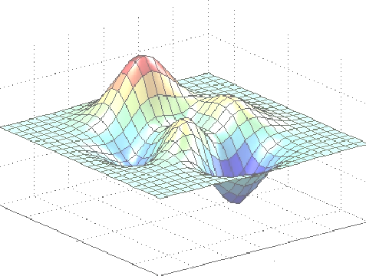

e(pu, qi)
pu
pu = pu+ γ ( - ∂E(pu, qi) )
qi
Stochastic Gradient Descent
∂pu
qi = qi+ γ ( - ∂E(pu, qi) )
∂qi

Slide 76
eui=rui-np.dot(P[u,:],Q[:,i]) P[u,:]=P[u,:]+gamma*2*(eui*Q[:,i]-lamda*P[u,:])
Q[:,i]=Q[:,i]+gamma*2*(eui*P[u,:]-lamda*Q[:,i])
Updating pu and qi

Slide 77

εui = rui-pu.qi
eui=rui-np.dot(P[u,:],Q[:,i]) P[u,:]=P[u,:]+gamma*2*(eui*Q[:,i]-lamda*P[u,:])
Q[:,i]=Q[:,i]+gamma*2*(eui*P[u,:]-lamda*Q[:,i])
Updating pu and qi

Slide 78


pu = pu+ γ ( -∂E(pu, qi) )
∂pu
eui=rui-np.dot(P[u,:],Q[:,i])
P[u,:]=P[u,:]+gamma*2*(eui*Q[:,i]-lamda*P[u,:])
Q[:,i]=Q[:,i]+gamma*2*(eui*P[u,:]-lamda*Q[:,i])
Updating pu and qi

Slide 79
pu = pu+ γ ( 2(εuiqi-λpu) )
eui=rui-np.dot(P[u,:],Q[:,i]) P[u,:]=P[u,:]+gamma*2*(eui*Q[:,i]-lamda*P[u,:])
Q[:,i]=Q[:,i]+gamma*2*(eui*P[u,:]-lamda*Q[:,i])
Updating pu and qi

Slide 80
qi = qi+ γ ( - ∂E(pu, qi) )
∂qi
eui=rui-np.dot(P[u,:],Q[:,i])
P[u,:]=P[u,:]+gamma*2*(eui*Q[:,i]-lamda*P[u,:])
Q[:,i]=Q[:,i]+gamma*2*(eui*P[u,:]-lamda*Q[:,i])
Updating pu and qi

Slide 81
qi = qi+ γ ( 2(εuipu-λqi) )
eui=rui-np.dot(P[u,:],Q[:,i]) P[u,:]=P[u,:]+gamma*2*(eui*Q[:,i]-lamda*P[u,:])
Q[:,i]=Q[:,i]+gamma*2*(eui*P[u,:]-lamda*Q[:,i])
Updating pu and qi

Slide 82
Understand the latent factors model for collaborative filtering
Summary
Contrast the latent factors model and the nearest neighbors model
Use optimization techniques to solve for latent factors
- Stochastic gradient descent

