Slide 1

Recommending Products Based on the Nearest Neighbors Model
Swetha Kolalapudi
CO-FOUNDER, LOONYCORN
www.loonycorn.com

Slide 2

Overview
Understand the nearest neighbors model for collaborative filtering
Measure similarity of users using distance metrics
Find the top 10 book recommendations for a user

Slide 3


Book Crossing
A network of book lovers

Slide 4
Finding Book Recommendations
You know what books a user already likes
- User ratings database
Find the top N books to recommend to that user

Slide 5









Recommendation Algorithms
Content based filtering
Collaborative filtering
Association rules learning
Find products with “similar” attributes
Find products liked by “similar” users
Find “complementary” products

Slide 6

Rating Matrix
Collaborative filtering
Users
 | P1 | P2 | P3 | P4 | P5
U1 | 3 | 4 | - | - | -
U2 | 3 | 2 | - | - | 5
U3 | - | 2 | - | 5 | 4
U4 | - | - | 4 | - | -
U5 | 1 | - | - | - | -
U6 | 3 | 4 | - | - | 5
Find products liked by “similar” users
Products

Slide 7
Rating Matrix
P1
P2
P3
P4
P5
Collaborative filtering
 | P1 | P2 | P3 | P4 | P5
U1 | 3 | 4 | - | - | -
U2 | 3 | 2 | - | - | 5
U3 | - | 2 | - | 5 | 4
U4 | - | - | 4 | - | -
U5 | 1 | - | - | - | -
U6 | 3 | 4 | - | - | 5
U1
3
4
-
-
-
U2
3
2
-
-
5
U3
-
2
-
5
4
U4
-
-
4
-
-
U5
1
-
-
-
-
U6
3
4
-
-
5
Find products liked by “similar” users

Slide 8


Collaborative Filtering Techniques
Nearest Neighbors Model
Latent Factor Analysis
Use the ratings of “most similar” users
Solve for underlying factors that drive the ratings

Slide 9
Understanding the Nearest Neighbors Model

Slide 10
Rating Matrix
 | P1 | P2 | P3 | P4 | P5
U1 | 3 | 4 | - | - | 4
U2 | 3 | 5 | 3 | 4 | 5
U3 | 4 | 2 | - | 5 | 4
U4 | 3 | - | 4 | 5 | 2
U5 | 1 | - | 4 | 2 | 1
U6 | 3 | 4 | - | 2 | 5
The rating data is represented using a matrix
Users
Books

Slide 11
Rating Matrix
 | P1 | P2 | P3 | P4 | P5
U1 | 3 | 4 | - | - | 4
U2 | 3 | 5 | 3 | 4 | 5
U3 | 4 | 2 | - | 5 | 4
U4 | 3 | - | 4 | 5 | 2
U5 | 1 | - | 4 | 2 | 1
U6 | 3 | 4 | - | 2 | 5
Ratings are on a
scale of 1-5

Slide 12

Rating Matrix
 | P1 | P2 | P3 | P4 | P5
U1 | 3 | 4 | - | - | 4
U2 | 3 | 5 | 3 | 4 | 5
U3 | 4 | 2 | - | 5 | 4
U4 | 3 | - | 4 | 5 | 2
U5 | 1 | - | 4 | 2 | 1
U6 | 3 | 4 | - | 2 | 5
User 1 has read books 1, 2, 5

Slide 13
Rating Matrix
 | P1 | P2 | P3 | P4 | P5
U1 | 3 | 4 | - | - | 4
U2 | 3 | 5 | 3 | 4 | 5
U3 | 4 | 2 | - | 5 | 4
U4 | 3 | - | 4 | 5 | 2
U5 | 1 | - | 4 | 2 | 1
U6 | 3 | 4 | - | 2 | 5
User 1 has not read books 3, 4

Slide 14
Rating Matrix
 | P1 | P2 | P3 | P4 | P5
U1 | 3 | 4 | - | - | 4
U2 | 3 | 5 | 3 | 4 | 5
U3 | 4 | 2 | - | 5 | 4
U4 | 3 | - | 4 | 5 | 2
U5 | 1 | - | 4 | 2 | 1
U6 | 3 | 4 | - | 2 | 5
Estimate the ratings for unrated books
Sort them in descending order
Pick the top 10

Slide 15
Rating Matrix
 | P1 | P2 | P3 | P4 | P5
U1 | 3 | 4 | - | - | 4
U2 | 3 | 5 | 3 | 4 | 5
U3 | 4 | 2 | - | 5 | 4
U4 | 3 | - | 4 | 5 | 2
U5 | 1 | - | 4 | 2 | 1
U6 | 3 | 4 | - | 2 | 5
How do we estimate user 1’s rating for book 3?

Slide 16

Rating Matrix
 | P1 | P2 | P3 | P4 | P5
U1 | 3 | 4 | - | - | 4
U2 | 3 | 5 | 3 | 4 | 5
U3 | 4 | 2 | - | 5 | 4
U4 | 3 | - | 4 | 5 | 2
U5 | 1 | - | 4 | 2 | 1
U6 | 3 | 4 | - | 2 | 5
An option:
Weighted average of ratings given by the “most similar” users

Slide 17
Rating Matrix
 | P1 | P2 | P3 | P4 | P5
U1 | 3 | 4 | - | - | 4
U2 | 3 | 5 | 3 | 4 | 5
U3 | 4 | 2 | - | 5 | 4
U4 | 3 | - | 4 | 5 | 2
U5 | 1 | - | 4 | 2 | 1
U6 | 3 | 4 | - | 2 | 5
User 2 is “more similar” to user 1
User 2 gets a higher weight

Slide 18
Rating Matrix
 | P1 | P2 | P3 | P4 | P5
U1 | 3 | 4 | - | - | 4
U2 | 3 | 5 | 3 | 4 | 5
U3 | 4 | 2 | - | 5 | 4
U4 | 3 | - | 4 | 5 | 2
U5 | 1 | - | 4 | 2 | 1
U6 | 3 | 4 | - | 2 | 5
User 5 is “less similar” to user 1
User 5 gets a lower weight

Slide 19
Nearest Neighbors Model
 | P1 | P2 | P3 | P4 | P5
U1 | 3 | 4 | - | - | 4
U2 | 3 | 5 | 3 | 4 | 5
U3 | 4 | 2 | - | 5 | 4
U4 | 3 | - | 4 | 5 | 2
U5 | 1 | - | 4 | 2 | 1
U6 | 3 | 4 | - | 2 | 5
Each user is represented as a set of numbers

Slide 20

User 1
User 2
How do we measure “similarity”?

Slide 21
User 1
User 2
How do we measure “similarity”?
Proximity is a measure of the “similarity”

Slide 22
“Similarity” is measured using distance metrics
How do we measure “similarity”?

Slide 23
Nearest Neighbors Model
All users

Slide 24
Nearest Neighbors Model
User 1

Slide 25

Nearest Neighbors Model

Slide 26
Nearest Neighbors Model
Nearest neighbors of user 1

Slide 27

Finding Top 10 Book Recommendations
Nearest neighbors of user 1
Find the K nearest neighbors of a user
Average the ratings of nearest neighbors for unrated books
Sort in descending order
Pick the top 10

Slide 28
Measuring Distance Between Users

Slide 29
User 1
User 2
Measure the distance
between users

Slide 30
Measure the distance
between users

Slide 31



Distance Metrics
Euclidean Distance
Correlation Distance
Hamming Distance

Slide 32
(x1, y1)
(x2, y2)
Euclidean Distance

Slide 33
(x2-x1)² + (y2-y1)²
(y2-y1)
(x2-x1)
Euclidean Distance

Slide 34
U1 | 1 | 4 | 3 | 4 | 2
U2 | 3 | 4 | 2 | 4 | 4
Correlation Distance

Slide 35


Correlation Distance

Slide 36


Correlation Distance

Slide 37

Mean
U1 | x1 | x2 | .. | .. | ..
x
U2 | y1 | y2 | .. | .. | ..
y
Correlation Distance

Slide 38
Correlation is a measure of similarity
Lies in the range of [-1 , 1]
Correlation distance = 1 - Correlation
Correlation Distance

Slide 39
Hamming Distance = % Disagreement
Hamming Distance

Slide 40
U1 | 3 | 3 | 5 | 2 | 1
U2 | 4 | 5 | 2 | 2 | 1
Hamming Distance

Slide 41
U1
U1 | 3 | 3 | 5 | 2 | 1
3
3
5
2
1
U2
U2 | 4 | 5 | 2 | 2 | 1
4
5
2
2
1
Hamming Distance
Disagreement = 0.6

Slide 42
Distance Metrics
Euclidean Distance
Correlation Distance
Hamming Distance

Slide 43
Implementing the Nearest Neighbors Model

Slide 44
Finding Top N Recommendations
Set up the data
Functions to access relevant information
Find the K Nearest Neighbors
Construct a rating matrix
The representation needed for collaborative filtering
Find the top N recommendations
Use the average ratings of the K nearest neighbors

Slide 45
Finding Top N Recommendations
Load 2 files
Set up the data
Functions to access relevant information
Ratings
User | ISBN | Rating
Book Metadata
ISBN | Title | Author

Slide 46
Finding Top N Recommendations
Set up the data
Functions to access relevant information
A function to lookup metadata for an ISBN
A function to find the favorite books for a user

Slide 47
Finding Top N Recommendations
Set up the data
Functions to access relevant information
Find the K Nearest Neighbors
Construct a rating matrix
The representation needed for collaborative filtering
Find the top N recommendations
Use the average ratings of the K nearest neighbors

Slide 48


Finding Top N Recommendations
 | P1 | P2 | P3 | P4 | P5
U1 | 3 | 4 | - | - | 4
U2 | 3 | 5 | 3 | 4 | 5
U3 | 4 | 2 | - | 5 | 4
U4 | 3 | - | 4 | 5 | 2
U5 | 1 | - | 4 | 2 | 1
U6 | 3 | 4 | - | 2 | 5
Construct a rating matrix
The representation needed for collaborative filtering
User | ISBN | Rating
pandas.pivot_table

Slide 49
Finding Top N Recommendations
The rating matrix is sparse
Restrict the size of the matrix for better computational performance
Construct a rating matrix
The representation needed for collaborative filtering

Slide 50
Finding Top N Recommendations
Set up the data
Functions to access relevant information
Find the K Nearest Neighbors
Construct a rating matrix
The representation needed for collaborative filtering
Find the top N recommendations
Use the average ratings of the K nearest neighbors

Slide 51

Finding Top N Recommendations
Find the K Nearest Neighbors
User 1
Distance between the users
Distance
scipy
User 2

Slide 52
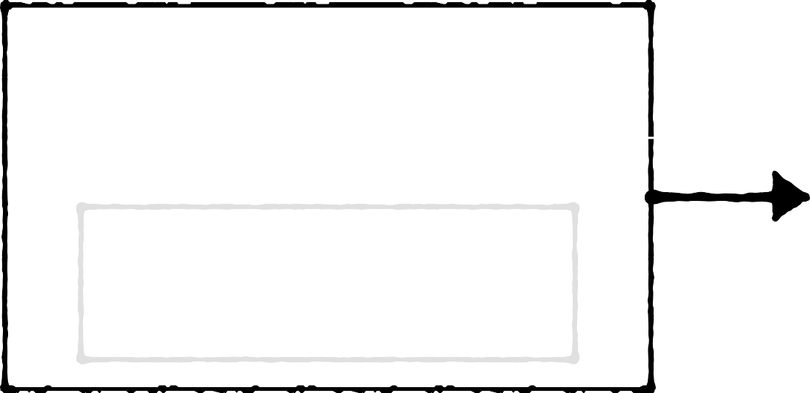
Finding Top N Recommendations
K Nearest Neighbors
Distance
Active User
K
Find the K Nearest Neighbors
K Nearest Neighbors

Slide 53
Finding Top N Recommendations
Set up the data
Functions to access relevant information
Find the K Nearest Neighbors
Construct a rating matrix
The representation needed for collaborative filtering
Find the top N recommendations
Use the average ratings of the K nearest neighbors

Slide 54
Finding Top N Recommendations
Average the ratings of nearest neighbors for unrated books
Sort in descending order
Pick the top N
Find the top N recommendations
Use the average ratings of the K nearest neighbors

Slide 55
Finding Top N Recommendations
Set up the data
Functions to access relevant information

Slide 56

Demo
Download the Book Crossing ratings dataset
Set up a function to find book metadata
Set up a function to find the favorite books for a user

Slide 57
User Id | Location | Age

Slide 58
ISBN | Title | Author | Year of Publication | Publisher

Slide 59
User | ISBN | Rating

Slide 60
Finding Top N Recommendations
Set up the data
Functions to access relevant information
Construct a rating matrix
The representation needed for collaborative filtering

Slide 61
Construct a rating matrix using book ratings in Python
Demo

Slide 62
Finding Top N Recommendations
Set up the data
Functions to access relevant information
Find the K Nearest Neighbors
Construct a rating matrix
The representation needed for collaborative filtering

Slide 63
Finding Top N Recommendations
Find the K Nearest Neighbors
User 1
Distance between the users
Distance
User 2

Slide 64
Compute the distance between a pair of users
Demo

Slide 65
Finding Top N Recommendations
Set up the data
Functions to access relevant information
Find the K Nearest Neighbors
Construct a rating matrix
The representation needed for collaborative filtering

Slide 66
Finding Top N Recommendations
K Nearest Neighbors
Distance
Active User
K
Find the K Nearest Neighbors
K Nearest Neighbors

Slide 67
Demo
Find the nearest neighbors for a user

Slide 68
Finding Top N Recommendations
Set up the data
Functions to access relevant information
Find the K Nearest Neighbors
Construct a rating matrix
The representation needed for collaborative filtering
Find the top N recommendations
Use the average ratings of the K nearest neighbors

Slide 69
Demo
Average the ratings of nearest neighbors for unrated books
Sort in descending order Pick the top N

Slide 70
Summary
Understand the nearest neighbors model for collaborative filtering
Measure similarity of users using distance metrics
Find the top 10 book recommendations for a user

