Slide 1
Recommendation Systems
Shravan kumar
15th May 2018

Slide 2







Relationships Among Users and Products
User-Product Relationships
Product-Product Relationships
User-User Relationships

Slide 3





Relationships Among Users and Products
These relationships can provide tremendous insight
What books will a person like?
If a person buys a phone, what else will they buy?
If A knows B, and B knows C, does A know C?
-
-
Relationships

Slide 4




Insight is Monetizable
Relationships
Insight
Monetization

Slide 5
Insight is Monetizable
-
Personalized promotional emails
Personalized homepage
Personalized notifications
-
-
Monetization

Slide 6

User Behavior Data
Ratings, Clicks, Purchases
User Demographic Data
Age, Education, Income, Location
Product Attribute Data
- Genre (Books), Cast (Movies), Cuisine (Food)
Data

Slide 7







Recommendation Algorithms
Content based
filtering
Collaborative based
filtering
Association rules learning
Find products with “similar” attributes
Find products liked by “similar” users
Find “complementary” products

Slide 8
Recommendation Algorithms
Content based filtering
Collaborative filtering
Association rules learning
Find products with “similar” attributes
Find products liked by “similar” users
Find “complementary” products

Slide 9
User A
“Lord of the Rings”
User A likes the movie “Lord of the Rings”

Slide 10
“Lord of the Rings”
A database has ratings against different attributes for “Lord of the Rings”
 | Rating
Direction | 10
Cast | 8
Cinematography | 10
Story | 9

Slide 11

“Lord of the Rings”
“The Hobbit”
“The Hobbit” has very similar ratings against these same attributes
 | Rating
Direction | 10
Cast | 8
Cinematography | 10
Story | 9
Rating
9.5
8
9
10

Slide 12
User A
“Lord of the Rings”
Recommend “The Hobbit” to User A
“The Hobbit”

Slide 13

“Lord of the Rings”
“The Hobbit”
How do we measure “similarity”?
Proximity is a measure of the “similarity”

Slide 14

A Full-Fledged Content Based Filtering System
Rate every product against the relevant attributes
Product | F1 | F2 | F3 | F4
A | 0 | 3 | 2 | 5
B | 5 | 2 | 3 | 4
C | 4 | 5 | 2 | 1
D | 3 | 4 | 5 | 2

Slide 15
A Full-Fledged Content Based Filtering System
Rate the user on the importance he/she gives to these factors
User
User | F1 | F2 | F3 | F4
A | 0 | 3 | 2 | 5
Ex : Average of ratings of products that the user already likes

Slide 16
Recommendation Algorithms
Content based filtering
Collaborative filtering
Association rules learning
Find products with “similar” attributes
Find products liked by “similar” users
Find “complementary” products

Slide 17

Collaborative Filtering
Content based filtering requires a product attribute database
Collaborative filtering uses easily captured user behavior data

Slide 18







Purchases
Pageviews
Clicks Ratings
User’s aﬃnity for some products
Aﬃnity for unseen products
Collaborative Filtering

Slide 19
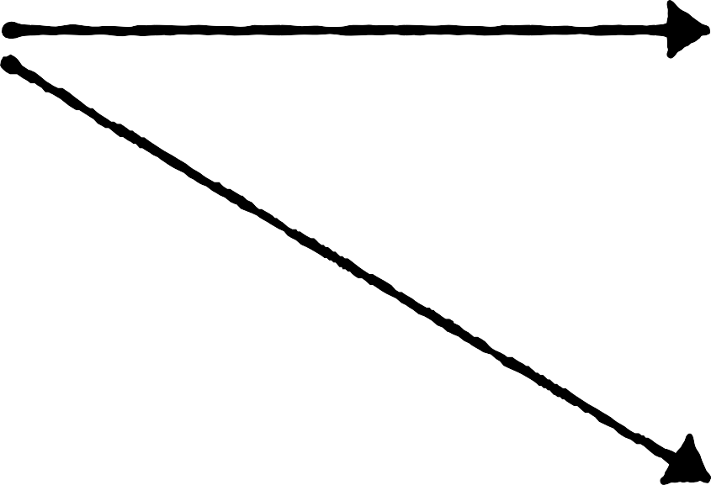
“Lord of the Rings”
User A
User A likes the movies “Lord of the Rings” and “The Hobbit”
“The Hobbit”

Slide 20

“Lord of the Rings”
User A
User B likes some of the same movies as User A .. and some other movies
User B is “similar” to User A
Movies that User B likes are “similar” to movies that User A likes
Recommend movies that User B likes to User A
“The Hobbit”
User B
“Casablanca”

Slide 21
Rating Matrix
 | P1 | P2 | P3 | P4 | P5
U1 | 3 | 4 | - | - | -
U2 | 3 | 2 | - | - | 5
U3 | - | 2 | - | 5 | 4
U4 | - | - | 4 | - | -
U5 | 1 | - | - | - | -
U6 | 3 | 4 | - | - | 5
The rating data is represented using a matrix
Users
Products

Slide 22
Rating Matrix
Different techniques to help fill the blank cells
Nearest neighbor
model
Latent factor
analysis
P1
P2
P3
P4
P5
 | P1 | P2 | P3 | P4 | P5
U1 | 3 | 4 | - | - | -
U2 | 3 | 2 | - | - | 5
U3 | - | 2 | - | 5 | 4
U4 | - | - | 4 | - | -
U5 | 1 | - | - | - | -
U6 | 3 | 4 | - | - | 5
U1
3
4
-
-
-
U2
3
2
-
-
5
U3
-
2
-
5
4
U4
-
-
4
-
-
U5
1
-
-
-
-
U6
3
4
-
-
5

Slide 23


Collaborative Filtering Techniques
Nearest Neighbors Model
Latent Factor Analysis
Use the ratings of “most similar” users
Solve for underlying factors that drive the ratings

Slide 24
Finding Top N Recommendations -- Nearest Neighbors Model
Set up the data
Functions to access relevant information
Find the K Nearest Neighbors
Construct a rating matrix
The representation needed for collaborative filtering
Find the top N recommendations
Use the average ratings of the K nearest neighbors

Slide 25
Latent Factor Analysis
Why are some products rated high and others low?
Why do some users like certain products?
Are there some underlying factors that influence all users’ ratings?

Slide 26


Latent Factor Analysis
 | P1 | P2 | P3 | P4 | P5
U1 | 3 | 4 | - | - | -
U2 | 3 | 2 | - | - | 5
U3 | - | 2 | - | 5 | 4
U4 | - | - | 4 | - | -
U5 | 1 | - | - | - | -
U6 | 3 | 4 | - | - | 5
 | F1 | F2 | F3
U1
U2
U3
U4
U5
U6
 | P1 | P2 | P3 | P4 | P5
F1
F2
F3
*
Users described by some underlying factors
Products described by the same underlying factors

Slide 27
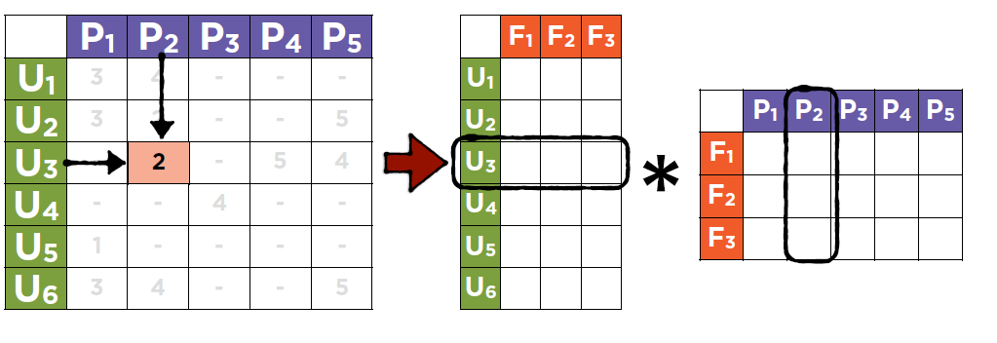
Latent Factor Analysis
Solve using known ratings

Slide 28


Latent Factor Analysis
P1 P2 P3 P4 P5
3 4 - - -
3 2 - - 5
- 2 - 5 4
- - 4 - -
1 - - - -
3 4 - - 5
 | F1 | F2 | F3
U1
U2
U3
U4
U5
U6
U1
U2
 | P1 | P2 | P3 | P4 | P5
F1
F2
F3
*
U3
-
U4
U5 U6
Use the solution to find unknown ratings

Slide 29
Latent Factor Analysis
 | F1 | F2 | F3
U1
U2
U3
U4
U5
U6
 | P1 | P2 | P3 | P4 | P5
F1
F2
F3
This representation is analogous to content based filtering
*

Slide 30
Content Based Filtering
Rate every product against the relevant attributes
Rate the user on the importance he/she gives to these factors
Product | F1 | F2 | F3 | F4
A | 0 | 3 | 2 | 5
B | 5 | 2 | 3 | 4
C | 4 | 5 | 2 | 1
D | 3 | 4 | 5 | 2
User | F1 | F2 | F3 | F4
A | 0 | 3 | 2 | 5
Ex : Average of ratings of products that the user already likes

Slide 31
Solving for Latent Factors
Set up the data
Functions to access relevant information
Initialize factor matrices
Update the factor matrices
Minimize the error using SGD
Construct a rating matrix
The representation needed for collaborative filtering
Compute the error
Set up a function to measure RMSE

Slide 32


Content Based vs Collaborative Filtering
Requires a 2 step process
1 step process
1. Manual process with human intervention
Extract information directly from user ratings
✓
2. An algorithm to extract
information

Slide 33
Recommendation Algorithms
Content based filtering
Collaborative filtering
Association rules learning
Find products with “similar” attributes
Find products liked by “similar” users
Find “complementary” products

Slide 34


You can also recommend complementary products
Users who buy smartphones also like to buy headphones
These are “associated” products

Slide 35

Recommendation Algorithms
Content based Collaborative
Association rules learning
^{Find products}
associated with another product
Help create offers
for buyers of a user
Find “complementary” products
“similar” attributes
by “similar” users

Slide 36

Measuring Rule Strength
Lift
‹
Support
Confidence

Slide 37

Measuring Rule Strength
What proportion of all transactions contain both items?
P( , ) = 1%
Support
‹

Slide 38

P( , )
Out of all transactions with how many include ?
Measuring Rule Strength
P( /
) =
‹
= 5 %
Confidence
P( )

Slide 39

How much does the likelihood of buying increase when is bought?
Measuring Rule Strength
P( ) = 3%
P( / ) = 5%
Lift( ‹ ) = 5% = 1.67
‹
Lift
3%

Slide 40
Support
Likelihood of all items in the rule being in a single transaction
Measuring Rule Strength
Confidence
Likelihood of second item being bought once the first is bought
‹
Lift
Change in likelihood of second item being bought once the first is bought

Slide 41
Apriori Algorithm
Find 1 item sets
Keep only those with a minimum support
Generate 2 item rules
Keep only those with a minimum confidence
Generate 3 item rules
Keep only those with a minimum confidence
Find 2 item sets
Use only the items left from previous step
Keep only item sets with minimum support
Find 3 item sets
Use only the items left from previous step
Keep only item sets with minimum support

Slide 42













Apriori Algorithm
Find all possible 1 item sets
Compute the support of each set
2/5 | 1/5 | 1/5 | 1/5 | 2/5 | 3/5 | 4/5
1
2
3
4
5

Slide 43
Apriori Algorithm
Find all possible 1 item sets
Compute the support of each set
2/5 | 1/5 | 1/5 | 1/5 | 2/5 | 3/5 | 4/5
2/5
1/5
1/5
1/5
2/5
3/5
4/5
Drop item sets with support below a minimum threshold

Slide 44

Apriori Algorithm
Find all possible 2 item sets
Compute the support of each set
0/5 | 1/5 | 2/5 | 2/5 | 0/5 | 2/5
0/5
1/5
2/5
2/5
0/5
2/5
Drop item sets with support below a minimum threshold

Slide 45


Apriori Algorithm
Find all possible 3 item sets
0/5 | 1/5 | 0/5 | 0/5
Compute the support of each set
1
2
3
4
5
Algorithm stops

Slide 46

Recommendation algorithms find relationships among users and products
Summary
Content based filtering
Rating database built by experts
Collaborative filtering
User provided ratings
Association rules learning
Conditional probabilities

