Slide 1


&

Slide 2
NOTE
This PPT can be used to create a basic idea of Git and GitHub.
The links to videos that were used for reference is mentioned below.
FreeCodeCamp - https://www.youtube.com/watch?v=RGOj5yH7evk
Edureka - https://www.youtube.com/watch?v=xuB1Id2Wxak&t=2664s
RSA Encryption - https://www.youtube.com/watch?v=j2NBya6ADSY
Beginners guide to SSH - https://www.youtube.com/watch?v=qWKK_PNHnnA

Slide 3
VERSION CONTROL
Scenario - Multiple people working on same project
Hard to track changes
Difficult to maintain and integrate changes made by everyone
Solution – Version control
Management of changes to documents, programs, websites or other collection of information
Version control helps saving in Collaboration
Version control also helps in saving snapshots, storing versions etc.
Provision to analyse changes – What changes are made and when.

Slide 4
WHAT IS GIT ? DIFFERENCE FROM GITHUB ?
GIT is a version control system similar to SVN
GIT is free and open source
GIT is a distributed version control system.
It is a command line tool
GitHub is a web-based Git repository hosting service
Repository – A central location where data is stored and managed.
GitHub is owned by Microsoft. There are other alternatives
Bitbucket – Owned by Atlassian and has built in JIRA integration
GitLab - Owned by Gitlab.Inc

Slide 5

GIT – GITHUB INTERACTION
Developer 1
Developer 2
Developer 3

Slide 6
FEW POINTS ABOUT GIT
All the operations are performed as commands.
All commands are lower case
Few important actions / commands-
clone - Brings a repository that is hosted somewhere like GitHub into a folder in local machine. Similar to SVN Checkout
add - Tells git to track changes (additions, deletions, updates etc.) - Similar to SVN add
commit - Save files in Git – No similar operation in SVN
push - Upload git commits to remote repo, like GitHub / BitBucket / GitLab - Similar to SVN Commit
pull - Download changes from remote repo to local machine. Opposite of push. It is similar to SVN Update.

Slide 7
INITIAL STEPS – SETTING UP GITHUB
Sign up for an account in GitHub - https://github.com/
In the dashboard of GitHub, we can create a new Repository.
A repository is basically a project with all of the coding files.
We can either create files and folders in local machine, or we can create files online.
Creation of README.md
md – Markdown. Can be read as both plain text and has HTML related features. For example ‘#’ for main heading
Committing a file –
A message and a description should be provided. Will have initial placeholders
NOTE: The message for a commit should answer two questions – What ? And Why ?
Updating a file –
The content of README.md can be modified and committed.
All the commits can be seen in the commits tab.

Slide 8
INITIAL STEPS – SETTING UP GIT
Mac usually have git installed by default.
To check if git is present, user can check it using ‘git –version’ command in terminal
Git for windows - https://gitforwindows.org/
During installation you can choose not to use Git from the Windows Command Prompt and to use GitBash instead.
Git Bash is an application for Windows that provides Git command line experience on the Operating System.

Slide 9
ENCRYPTION & DECRYPTION
To secure data during communication.
Two types
Symmetric encryption
Asymmetric encryption
Encryption and decryption are associated with keys.
Symmetric encryption uses a single key.
Asymmetric encryption uses two keys. Public and private.

Slide 10
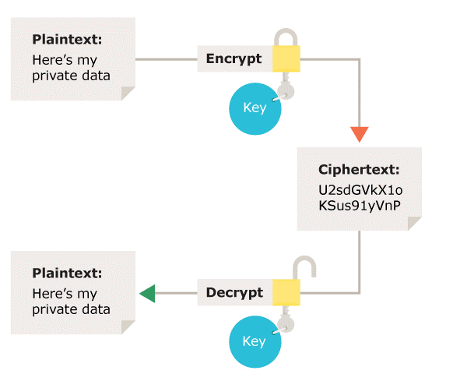
SYMMETRIC ENCRYPTION

Slide 11


SYMMETRIC ENCRYPTION
Simple scenario to understand symmetric encryption
Encryption with secret key
Decryption with secret key
Assume that the secret key + cipher reverses the alphabet series – Means, ABC -> XYZ
Ciphertext
XYZ
The description involves reversing the alphabets. This logic is known to receiver with the help of key
Decrypted text message ‘ABC’
Needs to send a message ‘ABC’ to receiver

Slide 12
ASYMMETRIC ENCRYPTION
Uses two keys to encrypt and decrypt data. One is a private key and the next is a public key.
The private key is always confidential and is used only for decryption.
The public key can be exposed and is used for encryption only.
The idea is ‘The public key can be generated only from private key’.
Any data encrypted using a public key can only be decrypted by a private key which generated the public key
An example for this is SSH protocol.

Slide 13




NOTE: Intended to be viewed in presentation mode as animations are involved
1. Person A add a file to briefcase
1. Person B adds his lock using private key
2. Person A locks it using his private key and a lock
2. Now, B can remove lock using private key 3. The briefcase can be opened. 4. The communication is verified
3. Person A gets the briefcase with the lock of person B. 4. He unlocks his lock using the private key and sends it to B
CONNECTION VERIFIED !!!

Slide 14
ASYMETRIC ENCRYPTION
So, we know that a private key and a public key can be used to encrypt data.
SSH encryption or Secure shell protocol encryption is an example of asymmetric encryption.
There are several means to create private key - public key pairs.
These means are called algorithms. One commonly used algorithm is the RSA algorithm.

Slide 15
RSA ALGORITHM
Example case:
NOTE: We have a GPG Encryption software
It encrypts a file using public key
It decrypts a file if you have a private key that corresponds to the public key
Max uses the software to generate public private key pairs.
Max stores the private key in his computer.
He sends the public key to Tyson via Email.
Tyson uses the software to encrypt the data to be sent, with the public key.
He sends the encrypted data to Max
Max uses the software to decrypt the data as he have the private key

Slide 16
RSA ALGORITHM
Based on the principle that factorization of a large number is not possible.
What are the factors of 12 ? [(1,12), (2,6), (3,4)]
What two numbers when multiplied will give 8,616,460,799 ? 89,681 and 96,079
The public key consists of two numbers where one number is multiplication of two large prime numbers
And private key is also derived from the same two prime numbers.
So if somebody can factorize the large number, the private key is compromised.
Therefore encryption strength totally lies on the key size and if we double or triple the key size, the strength of encryption increases exponentially.
RSA keys can be typically 1024 or 2048 bits long, but experts believe that 1024 bit keys could be broken in the near future.

Slide 17
SSH – What, Why ?
Imagine, we have a repository in GitHub and we need to pull the code or push the commits to the repo. What is the channel involved ? Internet.
Problems –
Does it act as a secure channel ? No, possibility of third person to get access to the code is high.
Do we need some kind of encryption – decryption mechanism ? Yes. And we know SSH using RSA.
To connect local machine to GitHub account, you have to prove to GitHub that you are the owner of the account.
One option to secure the interactions is that user can provide username and password every time along with commits. [HTTPS method].
An alternative and preferred approach is to use SSH Keys, elaborated as Secure shell protocol keys

Slide 18
SETTING UP SSH for GITHUB – GIT
Open git bash
Type ssh-keygen -t rsa -b 4096 -C "abhijithm13894@gmail.com"
ssh-keygen :- Command used to generate SSH key pair.
-t rsa :- Specifies the encryption algorithm.
-b 4096 :- Refers to the strength of encryption. Here it tells to generate a 4096 bit key.
-C “emailID” :- Used to specify email ID of the GitHub account
The private key will be stored at :- /c/Users/abhij/.ssh/id_rsa
User is prompted to provided password for SSH private key if required.
Use ‘ls’ command in Git bash to view the generated public and private key.
Use cat-keyname.pub to view the public key.
Copy that key and add it in the SSH section of GitHub

Slide 19
SSH – MORE STEPS
We need to add the key to SSH agent in our local machine.
This can be done using “ssh-add /c/Users/abhij/.ssh/id_rsa” command.
Now, if your agent is not running, you can evaluate it and make it running.
This can be done using “ eval `ssh-agent –s’ ” and “ssh-add” commands.
Now, to test the key and to activate it, use “ssh -vT git@github.com”.
Alternatively “ssh –T git@github.com” can be used

Slide 20
CREATING A LOCAL REPO
To create a local repo, we can make use of GitBash
Go to the place where you need to setup local repo and open GitBash
Use ‘git init’ to initialize the local repo.
Note that the git init initializes a master branch. However, In Aug 2021, Git has renamed master branch as main.
So, make sure that you use the main branch while performing operations.
This creates a .git folder which is responsible to provide the git related behaviour.
What is the next step ? Linking the repository to the GitHub
How to do that ? 2 Methods
HTTPS
Using SSH

Slide 21
LINKING REPOS - HTTPS
Navigate to GitHub. Go to the repository which is to be linked with local repo.
On the top right of the main content area, there is a green button called ‘Code’
Click on the button. There are three options. Use HTTPS and copy the link.
Go to the GitBash
Enter the command “git remote add origin “copiedlink”.
Now we can use git pull to fetch contents from remote repo.
This can be done using “git pull origin main” command.
Now we have same version of code in local and remote repo.
Make changes and use git commands to carry out operations

Slide 22
GIT COMMANDS
Add a new text file.
To see the status of all files, use “git status” command
To add it to git local repo, use “git add”
To add all files, use “git add –A”
To commit it to local repo, use “ git commit –m “message” –m “description” ”
“git commit .” or “git commit –a” means commit all the changes to LOCAL REPO
Use “git log” command to see the changes that we have made.
To revert a commit, you can use the first 8 characters of commit hash.
Use command “git checkout commithash filename”
Use command “git push origin main” to push code to remote repo

Slide 23
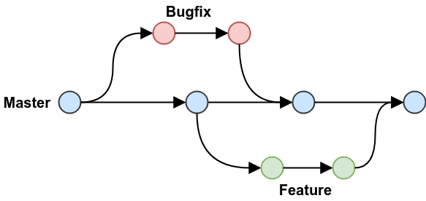
GIT BRANCHES
A branch is created when we need to do parallel development.
There is a main branch called ‘main’.
You can create a branch, carry out developments there, and merge the changes to main branch.
So the main branch always contains production ready code.
Use “git branch branchname” command to create a new branch.
Use “git checkout branchname” command to use the branch instead of master.
Add a new file in the branch. Commit it there.
Switch to master branch
Use git status command to verify that the new branch and the master are different.
To merge changes of branch to master, GO TO master.
It is important that you are at the branch to which merge is required. That is – Target
To merge – use “git merge branchname” command
Git has modified the default branch name from ‘master’ to ‘main in around Oct 2020. So, for repos prior to that, you might see master and for repos later, you might see main as default branch

Slide 24
ALTERNATIVE – USE OF GIT CLONE
You can use “git clone sshlink” or “git clone httpslink” to setup a local repo from remote repo. For this also, you can use HTTPS or SSH.
All the commands related to Git can be done in the local repo and can be pushed to remote repo.
Alternatively, you can use GitHub desktop to carry out operations without commands.

Slide 25
TROUBLESHOOTING – UNABLE TO PUSH or CLONE
Control Panel.
Credential Manager.
Click Windows Credentials.
In Generic Credential section ,there would be git url, update username and password
Restart Git Bash and try for clone.
Note that if you are adding address manually it is :- “api.github.com/accountname”

Slide 26
GIT – THE THREE TREES
There are three stages in GIT
Working directory – When local files are modified and git add is not performed.
Staging area – When locally added / modified files are added to git tracking.
Local repository – The place where committed files are.
LOCAL
REMOTE
LOCAL
Changes made locally and not added to Git
Working directory
When changes in working directory are added to git
When files in staging area are committed
Remote
Repository
Staging Area
(Index / Draft zone)
Local Repo
(HEAD)
git add
git commit
git fetch
git reset -- mixed
git reset -- soft
git reset -- hard
git merge
git checkout
git pull

Slide 27
GIT TREES
Files whose contents can be changed are in your working directory.
Files placed in your staging area are getting prepared to be packaged into a commit object.
These commits are saved in your Git repository.
Files that have already been committed are compressed files. They are hashed through a SHA-1, a cryptographic hash function.
The working directory represents the actual files on your computer's file system that are available to your code editor to apply changes.
The working directory is a version of a particular commit, a particular snapshot of a project that you checked out. It is the version of your Local repo that HEAD is pointing at, at any given moment.
"Checked out" means that you have the decompressed versions of files that were pulled out of your Git repository, available for editing. Now the head will point to the checked out position. You can create a branch at this point.
For reference about detached head: https://www.cloudbees.com/blog/git-detached-head

Slide 28
REVERTS AND UNDOS
Git reset command unstages files that are added. [“git reset README.md”]
“git reset HEAD~1” – Means that you are pointing to head now, and you want a revision to be reverted back. In other words, you revert a commit back.
“git reset –mixed”, “git-reset –soft” and “git reset –hard” are three options for reset.
Refer slide for ‘GIT Trees’ for further details.

Slide 29
EXERSISE
1. Download and Install Git.
2. Login to GitHub / Create an account.
3. Created a new repository called Python in GitHub
4. Copied the HTTPS link of the Repository
5. Cloned the Repository to local machine using "git clone" [ git clone = SVN checkout ]
6. Added files to our local repository.
7. Used "git status" command to view files status.
8. Used "git add ." to add files to git
9. Committed changes using "git commit -m "message" -m "description""
10. Used "git log" to verify changes.
11. Modified the README.md file.
12. Used "git status" to view the change.
13. Used "git commit" command to commit the changes.
14. used "git log" command to log the changes.
15. Reverted to first change - using "git checkout commithash" - Reverted the README.md change.

Slide 30
EXERSISE CONTD.
16. Pushed the changes made locally to GitHub using "git push". We had to enter login credentials.
18. Modified the README.md file from GitHub. Committed it from GitHub.
17. Used "git fetch" command and "git status" command to view changes in local repo from remote repo. This doesn't change the files in local repo. Git status said that local repo is behind remote repo by 1 commit.
18. Used "git pull" to fetch the remote repo changes to local repo.
19. You can use "git checkout COMMIT_ID" to pull specific commits only.
Commands used :-
git clone
git status
git add
git commit
git checkout
git push
git pull
git fetch

