Slide 1
MOPPA
Mobile parallel processing Agents
Elżbieta Żukrowska
Liana Gukasyan

Slide 2
Introduction

Slide 3
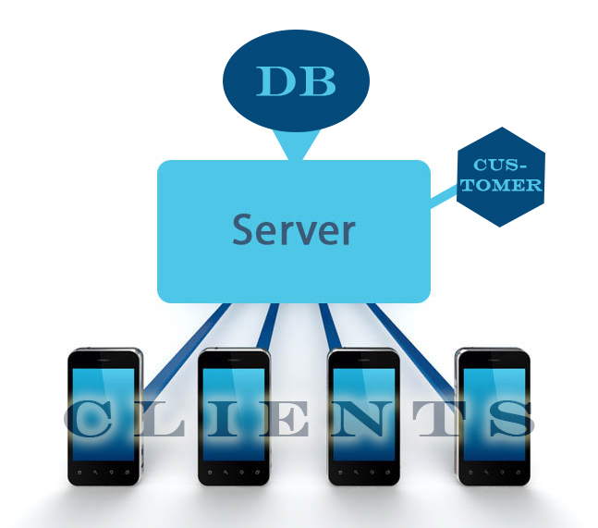
Purpose
To develop software, which will allow us to solve computational problems using computing power of mobile phones instead of server or cluster.

Slide 4
Product scope
Due to MOPPA you no longer need the clusters to perform the calculations. All you need - it's a mobile phones running on the Android platform.
The project will be solved the problem of computing the factorial of the given number (which should be <100).
Software includes three main parts: a mobile application, server and customer part.

Slide 5
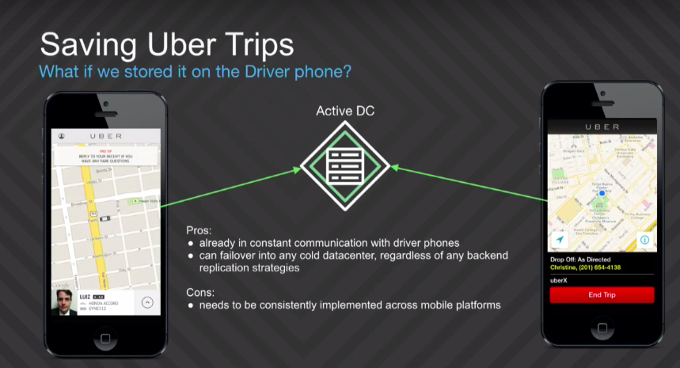
Product perspective
Nowadays, the idea of using the power of mobile phones more and more often found in the works of such successful companies as Uber, which use "using driver phones as a backup datacenter".

Slide 6

Product perspective
In the future, we can transform the server-mobiles part into a library, which can be used for other tasks.

Slide 7



User Classes and Characteristics
Mobile application users:
They only download the application and assent it to use free computation power of their phones
Webpage users (customers):
They are mainly scientists that want to make complex calculations for their research
Admins:
They maintain the website and database

Slide 8
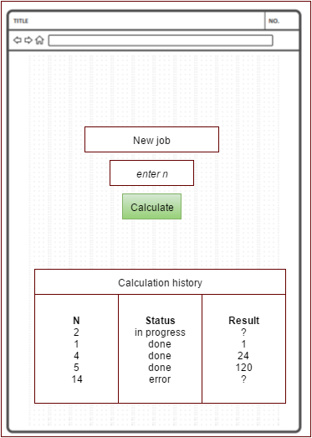
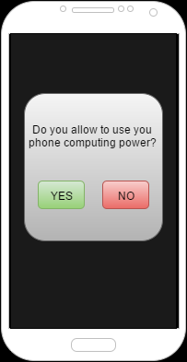
User interfaces
Webpage
Mobile device

Slide 9
Environment
Mobile application:
Android version > 4.1
It should work on:
Nexus 4
Nexus 5
Samsung S6
Samsung S7
Serwer:
Linux
High performance
JRE installed
DB installed

Slide 10





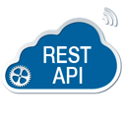
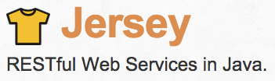

Design and Implementation Constraints
Mobile application: Android + Java + Eclipse + tools to control code quality
Database: Casandra
Communication protocol: REST
Framework for Web Service: Jersey
Improving performance of the server: Grizzly

Slide 11
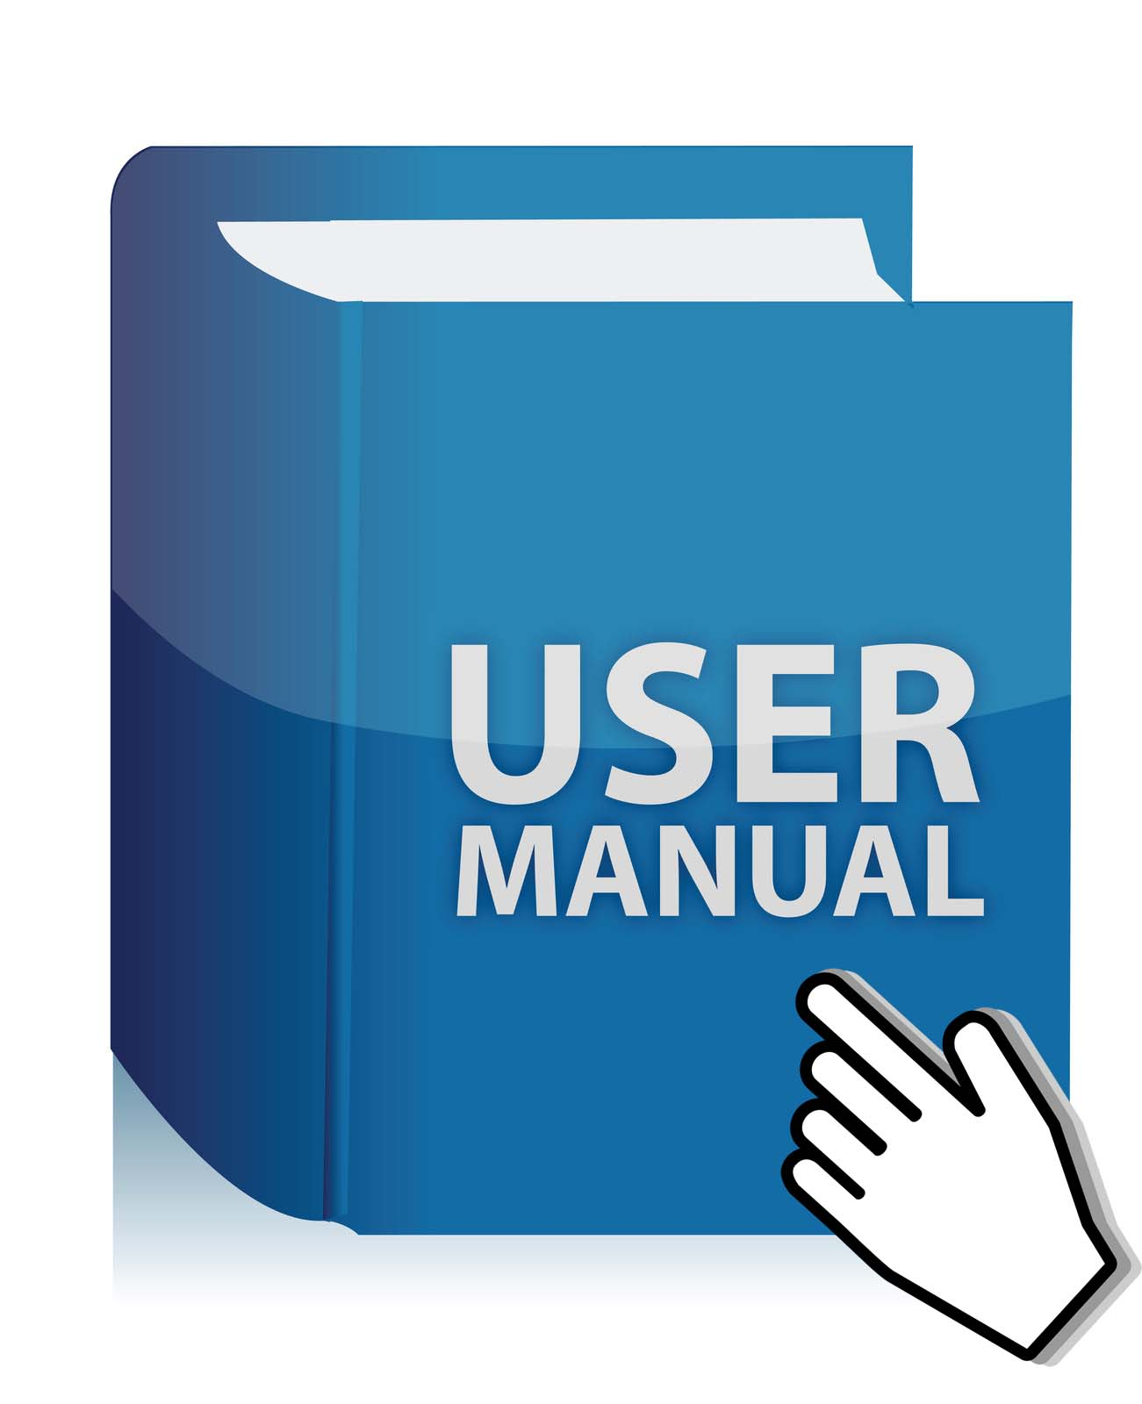
User documentation and manuals
No manuals and tutorials for mobile users
No manuals and tutorials for customers
User documentation available online

Slide 12
System features

Slide 13
FTR1: Download mobile application
Description :
People should have possibility to download mobile application and open it on his device.
Priority:HIGH

Slide 14
FTR2: Enter the data to compute
Description:
Customers should have possibility to enter the data they want to compute on the website.
Priority: HIGH

Slide 15
FTR3: Show request status
Description:
Customer should have possibility to see the status of his request,
Request can be in states: waiting, in progress, done, error.
Priority: HIGH

Slide 16
FTR4: Show the result
Description:
Customer should be able to see the result of his job
Priority: HIGH

Slide 17
FTR5: Request history
Description:
User should have possibility to see history of his requests with results
Priority: HIGH

Slide 18
FTR6: Check mobile phone status
Description:
Mobile application should be able to check if:
Phone is charging
Phone is connected to Wi-Fi network
Phone is idle
If 1-3 are fulfilled phone should send job request to a server.
Priority: HIGH

Slide 19
FTR7: Sending job request to server
Description:
If phone after checking its status is ready to work it should send job request to a server.
Job request should contain:
{phone identification, free RAM, … (TBD)}
Priority: HIGH

Slide 20
FTR8: Parallel processing
Description:
Calculation should be done in parallel, one request should be splitted between different devices.
Priority: HIGH

Slide 21
Other nonfunctional requirements

Slide 22
Reliability
The software should provide the right results on any operation in the Database.
If the server crashes, software should be able to run in a predetermined state, which is being loaded from the database.
If the phone does not respond within the timeout period, the device is considered like not working, and the task as failed and the job is given to another phone.

Slide 23
Maintainability
extendibility
The application should be easy to extend. The code should be written in a way that it favors implementation of new functions.
testability
Test environments should be built for the application to allow testing of the applications different functions.

Slide 24
Why will people install our application?
Lottery
Sientists community
Discount

Slide 25
Proposal of workflow
phase | team | kind of work
1 and 2 weeks | client-team | Experiments, how to meet requirements (wi-fi, charging etc.) and testing on different devices.
 | server-team | Mock API development, the establishment of communication protocols and streamlining of the system work with databases.
3 and 4 weeks | client-team | Debugging with API which is implemented in the server side, executes a test responses when the client satisfies the conditions
 | server-team | Writing a wrapper for a database, elaboration of architecture and class hierarchy

Slide 26
Proposal of workflow
phase | team | kind of work
5 and 6 weeks | client-team | CPU and GPU, write a specific implementation of a piece factorial counting
 | server-team | Development logic of problems selection from the database, creation subtasks and distribution for clients
7 and 8 weeks | client-team | Stress testing, bugs correction
 | server-team | Creation customer's webview to add tasks, and view their status

Slide 27
References
Uber Goes Unconventional: Using Driver Phones As A Backup Datacenter http://highscalability.com/blog/2015/9/21/uber-goes-unconventional-using-driver-phones-as-a-backup-dat.html?utm_source=vk.com&utm_medium=social&utm_campaign=chtoby-ne%C2%A0tratit-dengi-na%C2%A0mashinu,-my-po

