Slide 1

FINAL YEAR PROJECT 2
PRESENTATION
Machine Learning based intrusion detection system
ELZOBEIR SALIH MAHMOU MOHAMAD AIU21102130
AFRAH HAMID ALI NOOR MOHAMAD AIU21102155
Supervisor: Professor Dr. Khalid Hussain

Slide 2
Introduction
1.1Project Background
The Internet has become one of the essential aspects for modern society but introduces significant cybersecurity threats. Traditional Intrusion Detection Systems (IDS), relying on signature- or rule-based methods, struggle with real-time detection of evolving threats and handling imbalanced datasets. This study proposes enhancing IDS using machine learning algorithms to improve detection accuracy, address data imbalance, and analyze real-time traffic effectively. By leveraging the UNSW-NB15 dataset, this advanced IDS aims to tackle modern threats and adapt to diverse organizational needs.

Slide 3
Introduction
Types of IDS and Their Functions
IDS : is a cybersecurity solution designed to monitor, detect, and alert on unauthorized or suspicious activity within a network or system
Signature-Based IDS: Detects attacks by matching known patterns or “RULE based."
Limitation: Ineffective against unknown or novel threats.
Anomaly-Based IDS: Identifies deviations from normal behavior to detect potential threats.
Advantage: Can detect unknown threats but may produce false positives.

Slide 4
1.INTRODUCTION
1.2 Objectives
Develop an Intrusion Detection System (IDS) leveraging machine learning to detect and classify network attacks in real time.
Trigger real-time email alerts upon detection of malicious activities, ensuring prompt notification and response to potential threats.

Slide 5
1.INTRODUCTION
1.3 Problem Statement
Traditional Intrusion Detection Systems (IDS) often struggle to detect and respond to various cyber-attacks in real-time, leading to significant breaches and damage. These systems, which heavily rely on signature-based or rule-based methods, are insufficient for managing the diverse and evolving nature of network threats, especially when dealing with imbalanced datasets that hinder the accurate classification of different network intrusions (Abdallah, A. E.2023)
However, the studies using the NSL-KDD dataset commonly have some shortcomings, such as including outdated attack scenarios and being not useful for the real-world context of the modern network environment, and the performance of the models that are trained on this dataset is low. There are more recent and heterogeneous datasets like UNSW-NB15 that have a wider range of attack types and are closer to modern threats

Slide 6
2.Literature Review
Literature Review
Widodo and Aji introduced IDS and summed up papers regarding intrusion detection systems, and machine learning techniques in particular. They compared such models as Random Forest and Gradient Boosting and underlined their advantages connected with higher accuracy and higher speed of calculations. The study called for a realistic dataset to manage the emerging cybersecurity threats (Widodo & Aji, 2021)​.
Ayeni et al investigated CNN based models in modern network environments for intrusion detection . They discovered that random imbalances in datasets can be mitigated while convolution layers are useful in developing high dimensional features (Ayeni, Dorado, Ponce, Wang, & Ji, 2023)​.

Slide 7
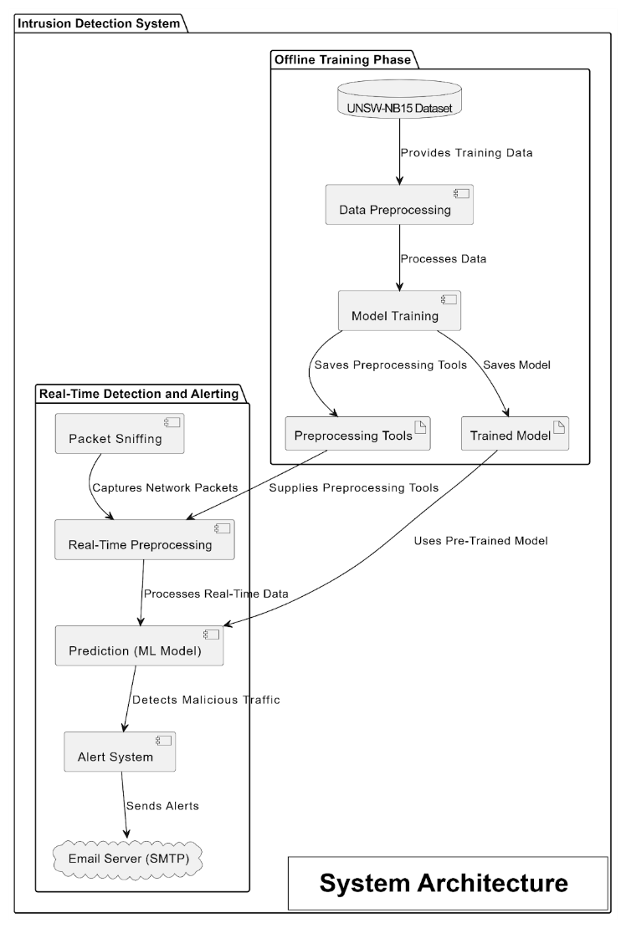
3.Methodology
3.1 System Architecture
Two Primary Phases:
Offline Training Phase:
UNSW-NB15 dataset processed for feature cleaning, encoding, and scaling.
Trained ML model and preprocessing tools (encoders/scalers) are stored.
Real-Time Detection Phase:
Live traffic captured using a packet-sniffing module.
Real-time preprocessing applies saved transformations.
ML model classifies traffic as normal or malicious.
Alert system sends email notifications for malicious traffic.

Slide 8
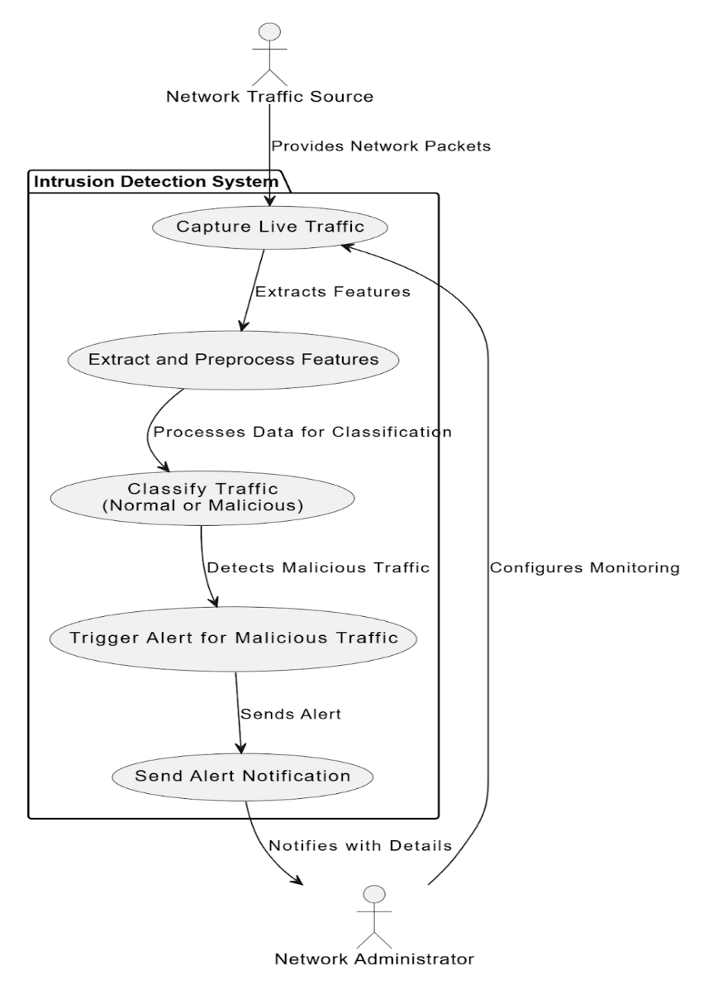
3.Methodology
3.2 Use Case Diagram

Slide 9
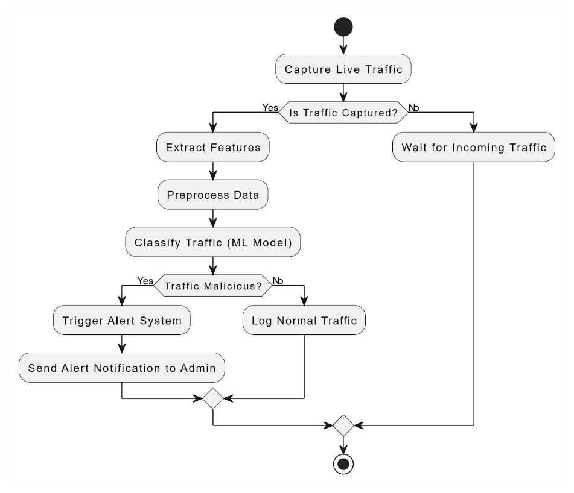
3.Methodology
3.3 Activity Diagram
Process:
Capture live network traffic.
Extract features and preprocess data.
Classify traffic using ML model.
If malicious, trigger alert system and notify administrator.
If normal, log traffic for future reference.
If no traffic is captured, system waits for incoming data.

Slide 10
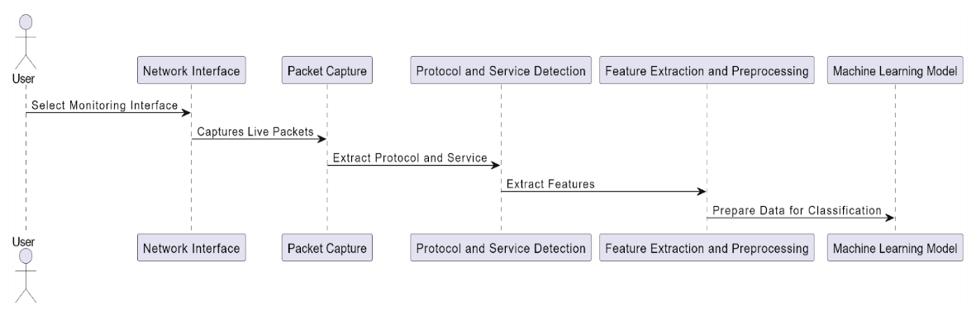
4.Implementation
4.1 Capture traffic work flow
User Interaction:
User selects the network interface to monitor.
Network Interface:
Captures incoming and outgoing traffic on the selected interface.
Packet Capture:
Tools like Scapy capture live packets in real-time.
Protocol and Service Detection:
Identifies protocols (e.g., TCP, UDP) and services (e.g., HTTP).
Feature Extraction and Preprocessing:
Extracts features like packet count data size, and traffic rate.
Applies one-hot encoding and normalization for model compatibility.
Output Preparation:
Structures extracted features for ML model input, bridging raw traffic with predictive analysis.

Slide 11
4.Implementation
Selected Features:
dur (Duration): Indicates session length; prolonged sessions might signify exfiltration or DoS attacks.
spkts (Source Packets): Tracks packets sent by the source to identify traffic patterns.
dpkts (Destination Packets): Measures packets received; anomalies may suggest malicious traffic.
sbytes (Source Bytes): Reflects data size sent by the source; large sizes could indicate data exfiltration.
dbytes (Destination Bytes): Tracks data size received; patterns help detect anomalies.
rate (Rate of Data Transfer): Useful for identifying excessive or idle traffic rates.
length (Total Data Length): Aggregates sbytes and dbytes to monitor overall session size.
direction (Packet Ratio): Analyzes balance between source and destination flows.
proto (Protocol Type): Identifies protocol (e.g., TCP, UDP); useful for protocol-specific anomalies.
service (Service Type): Tracks target services like HTTP or FTP to detect attack trends.
size_variance: Highlights asymmetry in data exchange; indicates spoofing or flood attacks.

Slide 12
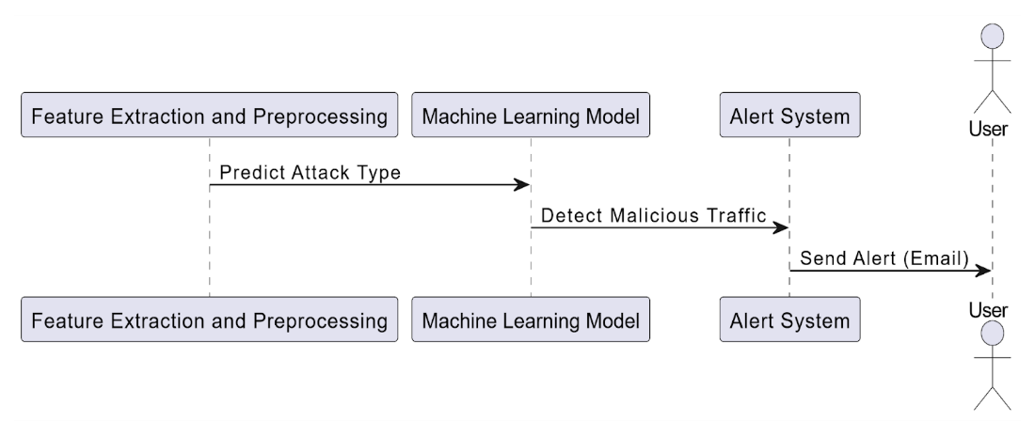
4. Implementation
4.2 Alert System
1.Input from Preprocessing:
Features extracted from network traffic are fed into the ML model.
Attack Classification:
Normal traffic: No action is taken.
Malicious traffic: Triggers the alert system.
Alert System:
Collects details on detected threat (e.g., type, timestamp, protocol, traffic characteristics).
User Notification:
Sends detailed email alerts using SMTP.
Output:
Provides logs and notifications to inform users for further action.

Slide 13
5.Result and Analysis
Real-Time Detection:
System successfully identified malicious activities like Backdoor attacks.
Features like Protocol Type, Packets Sent/Received, and Data Size were crucial for real-time predictions.
Logs validate accurate detection and provide actionable insights.
Model Evaluation:
XGBoost achieved the best accuracy (72.71%) compared to Random Forest (70.78%) and Decision Tree (68.90%).
Confusion matrix analysis highlighted minimal misclassifications and strong detection for diverse attack types.
Email Alert Efficiency:
Prompt notifications to administrators with details of detected attacks.
Includes attack type, timestamp, and traffic characteristics for immediate response.

Slide 14
6.Contribution to Social Business
Contribution to Social Business
Social enterprises face increasing cyber-attacks, necessitating improved cybersecurity.
Machine learning-based IDS is cost-effective and highly secure for small to medium-sized enterprises (SMEs).
Essential in protecting confidential information
Helps socially responsible organizations remain sustainable and impactful while mitigating cyber threats.

Slide 15
7.Future Work
Proposed Improvements
Deep Packet Inspection: Enable analysis of encrypted traffic to detect concealed attacks.
Integration with SIEM Systems: Enhance threat correlation and detection through real-time data integration.
Hybrid Detection Methods: Combine anomaly-based and signature-based techniques for better accuracy.
Automated Model Retraining: Address model drift and maintain detection accuracy.
Distributed Processing: Scale the IDS for large networks with high traffic volumes.
User-Friendly GUI: Improve usability for administrators and non-technical users.

Slide 16
8.Conclusion
Key Takeaways:
Effective use of machine learning (e.g., XGBoost) to detect and classify network intrusions.
UNSW-NB15 dataset and preprocessing techniques enabled strong detection performance.
Enhanced real-time monitoring and alert systems.
Adaptable architecture suitable for SMEs in critical fields like healthcare and education.
Persistent challenges include class imbalances, encrypted traffic analysis, and scalability issues.
Future advancements aim to overcome these limitations, ensuring a robust and user-friendly IDS.

Slide 17
9.References
Abdallah, A. E. (2023). AI-Powered Network Anomaly Detection System. International Journal of Managing Information Technology (IJMIT), 15(3), 1-12. Available at https://aircconline.com/ijmit/V15N3/15323ijmit01.pdf
Widodo, T., & Aji, A. S. (2021). Implementation of intrusion detection system (IDS) and Snort community rules to detect types of network attacks. International Journal of Computer Applications, 183(42).
Zhang, Y., Wang, L., & Lee, S. (2023). Machine learning approaches in intrusion detection systems: A comprehensive review. Computers & Security, 120, 102839. https://doi.org/10.1016/j.cose.2023.102839

Slide 18


