Slide 1
Watt?
Smart Home Energy Conservation System

Slide 2
Introduction
Introduction to IoT and connected devices
Remotely controllable and data accessible anywhere
Watt? Is simple IoT Application
Watt? Components
Watt? Smart Meter
Watt? Smart Plug
Watt? Application

Slide 3
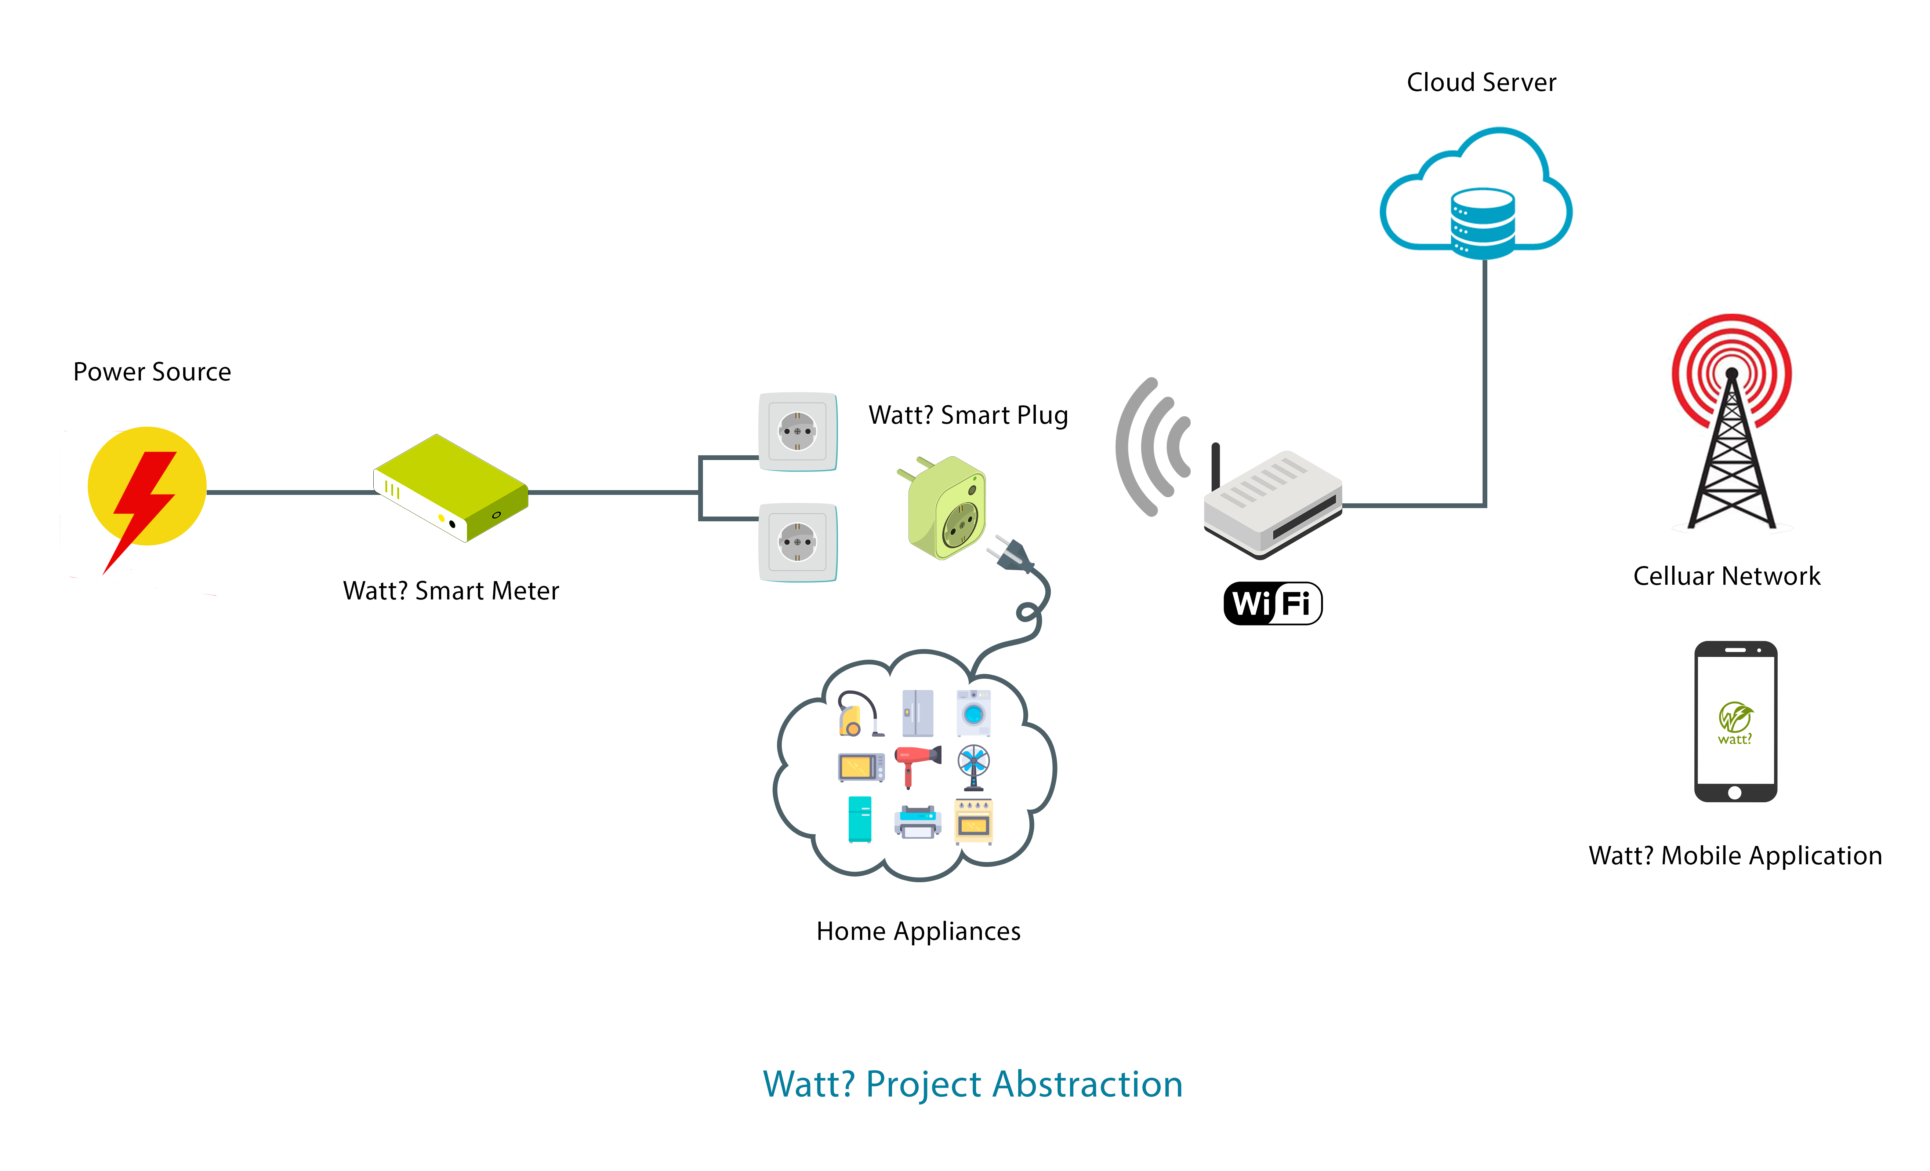
Introduction

Slide 4
Introduction
Advantages of IOT
Communication
Automation and Control
Information
Monitor
Money

Slide 5
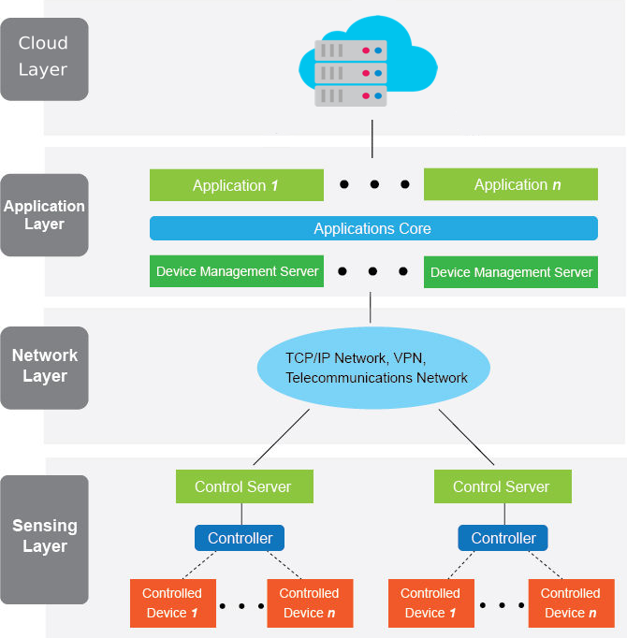
Introduction
Internet of Things Architecture
Notes:
Computing Environment [ESP8266]-
GPIO [Digital and Analog]

Slide 6
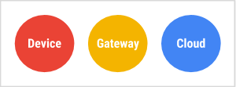
Sensing Layer : Introduction
IoT is a set of sprawling technologies [cloud - Internet - Microprocessor]
Three major components of any IoT application :
Device
Gateway
Cloud

Slide 7
Sensing Layer : Introduction
Device is an embedded system
Characteristics of Embedded Systems:
Single Functioned
Tightly Constrained
Reactive and Realtime
Connected Hardware/Software systems
Notes:
Single Functioned [Measuring power and energy consumption of home and control appliances]
Tightly Constrained [Cost - Size - Power - Performance]
Connected [connected to peripherals]
Hardware/Software systems [software for feature flexibility & Hardware for performance]

Slide 8
Sensing Layer : Introduction
There are :
Diverse Hardware.
Diverse Software and Operating Systems.
Different Networking Protocols.

Slide 9
Sensing Layer : Introduction
General Consideration when choosing hardware
Cost.
I/O Roles.
Power consumption.
Networking Environment.
Notes:
I/O Roles [ADC for analog sensingPWM - Actuators].
Networking Environment [Ethernet - Wireless - cellular].

Slide 10
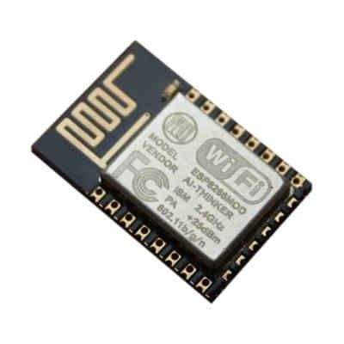
Sensing Layer : Hardware
Infrastructure Components
Microcontroller [ESP8266]
32-bit RISC CPU: Tensilica Xtensa L106 running at 80 MHz
64 KiB of instruction RAM, 96 KiB of data RAM
External QSPI flash: 512 KiB to 4 MiB (up to 16 MiB is supported)
IEEE 802.11 b/g/n WiFi .
Integrated TR switch, balun, LNA, power amplifier and matching network .
WEP or WPA/WPA2 authentication, or open networks.
16 GPIO pins.
SPI.
I²C - I²S interfaces with DMA (sharing pins with GPIO).
UART on dedicated pins, plus a transmit-only UART can be enabled on GPIO2 10-bit ADC (this is a Successive Approximation ADC).
Memory: 4MB external EEPROM.
Communication: WiFi

Slide 11
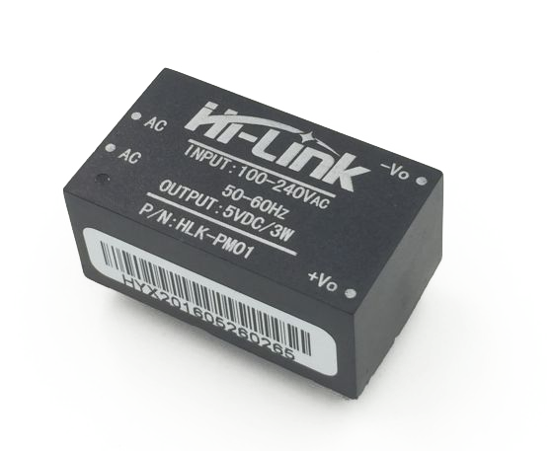
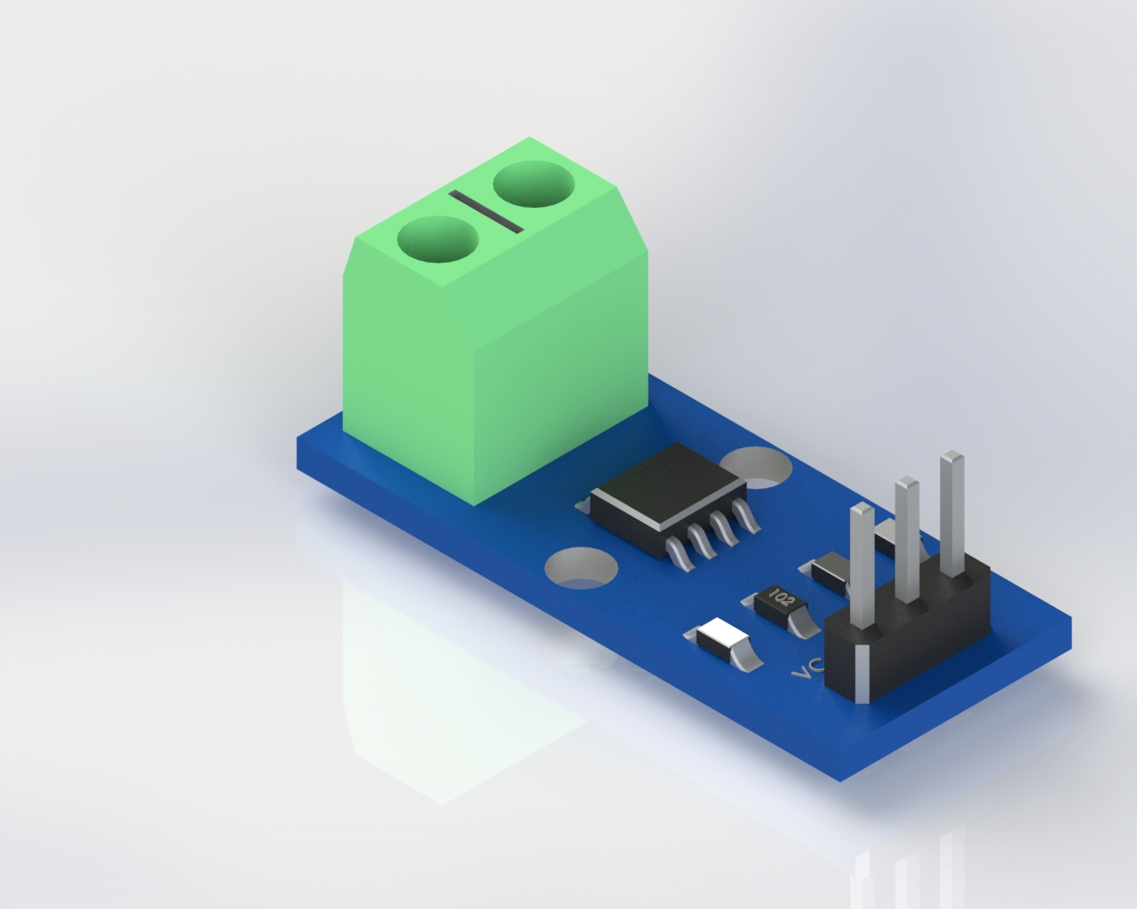
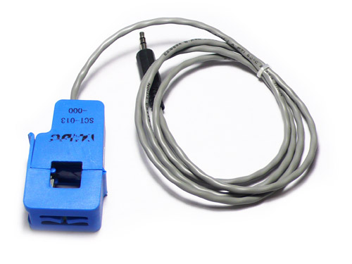
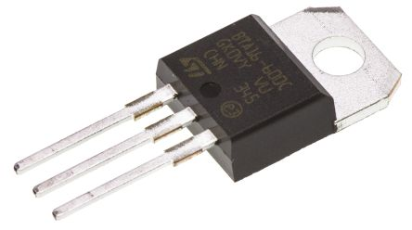
Sensing Layer : Hardware
Power supply components
Electricity Network
Hi-Link HLK-PM01 AC/DC Module
Voltage regulator
LM1117 LDO 3.3V-
Sensors
Current Transformer
ACS712 Current sensor IC - ACS712-20A Current sensor module.
Control Circuit
ST Microelectronics's BTA16 Triac

Slide 12
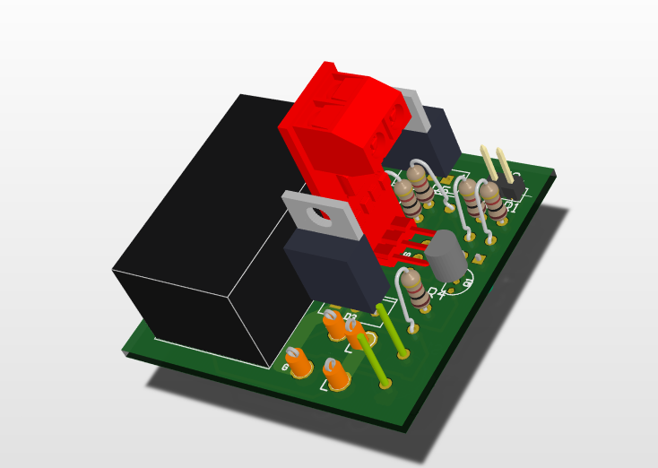
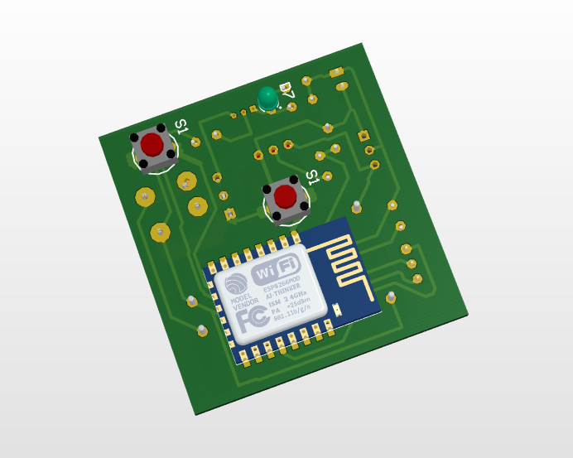
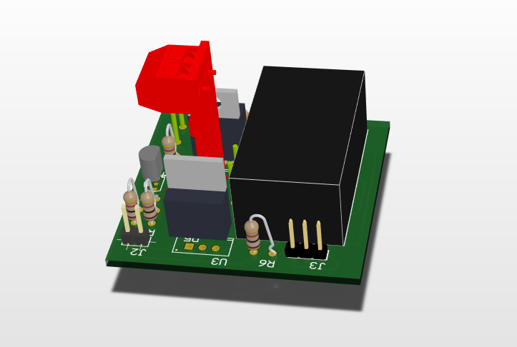
Sensing Layer : Hardware
PCB Design and Layout
PCB design using EDA software
PCB Layout and component placing
PCB Production capabilities
PCB Manufacturing challenges
High Cost by the local manufacturers in Egypt.
No high quality manufacturers found in Egypt.
High customs if manufactured abroad in china.
Preventing the manufactured products to arrive, from the national security in Egypt.
Take long time to arrive if manufactured abroad.
Bad quality of hand-made PCBs.
Bigger size when manufactured in home.

Slide 13
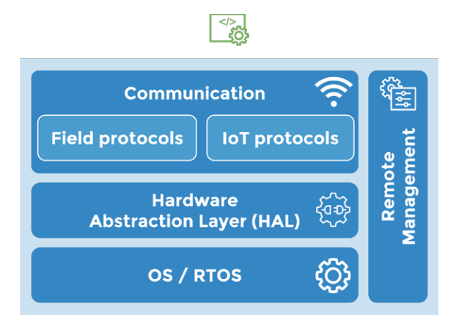
Sensing Layer : Software
The IoT Software Stack
IoT Operating system .
Hardware Abstraction Layer .
Communication Support.
Remote management.
Software architectures for Embedded Systems
Round robin.
Round robin with interrupts.
Function queue scheduling.
Realtime operating systems

Slide 14
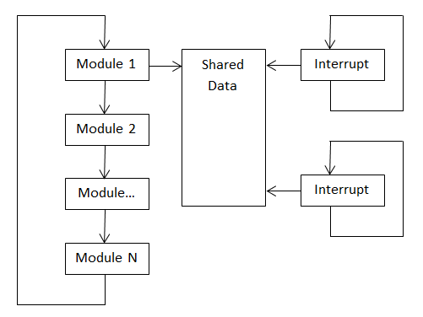
Embedded Software
Watt? Software architecture
Computing Environment
Hardware Interfaces
GPIO
UART
Notes:
Computing Environment [ESP8266]-
GPIO [Digital and Analog]

Slide 15
Sensing Layer : Software
On-device processing
Converting data from ADC output format to a typical current value
Calculating the Realtime power consumption.
Validating data to ensure it meets a set of rules.
Handling the external interrupts.
Reading the Internet time.
Calculating the cumulative energy consumptions.
Storing data in the EEPROM.
Combining data into aggregate values

Slide 16
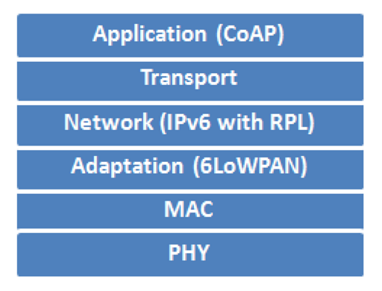
Network Layer
IoT Network Protocol Stack

Slide 17
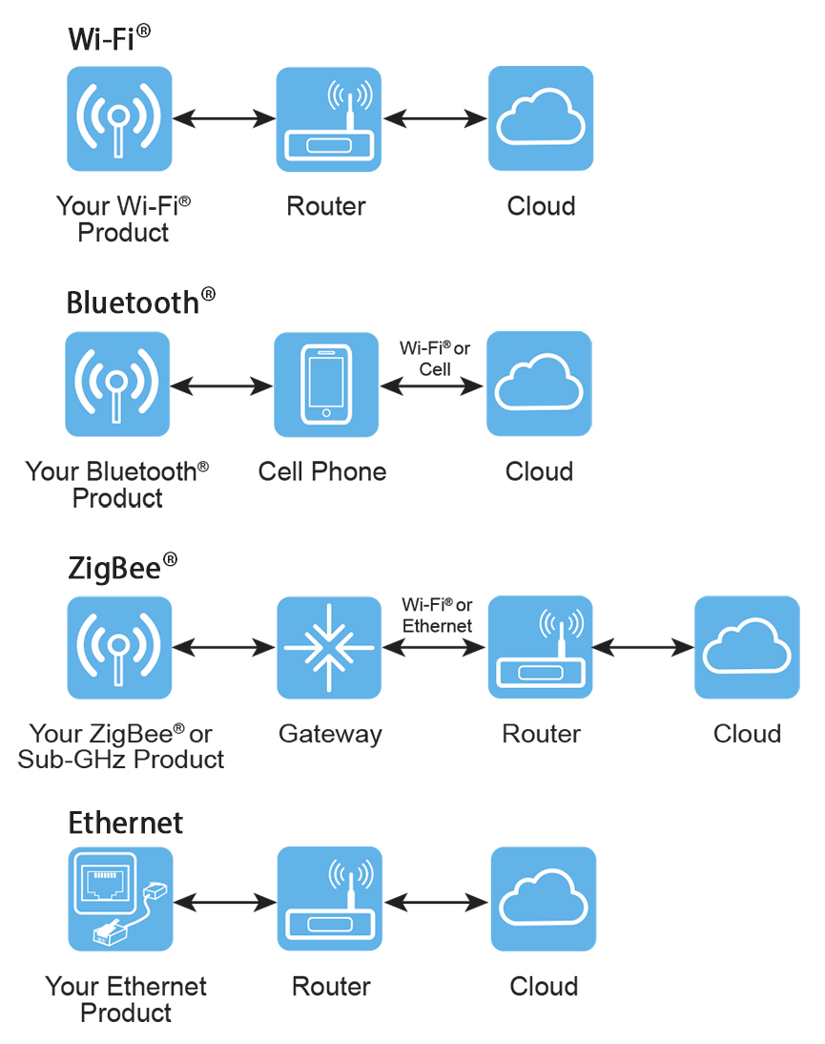
Network Layer
Watt? Networking
Low power WiFi.
Why WiFi ?
Internet connection.

Slide 18
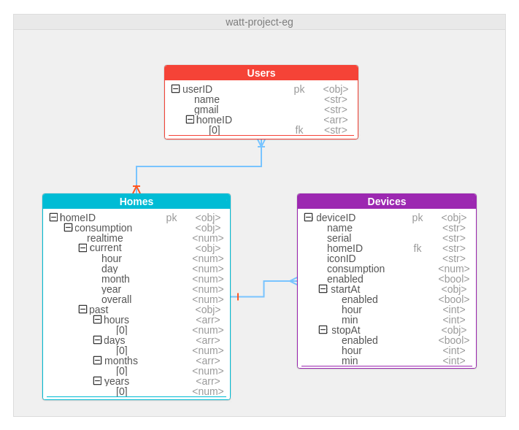
Cloud Layer : Watt? Database
Entity Relationship Diagram

Slide 19
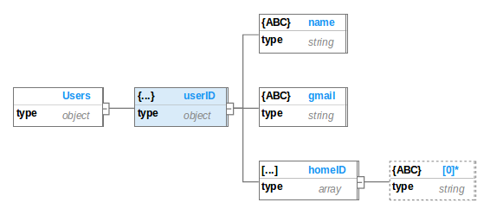
Cloud Layer : Watt? Database
Tree Diagram
User Tree

Slide 20
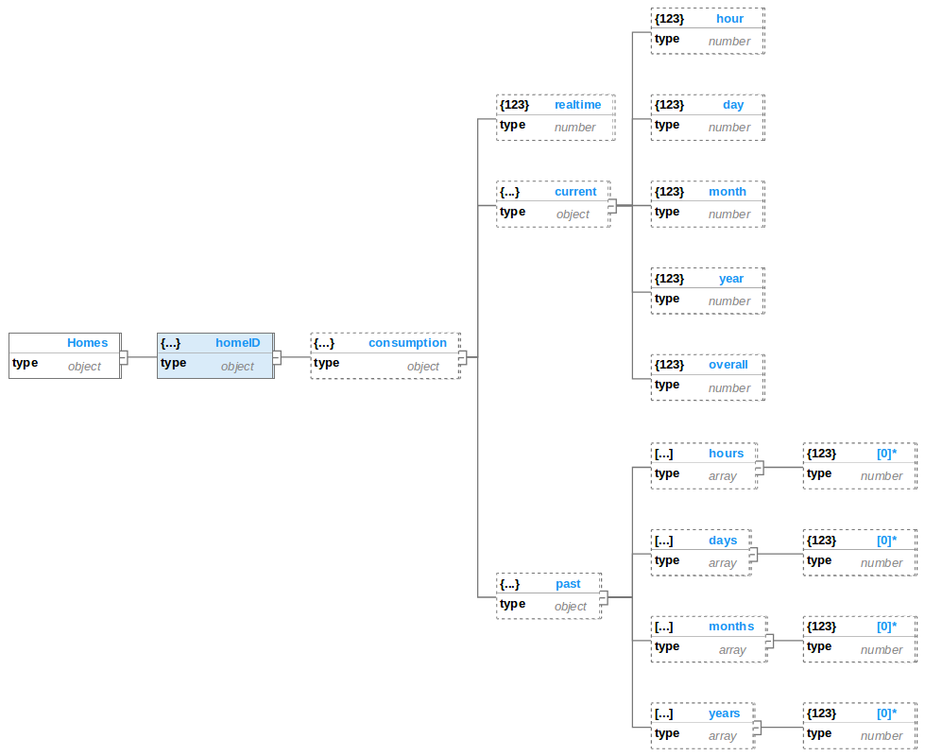
Cloud Layer : Watt? Database
Tree Diagram
Homes Tree

Slide 21
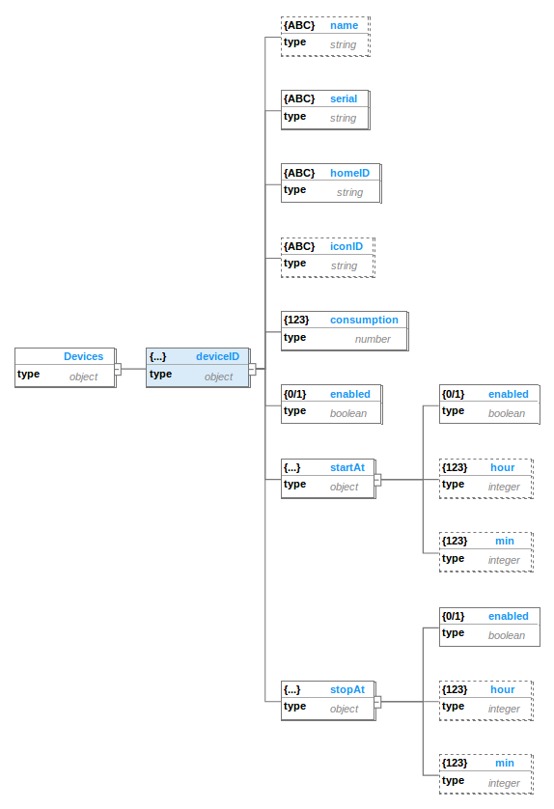
Cloud Layer : Watt? Database
Tree Diagram
Devices Tree

Slide 22
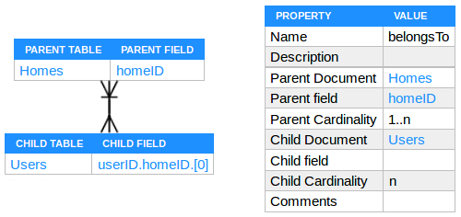
Cloud Layer : Watt? Database
Relations
Belongs To

Slide 23
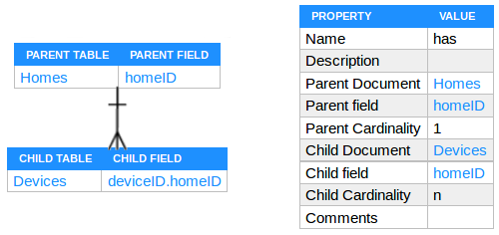
Cloud Layer : Watt? Database
Relations
Has

