Slide 1
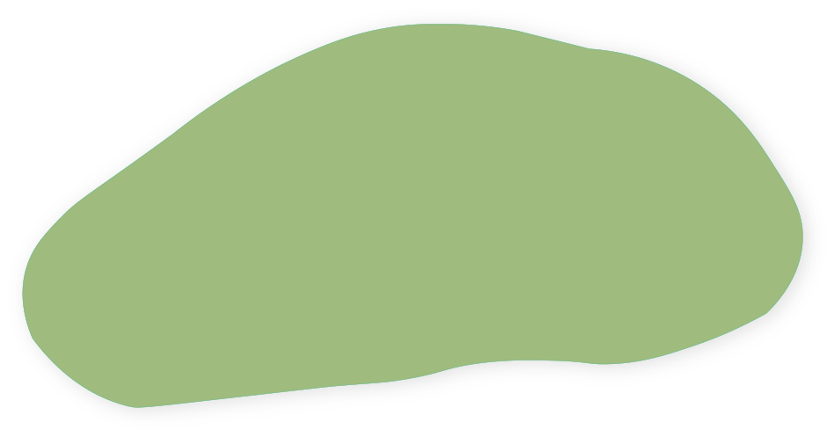

Kelp forest
Notes:
Schematic of methods used to survey biological communities adjacent to a kelp forest (green shaded area), kelp forest density, and NH₄⁺ inside vs outside the forest. We first ran a 50 m Reef Life Survey transect parallel to the kelp forest and surveyed fishes in the water column 5 m on either side of the transect (light blue shaded area), and cryptic fishes and macroinvertebrates 1 m on either side of the transect (darker blue shaded area). Next, we ran four 5 m long transects into the kelp forest 5 meters apart from each other to assess kelp density and biomass 0.5 m on either side of the transect (four perpendicular black lines). We took NH₄⁺ samples at the beginning and end of the first three kelp transects (yellow circles) to compare NH₄⁺ inside vs outside kelp forests.

Slide 2
(2)
(3)
(1)
Notes:
Schematic of methods used to survey biological communities adjacent to a kelp forest (shaded area), kelp forest density, and NH₄⁺ inside vs outside the forest. We first ran a (1) 50 m Reef Life Survey transect and surveyed (2) fishes in the water column 5 m on either side of the transect, and (3) cryptic fishes and macroinvertebrates 1 m on either side of the transect. Next, we ran four 5 m long and 1 m wide transects into the kelp forest 5 meters apart from each other to assess kelp density and biomass. We took NH₄⁺ samples at the beginning and end of the first three kelp transects (yellow circles) to compare NH₄⁺ inside vs outside kelp forests.
Isa’s comments: switch roman numerals to normal #’s. no (i) for kelp just say it’s the grey patch. Replace yellow X’s with coloured dots. Instead of 6 and 7, say direction of arrows indicate direction of transects. And NH₄⁺ samples were collected at the beginning and end of the kelp transects
Kieran: instead of shaded area use a dotted outline and say it’s kelp. Could also add a panel showing one of the kelp transects to show where the NH₄⁺ samples were taken
Claire: no dotted green borders around the kelp transects

Slide 3
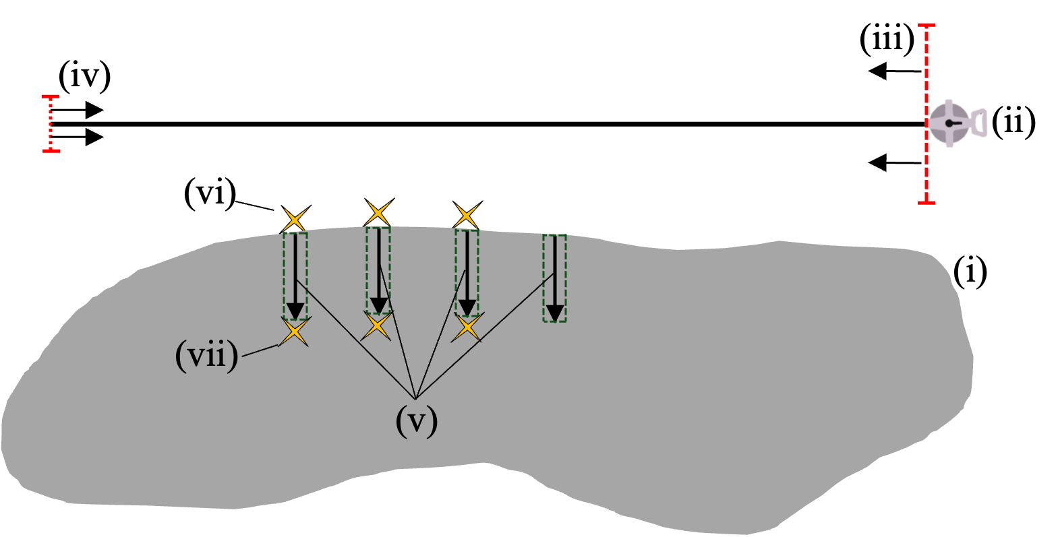

Slide 4
(iii)
(iv)
(ii)
(vi)
(v)
(i)
(vii)
Notes:
Schematic of methods used to survey biological communities adjacent to (i) kelp forest, kelp forest density, and NH₄⁺ inside vs outside the forest. We first ran a (ii) 50 m Reef Life Survey transect and surveyed (iii) fishes in the water column 5 m on either side of the transect, and (iv) cryptic fishes and macroinvertebrates 1 m on either side of the transect. Next, we ran (v) four 5 m long and 1 m wide transects into the kelp forest 5 meters apart from each other to assess kelp density and biomass. We took NH₄⁺ samples at the (vi) beginning and (vii) end of the first three kelp transects to compare NH₄⁺ inside vs outside kelp forests.

Slide 5
(iii)
(iv)
(ii)
(vi)
(v)
(i)
(vii)
Notes:
Schematic of methods used to survey biological communities adjacent to (i) kelp forest, kelp forest density, and NH₄⁺ inside vs outside the forest. We first ran a (ii) 50 m Reef Life Survey transect and surveyed (iii) fishes in the water column 5 m on either side of the transect, and (iv) cryptic fishes and macroinvertebrates 1 m on either side of the transect. Next, we ran (v) four 5 m long and 1 m wide transects into the kelp forest 5 meters apart from each other to assess kelp density and biomass. We took NH₄⁺ samples at the (vi) beginning and (vii) end of the first three kelp transects to compare NH₄⁺ inside vs outside kelp forests.

Slide 6
(iii)
(ii)
(iv)
(vi)
(v)
(i)
(vii)
Notes:
Schematic of methods used to survey biological communities adjacent to (i) kelp forest, kelp forest density, and NH₄⁺ inside vs outside the forest. We first ran a (ii) 50 m Reef Life Survey transect and surveyed (iii) fishes in the water column 5 m on either side of the transect, and (iv) cryptic fishes and macroinvertebrates 1 m on either side of the transect. Next, we ran (v) four 5 m long and 1 m wide transects into the kelp forest 5 meters apart from each other to assess kelp density and biomass. We took NH₄⁺ samples at the (vi) beginning and (vii) end of the first three kelp transects to compare NH₄⁺ inside vs outside kelp forests.

Slide 7
(iii)
(iv)
(ii)
(vi)
(v)
(i)
(vii)
Notes:
Schematic of methods used to survey biological communities adjacent to (i) kelp forest, kelp forest density, and NH₄⁺ inside vs outside the forest. We first ran a (ii) 50 m Reef Life Survey transect and surveyed (iii) fishes in the water column 5 m on either side of the transect, and (iv) cryptic fishes and macroinvertebrates 1 m on either side of the transect. Next, we ran (v) four 5 m long and 1 m wide transects into the kelp forest 5 meters apart from each other to assess kelp density and biomass. We took NH₄⁺ samples at the (vi) beginning and (vii) end of the first three kelp transects to compare NH₄⁺ inside vs outside kelp forests.

