Slide 1
SAN CARLOS INTEGRATED MANAGEMENT SYSTEM (SCIMS)

Slide 2
Objective
User Interface
Role Management
Permission Management
End Users Management

Slide 3
USER INTERFACE Administration

Slide 4
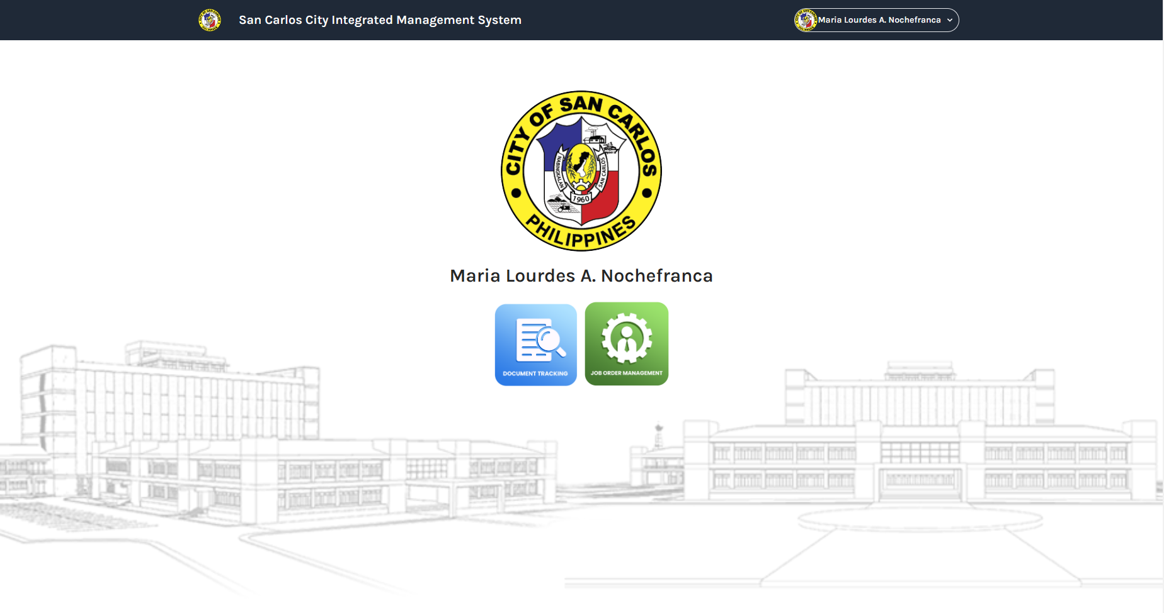
User Interface: Home screen
Note
SCC Logo will be the default photo of the new registered end user.
Add a icon menu name Administration directing to a new page.
The menus of that page are: Manage Role, Manage End User, Department.

Slide 5
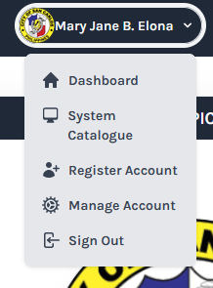
Note:
Remove the System Catalogue and Register Account menu.
The default photo for the new user if its not change is the SCC Logo.
Make sure it has a space between the End User Profile Photo and the End Users Full name.

Slide 6
ROLE & PERMISSION MANAGEMENT

Slide 7
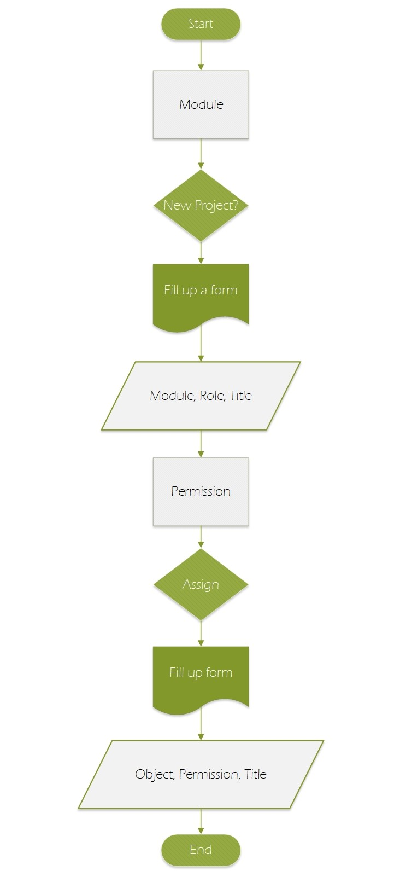

Slide 8
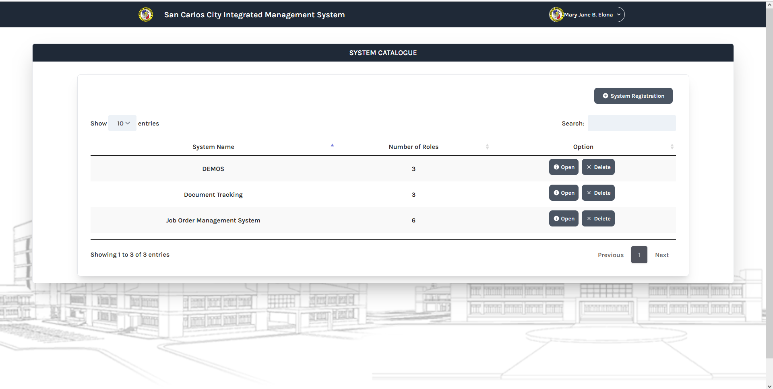
User Interface: Role Management

Slide 9
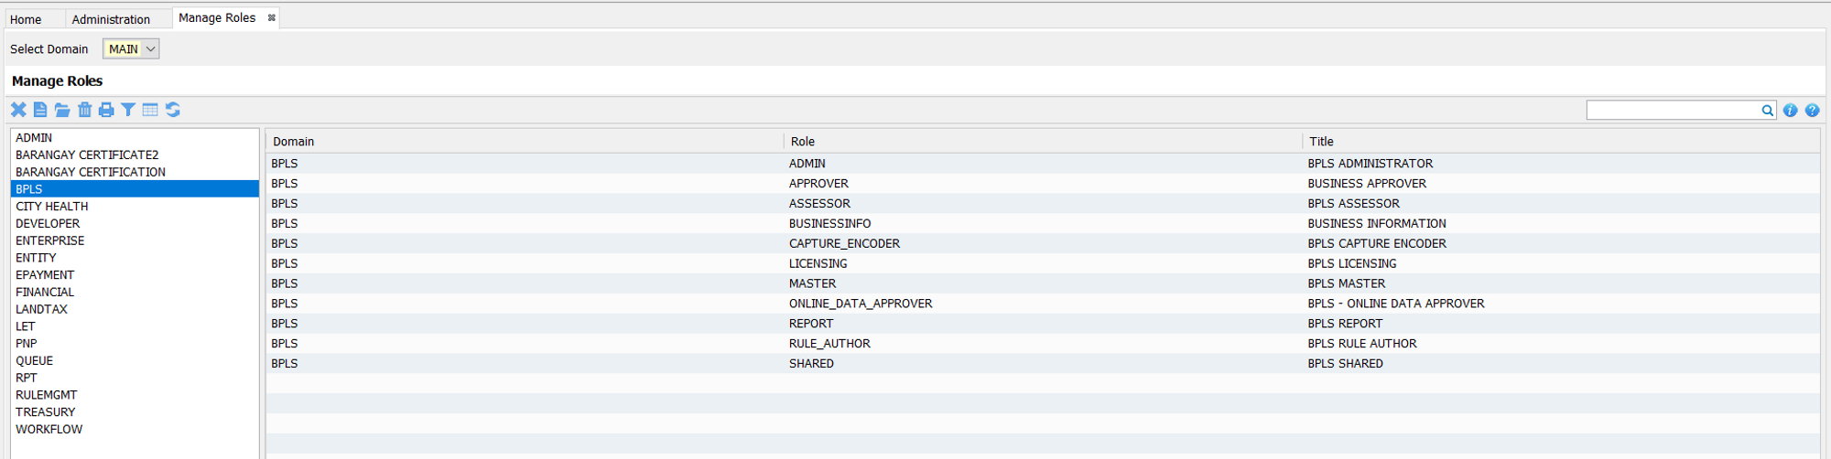
Note:
Two columns
First column (left) is the list of all the module projects.
Second column (right) is the data table of the roles in a project.
Upper left is the buttons (Add, Edit, Delete, Close)

Slide 10
User Interface: Role Management
The names of the column in the table are Role, Title and Option.
In the option column, Open/View & Delete must be shown.

Slide 11
UI: Add Module / New Project
Module
VAMOS
Note:
Input fields should be capitalized.
First row is the column name.
Second row will be the user role and the title.
User Role should be an array.
Plus sign must be a button that can add a row in the table.
 | User Role | Title
 | ADMINISTRATION | VAMOS ADMIN
 | DATA ENCODER | VAMOS DATA ENCODER
Save

Slide 12
Data Structure:
Table : role_management
# | COLUMN | DATA TYPE | LENGTH | REMARKS
PK | role_id | VARCHAR | 100 | Unique ID (module.role)
 | module | VARCHAR | 25
 | role | VARCHAR | 50
 | title | VARCHAR | 100

Slide 13
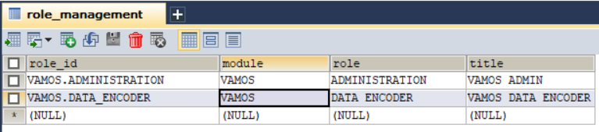
Sample Data for this table:

Slide 14
Account Type
Permissions
0 | None
1 | Super Admin
2 | Admin
3 | Data Encoders
4 | Helpdesk
5 | Viewer
6 | Barangay Encoders
7 | Validator
8 | Processors
9 | Controller
10 | Clerk
11 | Doctor
12 | Encoder
13
14
√ | Create
 | Delete
 | Edit
 | Print
 | View
 | Upload

Slide 15
Instruction

Slide 16
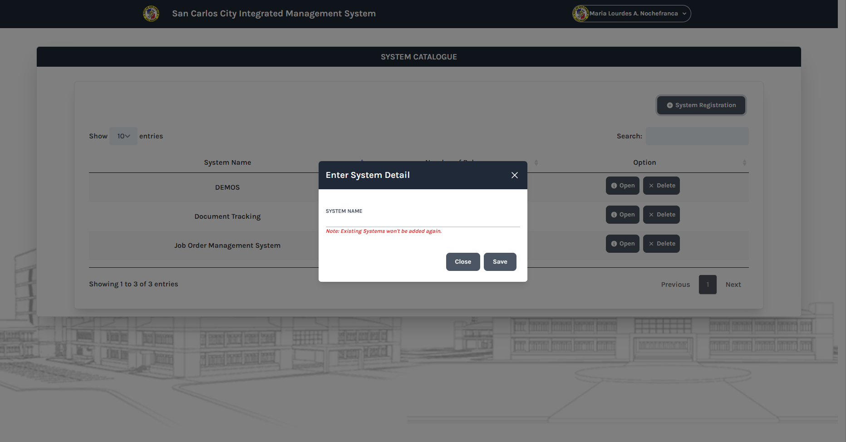

Slide 19
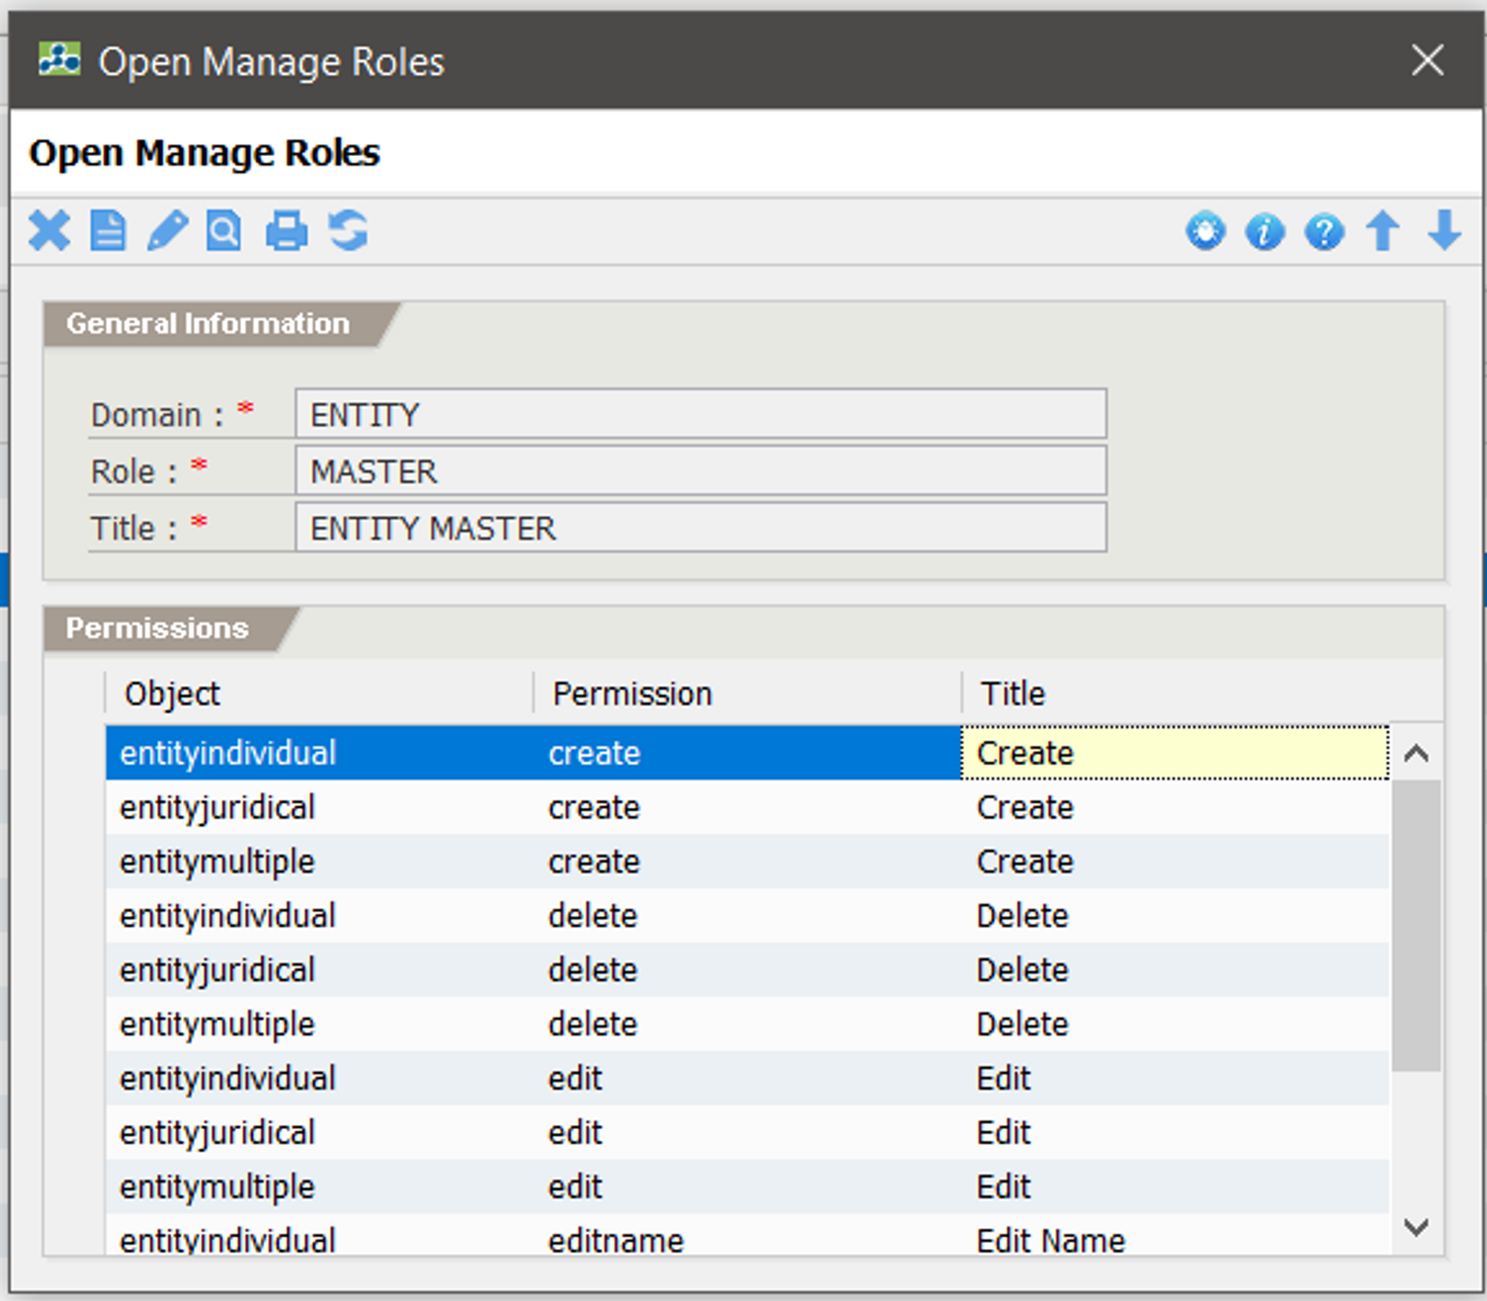
System Catalogue change to Role Management.

Slide 20
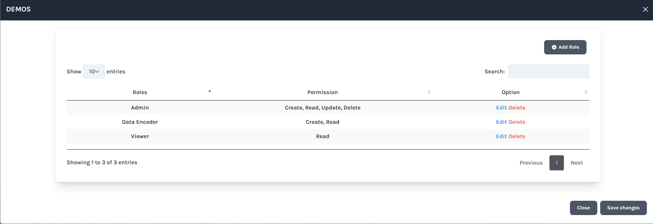

Slide 21
Instructions:
If new project, you have to alter the table account_type to add a column.

Slide 22

Table: account_type
# | COLUMN | DATA TYPE | LENGTH | REMARKS
PK | account_type_id | VARCHAR | 100 | Unique ID
FK | entity_no | CHAR | 15 | FK - individual_info
 | scims_sys | INT | 10
 | vamos_sys | INT | 10
 | resbakuna_sys | INT | 10
 | ikonsulta_sys | INT | 10
 | demos_sys | INT | 10
 | doctrack_sys | INT | 10
 | senior_sys | INT | 10
 | joborder_sys | INT | 10
 | barangay_sys | INT | 10
 | let_sys | INT | 10
 | pnp_sys | INT | 10

Slide 23
A

Slide 24
ACCOUNT TYPE

Slide 26
Permission Management

Slide 28
Create Module/System

Slide 29
Table: role_management
# | COLUMN | DATA TYPE | LENGTH | REMARKS
PK | role_id | VARCHAR | 100 | Unique ID (module.role)
 | module | VARCHAR | 25
 | role | VARCHAR | 50
 | title | VARCHAR | 100

Slide 31
Data Structure
# | COLUMN | DATA TYPE | LENGTH | REMARKS
PK | permission_id | VARCHAR | 100 | Unique ID (object.permission)
FK | role_id | VARCHAR | 50
 | object | VARCHAR | 25
 | permission | VARCHAR | 25
 | title | VARCHAR | 50

Slide 34
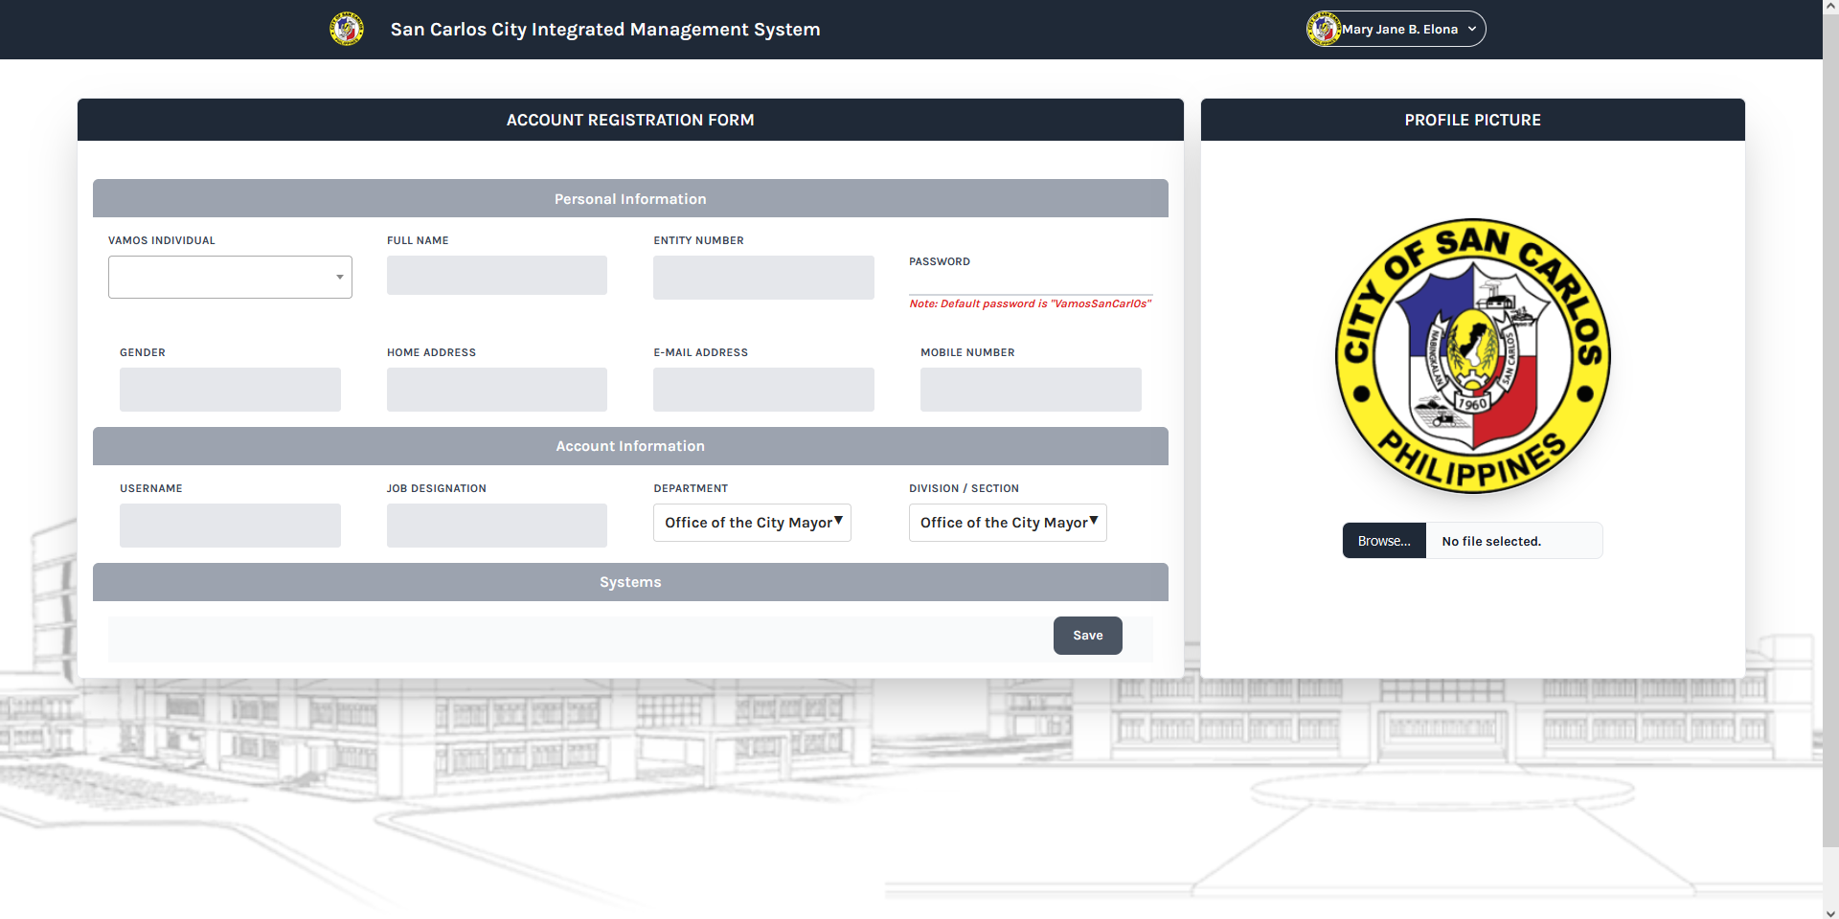

Slide 35
