Slide 1
SAN CARLOS INTEGRATED MANAGEMENT SYSTEM (SCIMS)

Slide 2
Objective
Roles Management
Permission Management
End Users Management

Slide 4
ROLE MANAGEMENT

Slide 5
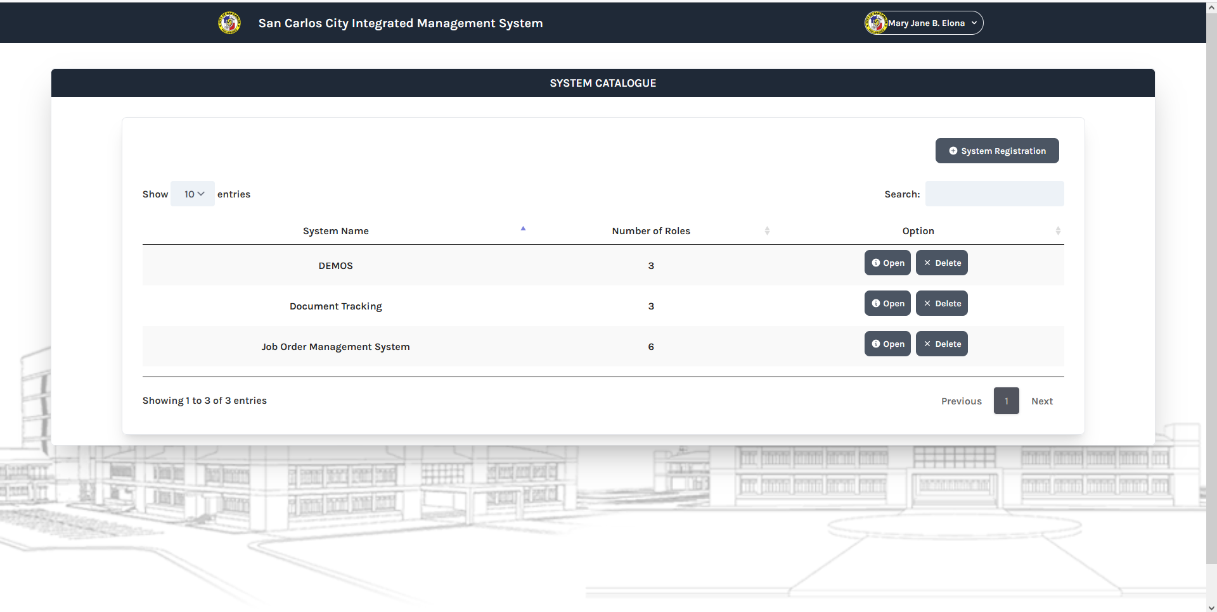
User Interface: Role Management

Slide 6
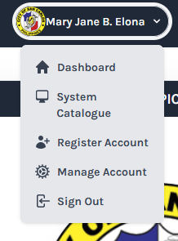
Note:
Remove the System Catalogue and Register Account menu.
The default photo for the new user if its not change is the SCC Logo.
Make sure it has a space between the End User Profile Photo and the End Users Full name.

Slide 7
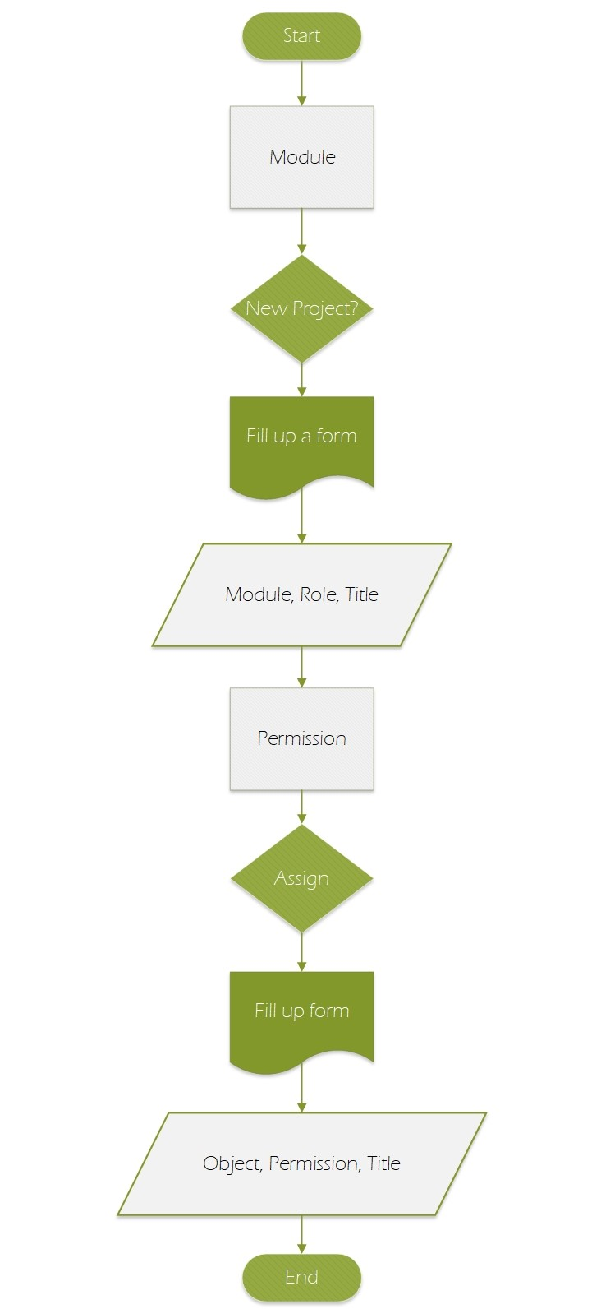

Slide 8
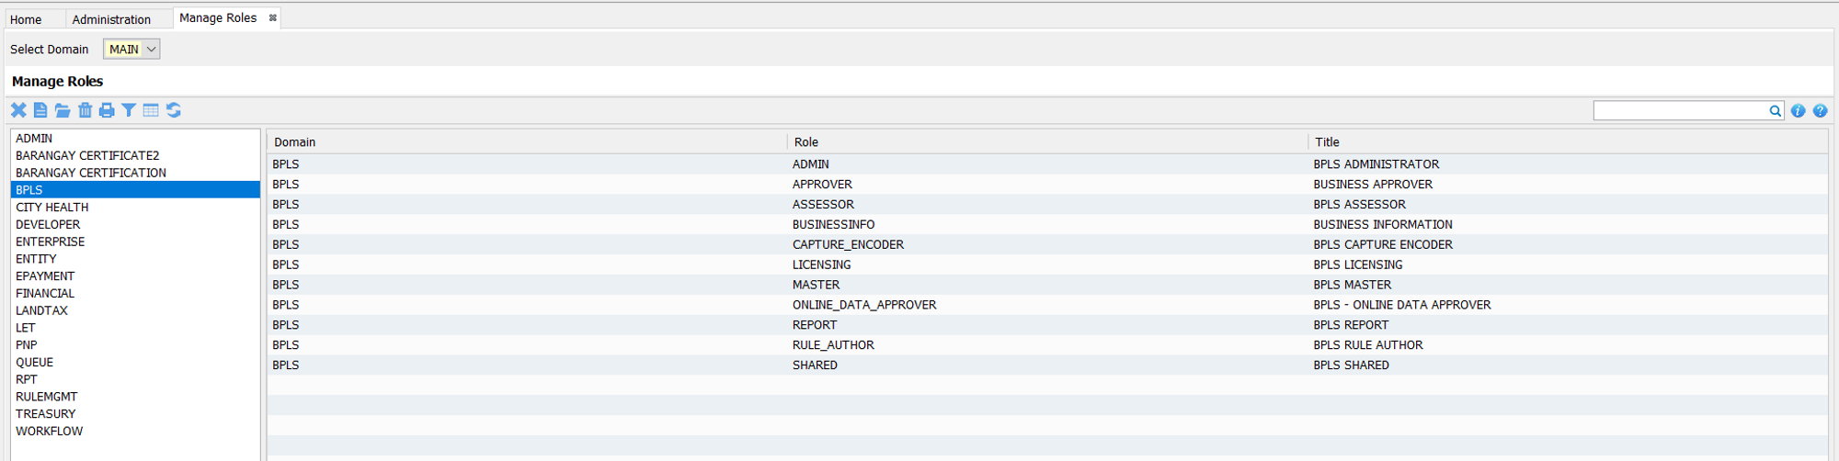
Note:
Two columns
First column (left) is the list of all the module projects.
Second column (right) is the data table of the roles in a project.
Upper left is the buttons (Add, Edit, Delete, Close)

Slide 9
User Interface: Role Management
Column names (Module, Role, Title)

Slide 10
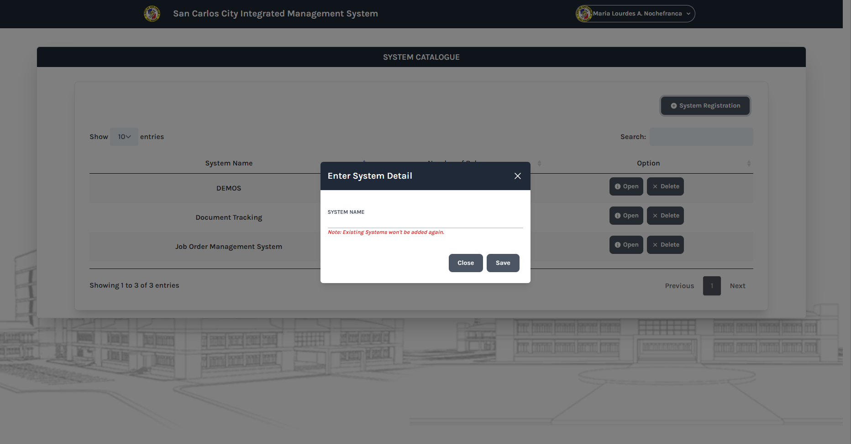

Slide 11
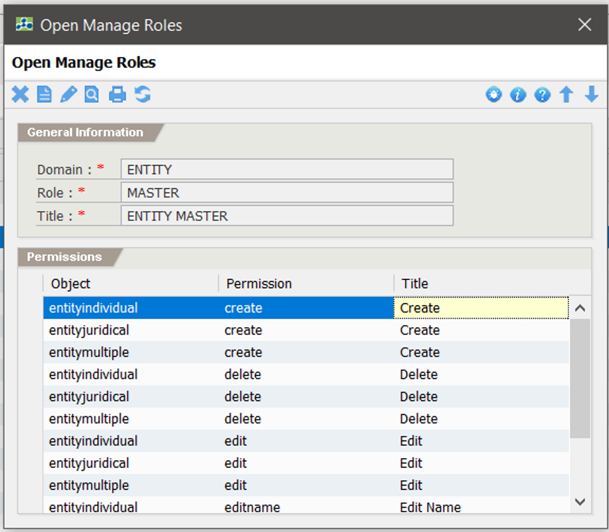
System Catalogue change to Role Management.

Slide 12
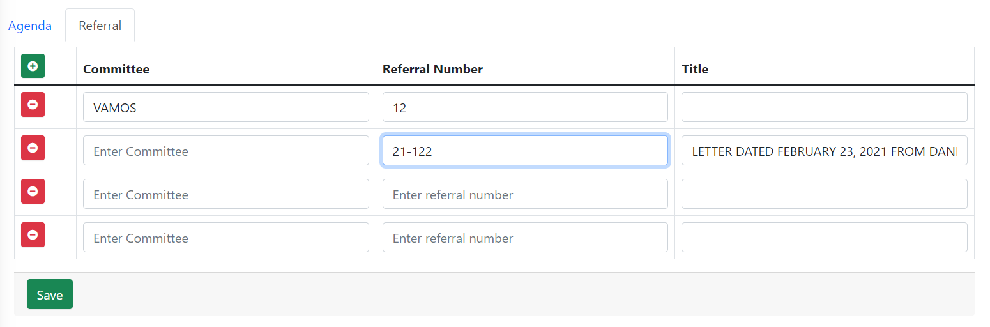

Slide 13
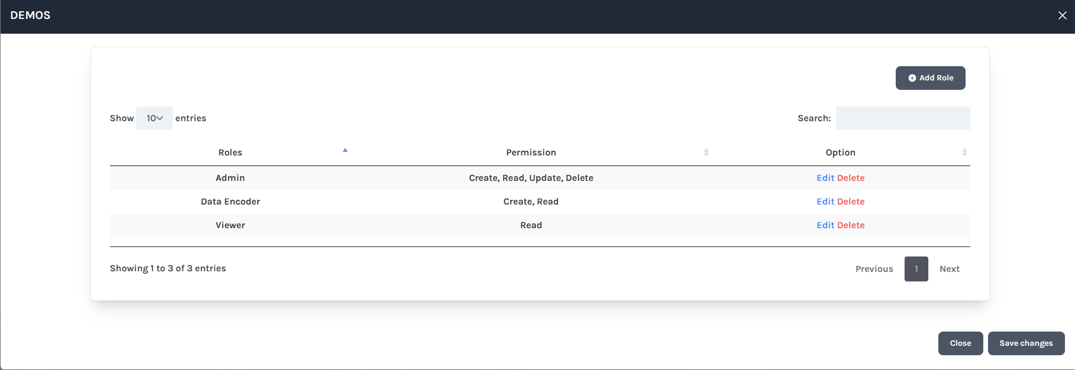

Slide 14
Instructions:
If new project, you have to alter the table account_type to add a column.

Slide 15

Table: account_type
# | COLUMN | DATA TYPE | LENGTH | REMARKS
PK | account_type_id | VARCHAR | 100 | Unique ID
FK | entity_no | CHAR | 15 | FK - individual_info
 | scims_sys | INT | 10
 | vamos_sys | INT | 10
 | resbakuna_sys | INT | 10
 | ikonsulta_sys | INT | 10
 | demos_sys | INT | 10
 | doctrack_sys | INT | 10
 | senior_sys | INT | 10
 | joborder_sys | INT | 10
 | barangay_sys | INT | 10
 | let_sys | INT | 10
 | pnp_sys | INT | 10

Slide 16
A

Slide 17
ACCOUNT TYPE

Slide 21
Permission Management

Slide 23
Create Module/System

Slide 24
Table: role_management
# | COLUMN | DATA TYPE | LENGTH | REMARKS
PK | role_id | VARCHAR | 100 | Unique ID (module.role)
 | module | VARCHAR | 25
 | role | VARCHAR | 50
 | title | VARCHAR | 100

Slide 26
Data Structure
# | COLUMN | DATA TYPE | LENGTH | REMARKS
PK | permission_id | VARCHAR | 100 | Unique ID (object.permission)
FK | role_id | VARCHAR | 50
 | object | VARCHAR | 25
 | permission | VARCHAR | 25
 | title | VARCHAR | 50

Slide 29
