Slide 1
THE ULTRASONIC DRONE PROJECT: CERBEUS
Emel TOHUMCUOĞLU & Kubilay KALKAN

Slide 2
BACKGROUND
We are 10th grader two friends in the same high school. We chose the Drones and Satellites For Urban Development challenge that because we thought it would be an interesting challenge where we could save people's lives and learn new things. While researching the sciences that study soil movements, we learned that our research is actually very fun and what a wonderful experience it is to learn and research. In these studies, we made use of NASA's own data, our school's teachers and our unlimited imagination. And we prepared a drone that will save the lives of innocent people during the earthquake and help the brave heroes who want to help them.

Slide 3
HOW IT WORKS?
Some of the technologies we use in this project are what we are inspired by other parts of life. Even pregnant women are among the things we are inspired by! Considering the bond between mothers and mother earth, we realized that the ultrasound technology used by pregnant women can be used in the soil. With this technology, by installing a mini ultrasonic sonar system on our drones, we can examine the earthquake zone after the earthquake as if examining the baby inside the womb of a mother, and we can see all the details inside the region and map it in detail and take pictures. By scanning the movements and shapes under the ground with ultrasonic waves, we can identify where there may be people, where there are risks, and any area in the soil, and by marking it, we can help the nearest aid service by assigning the location of that casualty or area.

Slide 4
PROBLEM & SOLUTION
Let's imagine a bad scenario: Imagine that the earthquake is happening and everywhere is filled with debris and collapsed houses, buildings, structures etc. Our drone comes to the region and lands at the most suitable point to land, scanned with its own artificial intelligence, and maps the underground using sonic waves, then marks important coordinates on the map with its own artificial intelligence. On this map with the color of the scenario that is suitable for that coordinate. Blue if there is a life opportunity, green if it is safe to enter that area, red if it is unsafe. For example, consider that there are two different roads leading to the x zone, one is the z road and the other is the y road. To list it briefly:

Slide 5
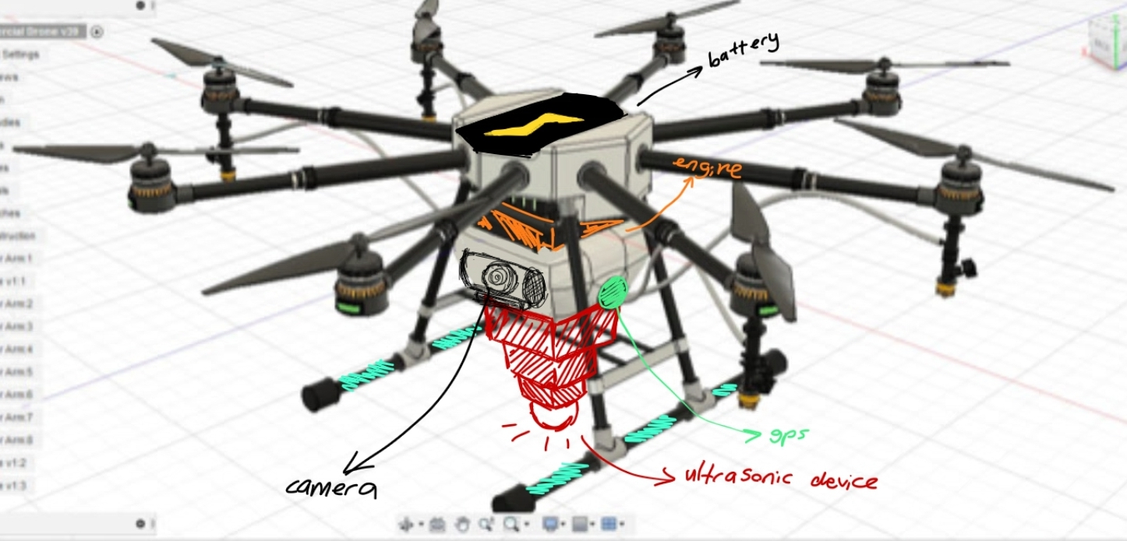
-The drone lands and sends ultrasonic waves into the ground
-The waves sent by the drone bounce back to it and it scans these waves with its ultrasonic technology and creates a detailed map of the underground.
-After the drone draws a detailed wave map of the bottom of the soil, it makes markings with its artificial intelligence on all the coordinates it finds important. It marks and indicates the safe and unsafe areas in detail.
-It sends this data to the relevant units and sends them information such as coordinate location etc. for their attention.

Slide 6
IT’S ECO-FRIENDLY!
Now comes one of the most important details of this project. Our drone will be completely environmentally friendly. The sonic waves it uses do not harm the environment and living things or organisms under the ground. In fact, this technology has already been used by nature for millions of years by whales and bats. We also plan to use hydrogen as a fuel, that is, it is a project that does not harm the environment as much as possible. On the contrary, it has the potential to save the lives of millions of people.

Slide 7
FUTURE PLANS
Finally, do not think that our project can only be used for earthquake issues! This project addresses a very wide area. It can be used in any way in the branches of science that examines the underground, even to search for precious metals and fuels, even water, etc. It may sound a little crazy, but if we can put this drone on a rocket and send it to other planets, we can get to know that planet much better than it is by examining the underground sources of those planets. And by then, we can develop this technology and probe deeply into the core of that planet. Remember, the past may be on earth, but our future is in the sky!

