Slide 1
Machine Unlearning by adding noise to model weights
Multi-Class Spiral Dataset Classification

Slide 2
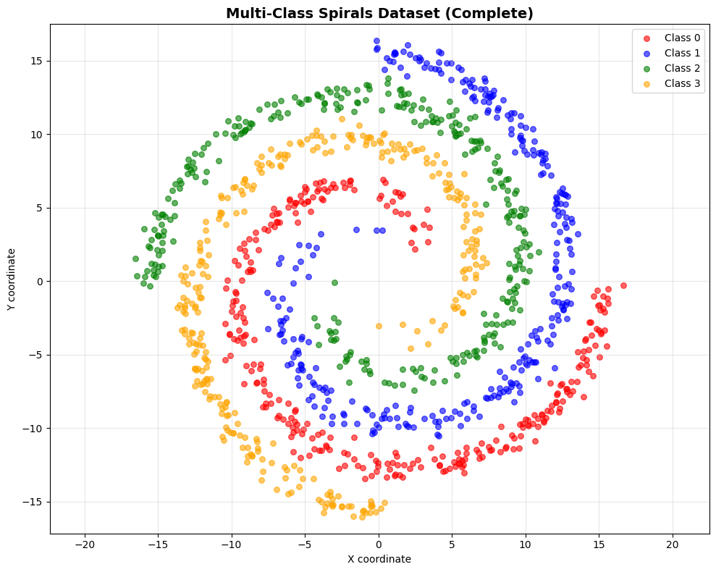
Dataset
Synthetic multi-class spirals (1200 samples, 4 classes)
300 samples per class
Archimedean spirals with Gaussian noise (σ=0.5)
Standardized to mean = 0 and std = 1

Slide 3
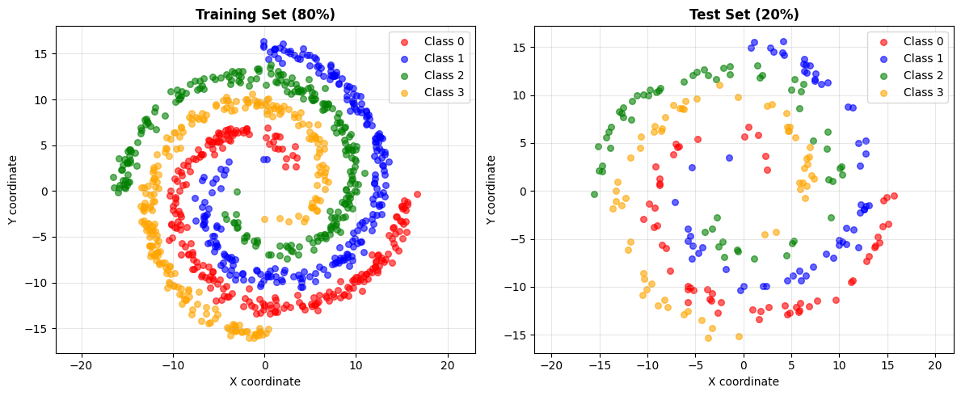
Train test split

Slide 4
Spiral Dataset Generation
Step 1: Generate theta values → θ = √(random) × 2π
Step 2: Calculate angle offset → Each class rotated by 90°
Step 3: Generate spiral radius → r = 2θ + π (Archimedean spiral)
Step 4: Convert to Cartesian → x = cos(θ + offset) × r
Step 5: Add Gaussian noise → data + N(0, 0.5²)
Step 6: Shuffle all points → Remove ordering bias
Result: 4 intertwined spirals, visually interpretable

Slide 5
Data Preparation Pipeline
1. Dataset Generation: Create 4-class spiral data (1200 samples)
2. Train/Test Split: 80-20 stratified split (960 train, 240 test)
3. Feature Standardization: Zero mean, unit variance (using training statistics)
4. PyTorch Conversion: Convert to tensors (float32 features, long labels)
5. Dataset Creation: TensorDatasets for efficient batching

Slide 6
Model Selection: TabNet
Model was developed by Google Cloud AI researchers.
Neural network model for tabular data
Key Features:
• Attention-based feature selection (learns what matters)
• Instance-wise importance (different features per sample)
• Built-in interpretability (see feature contributions)
• Sequential decision steps (3 steps in our config)
• Sparse attention mechanism (sparsemax)
• No preprocessing. Can often handle raw data directly, including categorical variables.
I use all the default paramateres provided by the pytorch_tabnet.tab_model.TabNetClassifier class

Slide 7
TabNet Model Configuration
Architecture Parameters:
• n_d = 8 (decision layer width)
• n_a = 8 (attention layer width)
• n_steps = 3 (num sequential decision steps)
• n_independent = 2 (GLU layers)
• n_shared = 2 (shared GLU layers)
Regularization:
• gamma = 1.3 (penalty for reuse of feature in multiple steps)
• lambda_sparse = 1e-3 (sparsity)
Training Parameters:
• Optimizer: Adam
• Learning rate: 0.02 (step size)
• Scheduler: StepLR (γ=0.9, step=10)
• Max epochs: 200
• Early stopping: patience=15
• Batch size: 256
• Virtual batch: 128 (Ghost BN)
Note: All default/recommended values

Slide 8
Training Process
Dataset: 960 training samples, 240 test samples
Early Stopping: Monitors test accuracy, stops after 15 epochs without improvement
Training Duration: ~2-3 seconds on CPU (66 epochs until convergence)
Validation: Continuous monitoring on test set
Best Performance: Achieved at epoch 51 (98.33% test accuracy)
Hardware: CPU (Apple Silicon) - sufficient for this dataset size

Slide 9
Model Performance Results
Training Accuracy: 98.85%
Test Accuracy: 98.33%
Overfitting Gap: 0.52% (excellent generalization!)
Misclassified Samples: ~4 out of 240 test samples
Training Time: 1.96 seconds (66 epochs)

Slide 10
Feature Importance Analysis
TabNet provides feature imporance metric:
print("=" * 60)
print("FEATURE IMPORTANCE")
print("=" * 60)
feature_names = ['X coordinate', 'Y coordinate']
for name, importance in zip(feature_names, feature_importances):
print(f"{name:15s}: {importance:.4f} ({importance*100:.2f}%)")
print("=" * 60)
Feature Contributions:
• X coordinate: ~50%
• Y coordinate: ~50%

Slide 11
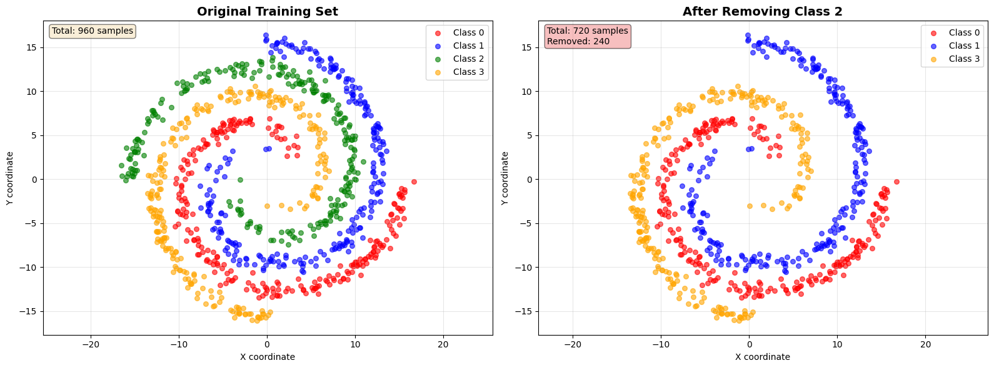
Forget requests
1. Class removal

Slide 12
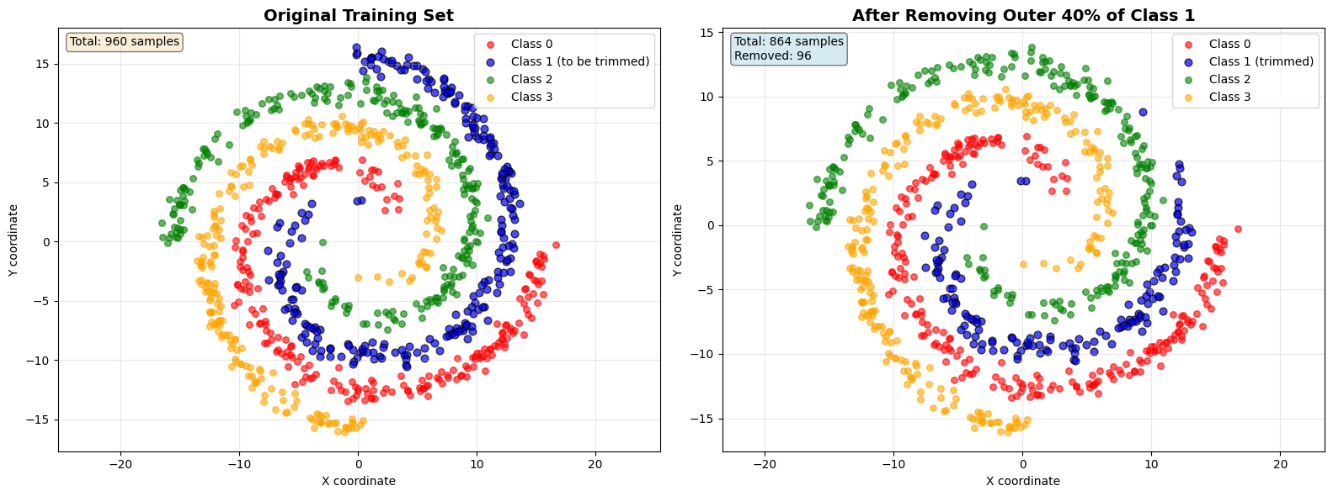
Forget requests
2. Edge removal of 1 class

Slide 13
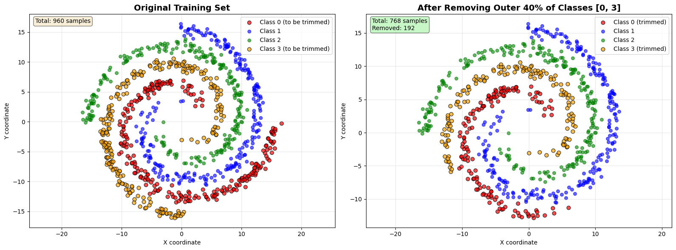
Forget requests
3. Edge removal of 2 classes.

Slide 14
Forget requests summary
Original Training Set: 960 samples
Forget Request 1 (Remove Class 2):
  Remaining: 720 samples (75.0%)
  Removed: 240 samples (25.0%)
Forget Request 2 (Trim Class 1):
  Remaining: 864 samples (90.0%)
  Removed: 96 samples (10.0%)
Forget Request 3 (Trim Classes 0 & 3):
  Remaining: 768 samples (80.0%)
  Removed: 192 samples (20.0%)

Slide 15
Retraining for baseline
Retraining with only retain set

Slide 16
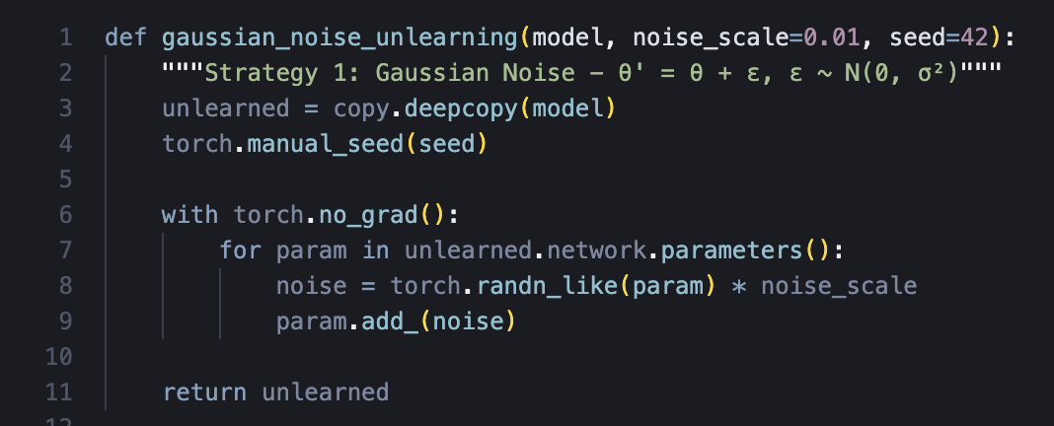
Unlearning methods used
1. Gaussian Noise
θ' = θ + ε, ε ~ N(0, σ²)

Slide 17
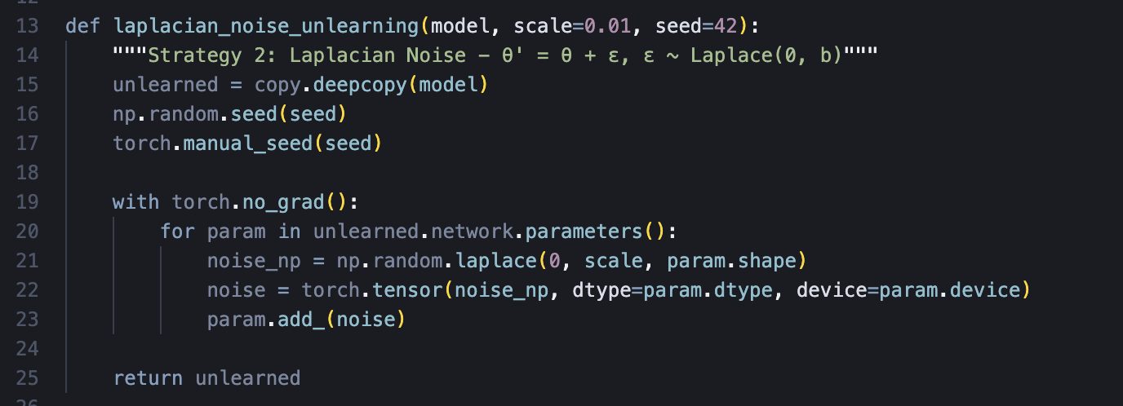
Unlearning methods used
2. Laplacian Noise
θ' = θ + ε, ε ~ Laplace(0, b)

Slide 18
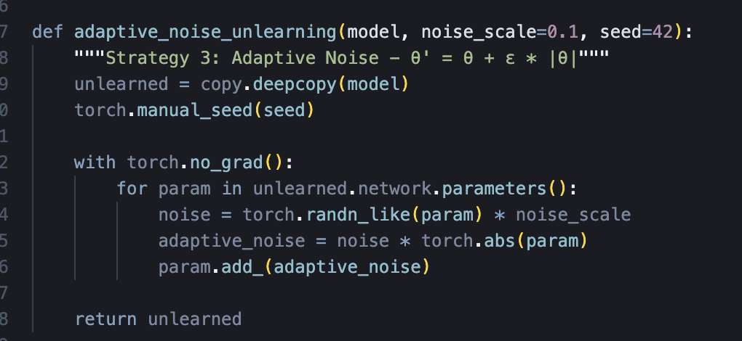
Unlearning methods used
3. Adaptive Noise
θ' = θ + ε * |θ|

Slide 19
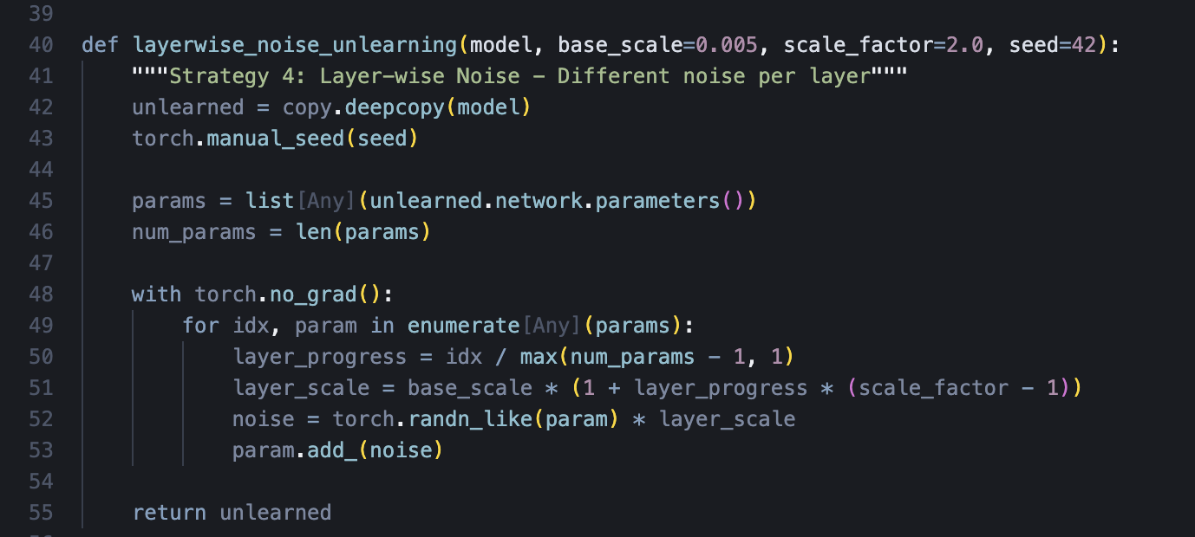
Unlearning methods used
4. Layer Wise Noise

Slide 20
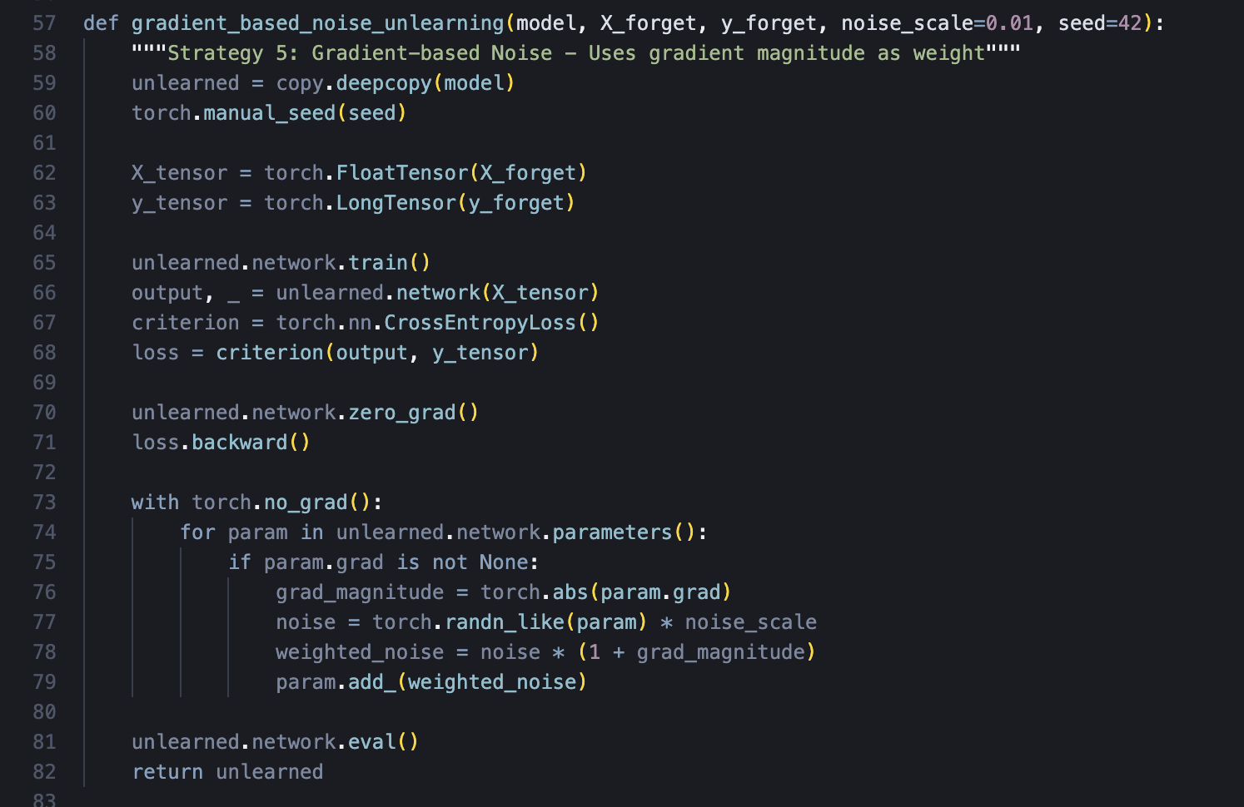
Unlearning methods used
5. Gardent based Noise

Slide 21
Unlearning tests
All three unlearning requests with all 5 methods
Currently testing different parameter combinations to find the ideal values

Slide 22
Questions
Are my three ideas of unlearning requests correct?
What can I use for real data now? Any publicly available datsets?

