Slide 1
circular queue

Slide 2
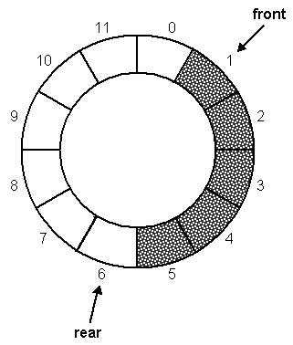
Array-based Queue
Use an array of size N in a circular fashion
Three variables keep track of the front, rear, and size
  f index of the front element
  r index immediately past the rear element, where we add new elements (enqueue)
  size is number of entries in the queue

Slide 3
Array-based Queue
Use an array of size N in a circular fashion
Three variables keep track of the front, rear, and size
  f index of the front element
  r index immediately past the rear element, where we add new elements (enqueue)
  size is number of entries in the queue
normal configuration
Q
0
1
2
f
r
wrapped-around configuration
Q
0
1
2
r
f
ADS Lecture 11

Slide 4
Queue Operations
We use the modulo operator (remainder of division)
Operation enqueue throws an exception if the array is full
This exception is implementation-dependent
Q
0
1
2
f
r
Q
0
1
2
r
f
Algorithm size()
return size
Algorithm isEmpty()
return size == 0
Algorithm enqueue(o)
if size() = N then
throw FullQueueException
else
Q[r] ← o
r ← (r + 1) mod N
update size!
size++
ADS Lecture 11

Slide 5
Queue Operations (cont.)
Operation dequeue throws an exception if the queue is empty
This exception is specified in the queue ADT
Algorithm dequeue()
if isEmpty() then
throw EmptyQueueException
else
o ← Q[f]
f ← (f + 1) mod N
return o
update size!
size--
Pros and cons of array based implementation:
Again: quick and easy, all methods run in constant time
But again, need good idea of capacity a priori
ADS Lecture 11

Slide 6

Your mission
See assessed exercise 2

