Slide 1
DB Final Project
tourist attraction guide with visitor ratings

Slide 2
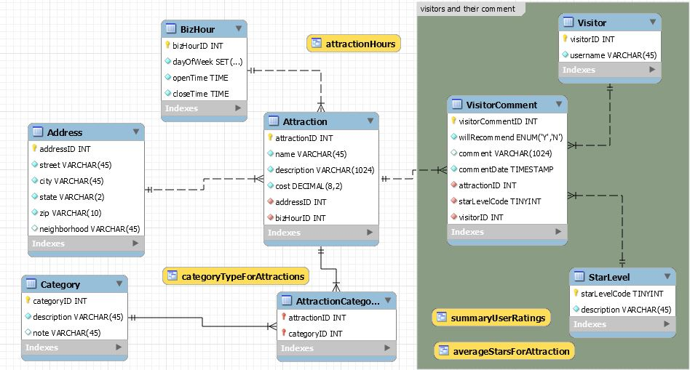
Top Level
EER Diagram

Slide 3
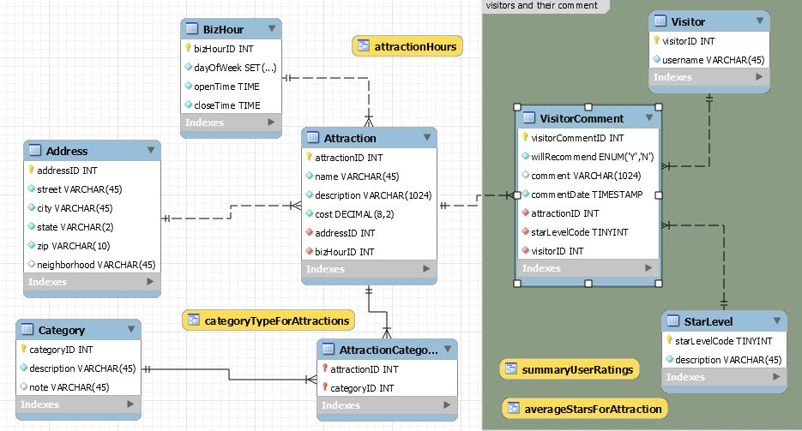
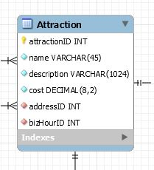
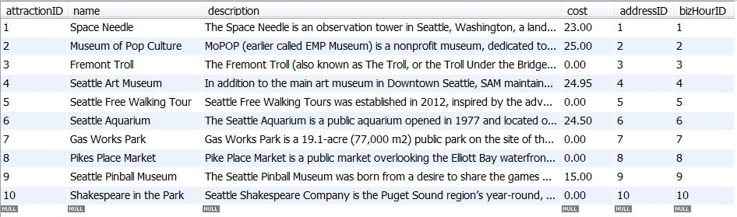
Attraction Table

Slide 4
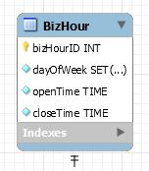
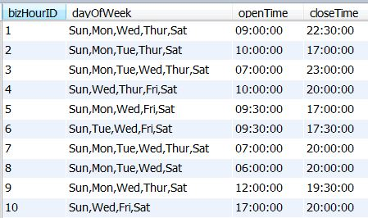
BizHour Table

Slide 5
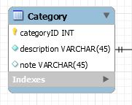
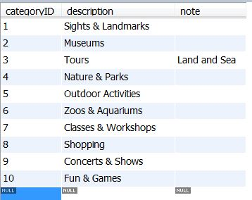
Category Table

Slide 6
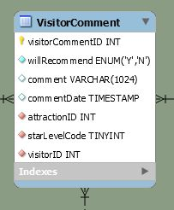
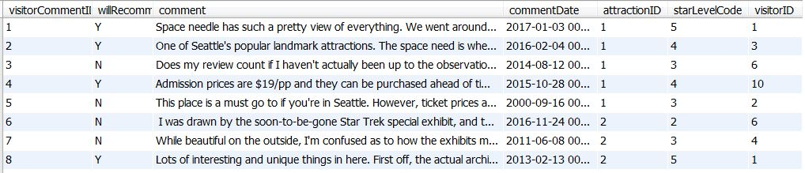
VisitorComment Table

Slide 7
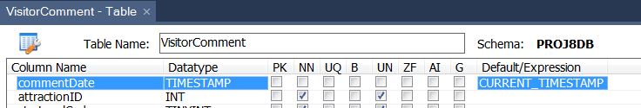
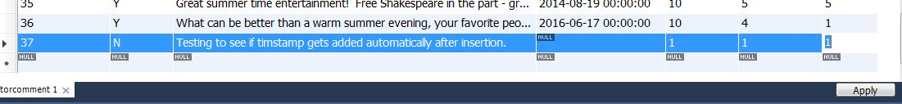
VisitorComment Table continued …
adding automatic timestamp at comment insertion.
( from week 7 slides, slide 12 of 28 )

Slide 8
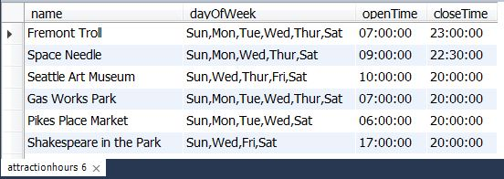
Query #1: biz hour view ( join )
CREATE VIEW attractionHours
AS
SELECT name, dayOfWeek, openTime, closeTime
FROM attraction
JOIN bizHour USING (bizHourID);
SELECT *
FROM attractionhours
WHERE closeTime > '18:30'
AND(FIND_IN_SET('Tue', dayOfWeek)
OR FIND_IN_SET(‘Wed', dayOfWeek));

Slide 9
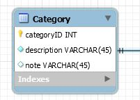
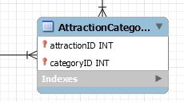
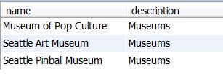
Query #2: attraction-category view ( join )
CREATE VIEW categoryTypeForAttractions
AS SELECT name, Category.description
FROM Attraction
JOIN AttractionCategory USING (attractionID) JOIN Category USING (categoryID)
ORDER BY attractionID;
SELECT *
FROM categoryTypeForAttractions
WHERE description = ‘Museums’;

Slide 10
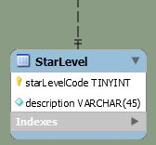
Query #3: attraction w/ star rating view ( summary )
CREATE VIEW averageStarsForAttraction
AS
SELECT name AS attraction,
COUNT(*) AS numOfComments, ROUND(AVG(starLevelCode)) AS averageStars
FROM attraction
JOIN visitorComment USING (attractionID)
JOIN StarLevel USING (starLevelCode)
GROUP BY attractionID;

Slide 11
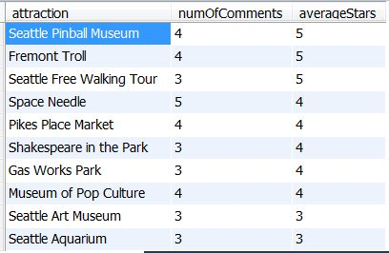
Query #3: attraction w/ star rating view continued ….
SELECT * FROM averageStarsForAttraction
ORDER BY averageStars DESC;

Slide 12

Query #4: using 2 views
SELECT *
FROM attractionHours view for biz hours
WHERE name IN
( SELECT attraction
FROM averageStartsForAttraction view for star ratings
WHERE averageStars > 4 );

Slide 13
my takeaways ….
Views, my BFF
reduced complexity …. hid a lot of ugly stuff.
reusable and disk space friendly because no actual data is stored in views.
Workbench is a pretty cool tool
allowed rapid prototyping …. took EER diagrams and forward engineered schemas.
did a lot of tedious and mind-numbing grunt work …. generated DDLs and DMLs statements.
Final Project, something to talk about
gained experience working on a (small) DB project, end-to-end.
juicy response to a potential interview question - “Tell me about a recent project you worked on .…”

Slide 14
It’s not wrong … but just bad design.
- me
thank you

