Slide 1

DriverPass System Analysis
Marcus J. Wilson
Notes:
[No speaker notes required for this slide.]

Slide 2

System Requirements
Functional Requirements:
Customers should be able to book driving lessons online or through their office secretary using the system.
A customer and a driver should be matched by the system, and it should keep track of which user is paired with which driver, time, and vehicle.
Nonfunctional Requirements:
In order to secure sensitive driver data from unauthorized access, the system should have security measures with different personnel having different permissions and functions.
In order to allow future expansion and ensure that it can handle an expanding number of drivers and trucking companies, the system should be easily scalable.
Notes:
DriverPass is able to simplify and streamline their scheduling process with the help of the first requirement, which enables clients to make appointments for driving lessons online or through their office secretary. Customers can easily book courses with this function without calling or coming into the office, which lessens the workload for the office secretary.
DriverPass can more effectively manage their drivers and lessons thanks to the second requirement, which pairs a driver with a customer and keeps track of the pairing. This feature allows DriverPass to keep track of drivers' availability and schedules, ensuring that they are matched with the appropriate clients and classes.

Slide 3
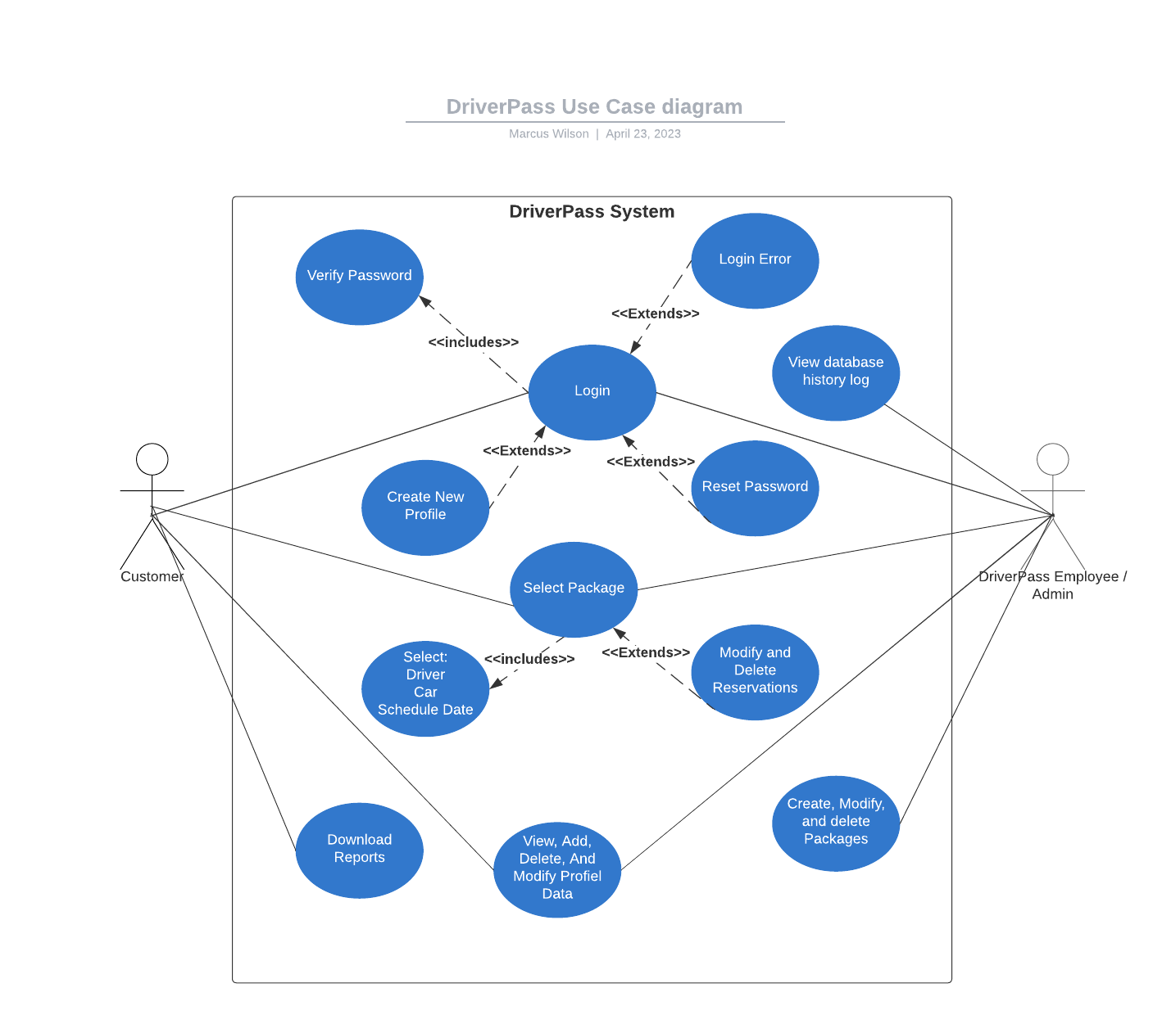
Use Case Diagram
Notes:
Within my Use case diagram, it depicts the different functions, roles, and relationships between Actors and processes. When the customer Actor logs into the DriverPass system, there is a lot happening behind the scenes, the Login screen is the interface that houses various functions. When a customer logs into the system there are prompts such as Create New profile, Reset password, and errors that occur if a login attempt fails. The Actor, DriverPass, in this situation posses the same functions as the Customer actor; however, there is an additional function “view database history log”, which allows the admin to collect and analyze data about business operations.
Another function that is available to both actors is the “select Package” function, within this function there are options to customize your driving experience, as well as modify reservations.
The Customer Actor has access to 4 shared functions:
- Login
- Select Package
- View, Add, Delete, And Modify profile data
- Download reports
The DriverPass Actor has access to 5 functions:
- Login
- Select Package
- View database history log
- View, Add, Delete, And Modify profile data
- Create, modify, and delete packages.

Slide 4
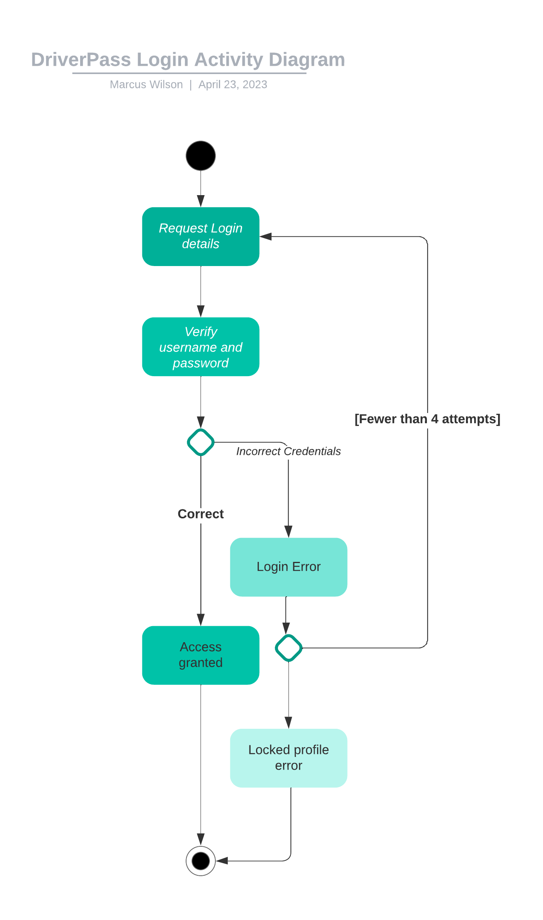
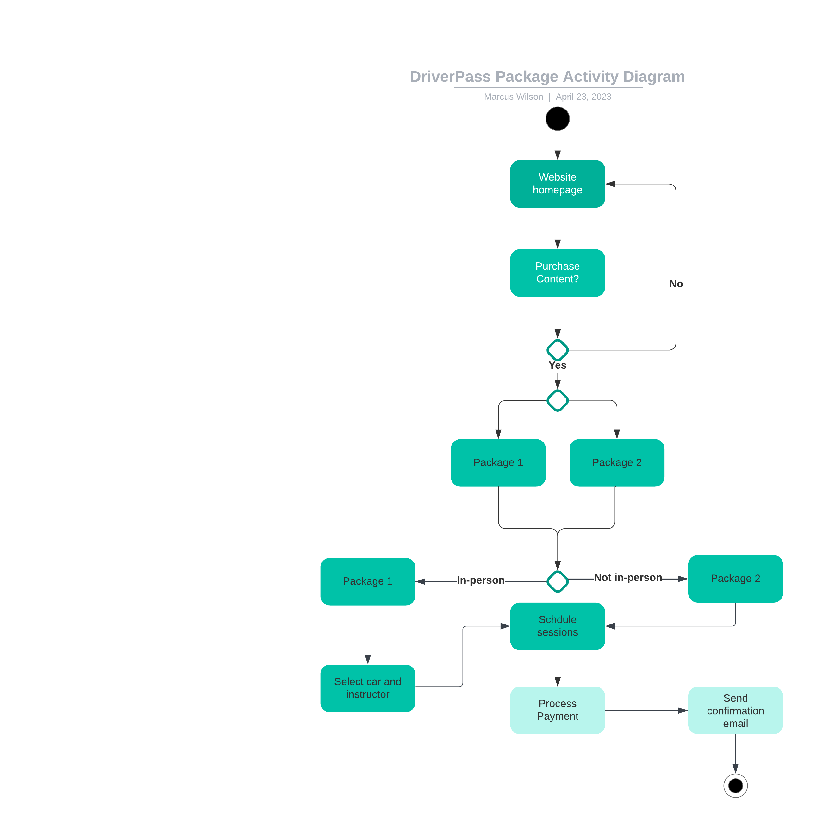
Activity Diagram
Notes:
In my design, I considered DriverPass's need for a secure login process that ensures only authorized users can access the system. To achieve this, the activity diagram shows a step-by-step flow of events that occurs when logging into the DriverPass program.
Firstly, the user is required to enter their username and password on the login screen. The system then verifies the entered credentials, and if they are correct, the user gains access to the system. However, if the entered credentials are incorrect, the system displays a login error message and prompts the user to try again. The user is given up to three attempts to enter the correct login credentials.
To further ensure security, the system displays a locked profile error message if the user exceeds the three attempts limit. This means that the user's profile is temporarily locked, and they cannot access the system until the profile is unlocked.
By including these steps, the system design accounts for DriverPass's need for a secure login process, which prevents unauthorized access to the system. The three attempts limit and locked profile error message also prevent brute-force attacks on the login credentials, enhancing the system's security.

Slide 5
Security
User authentication: The system will require users to enter a username and password to access the system, which helps prevent unauthorized access to sensitive data.
Role-based access control: Different users will have different roles and access levels within the system, which ensures that only authorized users can access certain functionalities.
Encryption: The system will use encryption to protect sensitive data in transit, such as when a user logs in or enters personal information.
Regular backups: The system will have regular backups to prevent data loss in case of a security breach or other system failure.
Monitoring and auditing: The system will log all user actions and system events to allow for monitoring and auditing of the system, which can help identify potential security issues.
Regular updates: The system will receive regular updates to ensure that security vulnerabilities are addressed and the system is up-to-date with the latest security standards.
Notes:
In designing the DriverPass system, security was a key consideration. I wanted to make sure that the system was secure and that sensitive driver information was protected. To do this, I incorporated several security measures into the system design.
Firstly, I designed the system to have different levels of user access. This means that different users will have different rights and roles within the system, so that only authorized users can access certain parts of the system.
Secondly, I implemented password protection and encryption to prevent unauthorized access to the system. Passwords are required to log in to the system, and passwords are stored in an encrypted format to protect them from being hacked.
We also incorporated measures to prevent against data loss or theft. Regular backups of the system data are performed, and access to the system is monitored and logged to detect any unauthorized access attempts.

Slide 6
System Limitations
The system may have limitations in terms of scalability, and may not be able to handle a large number of users or data input.
The security measures put in place may not be foolproof, and there may be potential security breaches if not constantly monitored and updated.
The system may be dependent on certain hardware and software requirements, which may limit its compatibility with different operating systems or devices.
The system may require ongoing maintenance and updates to keep up with changes in regulations or industry standards, which may require additional resources and expenses.
Notes:
- Firstly, as with any system, there is always a risk of unforeseen security vulnerabilities or flaws in the system design that may be exploited by hackers or attackers. While we have implemented security measures to mitigate these risks, there is always a possibility that new security vulnerabilities may be discovered and exploited.
- Secondly, the design assumes that users will follow best practices for password security, such as using strong passwords and not sharing them with others. If users do not follow these best practices, their accounts may be vulnerable to compromise.
- Thirdly, the system's performance may be impacted by the number of users or amount of data being processed. As the system scales up to support more users and data, additional resources may be required to maintain its performance.
- Finally, the design is based on current technology and may become outdated over time as new technology emerges. It will be important to regularly review and update the system to ensure it remains effective and secure.

