Slide 1
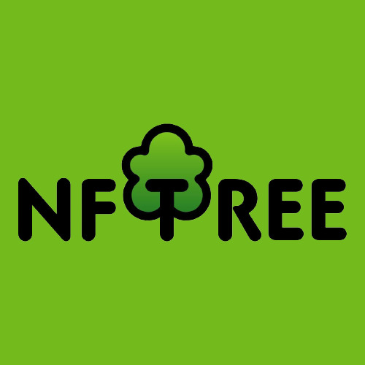
Curated by: Barberis Emanuele

Slide 2
INDEX
01
02
Idea
Technology & Implementation
03
04
Demo live
Future developments

Slide 3
01
IDEA

Slide 4
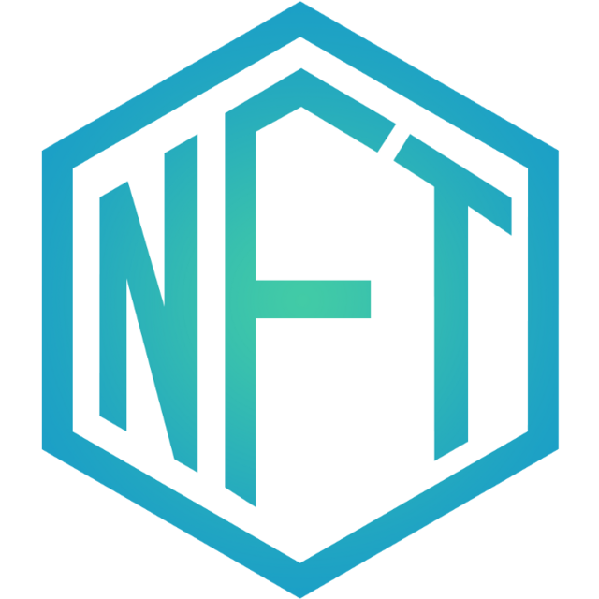
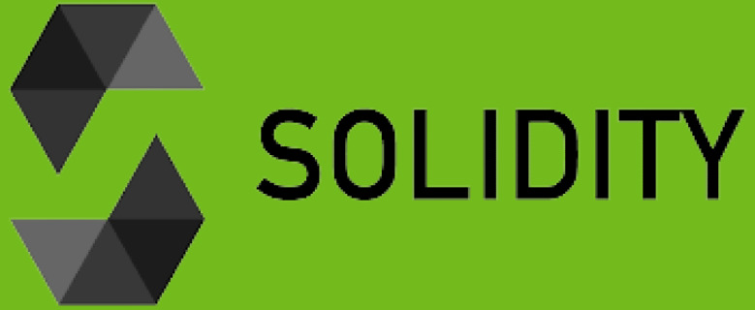
NFT & Solidity
An NFT, non-fungible token, is a special type of cryptographic token that represents the title deed and certificate of authenticity written on the Blockchain of a unique asset. Solidity is a high-level programming language that implements Smart Contract technology. Solidity offers a number of standards, including ERC-721 which supports non-fungible tokens.

Slide 5
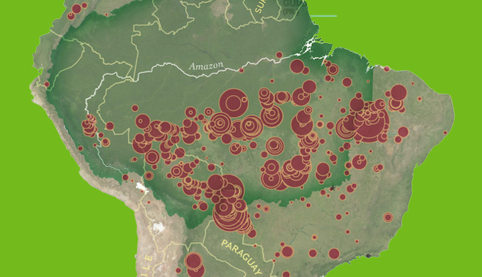
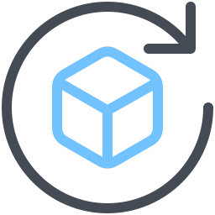
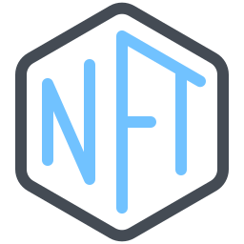

Protecting the 'Green Lung'
The idea behind it is to protect the Amazon rainforest by allocating every fee for the publication of an NFT and 5% of each transaction to an official non-profit organization that deals with protecting the 'green lung'. Within the web application, the user will be able to:
Selling/Buying NFTs;
View the NFTs you own;
View a transaction history.

Slide 6
02
TECHNOLOGY &
IMPLEMENTATION

Slide 7
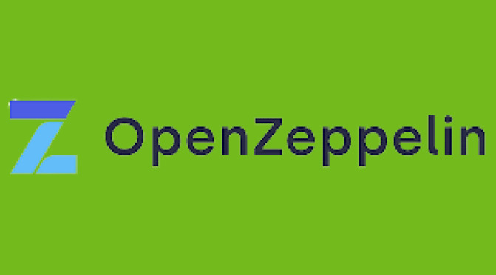
Back-End : Solidity & OpenZeppelin
Openzeppelin is a blockchain application development library that provides security, reliability, and risk management for Ethereum projects. In particular, the following libraries were used:
ERC721 ERC721URIStorage Counters ReentrancyGuard
Notes:
ERC721 per i token non fungibili,
ERC721URIStorage per archiviare i metadati off-chain ed essere in grado di impostare tokenURI individuali
Counters che fornisce dei contatori
ReentrancyGuard che aiuta a prevenire le chiamate rientranti a una funzione, impedendo a un contratto di richiamare se stesso direttamente o indirettamente

Slide 8
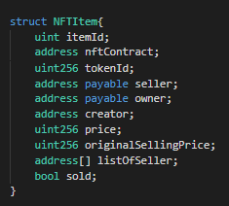
Structure NFT & NFTMarketplace
Within the code of NFT.sol, there are two functions, in addition to the builder, that allow you to create a Token and transfer ownership of it.
Within the code of NFTMarketplace.sol that creates and manages the marketplace there are, in addition to the builder:
Structure of an NFTItem; 2 modifiers to control access to functions; Different functions that deal with sales and purchasing management; Different functions that deal with searching for NFTs based on precise parameters.

Slide 9

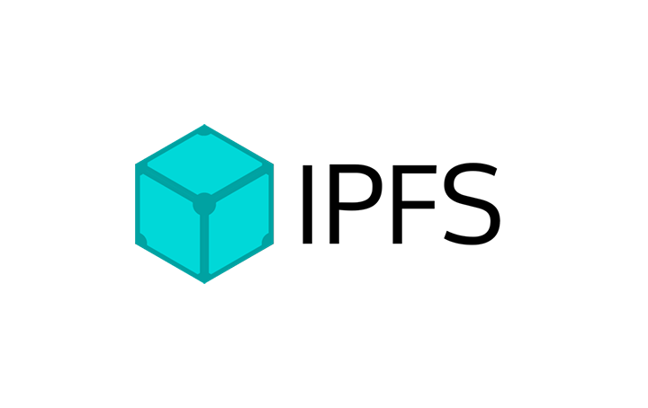
Metadata: Infura & IPFS
To associate metadata with an NFT, the Infura API suite was used, which provides reliable access to Web3 networks by offering the possibility of using IPFS, which is a distributed p2p network for saving and accessing files, applications and data. Each NFT has been associated, via tokenURI:
A name; A description; An image.
The JSON file, containing the metadata, is passed as input to IPFS which produces a CID, or content identifier, which is derived directly from the data itself. It will refer to only one piece of content so that it cannot be replaced or altered.

Slide 10
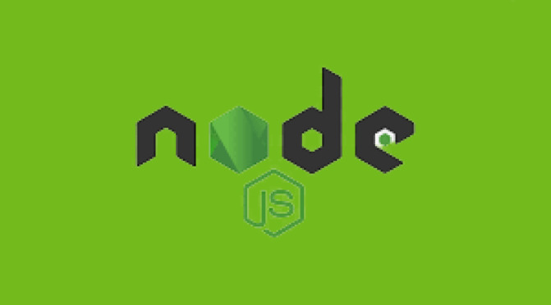

NodeJs & Metamask
Node.js is an event-oriented, cross-platform runtime system for executing JavaScript code. Necessary to develop the web application and establish a connection with a Web3Provider. The path to connect to a node is provided via Metamask which is directly present in the browser.
There are 5 javascript files created:
_app,js; index.js; create-item.js; my-nfts.js creator-panel.js

Slide 11
03
DEMO LIVE

Slide 12
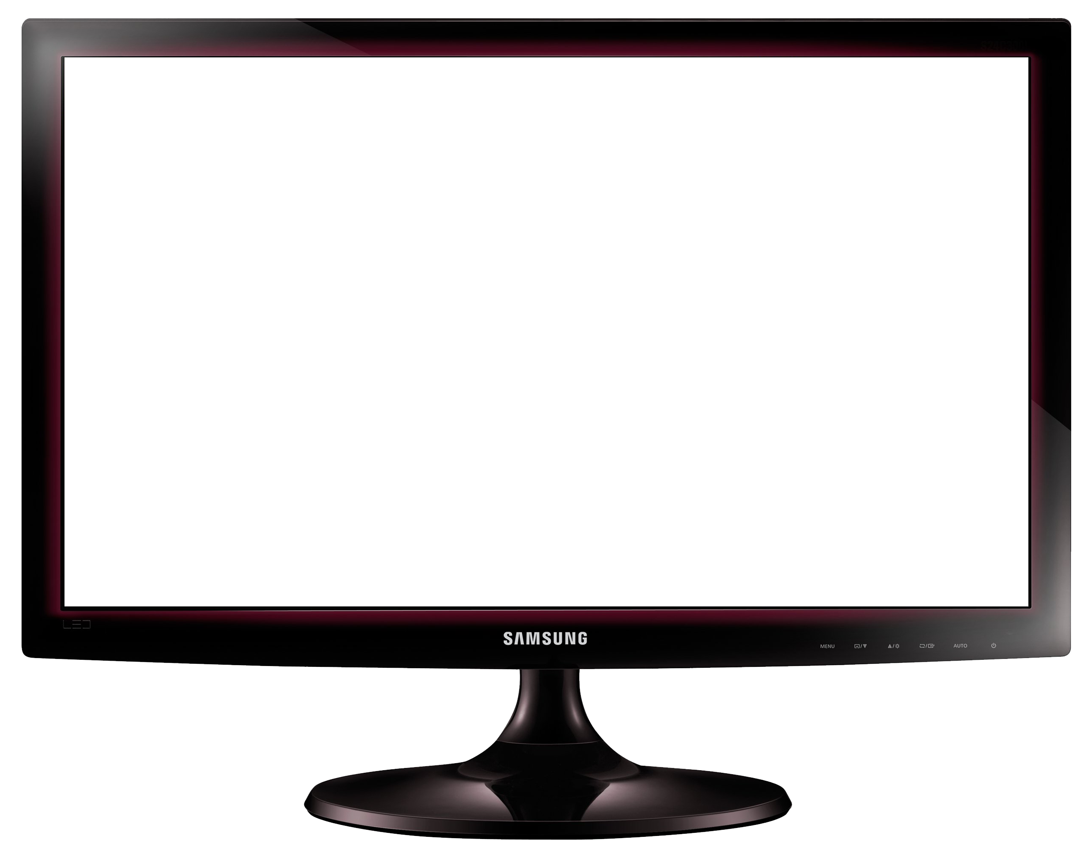
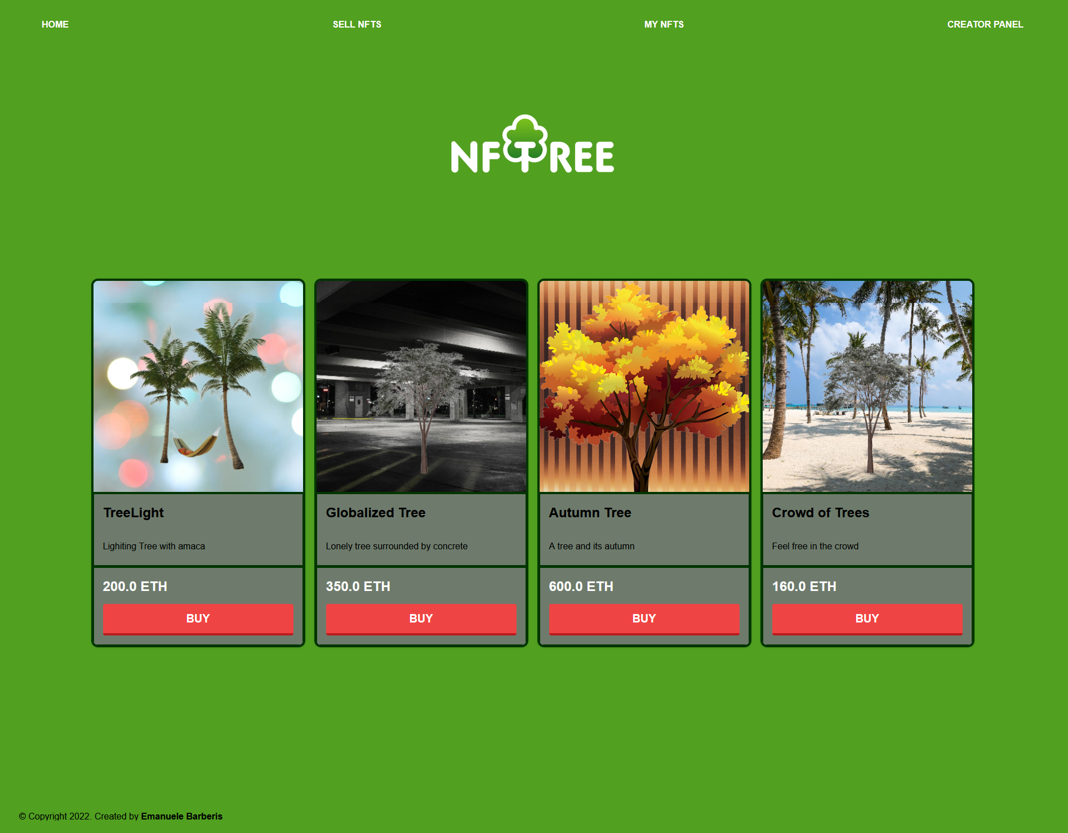

Slide 13
04
FUTURE DEVELOPMENTS

Slide 14
FUTURE DEVELOPMENTS
Add an additional meta data: Oxygen Credits, generated for each NFT every day that a user makes a holding transaction. Creating pools. Each user can decide to spend their Oxygen credits by participating in different projects that allow them to receive a reward after a certain amount of time. Add an additional metadata: Event. An owner of an NFT can give such an NFT as a gift, attaching the name of an event that will remain indelible and unchangeable.

Slide 15
THANK YOU FOR YOUR ATTENTION

