Slide 1

Smart Doorbell System
Explore Now

Slide 2
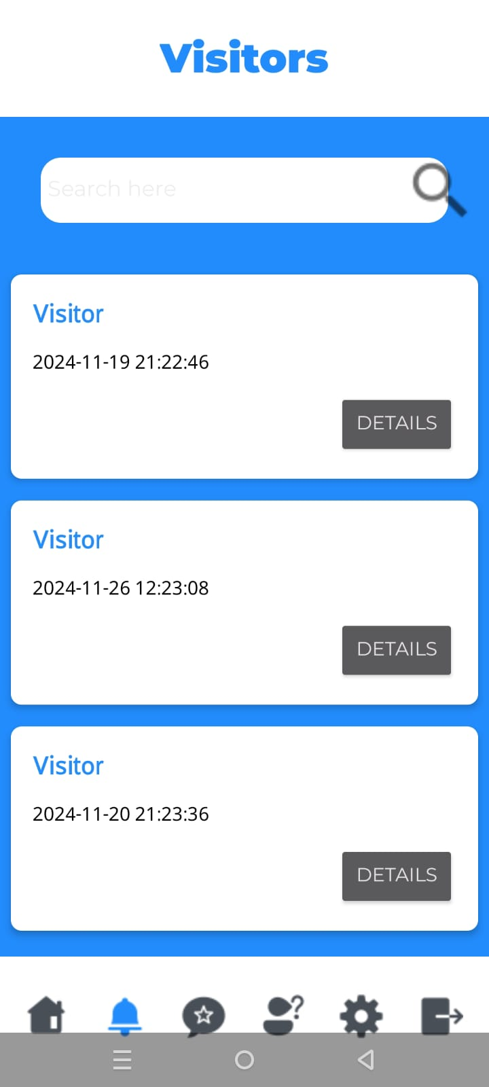
Introduction
SmartKnock is a smart doorbell that notify the homeowner about every knock at the door on their mobile phone all around the world!

Slide 3
Problem
Home security keeping track of visitors is always a real concern for homeowners who stay away from their homes most time of the day

Slide 4
Solution
SmarkKnock app is a solution which help keeping track of all visitors along with their picture as soon as they are at the door

Slide 5
Technologies
Hardware (Esp-32 cam module)
Firebase Realtime Database
Android Studio

Slide 6
Use Cases
Visitor Notification
Help Centre
Multi-user access control
DND mode scheduling
Visitors' history log
Give Feedback
Manage user’s accounts
Device Security Pin
Naming known visitors
Analyze Feedback

Slide 7
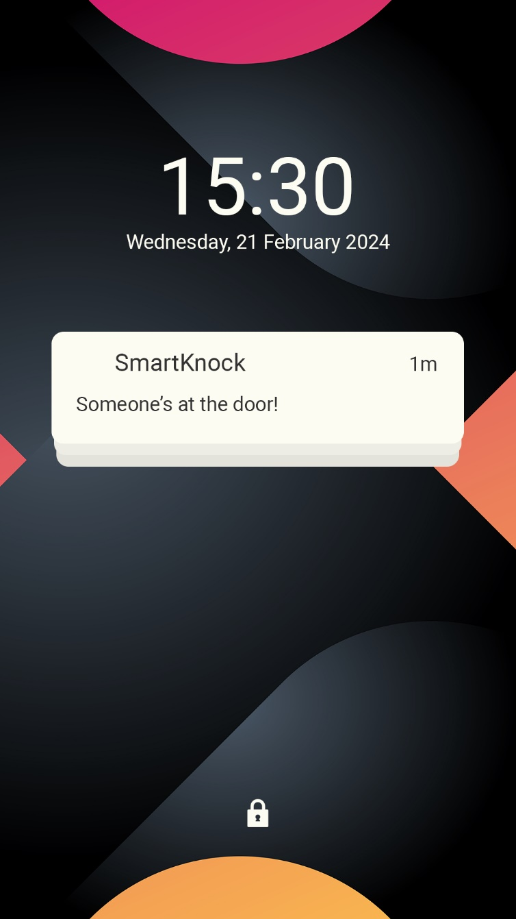
Major Use Case
Visitors Notification
Scope: Smart Knock smart doorbell system

Slide 8
Major Use Case
Visitors Notification
Level: User goal

Slide 9
Major Use Case
Visitors Notification
Primary Actor: User (Homeowner)

Slide 10
Major Use Case
Visitors Notification
Stakeholders and Interests:
User (Homeowner): Wants to be notified.
Cloud and Storage System: Ensures visitor images securely stored.
Doorbell: Detects the visitor press, captures the visitor’s image, and triggers the notification system.

Slide 11
Major Use Case
Visitors Notification
Preconditions: The Smart Knock doorbell is installed, connected to the user’s network, and integrated with the mobile app.

Slide 12
Major Use Case
Visitors Notification
Postconditions: The user receives a real-time notification on their mobile device with the visitor’s image and timestamp.

Slide 13
Main Success Scenario:
Actor’s Action | System's Responses
1. A visitor presses the Smart Knock doorbell. | 2. The system detects the press and triggers the visitor notification system
 | 3. The system captures an image of the visitor.
 | 4. A notification is sent to the user’s mobile device, including the visitor’s image and timestamp.
5. The user views the notification and decides if he wants to name the visitor in the log for easy accessibility in future. | 6. The system records the user's interaction and updates the database.

Slide 14
Extensions
Actor’s Action | System's Responses
1. The system encounters an error while sending the notification due to network issues. | 2. The system stores the event data and retries sending the notification once connectivity is restored.
 | 3. The user is notified of the event soon.

Slide 15
Major Use Case
Visitors Notification
Special Requirements:
The system must ensure that the visitor's image is captured and sent within seconds of the doorbell press.
The system must comply with privacy regulations, ensuring that visitor data is stored securely and not misused.

Slide 16
Major Use Case
Visitors Notification
Technology and Data Variations List: The app may send notifications based on user preferences.

Slide 17
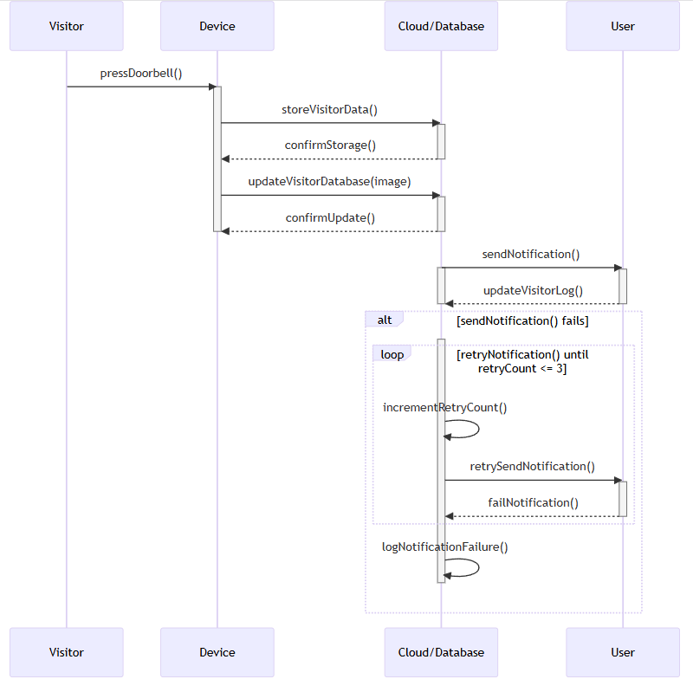
Action Sequence Diagram

Slide 18
Grasp
Controller
Acts as the façade and an intermediary between the UI (View) and the business logic (Model). It delegates tasks to the VisitorManager.

Slide 19
Grasp
Low-coupling
The VisitorManager and VisitorController are loosely coupled to the UI. The UI does not directly interact with Firebase but communicates via these classes.

Slide 20
Grasp
High-cohesion
VisitorAdapter focuses only on binding VisitorView data to the RecyclerView.
VisitorController handles the business logic of visitors.
VisitorsActivity focuses on displaying the list of visitors.

Slide 21
Grasp
Indirection
Decouples the Firebase database logic from the rest of the application. Instead of directly accessing Firebase, classes use DatabaseHelper.

Slide 22
Grasp
Pure Fabrication
VisitorController is not derived from the problem domain but is created to handle visitor-related logic and improve separation of concerns.

Slide 23
Design Patterns
Adapter Pattern
The VisitorAdapter adapts the visitor data (VisitorView objects) to the format suitable for display in a RecyclerView.

Slide 24
Design Patterns
MVC Pattern
Visitor Management:
Model: VisitorView represents visitor data.
View: Visitors and VisitorDetailsActivity display visitor data.
Controller: VisitorController manages the business logic for fetching and updating visitor data.

Slide 25
Design Patterns
Here are some other design patterns implemented in our project
Observer Pattern
Singleton Pattern
Factory Pattern
Callback Pattern

Slide 26
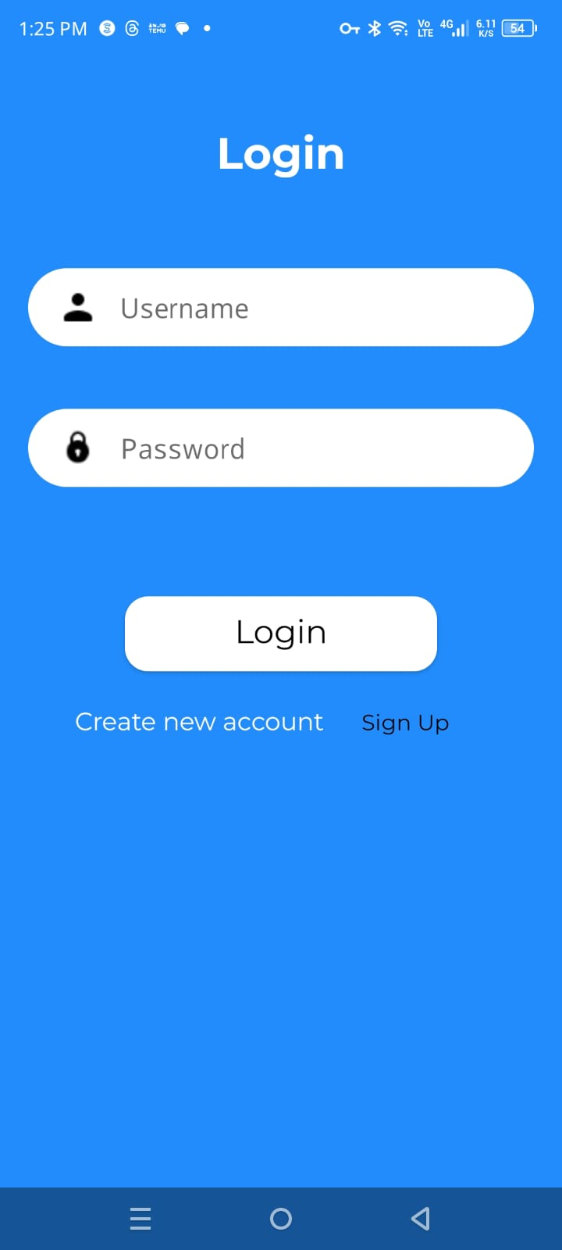
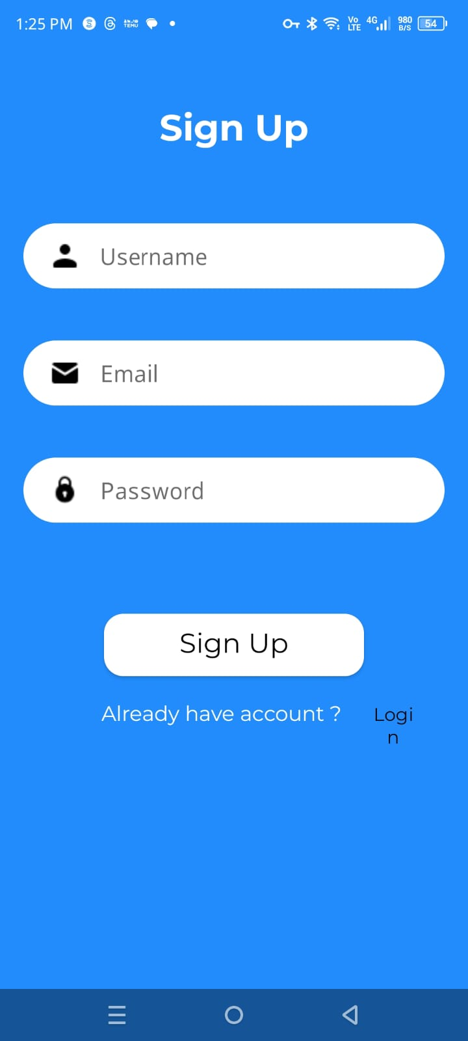
User Interface
Login
Signup

Slide 27
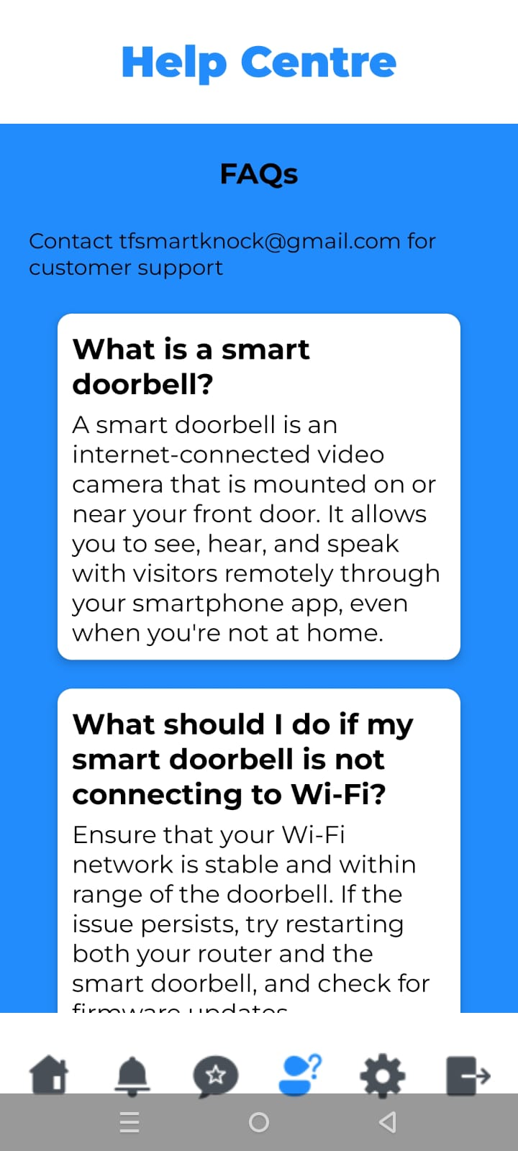
User Interface
Visitors Log
Help Centre

Slide 28
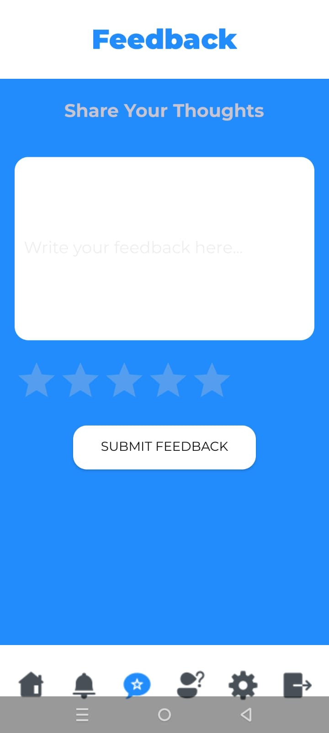
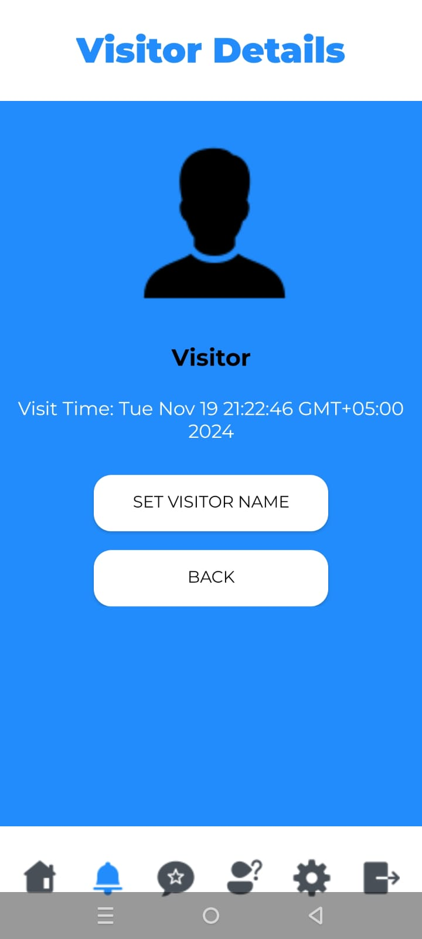
User Interface
Feedback
Visitors Details

Slide 29
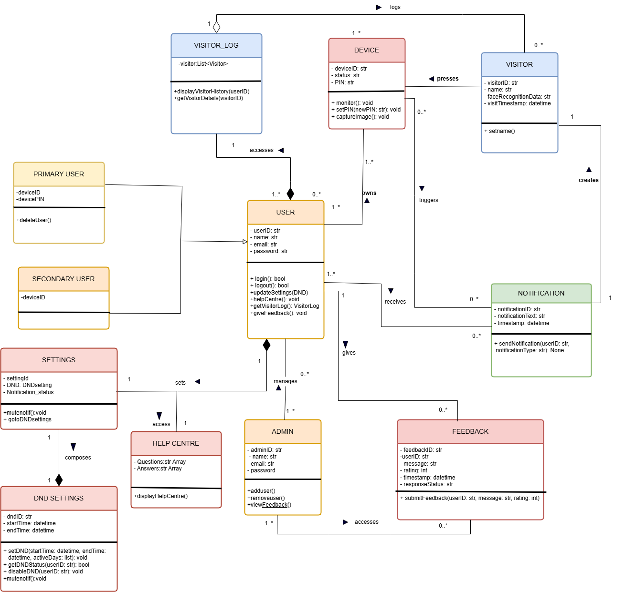
Class Diagram

Slide 30
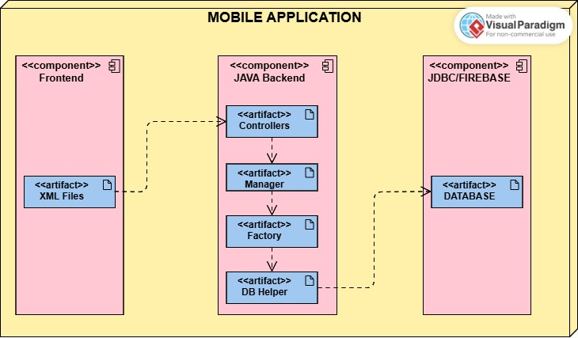
Deployment Diagram

Slide 31
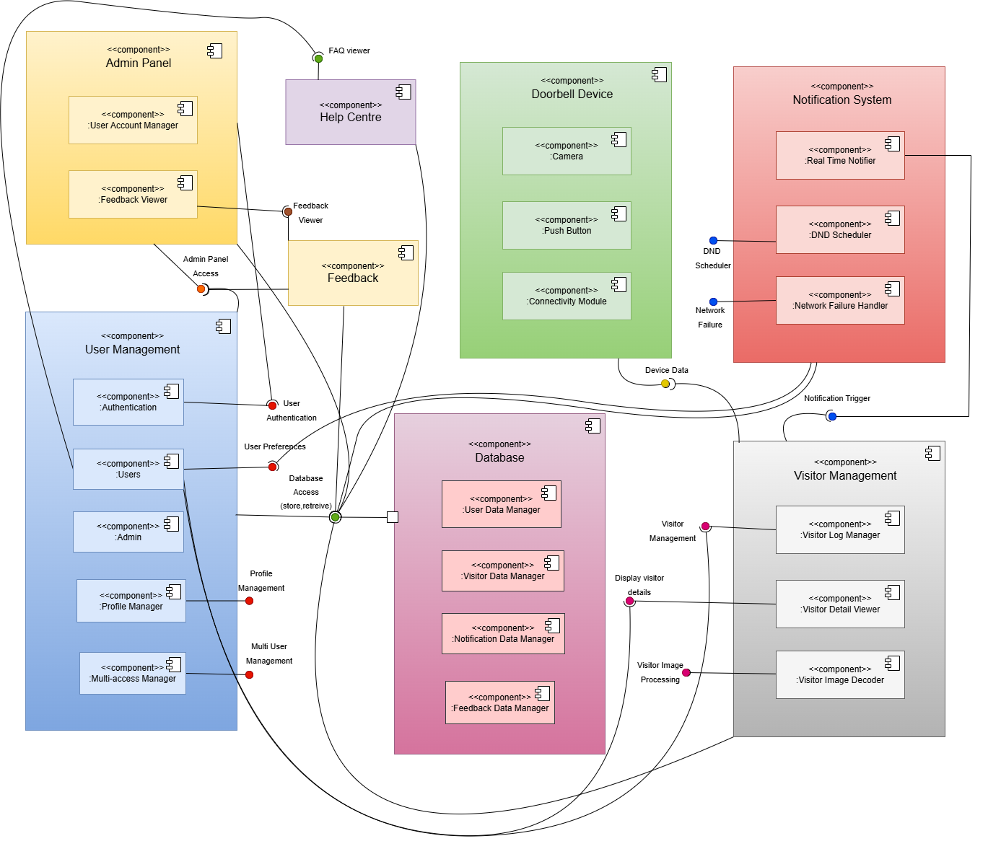
Component Diagram

Slide 32
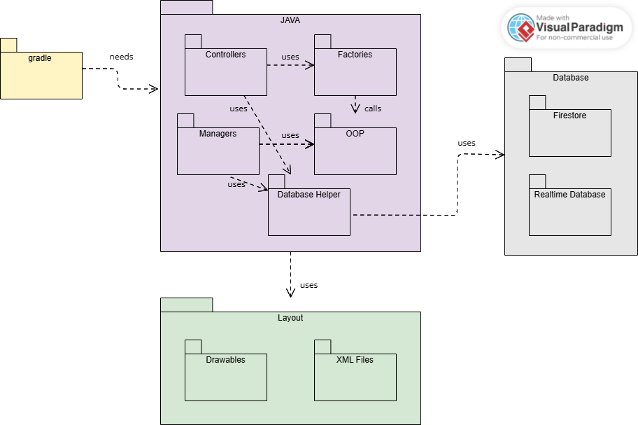
Package Diagram

Slide 33
Thank
You.

