Slide 1

Smart Doorbell System
Explore Now

Slide 2
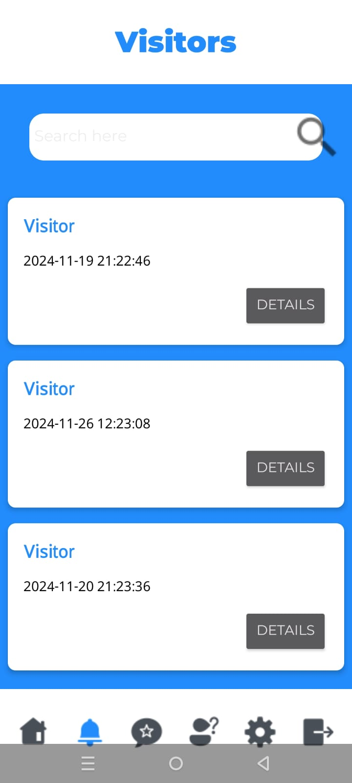
Introduction
SmartKnock is a smart doorbell that notify the homeowner about every knock at the door on their mobile phone all around the world!

Slide 3
Problem
Home security keeping track of visitors is always a real concern for homeowners who stay away from their homes most time of the day

Slide 4
Solution
SmarkKnock app is a solution which help keeping track of all visitors along with their picture as soon as they are at the door

Slide 5
Technologies
Hardware (Esp-32 cam module)
Firebase Realtime Database
Android Studio

Slide 6
Use Cases
Visitor Notification
Visitor Picture
Multi-user access control
DND mode scheduling
Visitors' history log
Feedback
Manage user’s accounts
Security Pin
Naming known visitors
Analyse Feedback

Slide 7
Grasp
Controller
Acts as the intermediary between the UI (View) and the business logic (Model). It delegates tasks to the VisitorManager.

Slide 8
Grasp
Low-coupling
The VisitorManager and VisitorController are loosely coupled to the UI. The UI does not directly interact with Firebase but communicates via these classes.

Slide 9
Grasp
High-cohesion
VisitorAdapter focuses only on binding VisitorView data to the RecyclerView.
VisitorController handles the business logic of visitors.
VisitorsActivity focuses on displaying the list of visitors.

Slide 10
Grasp
Indirection
Decouples the Firebase database logic from the rest of the application. Instead of directly accessing Firebase, classes use DatabaseHelper.

Slide 11
Grasp
Pure Fabrication
VisitorController is not derived from the problem domain but is created to handle visitor-related logic and improve separation of concerns.

Slide 12
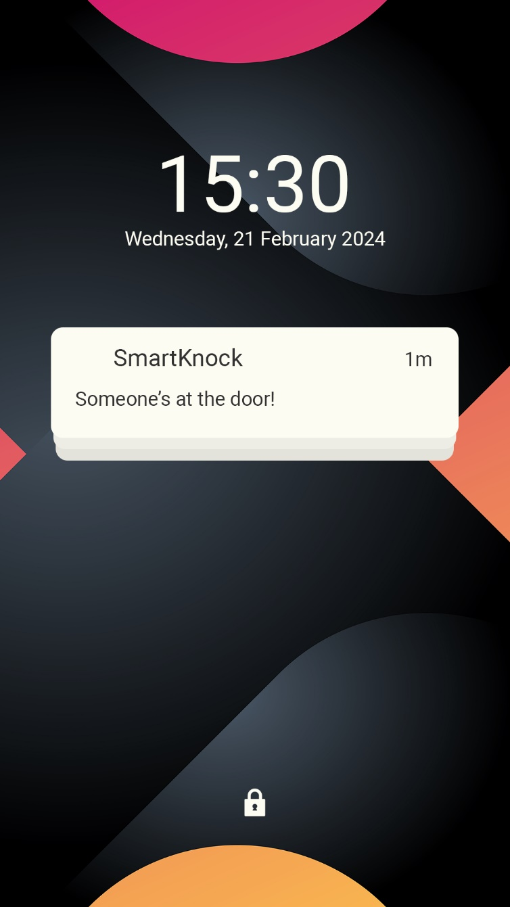
Major Use Case
Visitors Notification
Scope: Smart Knock smart doorbell system

Slide 13
Major Use Case
Visitors Notification
Level: User goal

Slide 14
Major Use Case
Visitors Notification
Primary Actor: User (Homeowner)

Slide 15
Major Use Case
Visitors Notification
Stakeholders and Interests:
User (Homeowner): Wants to be notified.
Cloud and Storage System: Ensures visitor images securely stored.
Doorbell: Detects the visitor press, captures the visitor’s image, and triggers the notification system.

Slide 16
Major Use Case
Visitors Notification
Preconditions: The Smart Knock doorbell is installed, connected to the user’s network, and integrated with the mobile app.

Slide 17
Major Use Case
Visitors Notification
Postconditions: The user receives a real-time notification on their mobile device with the visitor’s image and timestamp.

Slide 18
Main Success Scenario:
Actor’s Action | System's Responses
1. A visitor presses the Smart Knock doorbell. | 2. The system detects the press and triggers the visitor notification system
 | 3. The system captures an image of the visitor.
 | 4. A notification is sent to the user’s mobile device, including the visitor’s image and timestamp.
5. The user views the notification and decides if he wants to name the visitor in the log for easy accessibility in future. | 6. The system records the user's interaction and updates the database.

Slide 19
Extensions
Actor’s Action | System's Responses
1. The system encounters an error while sending the notification due to network issues. | 2. The system stores the event data and retries sending the notification once connectivity is restored.
 | 3. The user is notified of the event soon.

Slide 20
Major Use Case
Visitors Notification
Special Requirements:
The system must ensure that the visitor's image is captured and sent within seconds of the doorbell press.
The system must comply with privacy regulations, ensuring that visitor data is stored securely and not misused.

Slide 21
Major Use Case
Visitors Notification
Technology and Data Variations List: The app may send notifications based on user preferences.

Slide 22
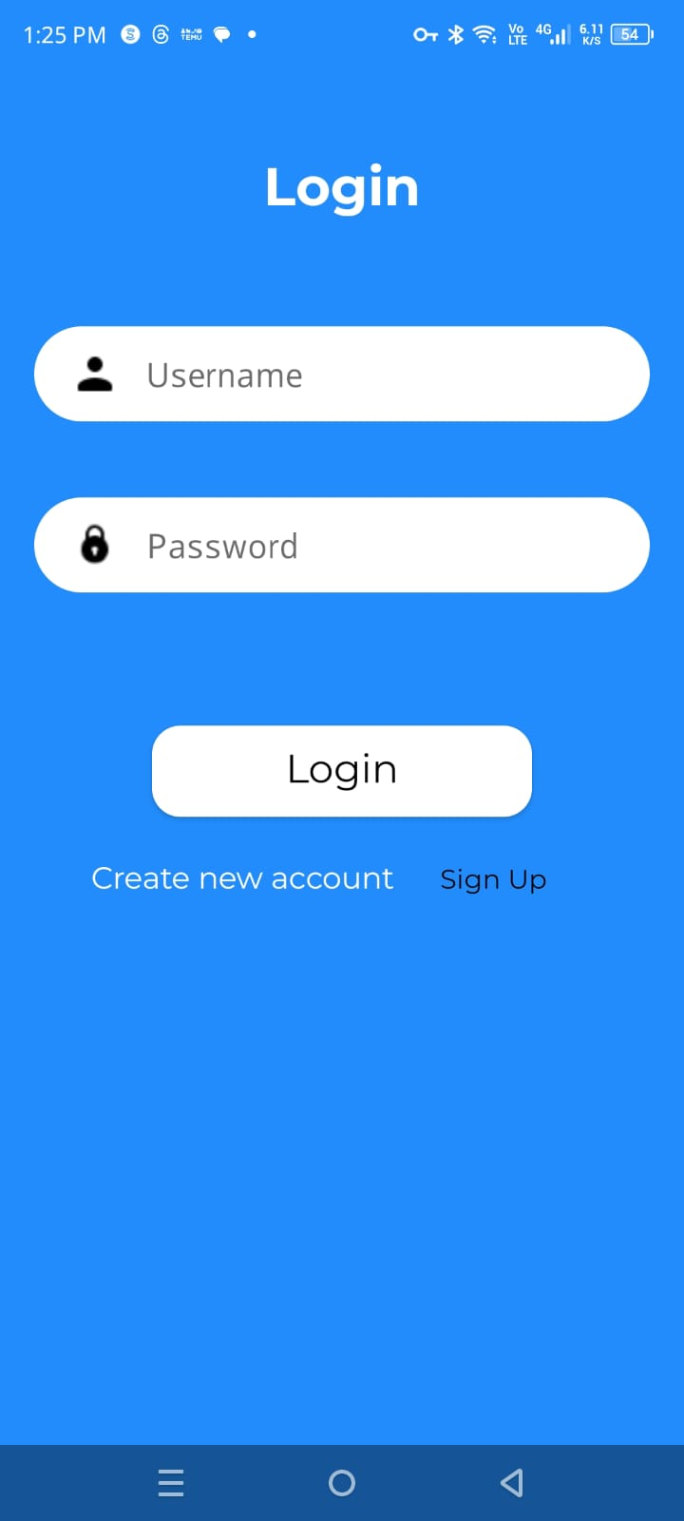
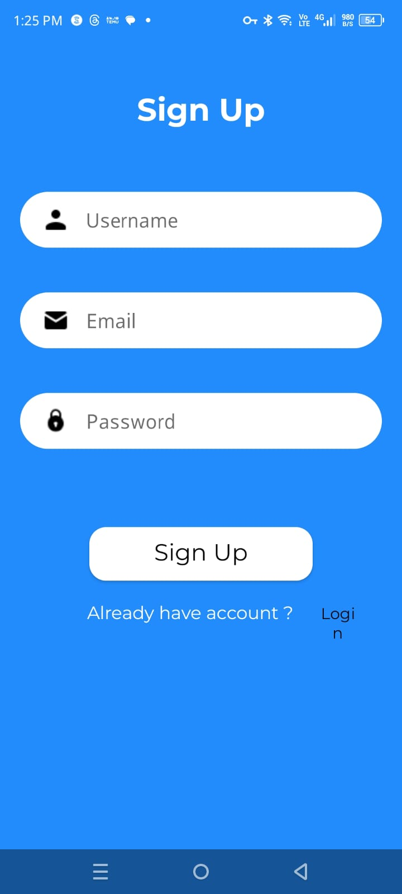
User Interface
Login
Signup

Slide 23
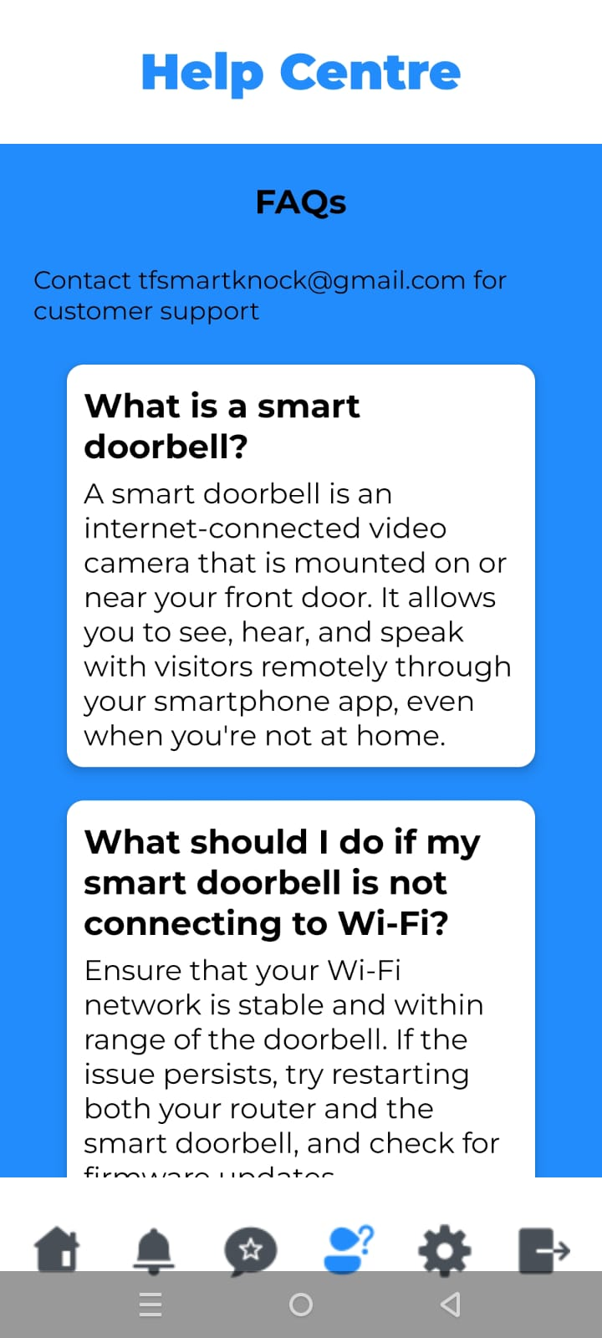
User Interface
Visitors Log
Help Centre

Slide 24
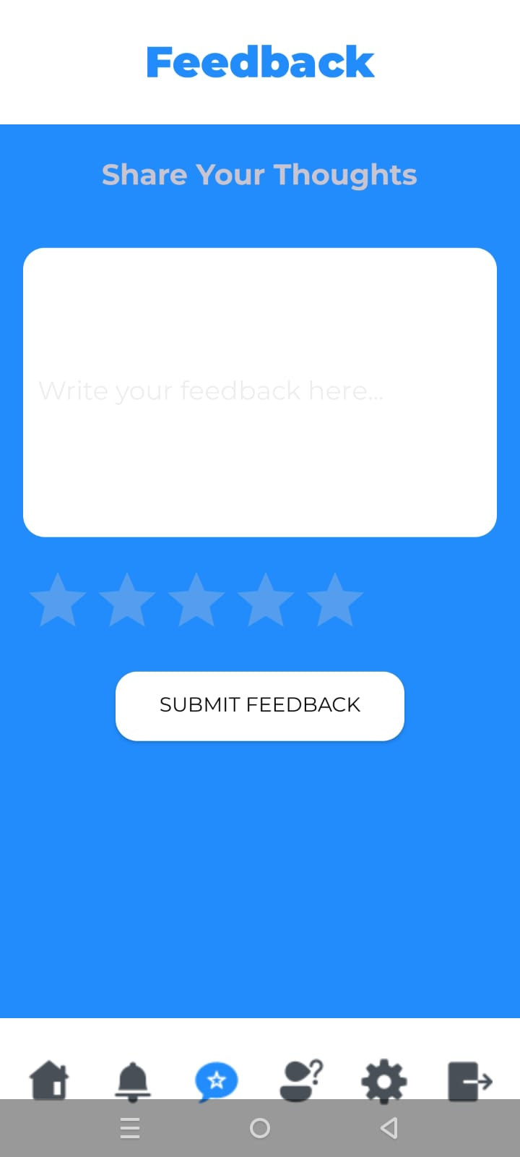
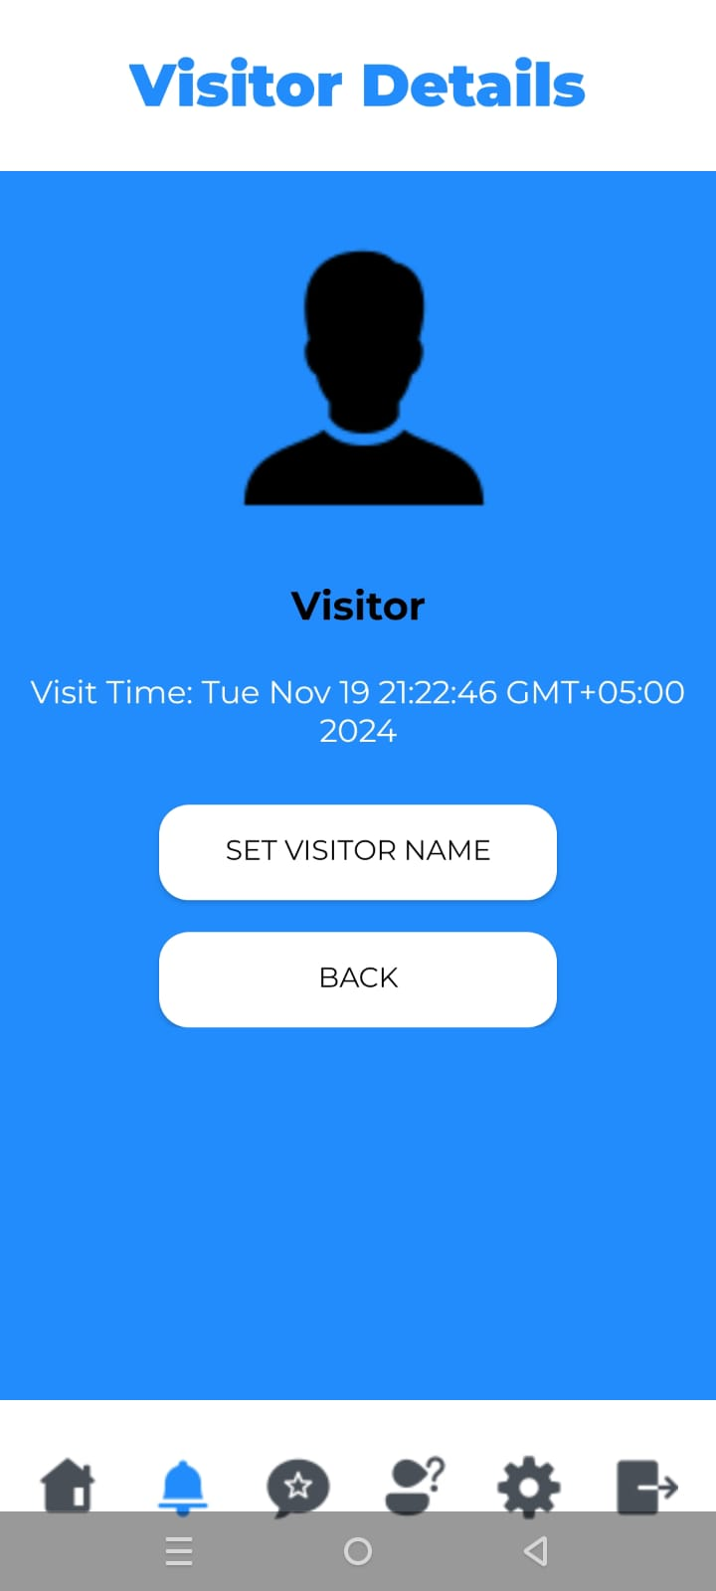
User Interface
Feedback
Visitors Details

Slide 25
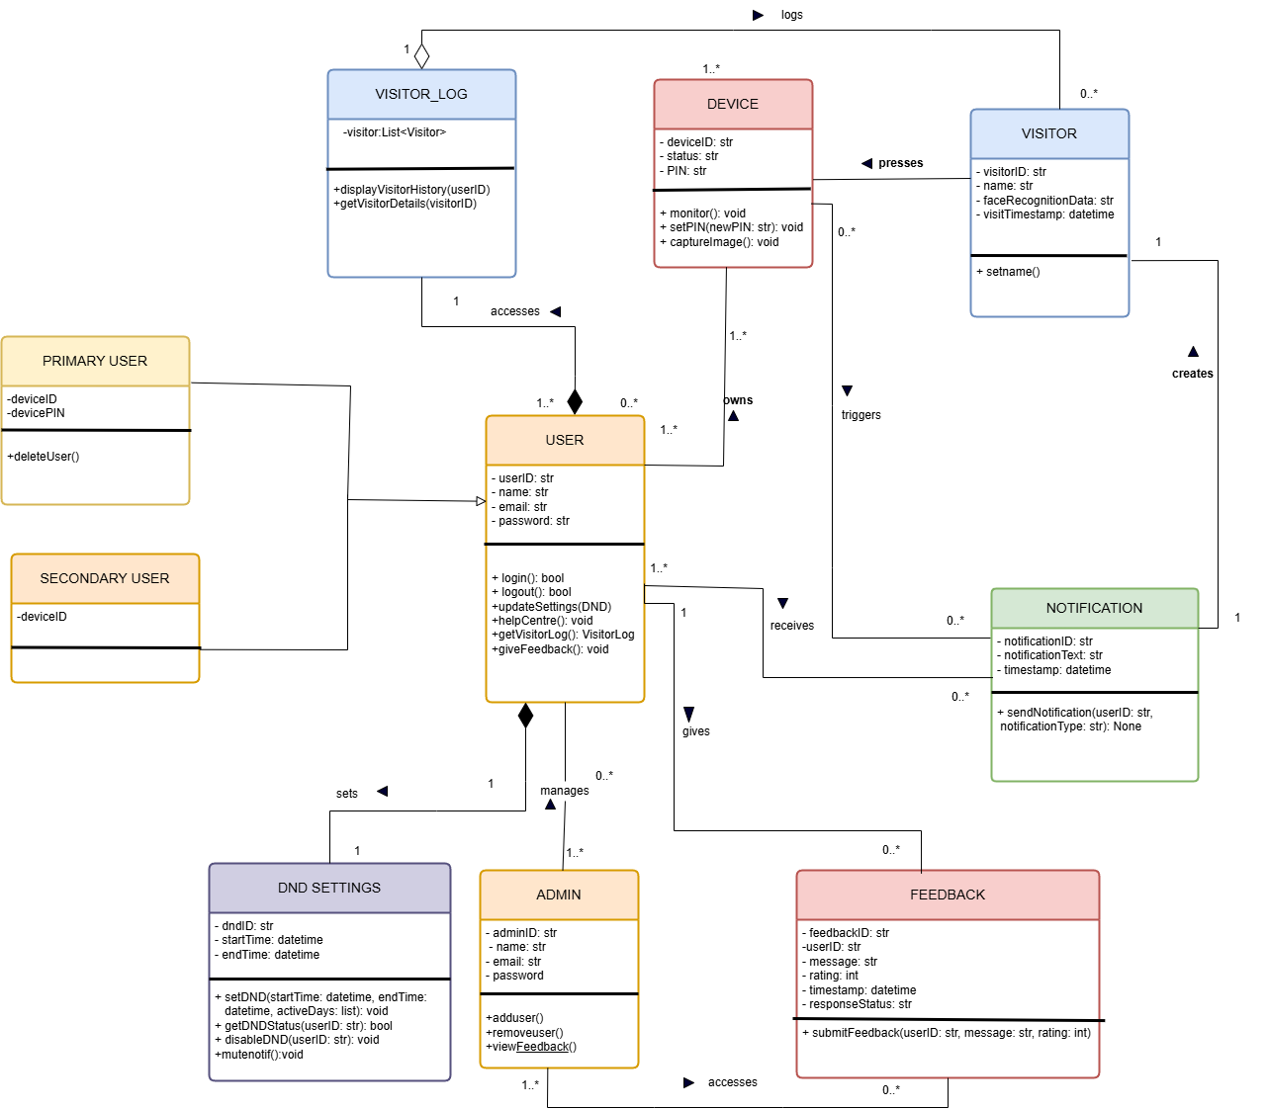
Class Diagram

Slide 26
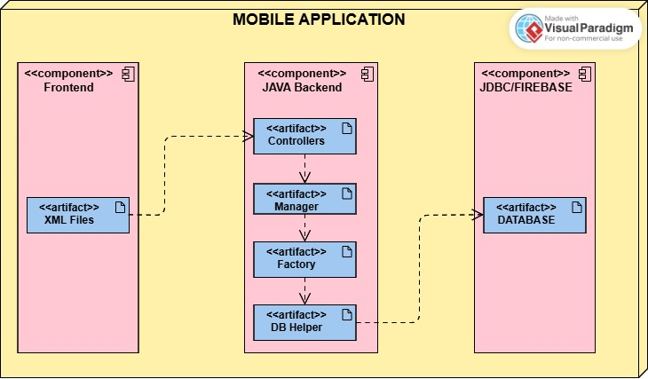
Deployment Diagram

Slide 27
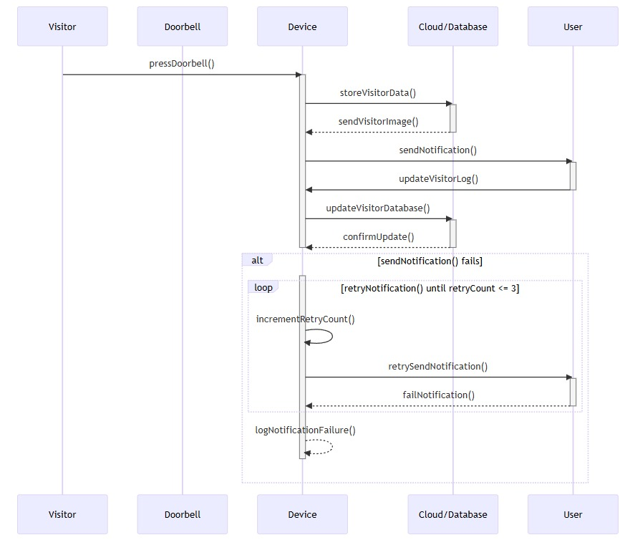
Sequence Diagram

Slide 28
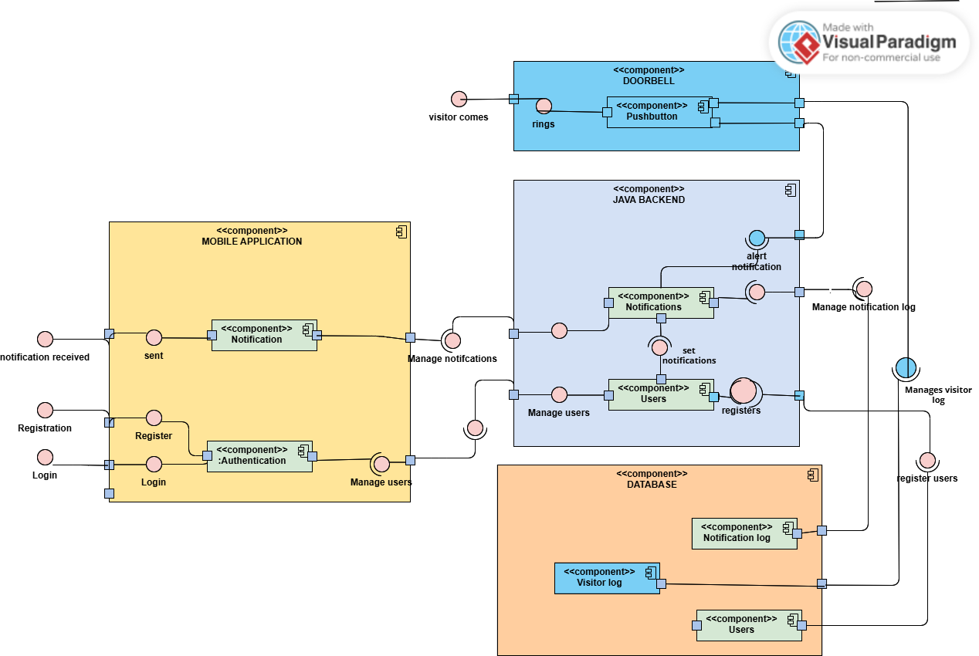
Component Diagram

Slide 29
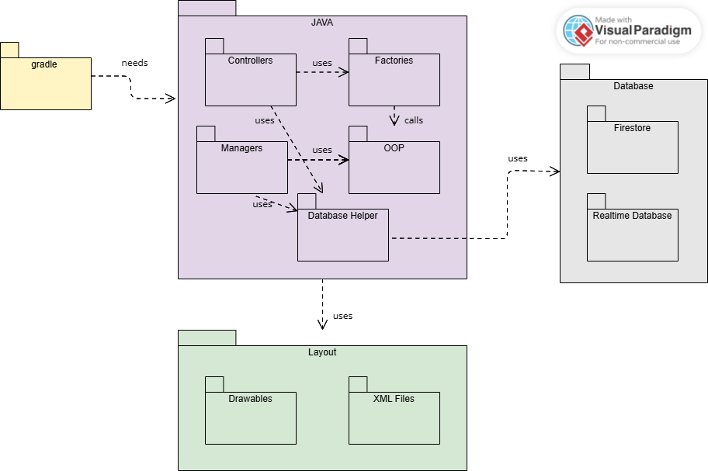
Package Diagram

Slide 30
Thank
You.

