Slide 1


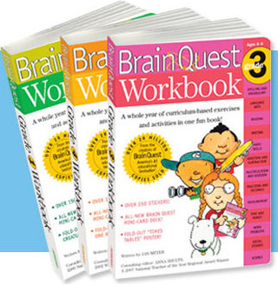

Slide 2
EARLY CHILDHOOD
(Kg 1)

Slide 3

WORKBOOK PRE-K (KG1)
Ages: 4-5
Jam-packed with hundreds of curriculum-based activities, exercises and games in ..

Slide 4
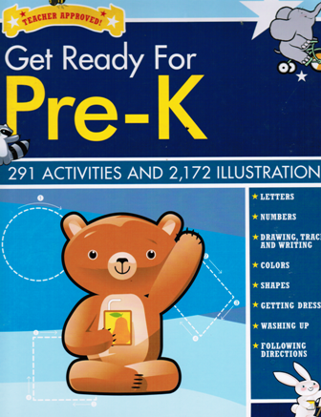
Get Ready for Pre-K
Ages : 2-5
Hard Cover
291 Activities and 2,172 Illustrations
Letters, Numbers, Drawing, Tracing and writing, colors, Shapes, Getting Dressed, Washing Up, Following Directions..

Slide 5

GET READY FOR KINDERGARTEN
Ages : 2-5
Hard Cover
294 Activities and 2,186 Illustrations
The Alphabets, Numbers and Counting, Colors, Shapes, Sizes and Comparisons, Opposites, Our World, Nature …

Slide 6

MATH AND SCIENCE
KG1
Ages:2-5
Hard cover
250 Teacher-Approved Activities,38 Flash Cards,100 Stickers
Learn about nature, Fun with counting, Find the pattern..

Slide 7

BRAIN QUEST PRESCHOOL
(Cards)
Ages: 4-5
300 Questions, 300 Answers to Get a Smart Start
What number comes right after 3? Pick out all the round objects in the picture…

Slide 8
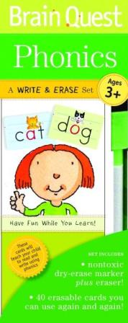
PHONICS
(cards with WIPE OFF PAGES)
Ages: 2-5
40 Erasable Cards you can use again and again
It's a brand-new Brain Quest format geared to give the earliest learners a leg up on writing, reading, and using numbers...

Slide 9
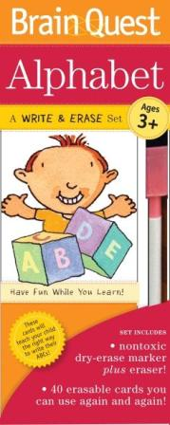
ALPHABET
(cards with WIPE OFF PAGES)
Ages: 2-5
40 Erasable Cards you can use again and again
It's a brand-new Brain Quest format geared to give the earliest learners a leg up on writing, reading, and using numbers..

Slide 10
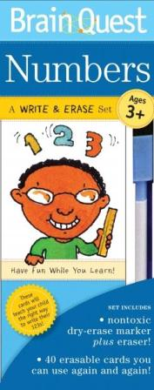
NUMBERS
(cards with WIPE OFF PAGES)
Ages: 2-5
40 Erasable Cards you can use again and again
It's a brand-new Brain Quest format geared to give the earliest learners a leg up on writing, reading, and using numbers...

Slide 11
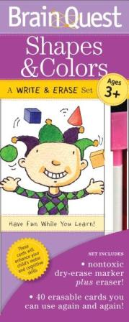
SHAPES & COLORS (cards with WIPE OFF PAGES)
Ages: 2-5
40 Erasable Cards you can use again and again
It's a brand-new Brain Quest format geared to give the earliest learners a leg up on writing, reading, and using numbers..

Slide 12
KINDERGARTEN
(KG 2)

Slide 13
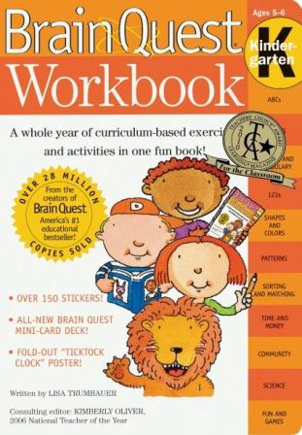
WORKBOOK KINDERGARTEN
Ages: 5-6
Jam-packed with hundreds of curriculum-based activities, exercises and games in ..

Slide 14

LETTERS
(Wipe Off Pages) You can use again and again
Ages: 5-6
Hard Cover
38 Memory Game Cards, 50 Vinyl Stickers, 96 write on, Wipe Off Pages, 3 Colored Pens

Slide 15

NUMBERS
(Wipe Off Pages)
You can use again and again
Ages: 5-6
Hard Cover
38 Memory Game Cards, 50 Vinyl Stickers, 96 write on, wipe off Pages, 3 Colored Pens

Slide 16

Shapes And Colors
(Wipe Off Pages )
You can use again and again
Ages: 5-6
Hard Cover
38 Memory Game Cards, 50 Vinyl Stickers, 96 write on, wipe off Pages, 3 Colored Pens

Slide 17

Activities And Games
Ages: 5-6
Hard Cover
38 Memory Game Cards, 250 Stickers, 240 Fun Activities

Slide 18

Mazes and Puzzles
Ages: 5-6
Hard Cover
38 Memory Game Cards, 250 Stickers, 240 Fun mazes and Puzzles

Slide 19

BRAIN QUEST KINDERGARTEN
Ages: 5-6
300 Questions and 300 Answers to Get a Smart Start
Count the marbles. What’s the opposite of fast? How many pennies make one nickel?

Slide 20
Grade 1

Slide 21
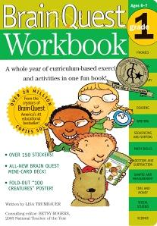
WORKBOOK GRADE 1
Ages: 6-7
Jam-packed with hundreds of curriculum-based activities, exercises and games in ..

Slide 22

Math and Science
Ages:6-7
Hard Cover
250 Teacher-approved Activities,38 Flash Cards,100 Stickers
Learn about the seasons, telling time is fun, you can add and subtract..

Slide 23

GET READY FOR 1ST GRADE
Ages: 6-7
Hard Cover
280 Activities and 2,074 Illustrations
Reading, Vowels, Consonants, Numbers and Counting, Addition and Subtraction, Shapes, Opposites, Colors, Our World

Slide 24

1ST GRADE MATH
Ages: 6-7
750 Questions and Answers to build Math smarts
How many months are in one year? Does a perimeter go around a school yard or right through it? Which has ..

Slide 25
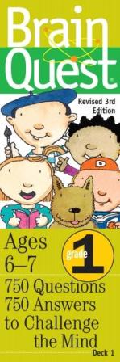
Brain quest
GRADE 1
Ages: 6-7
750 Questions and Answers to challenge the mind
What 3 numbers come between 18 and 22? Change these letters around to make a furry pet: a-c-t. How many stars...

Slide 26
Grade 2

Slide 27

WORKBOOK GRADE 2
Ages: 7-8
Jam-packed with hundreds of curriculum-based activities, exercises and games in ...

Slide 28

2ND GRADE MATH
Ages: 7-8
1000 Questions and Answers to Build Math Smarts
What do you call the line that cuts a circle in half? If May 31 is a Wednesday, what day of the week will June 2 be ...

Slide 29
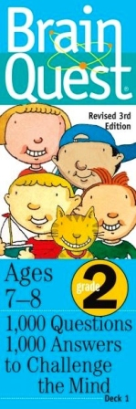
brain quest
GRADE 2
Ages: 7-8
1000 Questions and Answers to challenge the mind
Name the ship that brought the first Pilgrims to America. How many tens are in the number 90? Spell the word that means ...

Slide 30
Grade 3

Slide 31
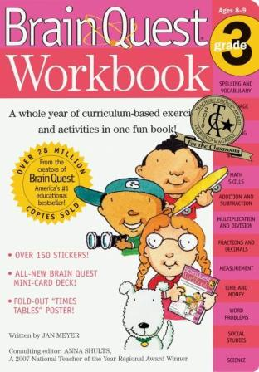
WORKBOOK GRADE 3
Ages: 8-9
Jam-packed with hundreds of curriculum-based activities, exercises and games in ..

Slide 32

3RD GRADE MATH
Ages: 8-9
1000 Questions and Answers to Build Math Smarts
It’s January and the outside temperature is 29 degrees C. Are you in Alaska or Hawaii?

Slide 33

3RD GRADE READING
Ages: 8-9
56 Stories with Questions and Answers
First comes a fully illustrated, original short text—a biography of Martin Luther King Jr., a fun poem ...

Slide 34

Brain Quest
GRADE 3
Ages: 8-9
1000 Questions and 1000 Answers to challenge the mind
Round the number 551 to the nearest ten. Spell the five-letter word that means the opposite of “wrong”. After Congress ..

Slide 35
Grade 4

Slide 36
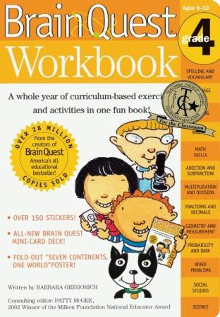
WORKBOOK GRADE 4
Ages: 9-10
Jam-packed with hundreds of curriculum-based activities, exercises and games in ..

Slide 37
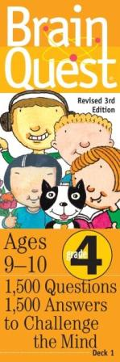
Brain Quest
GRADE 4
Ages: 9-10
1500 Questions and 1500 Answers to challenge the mind
When a liquid changes to gas, does it condense or evaporate? Spell the plural of “leaf.” If a truck weighs 3 ½ tons ..

Slide 38
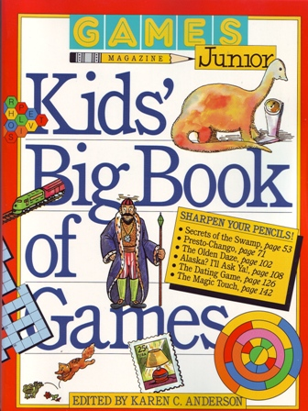
Kid’s Big Book of Games
Games Magazine

