Slide 1



Slide 2
KG-1

Slide 3
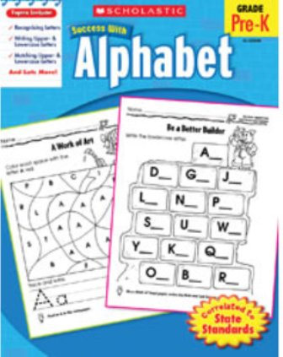
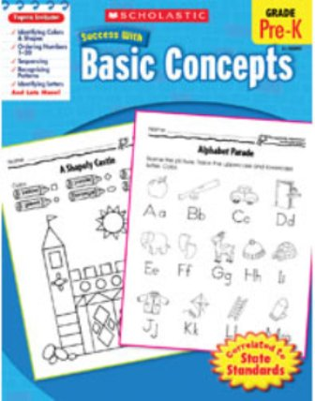
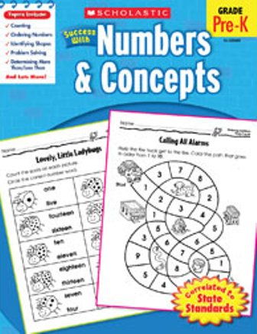

Alphabet
Numbers & Concepts
Basic Concepts
Targeted, skill-building practice students need with these standards-based books!
Each workbook includes more than 40 ready-to-reproduce practice pages. Easy-to-follow directions and fun exercises motivate students to work on their own.
48 pages each .

Slide 4
KG-2

Slide 5
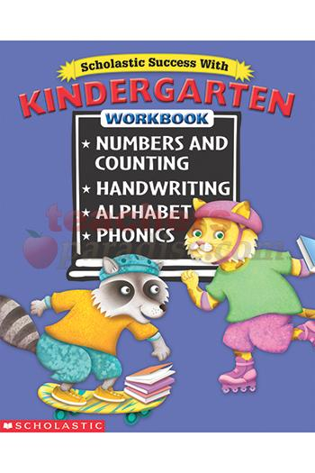
Scholastic Success with Kindergarten
  Numbers and symbols
  Whole numbers
  Symbolic, concrete, and pictorial representation
  Geometric shapes
  Spatial tense
  Simple patterns
  Conventions of print in writing
  Forms in print
  Upper and lower case letter
  Writing from left to right and top to bottom
Notes:
The activities in this workbook reinforce age-appropriate skills and will help your child meet the following standards established as goals by leading educators.
The mathematics portion of this book helps children understand that numbers are symbols used to represent quantities or attributes of real -world objects and understand symbolic, concrete and pictorial representation of numbers. It also teaches kids to count whole numbers and understand basic whole number relationships. Geometric shapes are taught to teach kids the concept of basic properties of the shapes and the similarities and differences between them as well as understanding that geometric shapes are useful for representing and describing real-world situations.
Kids will learn the common language of spatial sense and to extend simple patterns.

Slide 6
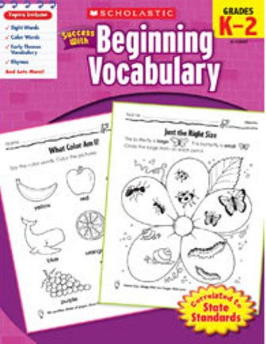
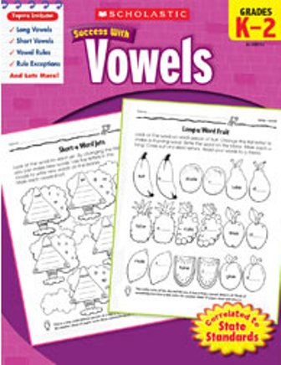
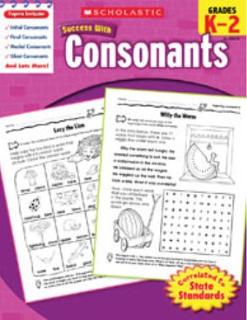
Beginning vocabulary
Vowels
Consonants
Targeted, skill-building practice students need with these standards-based books!
Each workbook includes more than 40 ready-to-reproduce practice pages.
Easy-to-follow directions and fun exercises motivate students to work on their own.
48 pages each.

Slide 7
Grade 1

Slide 8
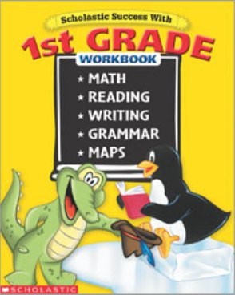
Scholastic Success with 1st Grade Bind-Up
Includes addition and subtraction, problem solving, number concepts, reading comprehension, handwriting, writing, grammar, maps, and lots more.
416 bright, colorful pages that give kids practice in the skills a 1st grader needs to be successful.

Slide 9
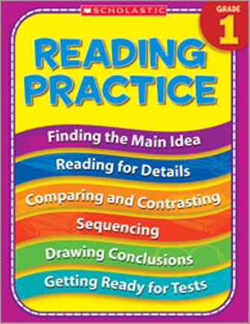
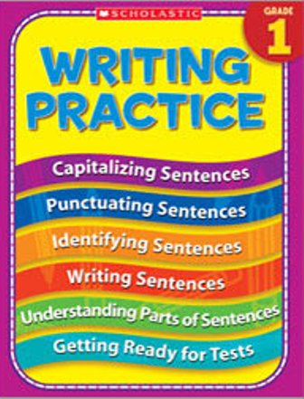
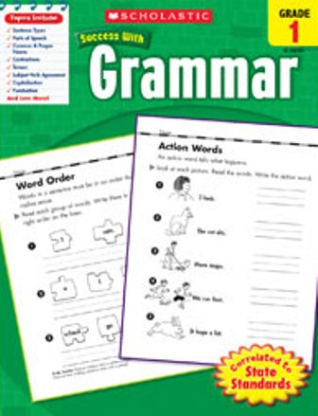
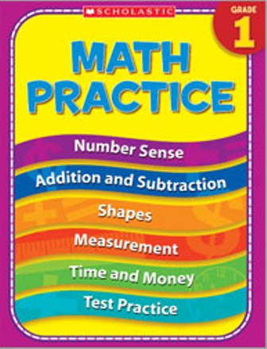
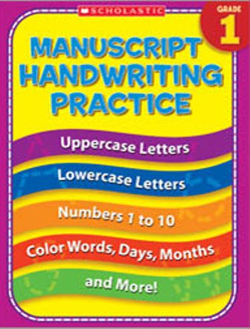
Reading Practice
Writing Practice
Grammar Practice
Handwriting practice
Math practice
Give students the skill-building practice they need in reading, writing, Grammar, handwriting and more with these engaging, full-color workbooks.
Easy-to-follow directions and fun exercises motivate students to work on their own.

Slide 10
Grade 2

Slide 11
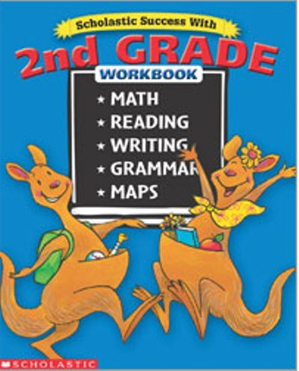
Scholastic Success with 2nd Grade Bind-Up
416 bright, colorful pages
It gives kids practice in the skills every 2nd grader needs to be successful.
Includes addition and subtraction, problem solving, number concepts, reading comprehension, handwriting, writing, grammar, maps.

Slide 12
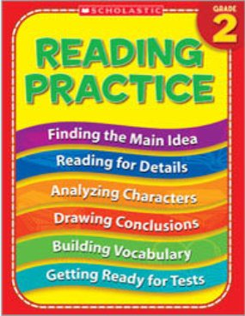
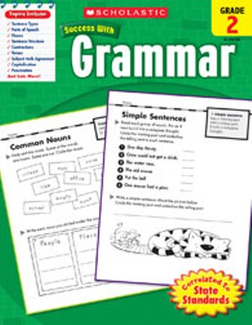
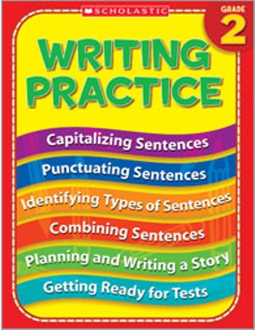
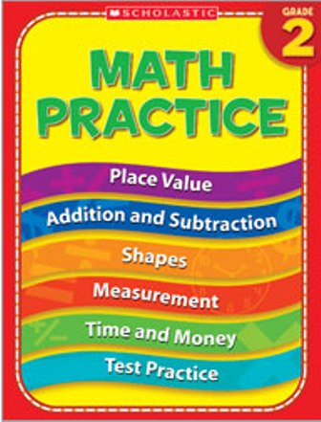
Reading Practice
Writing Practice
Grammar Practice
Handwriting practice
Math practice
Give students the skill-building practice they need in reading, writing, Grammar, handwriting, Math and more with these engaging, full-color workbooks
Easy-to-follow directions and fun exercises motivate students to work on their own

Slide 13
Grade 3

Slide 14
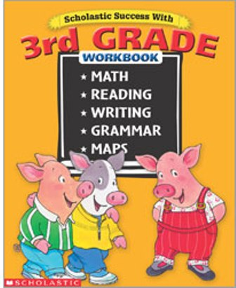
Scholastic Success with 3rd Grade
Bind-Up
416 bright, colorful pages
It gives kids practice in the skills every 3rd grader needs to be successful.
Includes addition and subtraction, multiplication and division, problem solving, number concepts, reading comprehension, cursive writing, writing, grammar, maps.

Slide 15
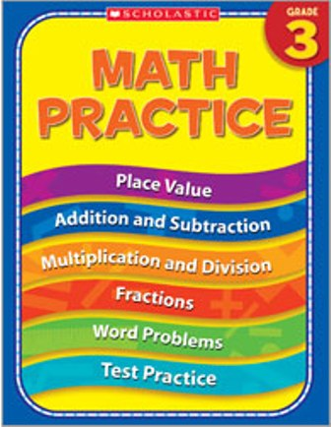
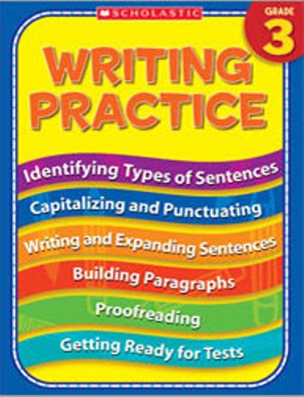
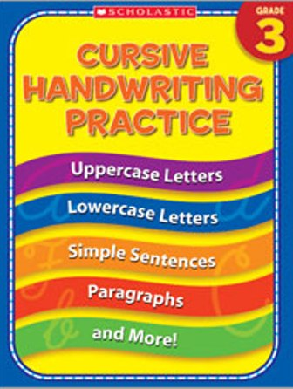
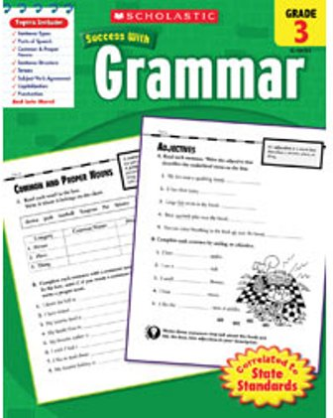
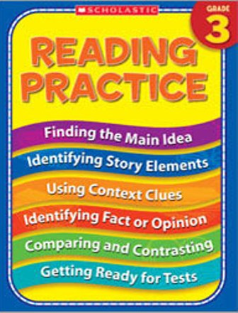
Reading Practice
Writing Practice
Grammar Practice
Handwriting practice
Math practice
Give students the skill-building practice they need in reading, writing, Grammar, handwriting, Math and more with these engaging, full-color workbooks
Easy-to-follow directions and fun exercises motivate students to work on their own

Slide 16
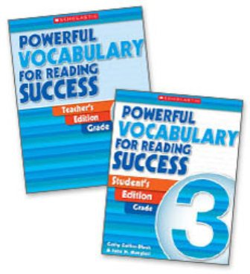
Powerful Vocabulary for Reading Success
15 Minutes a Day To Hundreds of New Words a Year!
The first vocabulary program to offer you a systematic, teacher-directed approach to improving your students' reading achievement. This unique program is:
Research-Based
proven effective for all students and No Child Left Behind for Vocabulary Development.
Explicit and Comprehensive
easy-to-manage, complete instructional program that models effective word learning and multiple exposures to hundreds of words.
Strategy Based
Teaches word learning principles and strategies together to increase vocabulary rapidly and to make vocabulary learning an on-going, cumulative process.

Slide 17
Grade 4

Slide 18
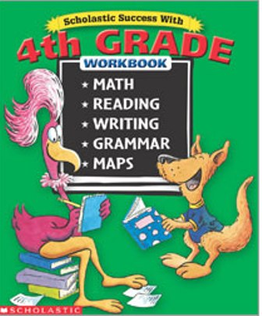
Scholastic Success with 4th Grade Bind-Up
416 bright, colorful pages
it gives kids practice in the skills every 4th grader needs to be successful.
Includes addition and subtraction, multiplication and division, fractions and decimals, problem solving, number concepts, reading comprehension, writing, grammar, maps.

Slide 19
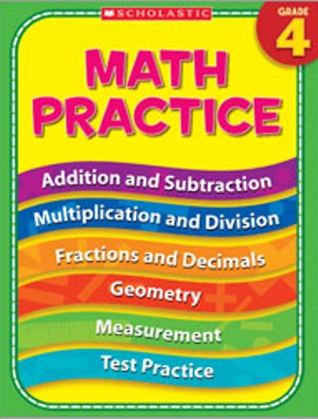
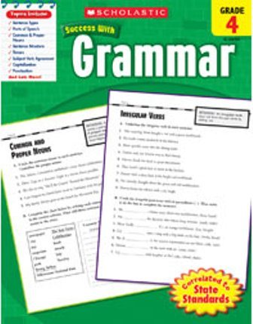
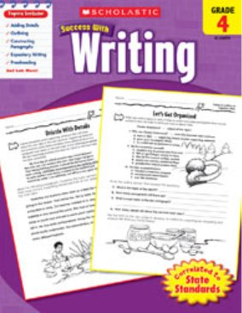
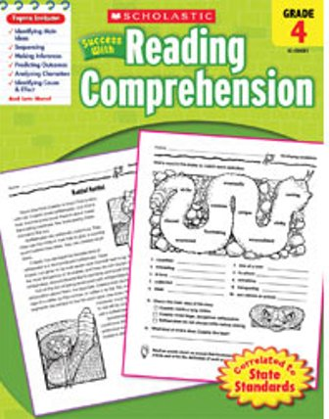
Reading Practice
Writing Practice
Grammar Practice
Math practice
Give students the skill-building practice they need in reading, writing, Grammar, handwriting, Math and more with these engaging, full-color workbooks
Easy-to-follow directions and fun exercises motivate students to work on their own

Slide 20
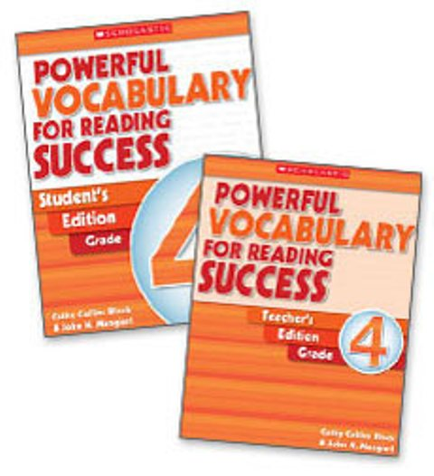
Powerful Vocabulary for Reading Success: Grade 4
15 Minutes a Day To Hundreds of New Words a Year!
Powerful Vocabulary for Reading Success is the first vocabulary program to offer you a systematic, teacher-directed approach to improving your students' reading achievement.
This unique program is:
Research-Based
Explicit and Comprehensive
Strategy Based

Slide 21
Extra

Slide 22
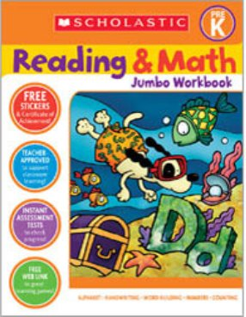
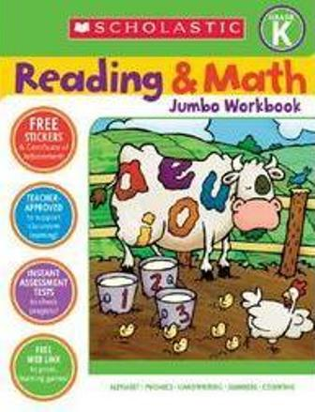
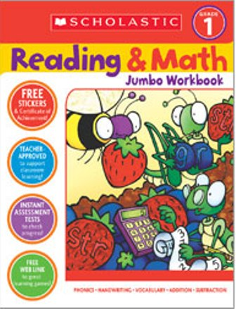
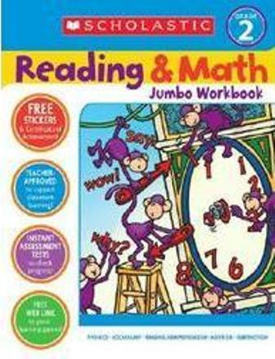
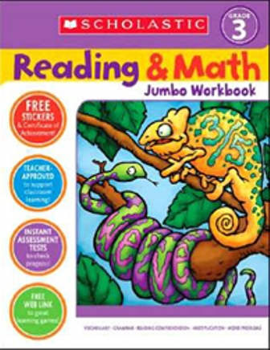
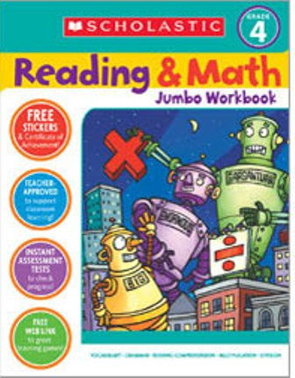
Reading & Math Workbook
300 skill-building pages that give kids practice with sight words, handwriting, phonics, addition, subtraction and everything they'll need to succeed as students.
320 pages + stickers.

Slide 23
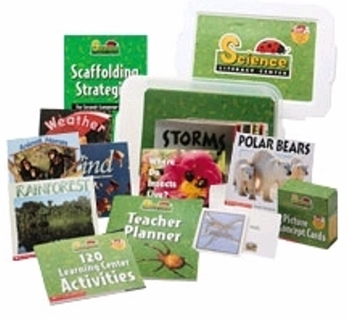
Science Literacy Centers: Set A & B
Themes covered:
Insects and Spiders (Set A)
Animal Homes (Set A)
Polar Regions (Set A)
Amazon Rainforest (Set A)
Weather (Set A)
Trees (Set A)
Energy and Force (Set B)
Machines and Tools (Set B)
Animal Life Cycles (Set B)
Birds (Set B)
Desert (Set B)
Ocean (Set B)
Nonfiction, informational text that builds vocabulary and expands children's knowledge base.
Hands-on activities to meet individual needs.
Instructional support and vocabulary-building opportunities for second-language learners.
Take-home pages.

Slide 24
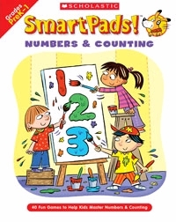
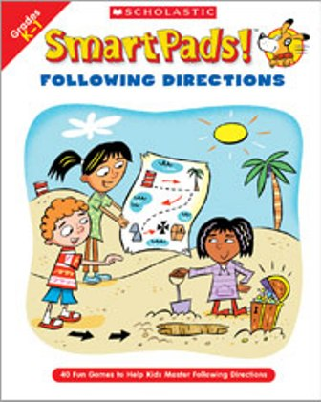
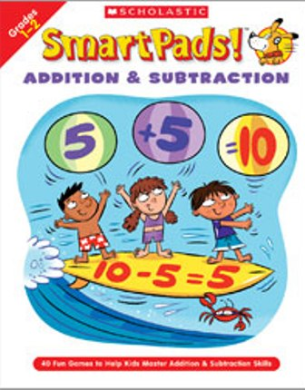
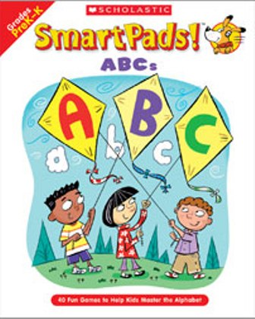
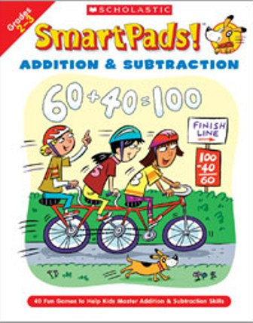
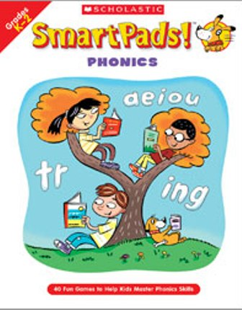
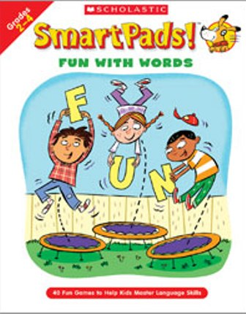
Smart Pads !
Super fun, easy-to-play games will help students master the basic skills necessary for success.
FOLLOWING DIRECTIONS
NUMBERS & COUNTING
FUN WITH WORDS
ADDITION & SUBTRACTION: GR 2-3
PHONICS
ADDITION & SUBTRACTION: GR 1-2
ABCS
MULTIPLICATION
HANDWRITING

