Slide 1
Automating Deployments
North Florida Ruby Brigade
Evan Machnic
2 November 2010

Slide 2
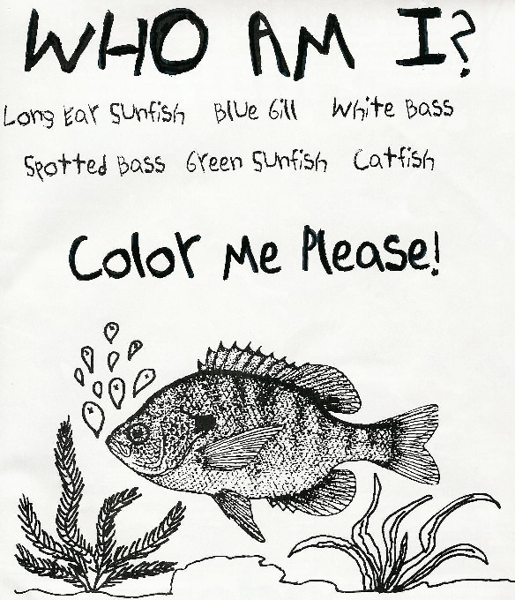
Automating Deployments

Slide 3
Automating Deployments
Evan Machnic
  BS in IT from FSU, 2009 (Web Development)
  Hired after graduation
  Layed off January 2009
  Freelancing with Ruby on Rails
  http://broadmac.net
  @emachnic on Twitter and Forrst

Slide 4

Automating Deployments

Slide 5

Automating Deployments
Tools
  Ruby
  Git
  Chef/Puppet
  Capistrano/Vlad the Deployer/Screwcap

Slide 6

Automating Deployments
Why
  Traditional methods suck
  No time
  I'm not a masochist

Slide 7
Automating Deployments
HOW?

Slide 8
Automating Deployments
Rails/Git/Chef/Capistrano

Slide 9
Automating Deployments
Rails

Slide 10
Automating Deployments
$ rails new myapp

Slide 11
Automating Deployments
Git

Slide 12
Automating Deployments
$ cd myapp
$ git init
$ git add .
$ git commit -am "Initial commit"
$ git remote add origin git://server.com/myapp.git
$ git push origin master

Slide 13
Automating Deployments
Chef

Slide 14
Automating Deployments
-c, --config CONFIG
-j, --json-attributes JSON_ATTRIBS
-r, --recipe-url RECIPE_URL

Slide 15
Automating Deployments
$ chef-solo -c ~/solo.rb -j http://www.example.com/node.json -r http://www.example.com/chef-solo.tar.gz

Slide 16
Automating Deployments
Chef Cookbooks
http://cookbooks.opscode.com/

Slide 17
Automating Deployments
Capistrano

Slide 18
Automating Deployments
$ cd myapp
$ capify .
$ cap deploy

Slide 19
Automating Deployments
Sample deploy.rb file

Slide 20
Automating Deployments
Wrap it up
  Infinite types of configurations depending on taste
  Use what you like
  Share your code

Slide 21
Automating Deployments
Resources
  http://rubyonrails.org
  http://git-scm.com
  http://opscode.com
  http://capify.org
  http://rubyhitsquad.com/Vlad_the_Deployer.html
  http://www.puppetlabs.com

Slide 22

Automating Deployments

