Slide 1


Survey/Data Presentation
Group M
Eric Baker
Nicholas Cook
Jonathan Kight
Evan Machnic
Time
Two Weeks (14 Days)‏

Slide 2
Our Organization
We represent the IIRWICOA (Is It Really Worth It Corporation Of America)‏
Overview
Brief Problem Summary
Evaluation of Question at Hand
Methods Used to Evaluate the Problem
Survey Description / Overview of Data
Interview Description / Overview of Data
Conclusion
I-I-R-W-I-C-O-A
Fixing Silly Companies, One At A Time
Question
Is the Night Nole effective in preventing drunk driving?

Slide 3
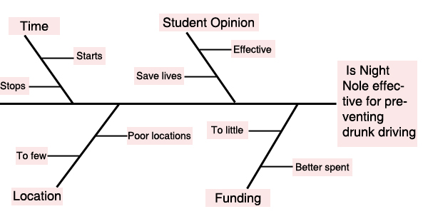
Solving the Problem
Methods
Survey for people who take advantage of the current bus system.
Interview for SGA Representative.
Interview for Tallahassee Police Department Representative.

Slide 4
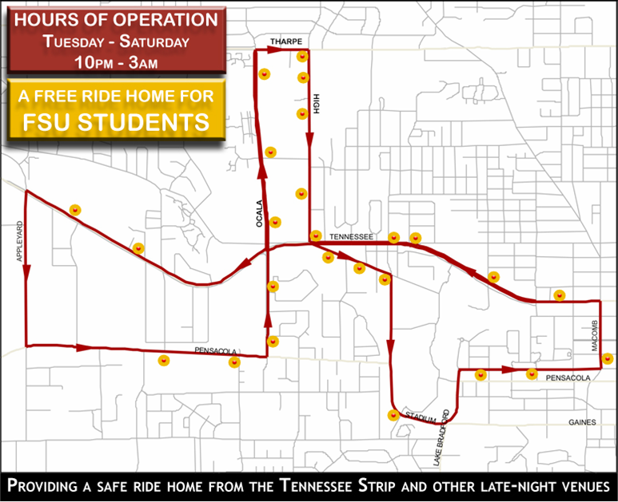

The Survey
Survey’s Design
Knowledge of Night Nole
Effectiveness of Stops
Effectiveness of Service
Survey Distribution
Night Nole Bus Riders
Daily FSU Campus Bus Riders

Slide 5
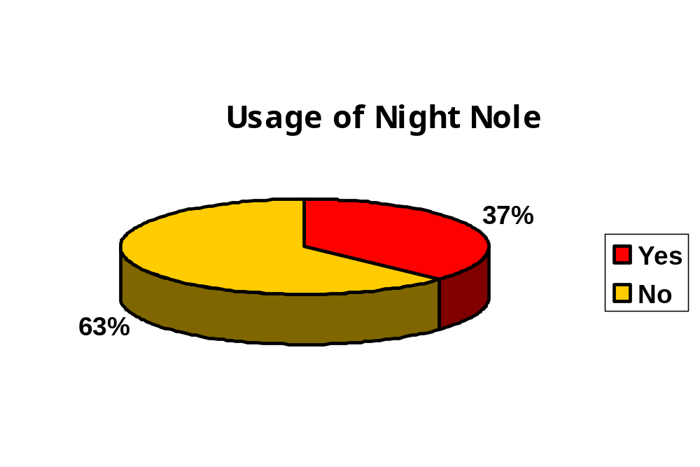
Survey Results
An estimated 63% of respondents report they have never used the Night Nole service.
An estimated 62% report not knowing of any Night Nole stop locations.
On a scale of 1 to 5, respondents give the coverage of the Tallahassee area a 4.2.

Slide 6
Survey Results
100% responded that the Night Nole service was a safe program.
100% of the respondents said that it does save lives.
91% claim that the Night Nole service is worth the time to use.
The Interview
Interview’s Design
Interview Distribution
Gathering Information About the Night Nole
When Service Started
Who Uses It
Is It Effective
What Could Improve It
Given By Group Member
Interviewed an SGA Representative (Information About Program)‏
Interviewed a Tallahassee Police Department Representative (Information About Statistical Effects)‏

Slide 7
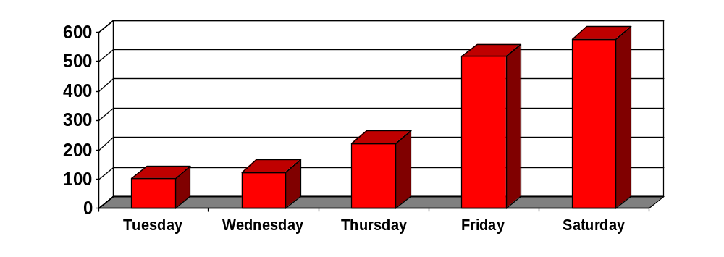
Interview Results
SGA Rep
How many people on average typically ride in one night?
What could be done to improve the Night Nole?
Need larger budget from the university service system.
Tallahassee Police Rep
What could be done to improve the Night Nole?
Student complex expansion and money invested.

Slide 8
August 2005 to July 2006
1061 DUIs and DWIs
August 2006 to July 2007
785 DUIs and DWIs
26% reduction since Night Nole began

Slide 9
Conclusion
Awareness of Night Nole
People are not aware of the service.
Better publicity action needs to be taken.
Current Night Nole Service
The stops should be expanded along with the routes.
The buses are a good size.
Time window that it covers should be expanded.
Overall Night Nole Service
It is an effective service.
Does save lives, but has potential to save many more.
Needs to be given a much larger budget.

Slide 10

Questions?

