Slide 1
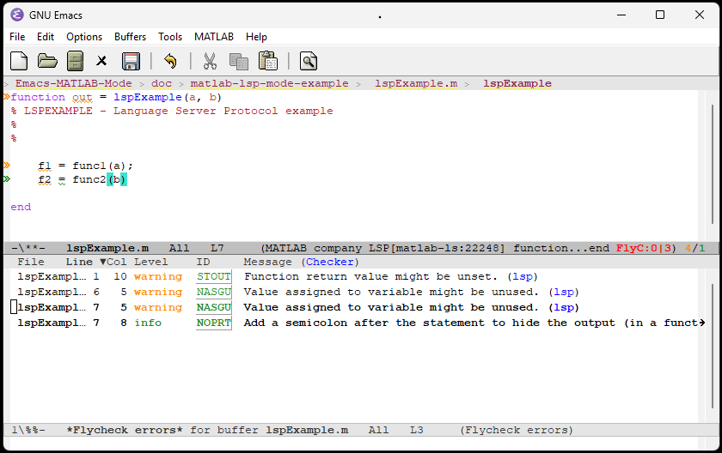
Navigation bar
flycheck-mode automatically shows issues from matlabls, click here or type ‘C-c ! L’ to see the
*Flycheck errors* window

Slide 2
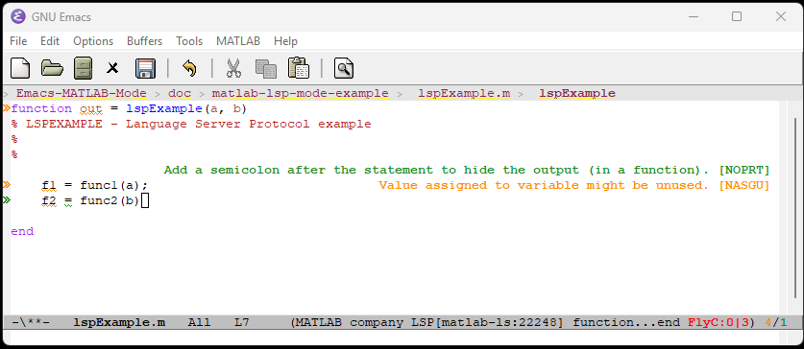
M-x lsp-ui-sideline-mode
enables on the fly display of issues identified by matlabls

Slide 3
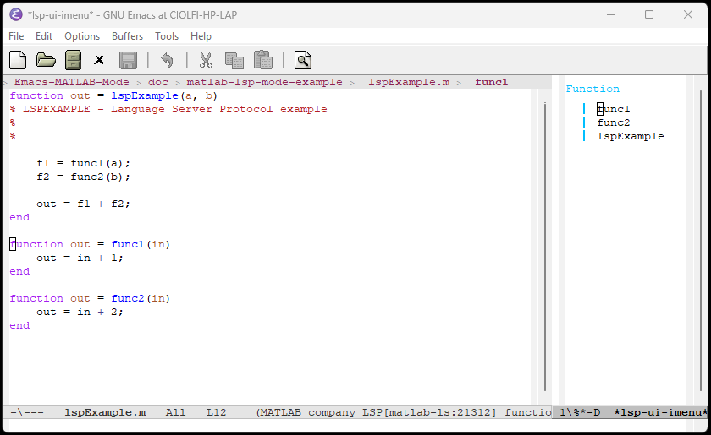
M-x lsp-ui-imenu
Enables navigation on right. Click to jump to definition.

Slide 4
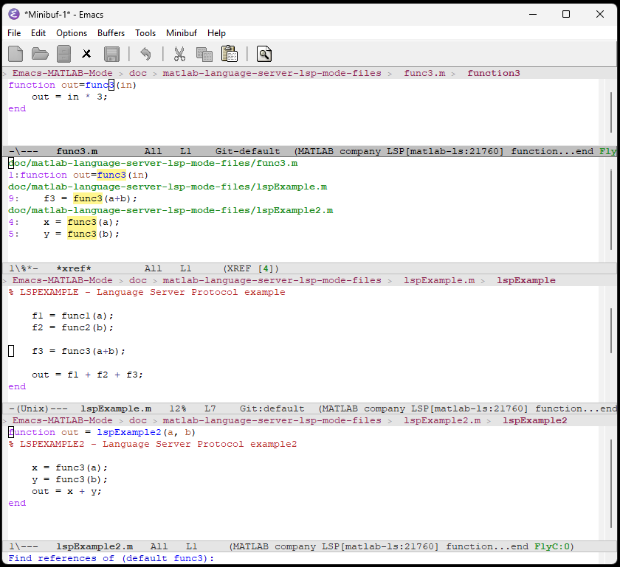
M-? (M-x xref-find-references)
1
Finds references in several files.
Click on references to visit the files they reside in
2

