Slide 1

Think Like an Architect – Episode 4
Architecture Patterns, Templates & Diagrams

Slide 2
What You’ll Learn Today
Architecture Patterns (Application & Network)
Templates (BRD, HLD, LLD)
Architecture Diagrams Types

Slide 3
Application Architecture Patterns
Monolithic
SOA (Service-Oriented Architecture)
Microservices

Slide 4
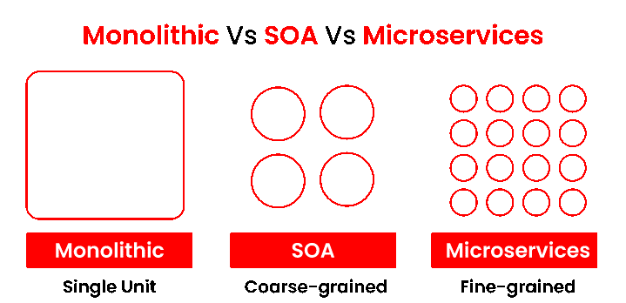
Application Architecture Patterns

Slide 5
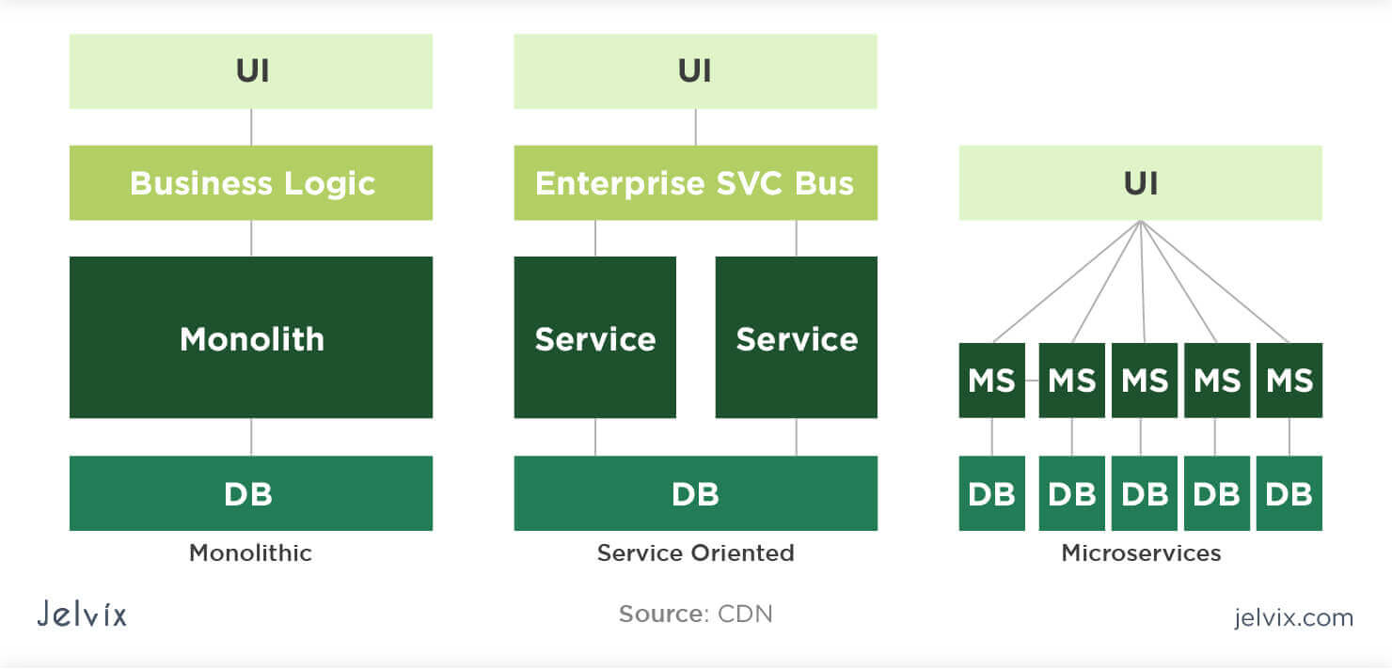
Architecture Patterns from Data storage

Slide 6
Network Architecture Patterns
N-Tier Architecture
Flat / Single-Tier
Hub-and-Spoke
Hybrid

Slide 7
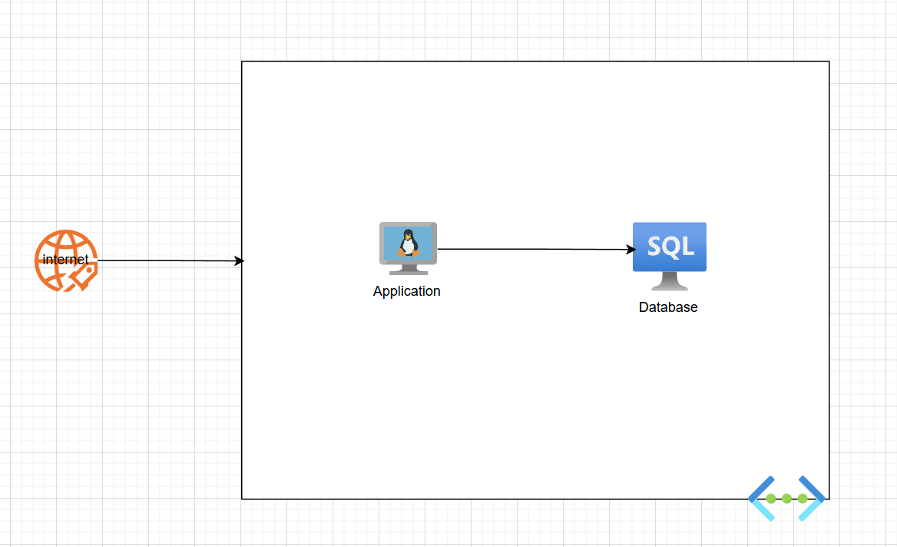
Flat / Single-Tier

Slide 8
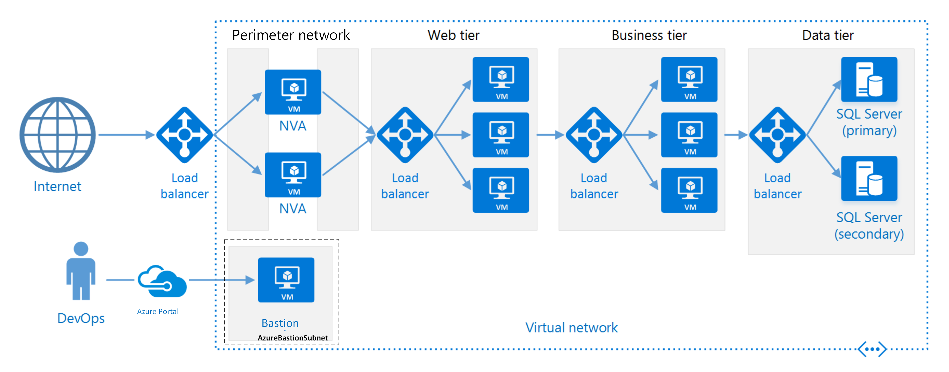
N-Tier Architecture

Slide 9
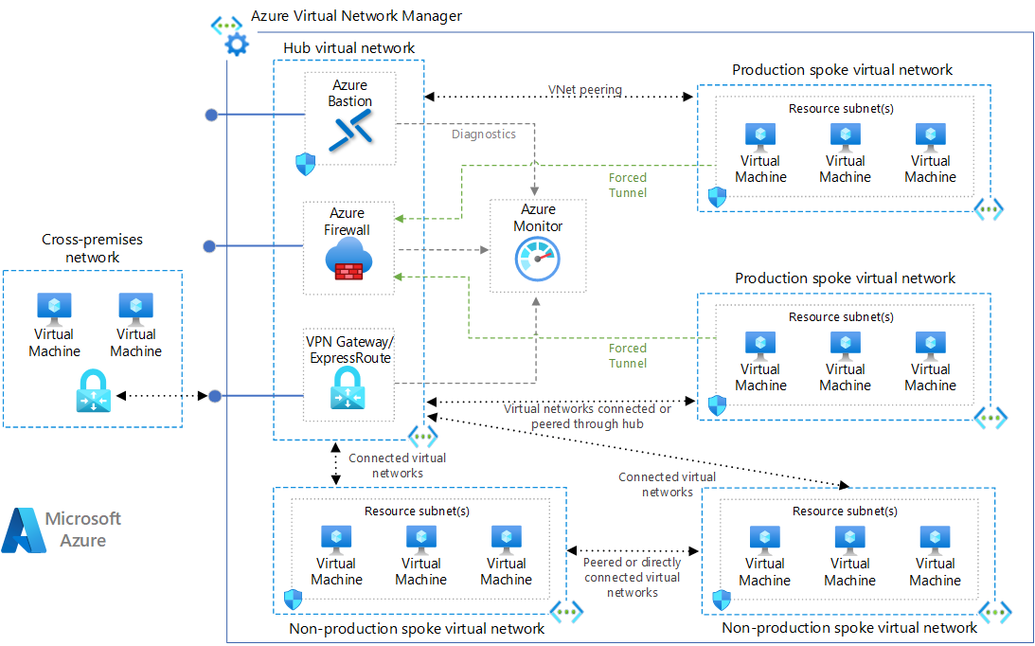
Hub-and-Spoke

Slide 10
Specialized Architectures
Serverless
Queue-Based
Cache-Based

Slide 11
Architecture Templates
BRD → Business Requirements Document
HLD → High-Level Design
LLD → Low-Level Design

Slide 12
Architecture Diagrams Overview
High level diagram
Low level diagram
Network diagram
Data flow diagram
Data diagram
Use case diagram

Slide 13






Diagrams Tools

Slide 14
HLD vs LLD Mapping
HLD Focus: Modules, Zones, Policies
LLD Focus: APIs, Subnets, Firewall rules

Slide 15
Episode Recap
Architecture = Translating requirements into structured design
Use right patterns & templates
Always document with clarity

Slide 16

Thank you!
Emad Adel
Multi-Cloud Solutions Architect
Microsoft MVP / MCT
Notes:
Arabic: اعرض مثال مبسط لصفحة من SAD أو مخطط وانسبه لمشروع خيالي.
English: Show a short walkthrough of a sample SAD page and a high-level diagram (e.g., e-commerce checkout).

