Slide 1
Implementation of AI Planner

Slide 2
Problem Formulation
Input:
A json file containing the planning task
Optimization Criteria
Manufacturers
States
Actions
Output:
Set of plans
Solution:
Using AI planner to find plans

Slide 3
Challenges
Different pre-conditions
Need for all possible solutions
Many sub-optimal solutions
Temporal information
Different processing time of actions
Different delivery time of actions‘ pre-conditions

Slide 4
PDDL vs. Graph-based planning
Approach\Challnge | Different Pre-conditions | Returning all possible solutions | Returning the optimal solution | Dealing with action-level temporal infomation | Dealing with pre-condition-level temporal infomation | Cloud or local
PDDL | Yes | No | Yes | Yes | No | Cloud
Graph-based | Yes | Yes | Yes | No | No | Local
Graph-based has big advantage of returning all possible solutions.
However, Cannot deal with temporal information

Slide 5
Planning vs. Scheduling
Planning
AI planning focuses on determining the logical sequence of actions to achieve goals
Scheduling
Scheduling deals with the temporal allocation of resources to execute those actions

Slide 6
Post-processing the Graph-planner
Idea:
Using the graph-based planner to enumerate all possible plans
scheduling plans
Approach\Challnge | Different Pre-conditions | Returning all possible solutions | Returning the optimal solution | Dealing with action-level temporal infomation | Dealing with pre-condition-level temporal infomation | Cloud or local
PDDL | Yes | No | Yes | Yes | No | Cloud
Graph-based | Yes | Yes | Yes | No | No | Local
Graph-based with scheduling | Yes | Yes | Yes | Yes | Yes | Local

Slide 7
Example 1
Let‘s Imagine this planning problem:
Planning task:
Planning actions:
InitialStates:
StateID: 1
StateID: 2
StateID: 3
FinalState:
StateID: 6
ID: 1
Pre-conditions:
StateID: 1, DeliveryTime: 0
StateID: 2, DeliveryTime: 1.5
Effect: StateID: 4
ProcessingTime: 2.5
Costs: 280
ID: 2
Pre-conditions:
StateID: 3, DeliveryTime: 0
Effect: StateID: 5
ProcessingTime: 4
Costs: 300
ID: 3
Pre-conditions:
StateID: 4, DeliveryTime: 0
StateID: 5, DeliveryTime: 1
Effect: StateID: 6
ProcessingTime: 3
Costs: 100
ID: 4
Pre-conditions:
StateID: 1, DeliveryTime: 0
StateID: 2, DeliveryTime: 1
StateID: 3, DeliveryTime: 2
Effect: StateID: 6
ProcessingTime: 3
Costs: 1000

Slide 8
Example 1
Planner’s output:
Action(id=1) => Action(id=2) => Action(id=3), Total cost: 680
Action(id=2) => Action(id=1) => Action(id=3), Total cost: 680
Action(id=4), Total cost: 1000
Features:
Returning all possible plans sorted
Take care of action’s dependency to pre-conditions
Shortcomming:
Plans are fully-ordered
No usage of temporal information

Slide 9
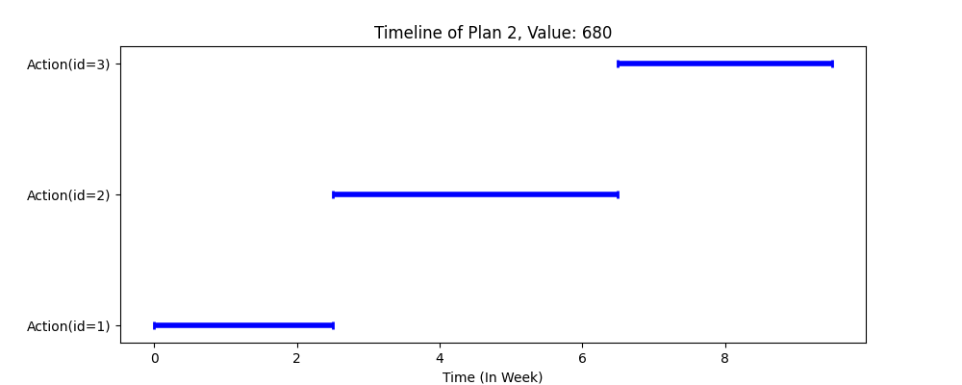
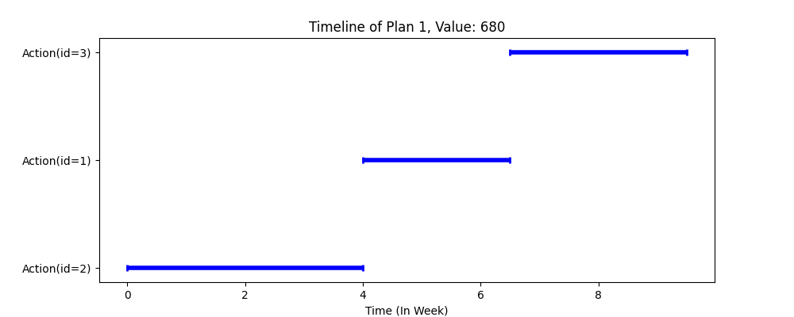
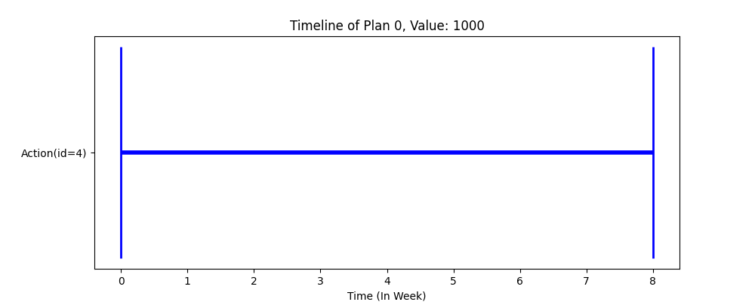
Example 1
Planner’s output:

Slide 10
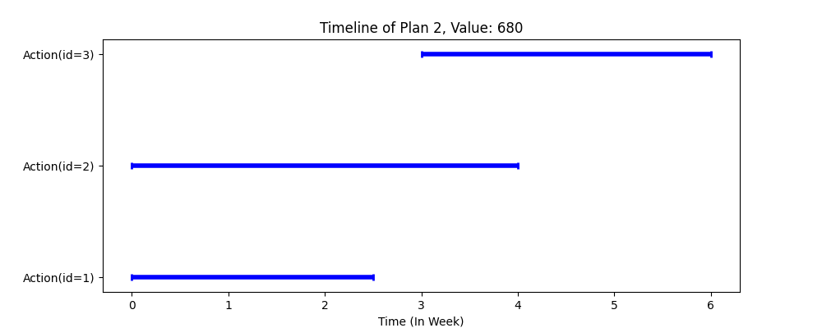
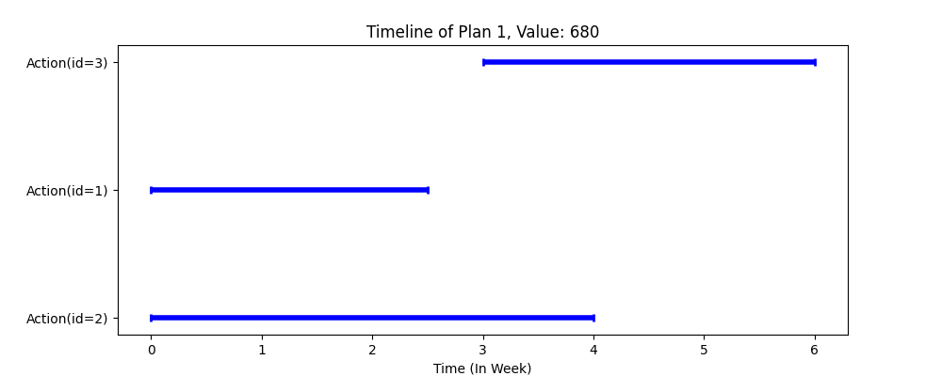
Example 1
Scheduler’s output:

Slide 11
Example 1
Prunning output:

