Slide 1
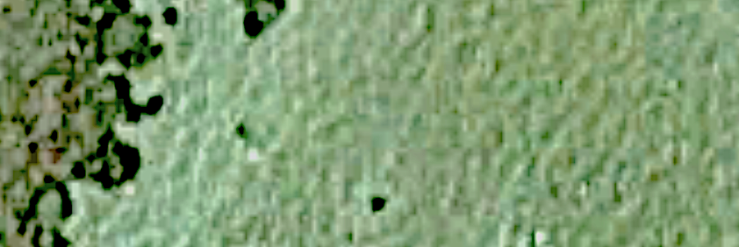
Key:
patch reef
camera
transect
FOV marker
field of view (FOV) at 3 m
??m
Setup (not to scale):
1.5m
4.5m
7.5m
10.5m
2m
2m
1
2
3
4
5
12m

