Slide 1









ML ENGINEER TASK
Dinu Ema Carmen

Slide 2
Project Overwiew
Goal:
Classify insurance-related companies based on their descriptions into a hierarchical taxonomy.
Approach:
Hybrid semi-supervised pipeline combining unsupervised TF-IDF + Cosine Similarity and supervised One-vs-Rest Logistic Regression.
Result:
High-coverage, interpretable label predictions with fallback logic.

Slide 3
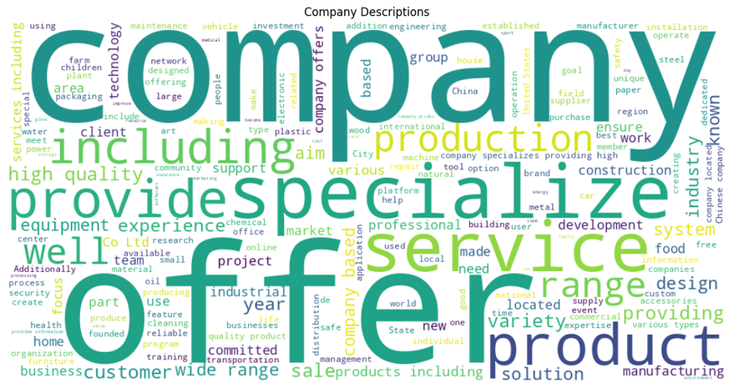
Data Cleaning & Representation
Preprocessing Choices:
Merged multiple fields (description, sector, category, niche) into a single textual input for easier training.
Applied custom stopword removal (along with the usual "and", "are", "as", [..] stopwords, I checked the most common words in the descriptions and removed redundant words like “specialize”, “company”, “offer”).
Used Snowball Stemming to normalize vocabulary and increase generalization ( I reduced words to their root form)
Result: more focused, signal-rich text.

Slide 4
Text Vectorization
Chose TF-IDF for:
Interpretability (easy to debug).
Suitability for sparse, short text.
Support for n-grams to capture phrase-level semantics.
Vectorized both taxonomy labels and company text → Cosine Similarity for weak supervision.
Manual Labeling to check effectiveness
I manually labeled 29 companies in order to check the pseudo-labeling algorithm for effectiveness before proceeding with training.

Slide 5


Experiments & Model Evolution
Random Forest (Initial Attempt)
Overfitting: High-dimensional sparse vectors (from TF-IDF) caused fast overfitting.
Poor generalization and the model showed weak performance.
Low interpretability: Not ideal for text-based tasks (hard to trace why a label was chosen).
Word2Vec (Initial Attempt)
Attempted Word2Vec trained on company descriptions.
Did not generalize well: Small corpus led to weak embeddings.
Context inconsistency: Business descriptions are too diverse for local embeddings to learn meaningful semantics.
Result: Low-quality vectors and poor classifier performance.
Logistic Regression (One-vs-Rest)
Excellent with sparse input: Works well with TF-IDF vectors.
Regularization: Tunable C value to avoid overfitting.
Per-class thresholding: Fine-grained control over predictions to improve F1-score.
Confidence outputs: Allowed intelligent fallback logic in the hybrid prediction phase.
Preprocessing Data
Merged all text fields to increase context.
Removed redundant filler words using a custom stopword.
Applied Snowball Stemming to normalize vocabulary, reduce sparsity, and improve vector matchability.
Final result: Cleaner, denser feature space with improved downstream performance.

Slide 6
Hybrid Prediction Strategy
Two-layered Inference
First attempt: Use the supervised Logistic Regression model for prediction.
If no confident predictions (below threshold), fallback to cosine similarity with taxonomy.
Models are imperfect — cosine similarity provides semantic backup.
Prevents "no label" cases — every description gets a best-effort tag.
Introduced "Other" Label
If no labels exceed even the fallback similarity threshold, assign label "Other".
Helps isolate truly unclassifiable or irrelevant descriptions.
Not just Pseudo-Labeling
Did not stop at cosine-based pseudo-labeling.
Trained a supervised model to learn from pseudo-labels and generalize better.
This hybrid approach led to significant F1 improvements and greater coverage.

Slide 7
Strengths
Handles the large dataset given efficiently.
Excellent label coverage and recall.
Interpretable pipeline: each prediction traceable to text or confidence.
Adaptive thresholding allows fine-tuned label selection.
Resilient to outliers via "Other" fallback.
TF-IDF + Logistic Regression scale to tens of thousands of examples on a laptop.
Cosine similarity is fast due to vector normalization.
Low memory footprint (sparse matrices, no neural networks).

Slide 8

Results
--Model results--
--- Enhanced Pseudo Evaluation Report ---
Total manually labeled samples: 29
Exact matches: 2 (6.90%)
Partial matches (>50% correct): 16 (55.17%)
Partial matches (<50% correct): 8 (27.59%)
No match: 3 (10.34%)
Micro Avg F1 0.70
Macro Avg F1 0.70
Samples Avg F1 0.67
Precision: 0.56
Recall: 0.95
The model generalizes well across many distinct business categories.
Long-tail classes (rare but important) still achieve meaningful recall due to the hybrid strategy.
Future improvements can target precision boosting, especially for ambiguous or overlapping class definitions.

Slide 9
Assumptions and Risks
Assumptions Made
Assumed that the company’s description accurately describes its operations. In reality, some businesses may have vague or marketing-heavy blurbs that don’t align with taxonomy labels.
Assumed the taxonomy is both comprehensive and non-overlapping. However, some labels are semantically close or hierarchical, which can confuse the classifier.
Assumed cosine-based pseudo-labels are good training signals. While many are accurate, some noise remains, especially in the long tail.
Risks
If the descriptions change style, performance may degrade unless the model is retrained.
Some categories are underrepresented, and the model is biased toward frequent classes.
Some manual labels might differ from what another expert would assign, making evaluation noisy.
Without access to full websites, services, or client rosters, the model relies entirely on textual cues.

Slide 10
Trade-Offs – Accuracy vs Efficiency
Switched from Random Forest to Logistic Regression
Gain: Faster training and inference, scalable to thousands of samples.
Loss: Potentially lower performance on non-linear patterns, but offset by better regularization and interpretability.
Used TF-IDF instead of Deep Embeddings
Gain: Lightweight, interpretable, fast to compute.
Loss: Less semantic depth than large-scale embeddings (e.g., BERT), but good enough for domain-specific tasks.
Dimensionality Control with max_features=20000
Keeps the model size reasonable.
May lose rare but meaningful terms.
Fallback to Cosine Similarity When Confidence is Low
Ensures full coverage (every company gets a label).
Adds a small overhead per prediction, but pays off in robustness.

Slide 11
Weaknesses & Future Improvements
Some rare labels still underperform due to:
Class imbalance.
Short/vague company descriptions.
Assumes descriptions are relevant to the actual business type.
Still rule-based in parts (threshold tuning), which may miss nuance.
Works well for popular classes with meaningful descriptions.
Struggles in long-tail and generic descriptions.
Still room for:
Active learning.
Semantic embeddings (e.g., BERT).
More intelligent fallback strategies.

Slide 12




THANK YOU!

