Slide 1
Production in the Game Development Process
From Prototype to Product

Slide 2
Production
After preproduction deliverables (eg. prototype or technology demonstrations) are accepted, you are free to proceed with production.
Development of the game based on the results from preproduction.
Testing of the game.
Release to manufacture.
Maintenance after release (typically in the form of patches and upgrades).

Slide 3
Development
Development is the long haul of video game production.
Development of modern video games typically lasts six months to two years.
Very little can be done well in less than six months; there is simply too much to do.
Anything longer than two years, and you risk your game going stale or becoming obsolete before it is even released.

Slide 4
Development
Time is very deceptive at the start of development.
It would seem you have more than enough time to get everything done on schedule.
As deadlines near, panic sets in as you realize that you do not have as much time as you thought.
It is critically important to break large tasks into small manageable tasks that can be rigorously tracked.
It is much easier to ensure that things are on time and progressing well this way.

Slide 5
Development
Be prepared to revisit your designs throughout development.
As you discover what works, and what does not work so well, redesign will be needed and documentation will need updating.
In the end, some form of iterative software development model might be necessary.
For example, some type of prototyping model (evolutionary or throwaway), or a spiral model (with risk analyses) might work best.

Slide 6
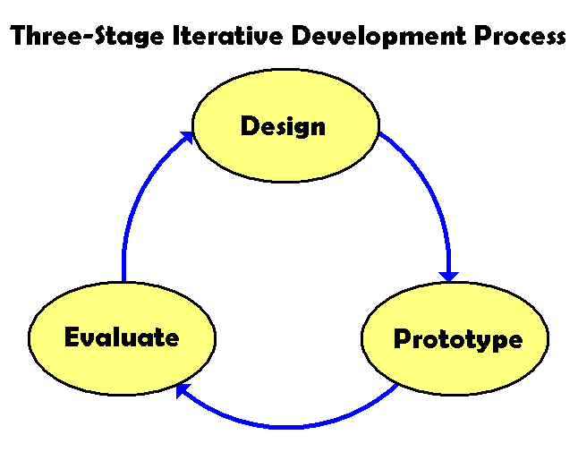
Development

Slide 7
Development
There is a growing interest in the games industry in agile software development.
Agile methods differ from traditional iterative methods in that their time period is measured in weeks rather than months, and work is performed in a highly collaborative manner.
Methods such as extreme programming, pair (or peer) programming, and the scrum development process might ultimately prove useful in the development of games.
Time and experience will tell what works best …

Slide 8
Development
A few survival tips to keep in mind:
Maintain good communication across the development team.
Keep design documentation up to date.
Maintain the team’s identity and spirit.
Give marketing and public relations the materials and demos they need – they will help keep people’s spirits up when things get tough.
Be ready for a shock or two. When these happen, keep your head down and do the work! Things are rarely as bad as they seem.
Have a few features ready to throw away to help manage scope in the long run.

Slide 9
Testing
Testing is important for both validation and verification purposes.
Validation:
Are we building the right game?
To improve game design, gameplay, and so on.
Verification:
Are we building the game right?
To eliminate bugs, remove imbalances, and so on.
Testing should occur throughout development to remove problems as soon as possible.

Slide 10
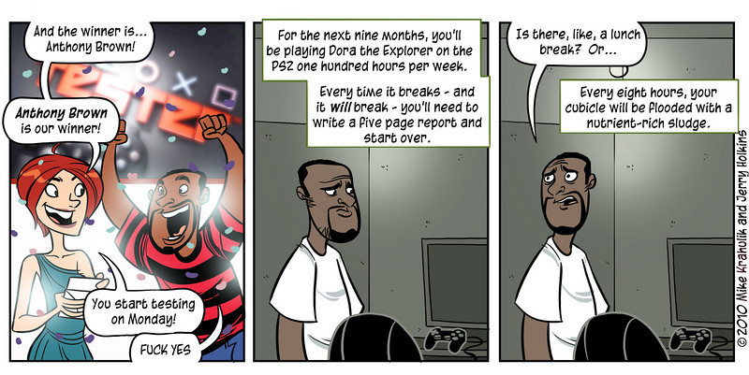
Testing
Game testing … the terrible, unspoken truth.

Slide 11
Testing: Different Types of Testing
Unit testing.
The testing of game modules on an individual basis.
System testing.
The testing of integrated game modules as a more-or-less complete system.
Acceptance testing.
An essentially complete game is demonstrated for acceptance and publishing.

Slide 12
Testing: Approaches to Testing
Black box (functional) testing:
Game functionality is tested according to specification, without looking at its internals.
White box (structural) testing:
The game is tested according to its internal structure and code to ensure it behaves correctly when provided with test data.
Regression testing:
Developing libraries of test cases that the game is sent through each time a change or update is made.
The purpose here is to retest the game to ensure it still works correctly after modifications.
Can be applied to both black box and white box testing equally well.

Slide 13
Code Freezes
A code freeze can occur at many times during game development to prevent changes that could cause significant problems and delays.
Code freezes to fix key interfaces between modules to allow module developers to complete their modules without fear of modifications.
Code freezes to prevent new functionality or features from being added too late in the development process.
Code freezes in the last days of beta testing that allow only critical or “showstopper” bugs to be removed.
Code freezes before a milestone or deliverable.

Slide 14
Milestones
Key milestones represent deliverables to the publisher.
Often, there are several internal milestones as well.
Key Milestones include:
First Playable (2nd, 3rd, 4th, etc may also exist)
Alpha, Beta, Gold

Slide 15
Milestones
Alpha
Internal testing.
The game is at the point where it is mostly playable from start to finish.
Some content and gameplay might be missing, but the engine, interface, and other major subsystems are complete.
The focus shifts from building to finishing; from creating to polishing.
This is the beginning of the end!

Slide 16
Milestones
Beta
Internal or external testing.
Everything is now complete and integrated into an essentially finalized game.
The goal here is to stabilize the game and eliminate remaining bugs before release.
If possible, doing a public beta gets a lot of extra testing done for very little cost.
The last portion of beta testing is crunch time, where the only important thing is finishing the game.

Slide 17
Milestones
Gold candidate
The game has been approved by the publisher.
Gold master
The game is released to manufacture when one of the gold candidate releases has been thoroughly tested and deemed acceptable by the console manufacturer.
You can finally celebrate!!

Slide 18
Maintenance
After release, the development is rarely over. There are often smaller releases that follow.
Patches:
Typically to fix bugs discovered after release, or to handle incompatibilities with user hardware or software configurations.
Upgrades and updates:
Represent additional content created to enhance the original game. Can be new levels, characters, weapons, story elements, and so on.
These are really mini-projects, and need to be handled as such, with the same management needs.

Slide 19
Pipelines in video game production

Slide 20
Introduction to pipelines
The pipeline is a process where an asset or element of the game moves from concept to completion and then into the game build through a series of steps where multiple team members each contribute a portion to the overall asset.
The notion of pipeline is not a new one! The car industry is using the pipeline for nearly a hundred years.
In your games, always try to define, form and use pipelines.
That is because they will give you an structured way to produce things.

Slide 21
An example of a pipeline
Game development consists of a series if interconnecting pipelines.
Each discipline can have numerous sub-pipelines within it and as each element is completed it branches off onto another pipeline, eventually working its way into the final code.
The clearest example of how a pipeline works is through the evolution of a character model.
The example that follows is very basic; there are numerous techniques,
styles, and approaches to a pipeline, this only being one.
These pipelines are also never clear lines, having the asset back-and-forth at various stages, with work in progress moving onto the other pipelines so as to not cause delays in the other disciplines work.

Slide 22
Character modeling pipeline
A primary character model in a game is rarely made by one single artist from start to finish.
Here is a simplified example showing the evolution of a character model as it goes through the artists ’ pipeline

Slide 23
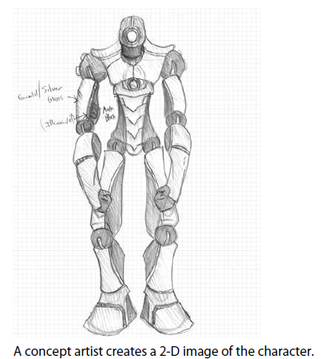
The modeling pipeline starts with a concept

Slide 24
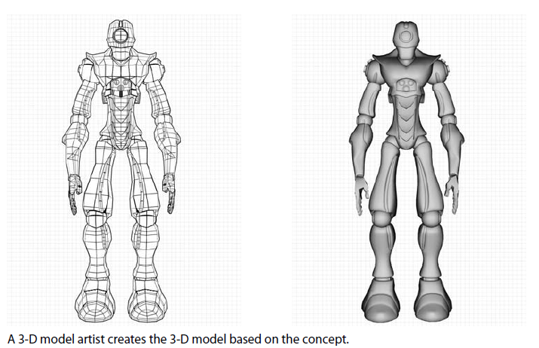
A 3d model is created from the concept

Slide 25
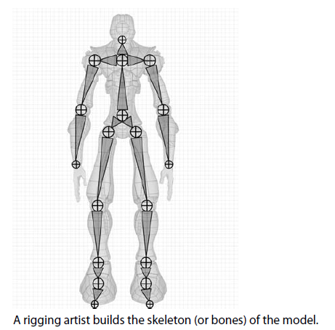
Rigging artist makes the skeleton for the mesh

Slide 26
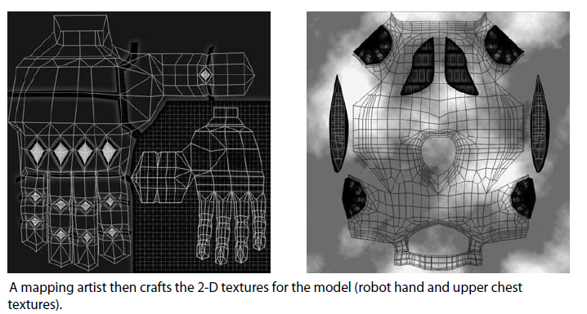
A mapping artist creates the textures

Slide 27
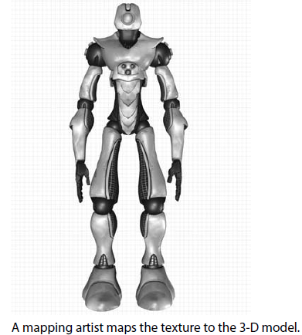
A mapping artist maps the texture to 3D model

Slide 28
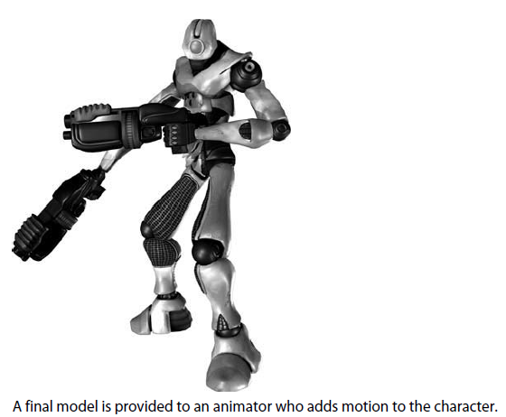
The final model is provided to animator who adds motion to the character

Slide 29
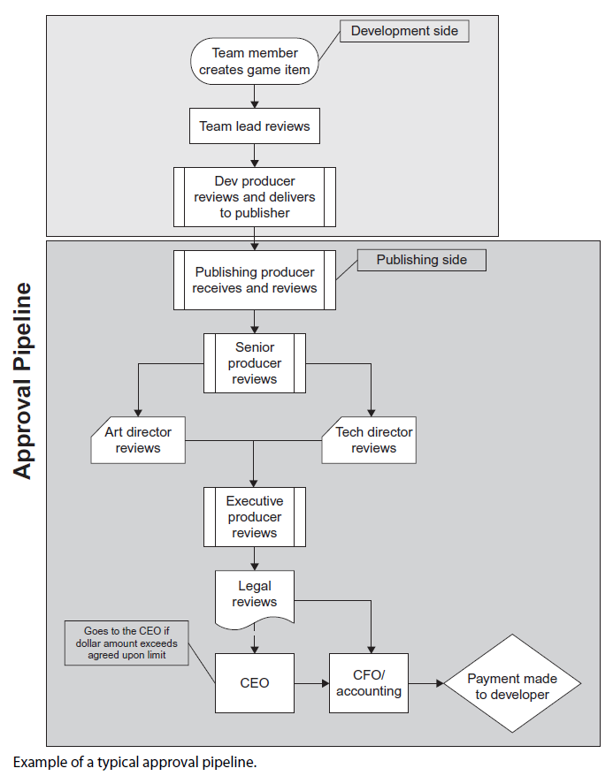
Even publishers use pipelines for the acceptance of a game

Slide 30
Post Mortem
After your game is complete always use a post mortem phase. In this stage you will ask yourself two primary questions:
What went right?
What went wrong?

