Slide 1
CS276
Information Retrieval and Web Search
Lecture 1: Boolean retrieval

Slide 2
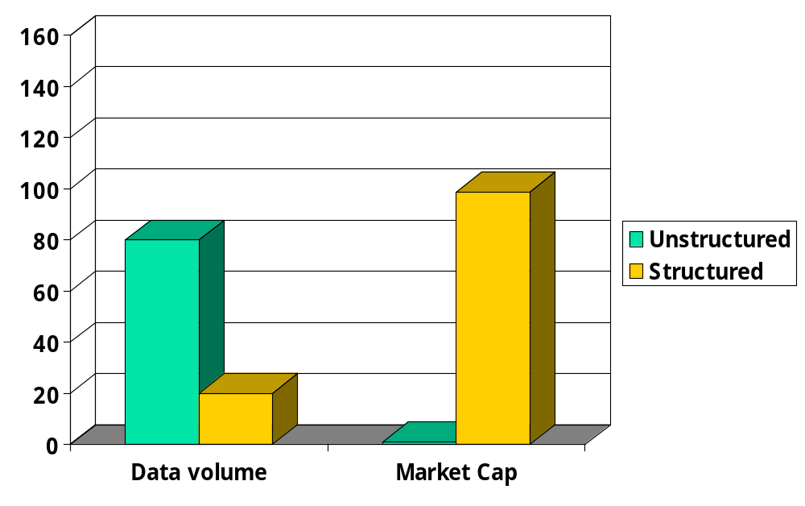
Unstructured (text) vs. structured (database) data in 1996

Slide 3
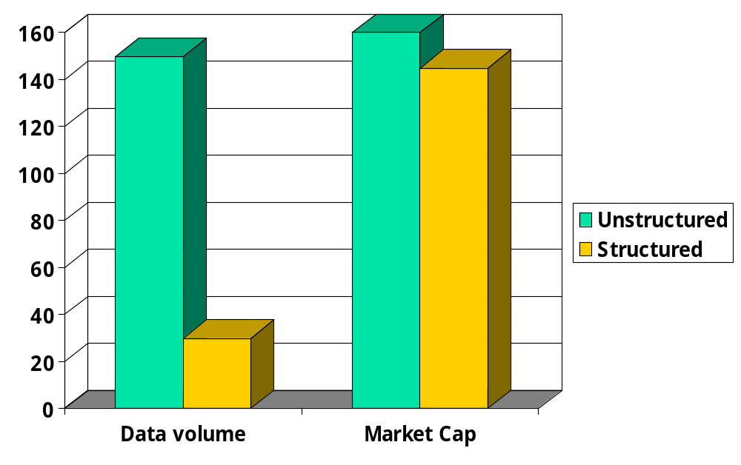




Unstructured (text) vs. structured (database) data in 2006

Slide 4
Unstructured data in 1680
Which plays of Shakespeare contain the words Brutus AND Caesar but NOT Calpurnia?
One could grep all of Shakespeare’s plays for Brutus and Caesar, then strip out lines containing Calpurnia?
  Slow (for large corpora)
  NOT Calpurnia is non-trivial
  Other operations (e.g., find the word Romans near countrymen) not feasible
  Ranked retrieval (best documents to return)
    Later lectures

Slide 5
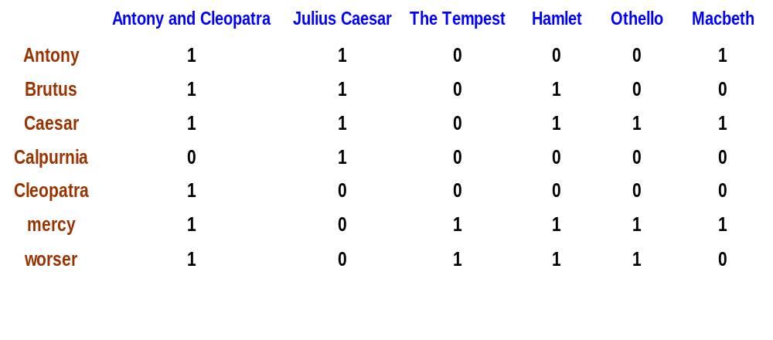
Term-document incidence
1 if play contains word, 0 otherwise
Brutus AND Caesar but NOT Calpurnia

Slide 6
Incidence vectors
So we have a 0/1 vector for each term.
To answer query: take the vectors for Brutus, Caesar and Calpurnia (complemented) ➔ bitwise AND.
110100 AND 110111 AND 101111 = 100100.

Slide 7
Answers to query
Antony and Cleopatra, Act III, Scene ii
Agrippa [Aside to DOMITIUS ENOBARBUS]: Why, Enobarbus,
When Antony found Julius Caesar dead,
He cried almost to roaring; and he wept
When at Philippi he found Brutus slain.
Hamlet, Act III, Scene ii
Lord Polonius: I did enact Julius Caesar I was killed i' the
Capitol; Brutus killed me.

Slide 8
Basic assumptions of Information Retrieval
Collection: Fixed set of documents
Goal: Retrieve documents with information that is relevant to user’s information need and helps him complete a task
SIGIR 2005

Slide 9

The classic search model
TASK
Get rid of mice in a politically correct way
Mis-conception
Info Need
Info about removing mice
without killing them
Mis-translation
Verbal form
How do I trap mice alive?
Mis-formulation
Query
mouse trap
SEARCH
ENGINE
Query
Refinement
Results
Corpus

Slide 10
How good are the retrieved docs?
Precision : Fraction of retrieved docs that are relevant to user’s information need
Recall : Fraction of relevant docs in collection that are retrieved
More precise definitions and measurements to follow in later lectures

Slide 11
Bigger collections
Consider N = 1M documents, each with about 1K terms.
Avg 6 bytes/term incl spaces/punctuation
  6GB of data in the documents.
Say there are m = 500K distinct terms among these.

Slide 12
Can’t build the matrix
500K x 1M matrix has half-a-trillion 0’s and 1’s.
But it has no more than one billion 1’s.
  matrix is extremely sparse.
What’s a better representation?
  We only record the 1 positions.
Why?

Slide 13
Inverted index
For each term T, we must store a list of all documents that contain T.
Do we use an array or a list for this?
Brutus
2
4
8
16
32
64
128
Calpurnia
1
2
3
5
8
13
21
34
Caesar
13
16
What happens if the word Caesar is added to document 14?

Slide 14
Inverted index
Linked lists generally preferred to arrays
  Dynamic space allocation
  Insertion of terms into documents easy
  Space overhead of pointers
Posting
Brutus
2
4
8
16
32
64
128
Calpurnia
1
2
3
5
8
13
21
34
Caesar
13
16
Dictionary
Postings lists
Sorted by docID (more later on why).

Slide 15





Inverted index construction
Documents to
be indexed.
Friends, Romans, countrymen.
Tokenizer
Token stream.
Friends
Romans
Countrymen
More on
these later.
Linguistic modules
Modified tokens.
friend
roman
countryman
Indexer
friend
2
4
roman
1
2
Inverted index.
countryman
13
16

Slide 16
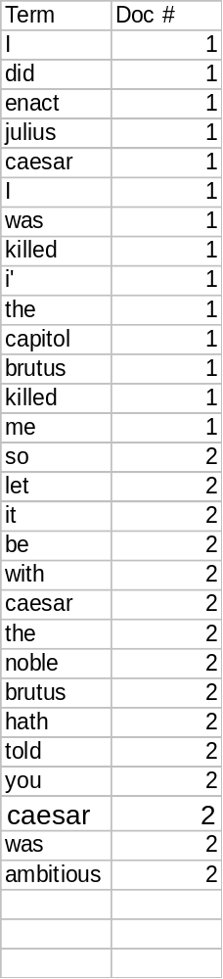
Indexer steps
Sequence of (Modified token, Document ID) pairs.
Doc 1
Doc 2
I did enact Julius
Caesar I was killed
i' the Capitol;
Brutus killed me.
So let it be with
Caesar. The noble
Brutus hath told you
Caesar was ambitious

Slide 17
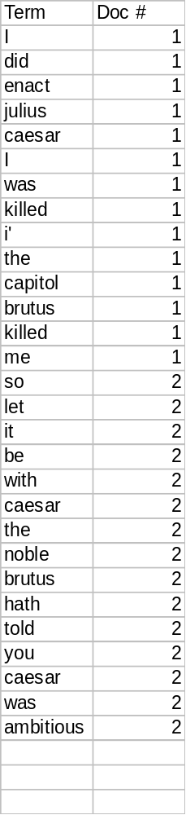
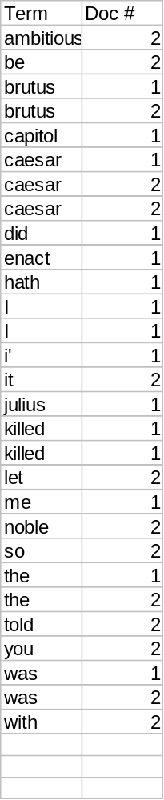
Sort by terms.
Core indexing step.

Slide 18
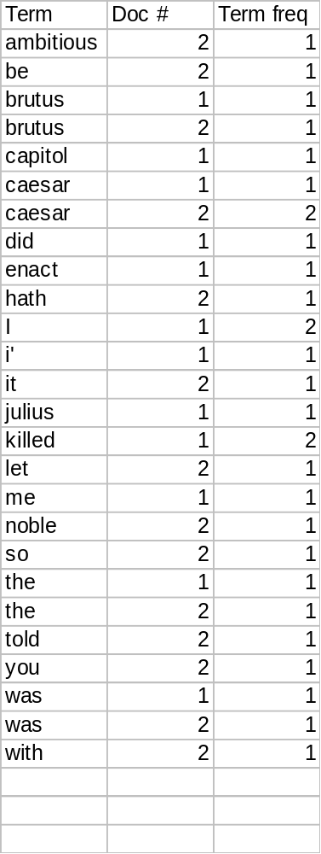
Multiple term entries in a single document are merged.
Frequency information is added.
Why frequency?
Will discuss later.

Slide 19
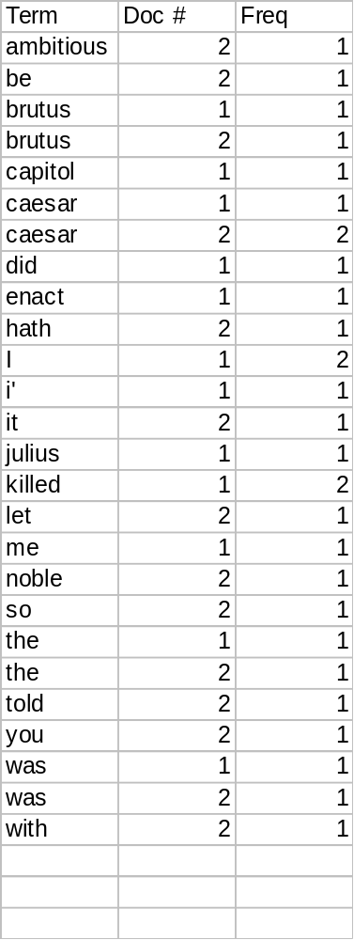
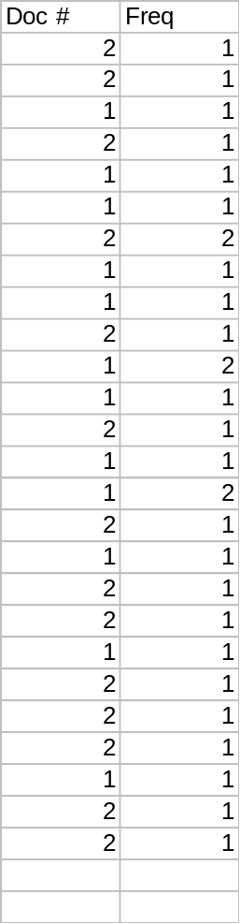
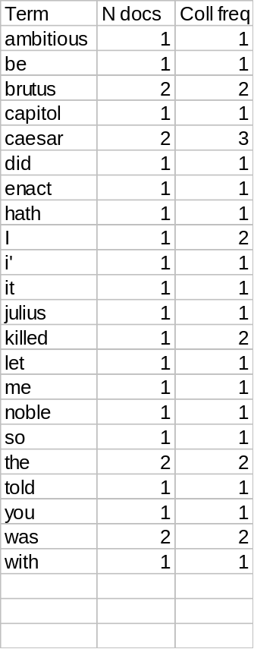
The result is split into a Dictionary file and a Postings file.

Slide 20
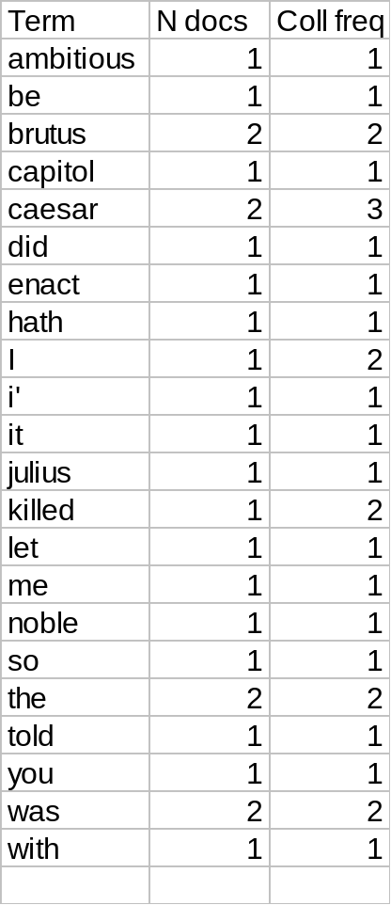
Where do we pay in storage?
Will quantify the storage, later.
Terms
Pointers

Slide 21
The index we just built
Today’s focus
How do we process a query?
  Later - what kinds of queries can we process?

Slide 22
Query processing: AND
Consider processing the query:
  Brutus AND Caesar
  Locate Brutus in the Dictionary;
    Retrieve its postings.
  Locate Caesar in the Dictionary;
    Retrieve its postings.
  “Merge” the two postings:
2
4
8
16
32
64
128
Brutus
1
2
3
5
8
13
21
34
Caesar

Slide 23
The merge
Walk through the two postings simultaneously, in time linear in the total number of postings entries
2
2
4
4
8
8
16
16
32
64
128
32
64
128
Brutus
2
8
1
Caesar
1
2
2
3
5
5
8
8
13
13
21
21
34
3
34
If the list lengths are x and y, the merge takes O(x+y)
operations.
Crucial: postings sorted by docID.

Slide 24
Boolean queries: Exact match
The Boolean Retrieval model is being able to ask a query that is a Boolean expression:
  Boolean Queries are queries using AND, OR and NOT to join query terms
    Views each document as a set of words
    Is precise: document matches condition or not.
Primary commercial retrieval tool for 3 decades.
Professional searchers (e.g., lawyers) still like Boolean queries:
  You know exactly what you’re getting.

Slide 25
Example: WestLaw http://www.westlaw.com/
Largest commercial (paying subscribers) legal search service (started 1975; ranking added 1992)
Tens of terabytes of data; 700,000 users
Majority of users still use boolean queries
Example query:
  What is the statute of limitations in cases involving the federal tort claims act?
  LIMIT! /3 STATUTE ACTION /S FEDERAL /2 TORT /3 CLAIM
/3 = within 3 words, /S = in same sentence

Slide 26
Example: WestLaw http://www.westlaw.com/
Another example query:
  Requirements for disabled people to be able to access a workplace
  disabl! /p access! /s work-site work-place (employment /3 place
Note that SPACE is disjunction, not conjunction!
Long, precise queries; proximity operators; incrementally developed; not like web search
Professional searchers often like Boolean search:
  Precision, transparency and control
But that doesn’t mean they actually work better….

Slide 27
Boolean queries:
More general merges
Exercise: Adapt the merge for the queries:
Brutus AND NOT Caesar
Brutus OR NOT Caesar
Can we still run through the merge in time O(x+y)?
What can we achieve?

Slide 28
Merging
What about an arbitrary Boolean formula?
(Brutus OR Caesar) AND NOT
(Antony OR Cleopatra)
Can we always merge in “linear” time?
  Linear in what?
Can we do better?

Slide 29
Query optimization
What is the best order for query processing?
Consider a query that is an AND of t terms.
For each of the t terms, get its postings, then AND them together.
Brutus
2
4
8
16
32
64
128
Calpurnia
1
2
3
5
8
16
21
34
Caesar
13
16
Query: Brutus AND Calpurnia AND Caesar

Slide 30
Query optimization example
Process in order of increasing freq:
  start with smallest set, then keep cutting further.
This is why we kept
freq in dictionary
Brutus
2
4
8
16
32
64
128
Calpurnia
1
2
3
5
8
13
21
34
Caesar
13
16
Execute the query as (Caesar AND Brutus) AND Calpurnia.

Slide 31
More general optimization
e.g., (madding OR crowd) AND (ignoble OR strife)
Get freq’s for all terms.
Estimate the size of each OR by the sum of its freq’s (conservative).
Process in increasing order of OR sizes.

Slide 32
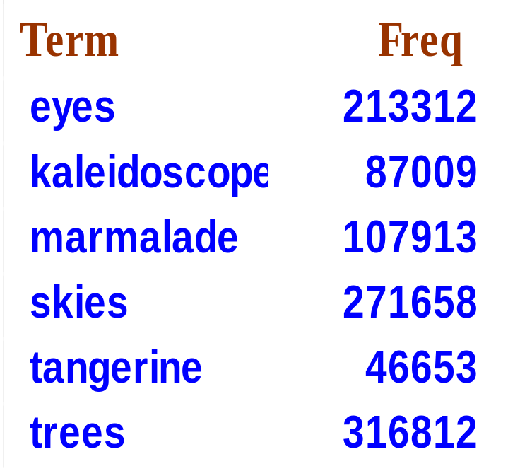
Exercise
Recommend a query processing order for
(tangerine OR trees) AND
(marmalade OR skies) AND
(kaleidoscope OR eyes)

Slide 33
Query processing exercises
If the query is friends AND romans AND (NOT countrymen), how could we use the freq of countrymen?
Exercise: Extend the merge to an arbitrary Boolean query. Can we always guarantee execution in time linear in the total postings size?
Hint: Begin with the case of a Boolean formula query: in this, each query term appears only once in the query.

Slide 34
Exercise
Try the search feature at http://www.rhymezone.com/shakespeare/
Write down five search features you think it could do better

Slide 35
What’s ahead in IR?
Beyond term search
What about phrases?
  Stanford University
Proximity: Find Gates NEAR Microsoft.
  Need index to capture position information in docs. More later.
Zones in documents: Find documents with (author = Ullman) AND (text contains automata).

Slide 36
Evidence accumulation
1 vs. 0 occurrence of a search term
  2 vs. 1 occurrence
  3 vs. 2 occurrences, etc.
  Usually more seems better
Need term frequency information in docs

Slide 37
Ranking search results
Boolean queries give inclusion or exclusion of docs.
Often we want to rank/group results
  Need to measure proximity from query to each doc.
  Need to decide whether docs presented to user are singletons, or a group of docs covering various aspects of the query.

Slide 38
IR vs. databases:
Structured vs unstructured data
Structured data tends to refer to information in “tables”
Employee
Manager
Salary
Smith
Jones
50000
Chang
Smith
60000
Ivy
Smith
50000
Typically allows numerical range and exact match
(for text) queries, e.g.,
Salary < 60000 AND Manager = Smith.

Slide 39
Unstructured data
Typically refers to free text
Allows
  Keyword queries including operators
  More sophisticated “concept” queries e.g.,
    find all web pages dealing with drug abuse
Classic model for searching text documents

Slide 40
Semi-structured data
In fact almost no data is “unstructured”
E.g., this slide has distinctly identified zones such as the Title and Bullets
Facilitates “semi-structured” search such as
  Title contains data AND Bullets contain search
    … to say nothing of linguistic structure

Slide 41
More sophisticated semi-structured search
Title is about Object Oriented Programming AND Author something like stro*rup
where * is the wild-card operator
Issues:
  how do you process “about”?
  how do you rank results?
The focus of XML search.

Slide 42
Clustering and classification
Given a set of docs, group them into clusters based on their contents.
Given a set of topics, plus a new doc D, decide which topic(s) D belongs to.

Slide 43
The web and its challenges
Unusual and diverse documents
Unusual and diverse users, queries, information needs
Beyond terms, exploit ideas from social networks
  link analysis, clickstreams ...
How do search engines work? And how can we make them better?

Slide 44
More sophisticated information retrieval
Cross-language information retrieval
Question answering
Summarization
Text mining
…

Slide 45
Course administrivia
Course URL: cs276.stanford.edu [a.k.a.,http://www.stanford.edu/class/cs276/]
Work/Grading:
  Problem sets (2) 20%
  Practical exercises (2) 10% + 20% = 30%
  Midterm 20%
  Final 30%
Textbook:
  Introduction to Information Retrieval
  We’d love comments on it!

Slide 46
Course staff
Professor: Christopher Manning
Office: Gates 158 manning@cs.stanford.edu
Professor: Prabhakar Raghavan pragh@yahoo-inc.com
TAs: Richa Bhayani, Jason Chuang, Dan Ramage, Kevin Wong
In general don’t use the above addresses, but:
  Newsgroup: su.class.cs276 [preferred]
  cs276-aut0809-staff@lists.stanford.edu

Slide 47
Resources for today’s lecture
Introduction to Information Retrieval, ch. 1
Managing Gigabytes, Chapter 3.2
Modern Information Retrieval, Chapter 8.2
Shakespeare: http://www.rhymezone.com/shakespeare/
  Try the neat browse by keyword sequence feature!
Any questions?

