Slide 1
Introduction to
Information Retrieval
Lecture 11: Text Classification;
Vector space classification
[Borrows slides from Ray Mooney and Barbara Rosario]

Slide 2
Recap: Naïve Bayes classifiers
Classify based on prior weight of class and conditional parameter for what each word says:
Training is done by counting and dividing:
Don’t forget to smooth

Slide 3
The rest of text classification
Today:
  Vector space methods for Text Classification
    K Nearest Neighbors
    Decision boundaries
    Vector space classification using centroids
    Decision Trees (briefly)
Next week
  More text classification
    Support Vector Machines
    Text-specific issues in classification

Slide 4
Recall: Vector Space Representation
Each document is a vector, one component for each term (= word).
Normally normalize vectors to unit length.
High-dimensional vector space:
  Terms are axes
  10,000+ dimensions, or even 100,000+
  Docs are vectors in this space
How can we do classification in this space?
14.1

Slide 5
Classification Using Vector Spaces
As before, the training set is a set of documents, each labeled with its class (e.g., topic)
In vector space classification, this set corresponds to a labeled set of points (or, equivalently, vectors) in the vector space
Premise 1: Documents in the same class form a contiguous region of space
Premise 2: Documents from different classes don’t overlap (much)
We define surfaces to delineate classes in the space

Slide 6
Documents in a Vector Space
Government
Science
Arts

Slide 7
Test Document of what class?
Government
Science
Arts

Slide 8
Test Document = Government
Is this
similarity
hypothesis
true in
general?
Government
Science
Arts
Our main topic today is how to find good separators

Slide 9
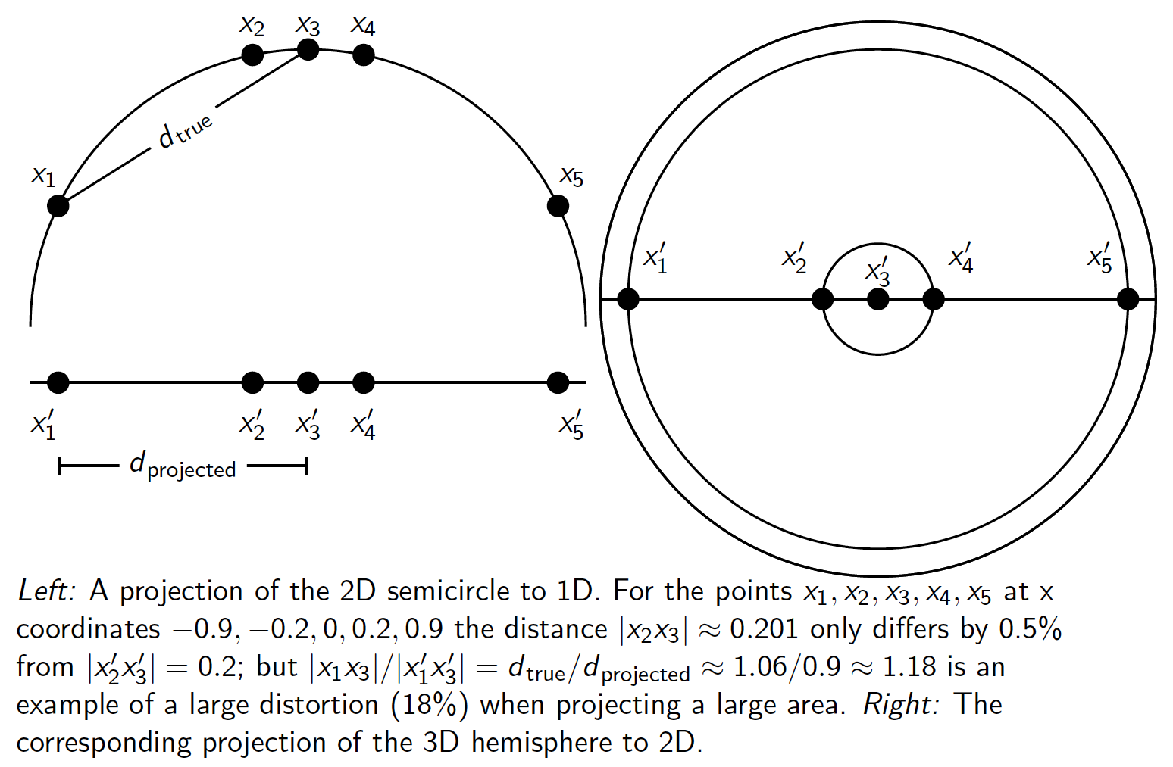
Aside: 2D/3D graphs can be misleading

Slide 10
k Nearest Neighbor Classification
kNN = k Nearest Neighbor
To classify document d into class c:
Define k-neighborhood N as k nearest neighbors of d
Count number of documents i in N that belong to c
Estimate P(c|d) as i/k
Choose as class argmax_{c} P(c|d) [ = majority class]
14.3

Slide 11
Example: k=6 (6NN)
P(science| )?
Government
Science
Arts

Slide 12
Nearest-Neighbor Learning Algorithm
Learning is just storing the representations of the training examples in D.
Testing instance x (under 1NN):
  Compute similarity between x and all examples in D.
  Assign x the category of the most similar example in D.
Does not explicitly compute a generalization or category prototypes.
Also called:
  Case-based learning
  Memory-based learning
  Lazy learning
Rationale of kNN: contiguity hypothesis

Slide 13
kNN Is Close to Optimal
Cover and Hart (1967)
Asymptotically, the error rate of 1-nearest-neighbor classification is less than twice the Bayes rate [error rate of classifier knowing model that generated data]
In particular, asymptotic error rate is 0 if Bayes rate is 0.
Assume: query point coincides with a training point.
Both query point and training point contribute error → 2 times Bayes rate

Slide 14
k Nearest Neighbor
Using only the closest example (1NN) to determine the class is subject to errors due to:
  A single atypical example.
  Noise (i.e., an error) in the category label of a single training example.
More robust alternative is to find the k most-similar examples and return the majority category of these k examples.
Value of k is typically odd to avoid ties; 3 and 5 are most common.

Slide 15
kNN decision boundaries
Boundaries are in principle arbitrary surfaces – but usually polyhedra
Government
Science
Arts
kNN gives locally defined decision boundaries between
classes – far away points do not influence each classification
decision (unlike in Naïve Bayes, Rocchio, etc.)

Slide 16
Similarity Metrics
Nearest neighbor method depends on a similarity (or distance) metric.
Simplest for continuous m-dimensional instance space is Euclidean distance.
Simplest for m-dimensional binary instance space is Hamming distance (number of feature values that differ).
For text, cosine similarity of tf.idf weighted vectors is typically most effective.

Slide 17
Illustration of 3 Nearest Neighbor for Text Vector Space

Slide 18
Nearest Neighbor with Inverted Index
Naively finding nearest neighbors requires a linear search through |D| documents in collection
But determining k nearest neighbors is the same as determining the k best retrievals using the test document as a query to a database of training documents.
Use standard vector space inverted index methods to find the k nearest neighbors.
Testing Time: O(B|V_{t}|) where B is the average number of training documents in which a test-document word appears.
  Typically B << |D|

Slide 19
kNN: Discussion
No feature selection necessary
Scales well with large number of classes
  Don’t need to train n classifiers for n classes
Classes can influence each other
  Small changes to one class can have ripple effect
Scores can be hard to convert to probabilities
No training necessary
  Actually: perhaps not true. (Data editing, etc.)
May be more expensive at test time

Slide 20
kNN vs. Naive Bayes
Bias/Variance tradeoff
  Variance ≈ Capacity
kNN has high variance and low bias.
  Infinite memory
NB has low variance and high bias.
  Decision surface has to be linear (hyperplane – see later)
Consider asking a botanist: Is an object a tree?
  Too much capacity/variance, low bias
    Botanist who memorizes
    Will always say “no” to new object (e.g., different # of leaves)
  Not enough capacity/variance, high bias
    Lazy botanist
    Says “yes” if the object is green
  You want the middle ground
        (Example due to C. Burges)
Notes:
Bias/variance in terms of resulting classifier given randomly selected training set; why it is a tradeoff; when to choose low-bias method, when to choose low-variance method

Slide 21
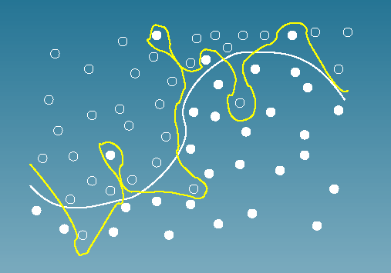
Bias vs. variance:
Choosing the correct model capacity
14.6

Slide 22
Linear classifiers and binary and multiclass classification
Consider 2 class problems
  Deciding between two classes, perhaps, government and non-government
    One-versus-rest classification
How do we define (and find) the separating surface?
How do we decide which region a test doc is in?
14.4

Slide 23
Separation by Hyperplanes
A strong high-bias assumption is linear separability:
  in 2 dimensions, can separate classes by a line
  in higher dimensions, need hyperplanes
Can find separating hyperplane by linear programming
  (or can iteratively fit solution via perceptron):
  separator can be expressed as ax + by = c

Slide 24
Linear programming / Perceptron
Find a,b,c, such that
ax + by > c for red points
ax + by < c for green points.

Slide 25
Which Hyperplane?
In general, lots of possible
solutions for a,b,c.

Slide 26
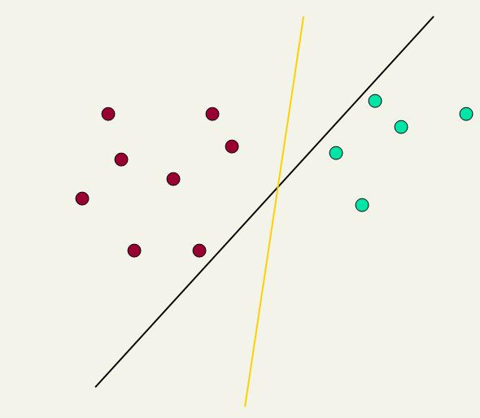
Which Hyperplane?
Lots of possible solutions for a,b,c.
Some methods find a separating hyperplane, but not the optimal one [according to some criterion of expected goodness]
  E.g., perceptron
Most methods find an optimal separating hyperplane
Which points should influence optimality?
  All points
    Linear regression
    Naïve Bayes
  Only “difficult points” close to decision boundary
    Support vector machines

Slide 27
Linear classifier: Example
Class: “interest” (as in interest rate)
Example features of a linear classifier
w_{i} t_{i} w_{i} t_{i}
To classify, find dot product of feature vector and weights
0.70 prime
0.67 rate
0.63 interest
0.60 rates
0.46 discount
0.43 bundesbank
-0.71 dlrs
-0.35 world
-0.33 sees
-0.25 year
-0.24 group
-0.24 dlr

Slide 28
Linear Classifiers
Many common text classifiers are linear classifiers
  Naïve Bayes
  Perceptron
  Rocchio
  Logistic regression
  Support vector machines (with linear kernel)
  Linear regression
Despite this similarity, noticeable performance differences
  For separable problems, there is an infinite number of separating hyperplanes. Which one do you choose?
  What to do for non-separable problems?
  Different training methods pick different hyperplanes
Classifiers more powerful than linear often don’t perform better on text problems. Why?

Slide 29
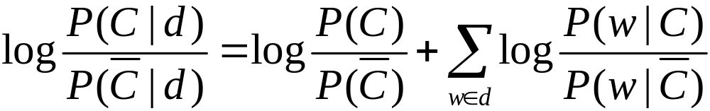
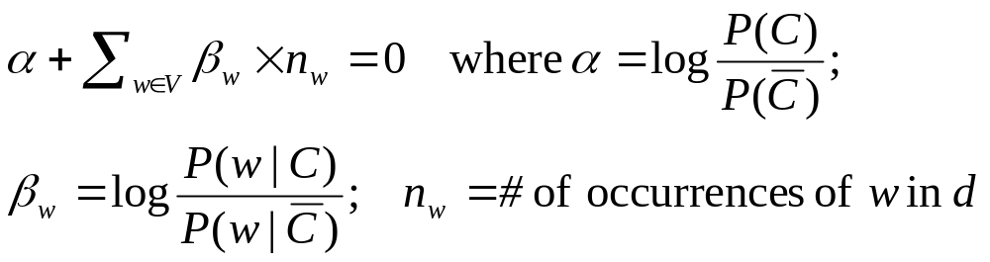
Naive Bayes is a linear classifier
Two-class Naive Bayes. We compute:
Decide class C if the odds is greater than 1, i.e., if the log odds is greater than 0.
So decision boundary is hyperplane:

Slide 30
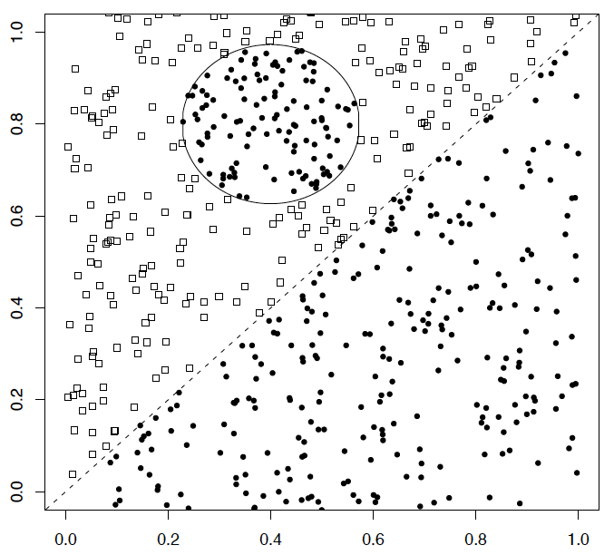
A nonlinear problem
A linear classifier like Naïve Bayes does badly on this task
kNN will do very well (assuming enough training data)

Slide 31
High Dimensional Data
Pictures like the one at right are absolutely misleading!
Documents are zero along almost all axes
Most document pairs are very far apart (i.e., not strictly orthogonal, but only share very common words and a few scattered others)
In classification terms: often document sets are separable, for most any classification
This is part of why linear classifiers are quite successful in this domain

Slide 32
More Than Two Classes
Any-of or multivalue classification
  Classes are independent of each other.
  A document can belong to 0, 1, or >1 classes.
  Decompose into n binary problems
  Quite common for documents
One-of or multinomial or polytomous classification
  Classes are mutually exclusive.
  Each document belongs to exactly one class
  E.g., digit recognition is polytomous classification
    Digits are mutually exclusive
14.5

Slide 33
Set of Binary Classifiers: Any of
Build a separator between each class and its complementary set (docs from all other classes).
Given test doc, evaluate it for membership in each class.
Apply decision criterion of classifiers independently
Done
  Though maybe you could do better by considering dependencies between categories

Slide 34
Set of Binary Classifiers: One of
Build a separator between each class and its complementary set (docs from all other classes).
Given test doc, evaluate it for membership in each class.
Assign document to class with:
  maximum score
  maximum confidence
  maximum probability
Why different from multiclass/ any of classification?
?
?
?

Slide 35
Using Rocchio for text classification
Relevance feedback methods can be adapted for text categorization
  As noted before, relevance feedback can be viewed as 2-class classification
    Relevant vs. nonrelevant documents
Use standard TF/IDF weighted vectors to represent text documents
For training documents in each category, compute a prototype vector by summing the vectors of the training documents in the category.
  Prototype = centroid of members of class
Assign test documents to the category with the closest prototype vector based on cosine similarity.
14.2

Slide 36
Illustration of Rocchio Text Categorization

Slide 37
Definition of centroid
Where D_{c} is the set of all documents that belong to class c and v(d) is the vector space representation of d.
Note that centroid will in general not be a unit vector even when the inputs are unit vectors.

Slide 38
Rocchio Properties
Forms a simple generalization of the examples in each class (a prototype).
Prototype vector does not need to be averaged or otherwise normalized for length since cosine similarity is insensitive to vector length.
Classification is based on similarity to class prototypes.
Does not guarantee classifications are consistent with the given training data.
Why not?

Slide 39
Rocchio Anomaly
Prototype models have problems with polymorphic (disjunctive) categories.

Slide 40
3 Nearest Neighbor Comparison
Nearest Neighbor tends to handle polymorphic categories better.

Slide 41
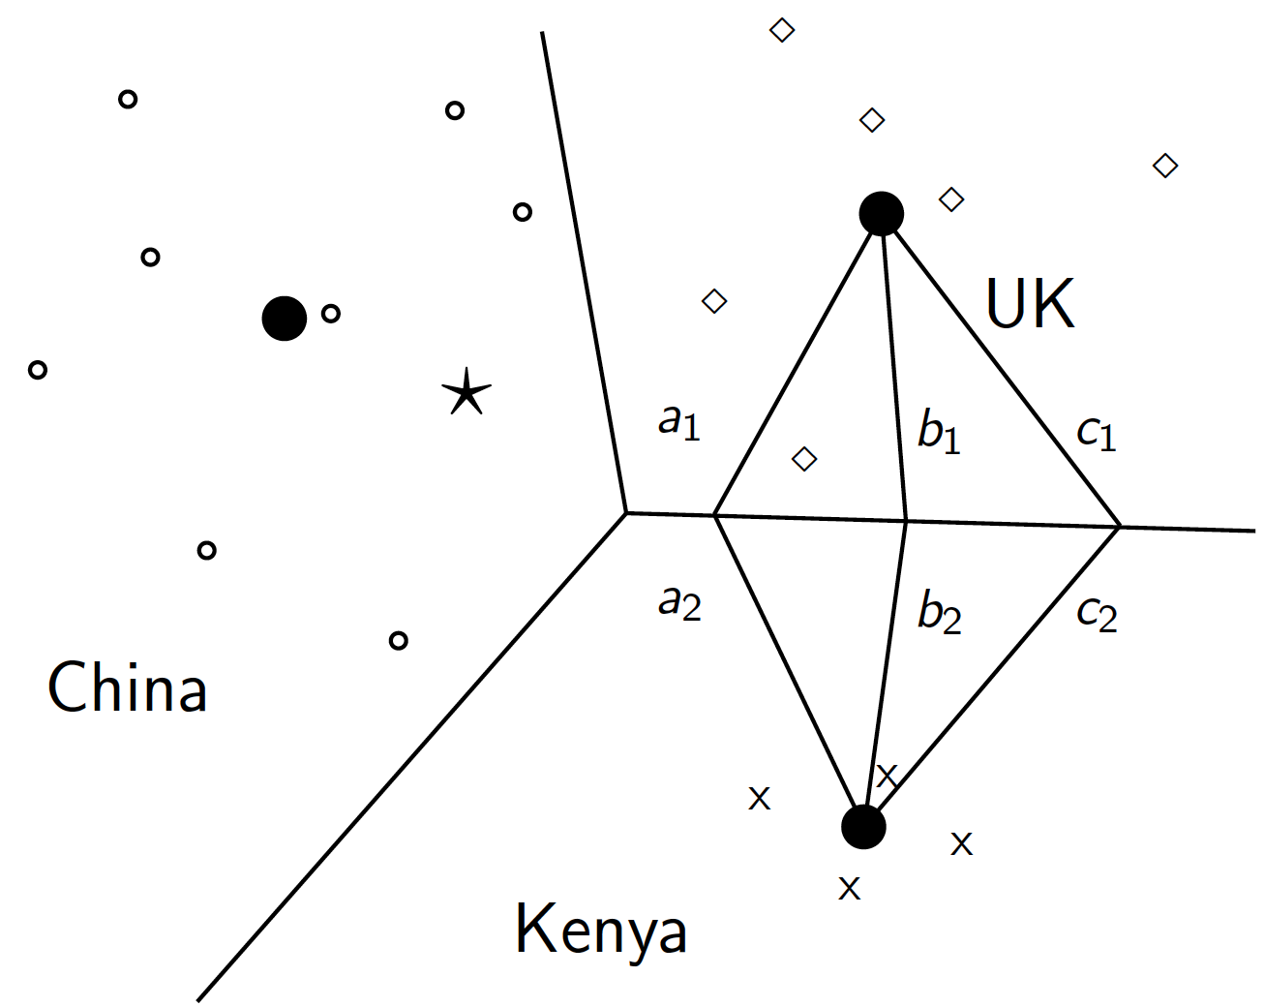
Rocchio is a linear classifier

Slide 42
Two-class Rocchio as a linear classifier
Line or hyperplane defined by:
For Rocchio, set:

Slide 43
Rocchio classification
Rocchio forms a simple representation for each class: the centroid/prototype
Classification is based on similarity to / distance from the prototype/centroid
It does not guarantee that classifications are consistent with the given training data
It is little used outside text classification, but has been used quite effectively for text classification
Again, cheap to train and test documents

Slide 44
Decision Tree Classification
Tree with internal nodes labeled by terms
Branches are labeled by tests on the weight that the term has
Leaves are labeled by categories
Classifier categorizes document by descending tree following tests to leaf
The label of the leaf node is then assigned to the document
Most decision trees are binary trees (never disadvantageous; may require extra internal nodes)
DT make good use of a few high-leverage features

Slide 45
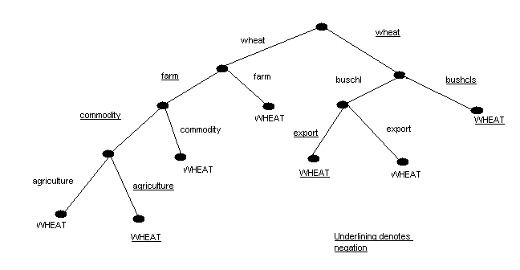
Decision Tree Categorization:
Example
Geometric interpretation of DT?

Slide 46
Decision Tree Learning
Learn a sequence of tests on features, typically using top-down, greedy search
  At each stage choose the unused feature with highest Information Gain
    That is, feature/class Mutual Information
Binary (yes/no) or continuous decisions
f₁
!f₁
f₇
!f₇
P(class) = .9
P(class) = .6
P(class) = .2

Slide 47
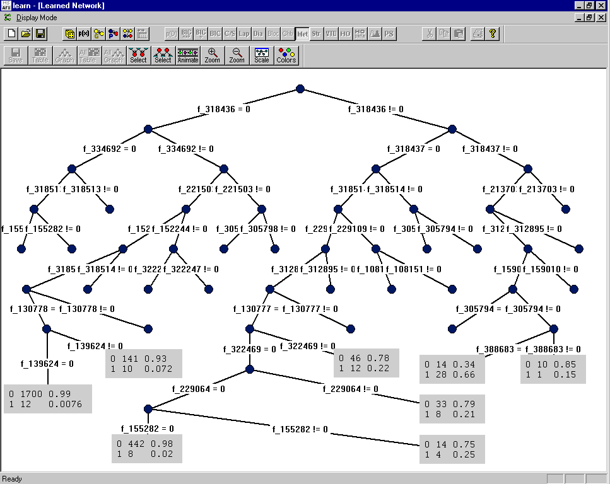
Category: “interest” – Dumais et al. (Microsoft) Decision Tree
rate=1
rate.t=1
lending=0
prime=0
discount=0
pct=1
year=0
year=1

Slide 48
Summary: Representation of
Text Categorization Attributes
Representations of text are usually very high dimensional (one feature for each word)
High-bias algorithms that prevent overfitting in high-dimensional space generally work best
For most text categorization tasks, there are many relevant features and many irrelevant ones
Methods that combine evidence from many or all features (e.g. naive Bayes, kNN, neural-nets) often tend to work better than ones that try to isolate just a few relevant features (standard decision-tree or rule induction)*
*Although the results are a bit more mixed than often thought
Notes:
Explain supervised learning

Slide 49
Which classifier do I use for a given text classification problem?
Is there a learning method that is optimal for all text classification problems?
No, because there is a tradeoff between bias and variance.
Factors to take into account:
  How much training data is available?
  How simple/complex is the problem? (linear vs. nonlinear decision boundary)
  How noisy is the problem?
  How stable is the problem over time?
    For an unstable problem, it’s better to use a simple and robust classifier.

Slide 50
References
IIR 14
Fabrizio Sebastiani. Machine Learning in Automated Text Categorization. ACM Computing Surveys, 34(1):1-47, 2002.
Tom Mitchell, Machine Learning. McGraw-Hill, 1997.
Yiming Yang & Xin Liu, A re-examination of text categorization methods. Proceedings of SIGIR, 1999.
Evaluating and Optimizing Autonomous Text Classification Systems (1995) David Lewis. Proceedings of the 18th Annual International ACM SIGIR Conference on Research and Development in Information Retrieval
Trevor Hastie, Robert Tibshirani and Jerome Friedman, Elements of Statistical Learning: Data Mining, Inference and Prediction. Springer-Verlag, New York.
Open Calais: Automatic Semantic Tagging
  Free (but they can keep your data), provided by Thompson/Reuters
Weka: A data mining software package that includes an implementation of many ML algorithms

