Slide 1
Introduction to
Information Retrieval
Lecture 12: Support vector machines and machine learning on documents
[Borrows slides from Ray Mooney]

Slide 2
Text classification: Last time and today
Last time: 3 algorithms for text classification
  K Nearest Neighbor classification
    Simple, expensive at test time, high variance, non-linear
  Vector space classification using centroids and hyperplanes that split them
    Simple, linear classifier; perhaps too simple (or maybe not*)
  (Decision Trees)
    Pick out hyperboxes; nonlinear; use just a few features
Today
  SVMs
  Some empirical evaluation and comparison
  Text-specific issues in classification
Notes:
*Li and Yiming Yang 2003 ICML give very good performance from Rocchio, whereas Dumais et al. don’t

Slide 3
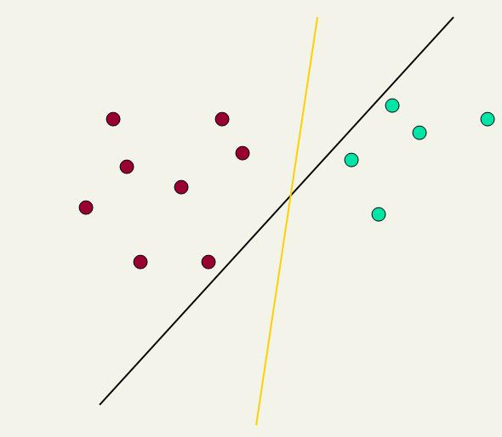
Linear classifiers: Which Hyperplane?
Lots of possible solutions for a,b,c.
Some methods find a separating hyperplane, but not the optimal one [according to some criterion of expected goodness]
  E.g., perceptron
Support Vector Machine (SVM) finds an optimal solution.
  Maximizes the distance between the hyperplane and the “difficult points” close to decision boundary
  One intuition: if there are no points near the decision surface, then there are no very uncertain classification decisions
This line represents the decision boundary:
ax + by - c = 0
15.0

Slide 4
Another intuition
If you have to place a fat separator between classes, you have less choices, and so the capacity of the model has been decreased

Slide 5
Support Vector Machine (SVM)
SVMs maximize the margin around the separating hyperplane.
    A.k.a. large margin classifiers
The decision function is fully specified by a subset of training samples, the support vectors.
Solving SVMs is a quadratic programming problem
Seen by many as the most successful current text classification method*
Support vectors
Maximize
margin
*but other discriminative methods often perform very similarly
15.1

Slide 6
Maximum Margin: Formalization
w: decision hyperplane normal vector
x_{i}: data point i
y_{i}: class of data point i (+1 or -1) NB: Not 1/0
Classifier is: f(x_{i}) = sign(w^{T}x_{i} + b)
Functional margin of x_{i} is: y_{i} (w^{T}x_{i} + b)
  But note that we can increase this margin simply by scaling w, b….
Functional margin of dataset is twice the minimum functional margin for any point
  The factor of 2 comes from measuring the whole width of the margin

Slide 7
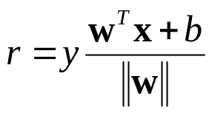
Geometric Margin
Distance from example to the separator is
Examples closest to the hyperplane are support vectors.
Margin ρ of the separator is the width of separation between support vectors of classes.
x
ρ
Derivation of finding r:
Dotted line x’-x is perpendicular to
decision boundary so parallel to w.
Unit vector is w/|w|, so this one is rw/|w|.
x’ = x – rw/|w|.
x’ satisfies w^{T}x’+b = 0.
So w^{T}(x –rw/|w|) + b = 0
Recall that |w| = sqrt(w^{T}w).
So, solving for r gives:
r = y(w^{T}x + b)/|w|
r
x′
w
Notes:
Looking for distance r. Dotted line x’-x is perpendicular to decision boundary so parallel to w. Unit vector is w/|w|, so this one is rw/|w|.
x’ = x – rw/|w|. X’ satisfies wx+b = 0.
So wT(x –rw/|w|) + b = 0
Recall that |w| = sqrt(wTw). So, solving for r gives:
r = y(wTx + b)/|w|

Slide 8
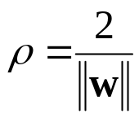
Linear SVM Mathematically
The linearly separable case
Assume that all data is at least distance 1 from the hyperplane, then the following two constraints follow for a training set {(x_{i} ,y_{i})}
For support vectors, the inequality becomes an equality
Then, since each example’s distance from the hyperplane is
The margin is:
w^{T}x_{i} + b ≥ 1 if y_{i} = 1
w^{T}x_{i} + b ≤ -1 if y_{i} = -1

Slide 9
Linear Support Vector Machine (SVM)
ρ
w^{T}x_{a} + b = 1
Hyperplane
w^{T} x + b = 0
Extra scale constraint:
min_{i=1,…,n} |w^{T}x_{i} + b| = 1
This implies:
w^{T}(x_{a}–x_{b}) = 2
ρ = ||x_{a}–x_{b}||₂ = 2/||w||₂
w^{T}x_{b} + b = -1
w^{T} x + b = 0

Slide 10
Linear SVMs Mathematically (cont.)
Then we can formulate the quadratic optimization problem:
A better formulation (min ||w|| = max 1/ ||w|| ):
Find w and b such that
is maximized; and for all {(x_{i} , y_{i})}
w^{T}x_{i} + b ≥ 1 if y_{i}=1; w^{T}x_{i} + b ≤ -1 if y_{i} = -1
Find w and b such that
Φ(w) =½ w^{T}w is minimized;
and for all {(x_{i} ,y_{i})}: y_{i} (w^{T}x_{i} + b) ≥ 1

Slide 11
Solving the Optimization Problem
This is now optimizing a quadratic function subject to linear constraints
Quadratic optimization problems are a well-known class of mathematical programming problem, and many (intricate) algorithms exist for solving them (with many special ones built for SVMs)
The solution involves constructing a dual problem where a Lagrange multiplier α_{i} is associated with every constraint in the primary problem:
Find w and b such that
Φ(w) =½ w^{T}w is minimized;
and for all {(x_{i} ,y_{i})}: y_{i} (w^{T}x_{i} + b) ≥ 1
Find α₁…α_{N} such that
Q(α) =Σα_{i} - ½ΣΣα_{i}α_{j}y_{i}y_{j}x_{i}^{T}x_{j} is maximized and
(1) Σα_{i}y_{i} = 0
(2) α_{i} ≥ 0 for all α_{i}

Slide 12
The Optimization Problem Solution
The solution has the form:
Each non-zero α_{i} indicates that corresponding x_{i} is a support vector.
Then the classifying function will have the form:
Notice that it relies on an inner product between the test point x and the support vectors x_{i} – we will return to this later.
Also keep in mind that solving the optimization problem involved computing the inner products x_{i}^{T}x_{j} between all pairs of training points.
w =Σα_{i}y_{i}x_{i} b= y_{k}- w^{T}x_{k} for any x_{k} such that α_{k}≠ 0
f(x) = Σα_{i}y_{i}x_{i}^{T}x + b

Slide 13
Soft Margin Classification
If the training data is not linearly separable, slack variables ξ_{i} can be added to allow misclassification of difficult or noisy examples.
Allow some errors
  Let some points be moved to where they belong, at a cost
Still, try to minimize training set errors, and to place hyperplane “far” from each class (large margin)
ξ_{i}
ξ_{j}
15.2.1

Slide 14
Soft Margin Classification Mathematically
The old formulation:
The new formulation incorporating slack variables:
Parameter C can be viewed as a way to control overfitting – a regularization term
Find w and b such that
Φ(w) =½ w^{T}w is minimized and for all {(x_{i} ,y_{i})}
y_{i} (w^{T}x_{i} + b) ≥ 1
Find w and b such that
Φ(w) =½ w^{T}w + CΣξ_{i} is minimized and for all {(x_{i} ,y_{i})}
y_{i} (w^{T}x_{i} + b) ≥ 1- ξ_{i} and ξ_{i} ≥ 0 for all i

Slide 15
Soft Margin Classification – Solution
The dual problem for soft margin classification:
Neither slack variables ξ_{i} nor their Lagrange multipliers appear in the dual problem!
Again, x_{i} with non-zero α_{i} will be support vectors.
Solution to the dual problem is:
Find α₁…α_{N} such that
Q(α) =Σα_{i} - ½ΣΣα_{i}α_{j}y_{i}y_{j}x_{i}^{T}x_{j} is maximized and
(1) Σα_{i}y_{i} = 0
(2) 0 ≤ α_{i} ≤ C for all α_{i}
w is not needed explicitly for classification!
w = Σα_{i}y_{i}x_{i}
B = y_{k}(1- ξ_{k}) - w^{T}x_{k} where k = argmax α_{k’}
k’
f(x) = Σα_{i}y_{i}x_{i}^{T}x + b

Slide 16
Classification with SVMs
Given a new point x, we can score its projection onto the hyperplane normal:
  I.e., compute score: w^{T}x + b = Σα_{i}y_{i}x_{i}^{T}x + b
  Can set confidence threshold t.
Score > t: yes
Score < -t: no
Else: don’t know
7
5
3

Slide 17
Linear SVMs: Summary
The classifier is a separating hyperplane.
Most “important” training points are support vectors; they define the hyperplane.
Quadratic optimization algorithms can identify which training points x_{i} are support vectors with non-zero Lagrangian multipliers α_{i}.
Both in the dual formulation of the problem and in the solution training points appear only inside inner products:
Find α₁…α_{N} such that
Q(α) =Σα_{i} - ½ΣΣα_{i}α_{j}y_{i}y_{j}x_{i}^{T}x_{j} is maximized and
(1) Σα_{i}y_{i} = 0
(2) 0 ≤ α_{i} ≤ C for all α_{i}
f(x) = Σα_{i}y_{i}x_{i}^{T}x + b

Slide 18
Non-linear SVMs
Datasets that are linearly separable (with some noise) work out great:
But what are we going to do if the dataset is just too hard?
How about … mapping data to a higher-dimensional space:
0
x
0
x
x²
0
x
15.2.3

Slide 19
Non-linear SVMs: Feature spaces
General idea: the original feature space can always be mapped to some higher-dimensional feature space where the training set is separable:
Φ: x → φ(x)

Slide 20
The “Kernel Trick”
The linear classifier relies on an inner product between vectors K(x_{i},x_{j})=x_{i}^{T}x_{j}
If every datapoint is mapped into high-dimensional space via some transformation Φ: x → φ(x), the inner product becomes:
K(x_{i},x_{j})= φ(x_{i}) ^{T}φ(x_{j})
A kernel function is some function that corresponds to an inner product in some expanded feature space.
Example:
2-dimensional vectors x=[x₁ x₂]; let K(x_{i},x_{j})=(1 + x_{i}^{T}x_{j})²,
Need to show that K(x_{i},x_{j})= φ(x_{i}) ^{T}φ(x_{j}):
K(x_{i},x_{j})=(1 + x_{i}^{T}x_{j})²,= 1+ x_{i1}²x_{j1}² + 2 x_{i1}x_{j1} x_{i2}x_{j2}+ x_{i2}²x_{j2}² + 2x_{i1}x_{j1} + 2x_{i2}x_{j2}=
= [1 x_{i1}² √2 x_{i1}x_{i2} x_{i2}² √2x_{i1} √2x_{i2}]^{T} [1 x_{j1}² √2 x_{j1}x_{j2} x_{j2}² √2x_{j1} √2x_{j2}]
= φ(x_{i}) ^{T}φ(x_{j}) where φ(x) = [1 x₁² √2 x₁x₂ x₂² √2x₁ √2x₂]

Slide 21

Kernels
Why use kernels?
  Make non-separable problem separable.
  Map data into better representational space
Common kernels
  Linear
  Polynomial K(x,z) = (1+x^{T}z)^{d}
    Gives feature conjunctions
  Radial basis function (infinite dimensional space)
Haven’t been very useful in text classification

Slide 22
Evaluation: Classic Reuters Data Set
Most (over)used data set
21578 documents
9603 training, 3299 test articles (ModApte split)
118 categories
  An article can be in more than one category
  Learn 118 binary category distinctions
Average document: about 90 types, 200 tokens
Average number of classes assigned
  1.24 for docs with at least one category
Only about 10 out of 118 categories are large
Common categories
(#train, #test)
Earn (2877, 1087)
Acquisitions (1650, 179)
Money-fx (538, 179)
Grain (433, 149)
Crude (389, 189)
Trade (369,119)
Interest (347, 131)
Ship (197, 89)
Wheat (212, 71)
Corn (182, 56)

Slide 23
Reuters Text Categorization data set (Reuters-21578) document
<REUTERS TOPICS="YES" LEWISSPLIT="TRAIN" CGISPLIT="TRAINING-SET" OLDID="12981" NEWID="798">
<DATE> 2-MAR-1987 16:51:43.42</DATE>
<TOPICS><D>livestock</D><D>hog</D></TOPICS>
<TITLE>AMERICAN PORK CONGRESS KICKS OFF TOMORROW</TITLE>
<DATELINE> CHICAGO, March 2 - </DATELINE><BODY>The American Pork Congress kicks off tomorrow, March 3, in Indianapolis with 160 of the nations pork producers from 44 member states determining industry positions on a number of issues, according to the National Pork Producers Council, NPPC.
Delegates to the three day Congress will be considering 26 resolutions concerning various issues, including the future direction of farm policy and the tax law as it applies to the agriculture sector. The delegates will also debate whether to endorse concepts of a national PRV (pseudorabies virus) control and eradication program, the NPPC said.
A large trade show, in conjunction with the congress, will feature the latest in technology in all areas of the industry, the NPPC added. Reuter
&#3;</BODY></TEXT></REUTERS>

Slide 24
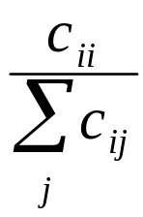
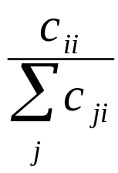
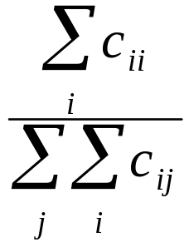
Per class evaluation measures
Recall: Fraction of docs in class i classified correctly:
Precision: Fraction of docs assigned class i that are actually about class i:
“Correct rate”: (1 - error rate) Fraction of docs classified correctly:

Slide 25
Micro- vs. Macro-Averaging
If we have more than one class, how do we combine multiple performance measures into one quantity?
Macroaveraging: Compute performance for each class, then average.
Microaveraging: Collect decisions for all classes, compute contingency table, evaluate.

Slide 26
Micro- vs. Macro-Averaging: Example
Class 1
Class 2
Micro.Av. Table
 | Truth: yes | Truth: no
Classifier: yes | 10 | 10
Classifier: no | 10 | 970
 | Truth: yes | Truth: no
Classifier: yes | 90 | 10
Classifier: no | 10 | 890
 | Truth: yes | Truth: no
Classifier: yes | 100 | 20
Classifier: no | 20 | 1860
Macroaveraged precision: (0.5 + 0.9)/2 = 0.7
Microaveraged precision: 100/120 = .83
Why this difference?

Slide 27
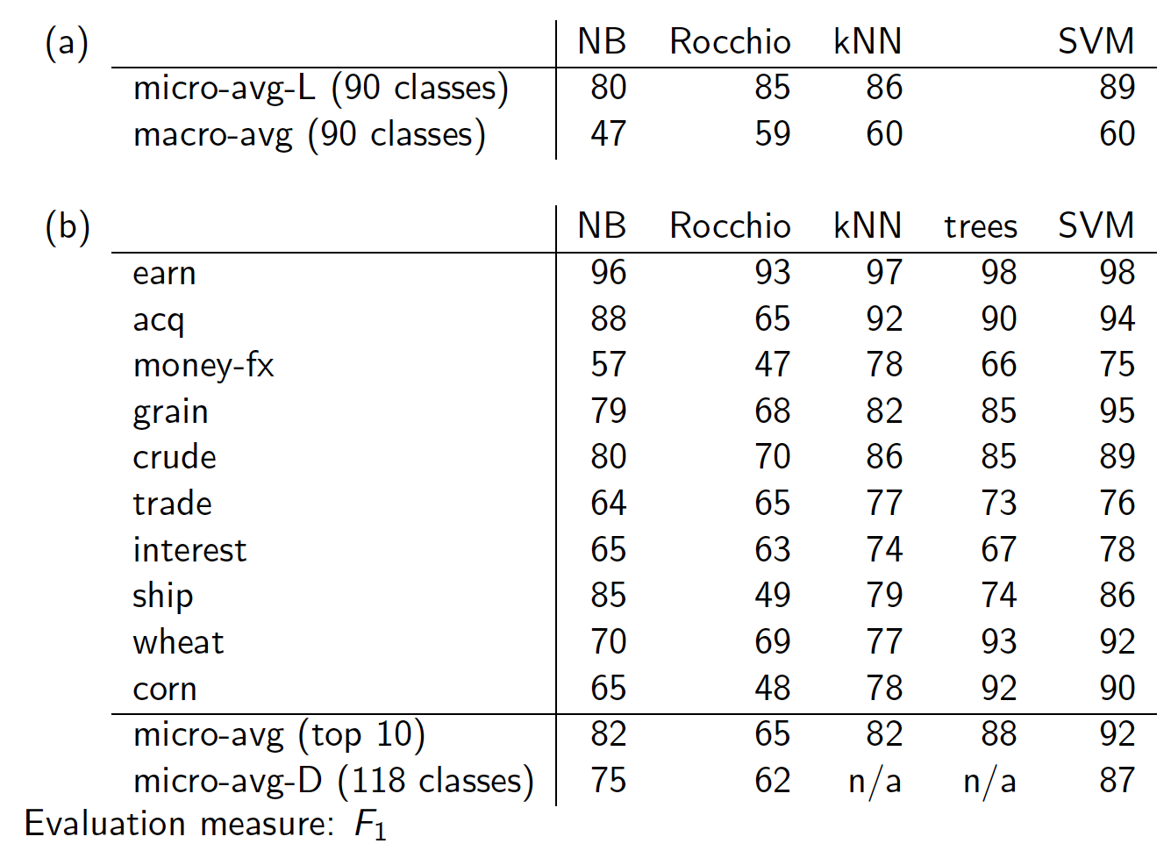

Slide 28
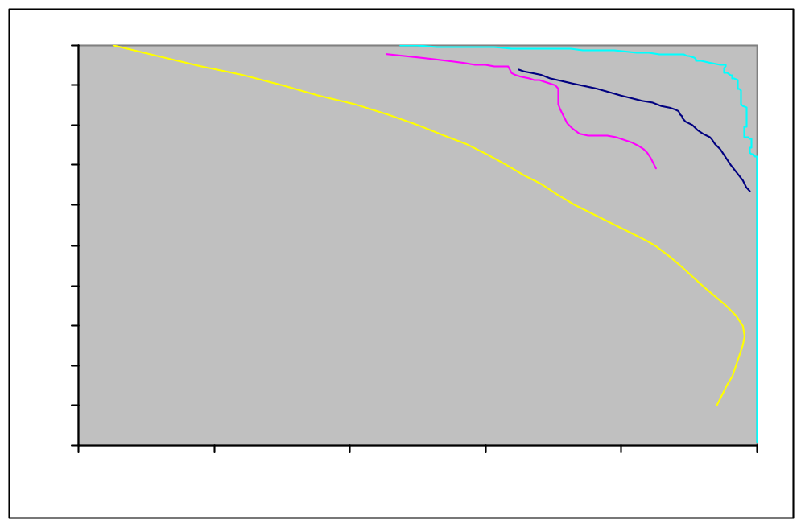
Reuters ROC - Category Grain
Recall
LSVM
Decision Tree Naïve Bayes
Find Similar
Precision
Recall: % labeled in category among those stories that are really in category
Precision: % really in category among those stories labeled in category

Slide 29
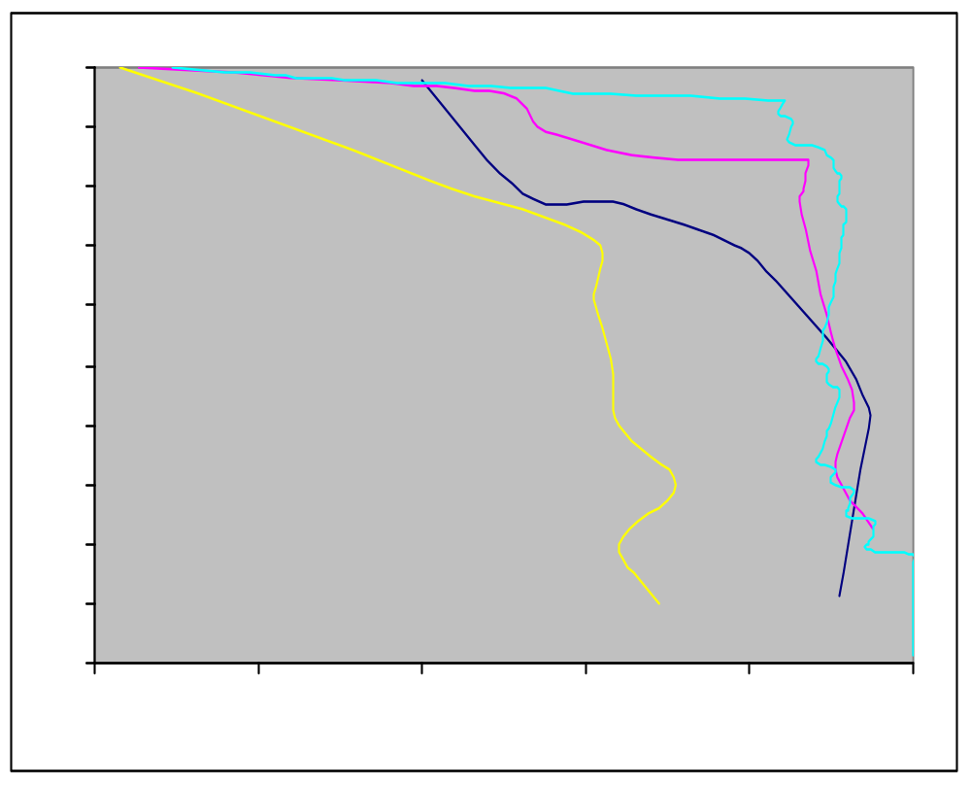
ROC for Category - Ship
Recall
LSVM
Decision Tree Naïve Bayes
Find Similar
Precision

Slide 30
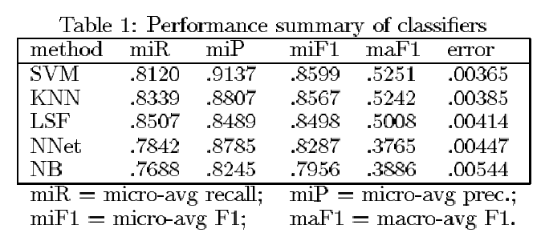
Yang&Liu: SVM vs. Other Methods

Slide 31
Good practice department:
Confusion matrix
This (i, j) entry means 53 of the docs actually in
class i were put in class j by the classifier.
Class assigned by classifier
Actual Class
53
In a perfect classification, only the diagonal has non-zero entries

Slide 32
The Real World
P. Jackson and I. Moulinier: Natural Language Processing for Online Applications
“There is no question concerning the commercial value of being able to classify documents automatically by content. There are myriad potential applications of such a capability for corporate Intranets, government departments, and Internet publishers”
“Understanding the data is one of the keys to successful categorization, yet this is an area in which most categorization tool vendors are extremely weak. Many of the ‘one size fits all’ tools on the market have not been tested on a wide range of content types.”

Slide 33
The Real World
Gee, I’m building a text classifier for real, now!
What should I do?
How much training data do you have?
  None
  Very little
  Quite a lot
  A huge amount and its growing

Slide 34
Manually written rules
No training data, adequate editorial staff?
Never forget the hand-written rules solution!
  If (wheat or grain) and not (whole or bread) then
    Categorize as grain
In practice, rules get a lot bigger than this
  Can also be phrased using tf or tf.idf weights
With careful crafting (human tuning on development data) performance is high:
  Construe: 94% recall, 84% precision over 675 categories (Hayes and Weinstein 1990)
Amount of work required is huge
  Estimate 2 days per class … plus maintenance

Slide 35
Very little data?
If you’re just doing supervised classification, you should stick to something high bias
  There are theoretical results that Naïve Bayes should do well in such circumstances (Ng and Jordan 2002 NIPS)
The interesting theoretical answer is to explore semi-supervised training methods:
  Bootstrapping, EM over unlabeled documents, …
The practical answer is to get more labeled data as soon as you can
  How can you insert yourself into a process where humans will be willing to label data for you??

Slide 36
A reasonable amount of data?
Perfect!
We can use all our clever classifiers
Roll out the SVM!
But if you are using an SVM/NB etc., you should probably be prepared with the “hybrid” solution where there is a Boolean overlay
  Or else to use user-interpretable Boolean-like models like decision trees
  Users like to hack, and management likes to be able to implement quick fixes immediately

Slide 37
A huge amount of data?
This is great in theory for doing accurate classification…
But it could easily mean that expensive methods like SVMs (train time) or kNN (test time) are quite impractical
Naïve Bayes can come back into its own again!
  Or other advanced methods with linear training/test complexity like regularized logistic regression (though much more expensive to train)

Slide 38
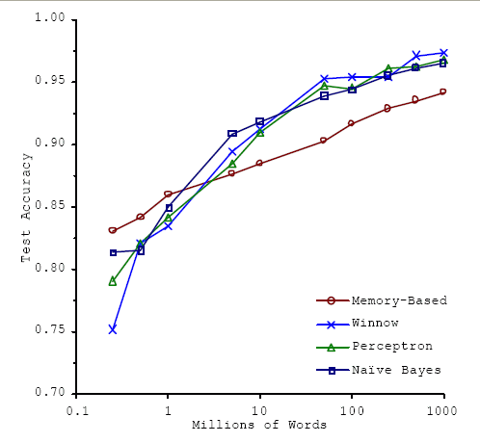
A huge amount of data?
With enough data the choice of classifier may not matter much, and the best choice may be unclear
  Data: Brill and Banko on context-sensitive spelling correction
But the fact that you have to keep doubling your data to improve performance is a little unpleasant

Slide 39
How many categories?
A few (well separated ones)?
  Easy!
A zillion closely related ones?
  Think: Yahoo! Directory, Library of Congress classification, legal applications
  Quickly gets difficult!
    Classifier combination is always a useful technique
      Voting, bagging, or boosting multiple classifiers
    Much literature on hierarchical classification
      Mileage fairly unclear
    May need a hybrid automatic/manual solution

Slide 40
How can one tweak performance?
Aim to exploit any domain-specific useful features that give special meanings or that zone the data
  E.g., an author byline or mail headers
Aim to collapse things that would be treated as different but shouldn’t be.
  E.g., part numbers, chemical formulas

Slide 41
Does putting in “hacks” help?
You bet!
You can get a lot of value by differentially weighting contributions from different document zones:
  Upweighting title words helps (Cohen & Singer 1996)
    Doubling the weighting on the title words is a good rule of thumb
  Upweighting the first sentence of each paragraph helps (Murata, 1999)
  Upweighting sentences that contain title words helps (Ko et al, 2002)

Slide 42
Two techniques for zones
Have a completely separate set of features/parameters for different zones like the title
Use the same features (pooling/tying their parameters) across zones, but upweight the contribution of different zones
Commonly the second method is more successful: it costs you nothing in terms of sparsifying the data, but can give a very useful performance boost
    Which is best is a contingent fact about the data

Slide 43
Text Summarization techniques in text classification
Text Summarization: Process of extracting key pieces from text, normally by features on sentences reflecting position and content
Much of this work can be used to suggest weightings for terms in text categorization
    See: Kolcz, Prabakarmurthi, and Kalita, CIKM 2001: Summarization as feature selection for text categorization
  Categorizing purely with title,
  Categorizing with first paragraph only
  Categorizing with paragraph with most keywords
  Categorizing with first and last paragraphs, etc.

Slide 44
Does stemming/lowercasing/… help?
As always it’s hard to tell, and empirical evaluation is normally the gold standard
But note that the role of tools like stemming is rather different for TextCat vs. IR:
  For IR, you often want to collapse forms of the verb oxygenate and oxygenation, since all of those documents will be relevant to a query for oxygenation
  For TextCat, with sufficient training data, stemming does no good. It only helps in compensating for data sparseness (which can be severe in TextCat applications). Overly aggressive stemming can easily degrade performance.

Slide 45
Measuring Classification
Figures of Merit
Not just accuracy; in the real world, there are economic measures:
  Your choices are:
    Do no classification
      That has a cost (hard to compute)
    Do it all manually
      Has an easy to compute cost if doing it like that now
    Do it all with an automatic classifier
      Mistakes have a cost
    Do it with a combination of automatic classification and manual review of uncertain/difficult/“new” cases
  Commonly the last method is most cost efficient and is adopted

Slide 46
A common problem: Concept Drift
Categories change over time
Example: “president of the united states”
  1999: clinton is great feature
  2002: clinton is bad feature
One measure of a text classification system is how well it protects against concept drift.
  Can favor simpler models like Naïve Bayes
Feature selection: can be bad in protecting against concept drift

Slide 47
Summary
Support vector machines (SVM)
  Choose hyperplane based on support vectors
    Support vector = “critical” point close to decision boundary
  (Degree-1) SVMs are linear classifiers.
  Kernels: powerful and elegant way to define similarity metric
  Perhaps best performing text classifier
    But there are other methods that perform about as well as SVM, such as regularized logistic regression (Zhang & Oles 2001)
  Partly popular due to availability of SVMlight
    SVMlight is accurate and fast – and free (for research)
  Now lots of software: libsvm, TinySVM, ….
Comparative evaluation of methods
Real world: exploit domain specific structure!

Slide 48
Resources
A Tutorial on Support Vector Machines for Pattern Recognition (1998) Christopher J. C. Burges
S. T. Dumais, Using SVMs for text categorization, IEEE Intelligent Systems, 13(4), Jul/Aug 1998
S. T. Dumais, J. Platt, D. Heckerman and M. Sahami. 1998. Inductive learning algorithms and representations for text categorization. CIKM ’98, pp. 148-155.
A re-examination of text categorization methods (1999) Yiming Yang, Xin Liu 22nd Annual International SIGIR
Tong Zhang, Frank J. Oles: Text Categorization Based on Regularized Linear Classification Methods. Information Retrieval 4(1): 5-31 (2001)
Trevor Hastie, Robert Tibshirani and Jerome Friedman, "Elements of Statistical Learning: Data Mining, Inference and Prediction" Springer-Verlag, New York.
‘Classic’ Reuters data set: http://www.daviddlewis.com /resources /testcollections/reuters21578/
T. Joachims, Learning to Classify Text using Support Vector Machines. Kluwer, 2002.
Fan Li, Yiming Yang: A Loss Function Analysis for Classification Methods in Text Categorization. ICML 2003: 472-479.

